Slide 1
Financial interactions University Hospital, Sandoval Regional Medical Center and UNM Medical Group
Laura Putz, Associate Controller
4/24/14

Slide 2
Intercompany Invoicing
Financial Interactions routinely occur between UNM, University Hospital (UH), Sandoval Regional Medical Center (SRMC) and UNM Medical Group (UNM MG)
These interactions can involve either revenue or expense for Health Sciences Center (HSC) or Main Campus
UH, SRMC, UNMMG, UNM / HSC are related entities and these transactions must be tracked separately in order to comply with financial reporting requirements

Slide 3
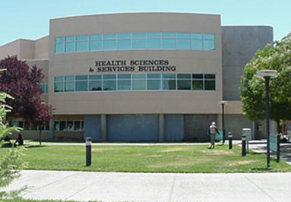
UNM HSC

Slide 4
When HSC Bills UH
UNM/HSC departments provide services and
support to UH departments regularly.
Salary Agreement Contracts
HSC employee providing UH with their services
Memorandum of Understanding (MOU)
general support
Other Agreements
space lease or flow through expenditures, such as utilities and insurance
Notes:
UNM/HSC departments provide services and support to UH departments regularly.
The support frequently involves Salary Agreement Contracts for HSC employee is providing the hospital with their services, Memorandum of Understanding (MOU) for general support, Occupancy Agreements for space lease or flow through expenditures, such as utilities and insurance. All of these contract will now go through Contract Director.
Once an intercompany agreement has been reached in Contract Director the HSC AR Coordinator will prepare monthly invoices on behalf of the HSC departments that have entered into the agreements with UH.
At HSC, a Banner module called Non Student Accounts Receivable (NSAR) is used to produce and track these invoices. You will frequently hear this type of invoice referred to as a “Non Student AR” invoice, or NSAR invoice.

Slide 5
When HSC bills UH
An intercompany agreement is reached using:
Contract Director
Supporting Documentation
monthly invoices are prepared and sent to UH for payment
Non Student Accounts Receivable (NSAR) is
used to produce and track invoices
Notes:
UNM/HSC departments provide services and support to UH departments regularly.
The support frequently involves Salary Agreements for HSC employee is providing the hospital with their services, Memorandum of Understanding (MOU) for general support, Occupancy Agreements for space lease or flow through expenditures, such as utilities and insurance.
Once an intercompany agreement has been reached using Contract Director for the electronic approval process,the AR Coordinator prepares monthly invoices on behalf of the HSC departments that have entered into the agreements with UH.
At HSC, a Banner module called Non Student Accounts Receivable (NSAR) is used to produce and track these invoices. You will frequently hear this type of invoice referred to as a “Non Student AR” invoice.

Slide 6
Salary Agreement Template
Template for Salary Agreement is located on the
Unrestricted Accounting-HSC’s website in the forms section
http://hsc.unm.edu/financialservices/accounting/Forms%20&%20Documents.shtml
Template updated each fiscal year for current fringe benefit percentages
Notes:
The template to initiate a Salary Agreement Contract is located on the Unrestricted Accounting-HSC’s website http://hsc.unm.edu/financialservices/acccounting/ in the Forms section
It is important to use the correct version of the template as it is updated each fiscal year for current fringe benefit projections

Slide 7
Salary Agreement Template
Template contains macros and formulas that should not be overwritten when preparing the document
Data entry cells are shaded yellow
Completed template is entered into Contract Director and scanned and attached to the contract
Notes:
The form contains macros and formulas that should not be overwritten when preparing the document
Data entry is done only in the cells that are shaded yellow.
Send the completed form to the AR Coordinator for input into Contract Director, which will initiate the contract approval process

Slide 8
Salary Agreement Procedures UNM Employee
UNM department initiates the Salary Agreement and sends to HSC AR Coordinator for entry into Contract Director.
The HSC AR Coordinator sends the contract via workflow to UH for electronic review and approval. Contract also requires college level approval, also obtained via workflow allowing for electronic review and approval.
When approved electronically by UH, the contract is considered an executed contract.
The HSC AR Coordinator creates monthly invoices to send to UH Finance.

Slide 9
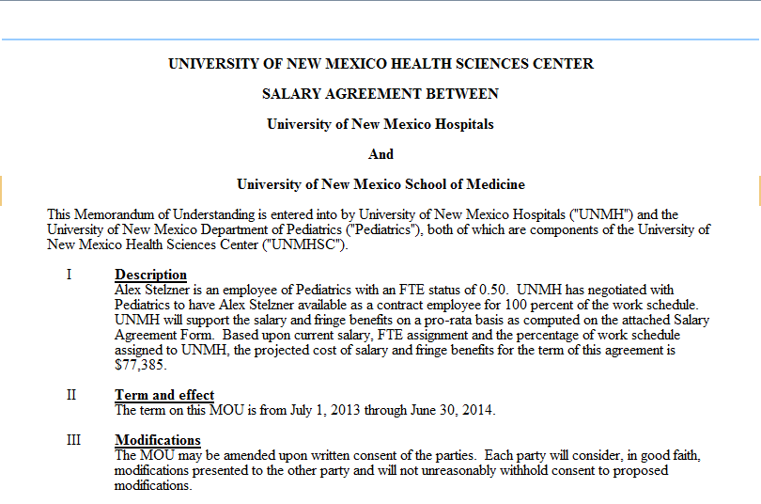
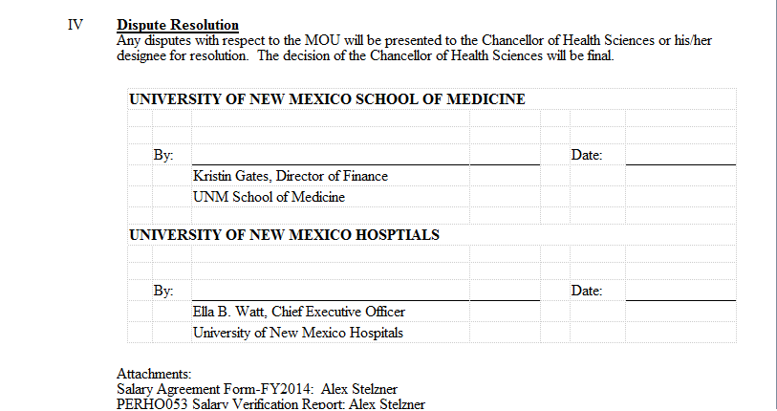
Salary Agreement Contract - HSC bills UH
Notes:
When an HSC staff member spends time on an UH(Main Hospital Carrie Tingley, University Psychiatric Center, etc.) or MG project, a salary agreement Contract between HSC and UH or MG is created in Contract Director so that HSC is reimbursed for the salary expense associated with that employee. The agreement is initiated by HSC and provides the terms of the agreement, as in the example above.
(click)Notice that two contact names are listed on Salary Agreements; one for each department involved.
(click)By noting which entity employs the employee, you will know who is paying for the employee’s services. If the employee is an HSC employee, UH or MG is entering into an agreement to use the employee’s services, and they will be reimbursing HSC for part or all of the employee’s salary, as per the agreement.

Slide 10
Identifying the Revenue
Revenue is recorded in the department index each time an invoice is generated
Banner form FGITRND supplies a detail listing of account detail
Account code 0340 – University Hospital Revenue is used

Slide 11
Identifying the Revenue
Notes:
The top record shows the detail for the Salary Agreement in our example that was posted for February 28, 2014. Notice that the amount is the $10,141.99 shown on the invoice that follows.
Banner form FGITRND can be accessed directly or the user can drill into the detail listing from FGIBDST, by Options, then Transaction Detail Information.

Slide 12
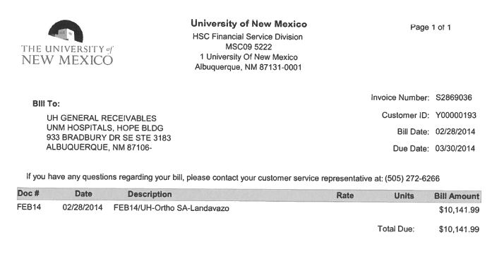
Identifying the Revenue
Notes:
This is the invoice for which payment (income for HSC) is recorded in the above example on the top line.

Slide 13
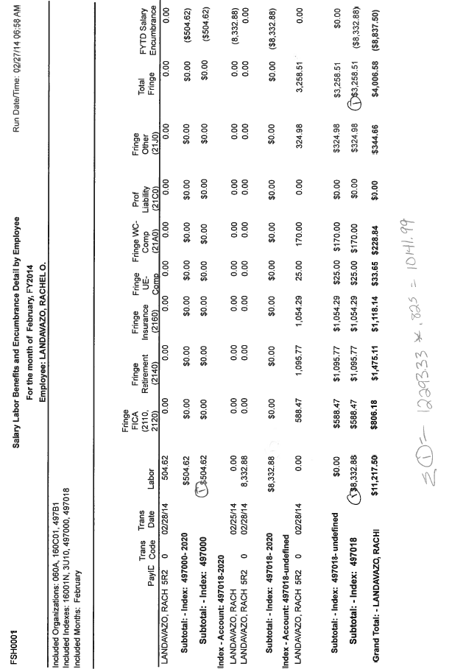
Identifying the Revenue
Notes:
Here is the payroll report used in the salary agreement example provided. Notice that the Payroll amounts are reconciled to the recorded invoiced amount of $10,141.99.

Slide 14
Travel Reimbursements
HSC Traveler submits receipts to HSC
HSC department reimburses employee
HSC bills Hospital while providing documentation on agreed upon support.
Notes:
UNM Hospital may agree to reimburse HSC for a variety of expense. For example, specialized training for an HSC employee may be requested by an HSC department that agrees to cover the hospital supplied training costs, including any travel.
In this situation, the HSC traveler must submit the receipts for reimbursement to HSC for consideration. Each entity must reimburse according to the policies and procedures that govern their employee. In the above example, HSC will pay the actual travel expenses of the employees for whom the hospital has agreed to reimburse certain travel expenses. HSC will then document those travel expenses and bill the Hospital, recouping their costs from the revenue their bill generates. On the HSC financial statement, the travel expense will net to zero as the amount received from the Hospital will offset the expenditures. This is commonly referred to in the HSC financial statements as “pass through” treatment. The travel expense would be reported appropriately in the Hospital.

Slide 15
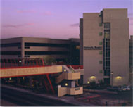
UNM Hospital

Slide 16
When UH bills HSC
What they bill:
Salary Agreements
Memorandum of Understanding (MOU)
Interpreter Services
Catering Charges
Facility Charges related to Clinical Trials
X-rays
Blood tests
Lab work

Slide 17
Salary Agreement Procedures UH Employee
UH department initiates the Salary Agreement and sends to UH Financial Analyst III for entry into Contract Director and routes to HSC AR Coordinator.
HSC AR Coordinator sends the contract via workflow to the department for electronic review and approval.
Department attaches Internal Purchase Requisition to agreement in Contract Director and electronically approves by the agreement.
When approved electronically by all parties, the contract is considered an executed contract.
The UH Special Billing Unit creates monthly invoices to send to HSC AR Coordinator.

Slide 18
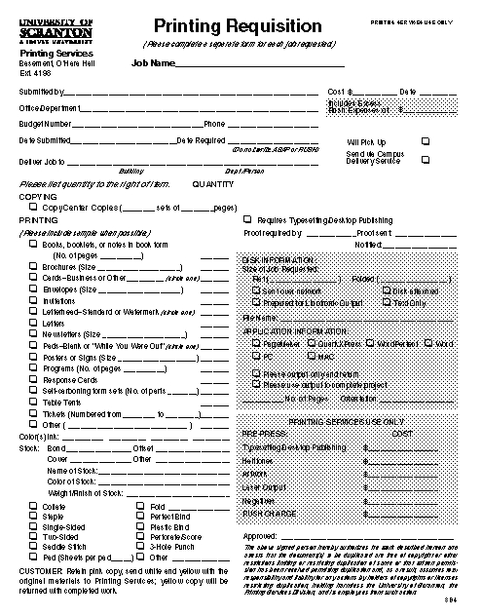
When UH bills HSC
HSC department issues an internal purchase requisition
Includes Banner Index
Includes Banner Account
Includes contact names
Internal UNM Requisition
Notes:
This IPO includes:
The Banner index and account that is to be billed
A contact name at the department level in UH
Frequently the contact person is from the Special Billing/Referral Department (SBD) in UH.

Slide 19
When UH bills HSC
Data evaluated at HSC-UA and loaded into Banner Finance by FSM
Expense items post to the index/account code as found in the internal Purchase Requisition
Document number is “HSYXXXXX”
HSC UA mails invoices to departments
Notes:
The data file sent by UH is:
evaluated by Unrestricted Accounting-HSC in order to validate appropriate FOPAL element and account codes
and then the file is loaded into Banner Finance.
The expense items are directed to the index /account code combination indicated on the internal purchase order.
The UH invoice file is posted as a journal document, with the document number beginning “HSYXXXXX”.

Slide 20
When UH bills HSC
Invoice numbers that begin with:
BL are standard invoices
BM are credit adjustments
Notes:
Invoice numbers that begin with:
a “BL” for a debit invoice
a “BM” for a credit invoice

Slide 21
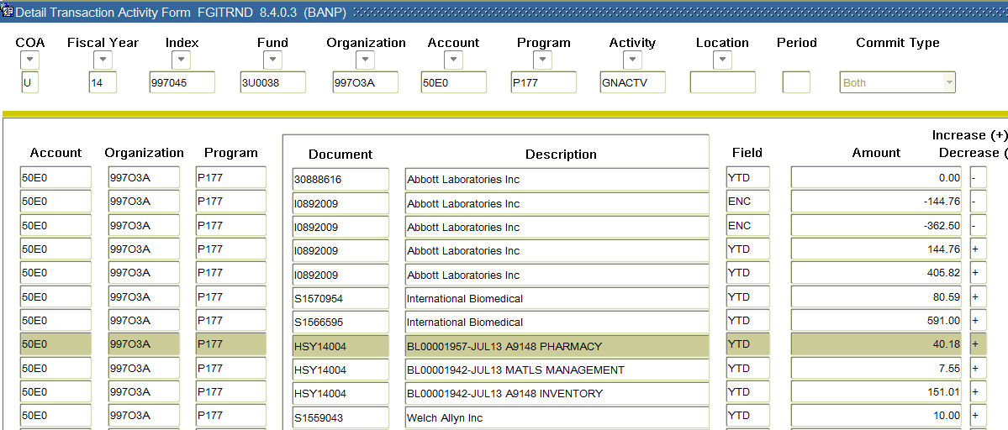
When UH bills HSC
Notes:
This screen shot is an example of UH invoices that have been posted into Banner Finance
(1st click)The document numbers begin with “HSY”
(2nd click)The description line indicates that the item processed is a UH Invoice by the “BL” at the beginning. The BL number is on the invoice. (a credit would begin with “BM” and be on the invoice)

Slide 22
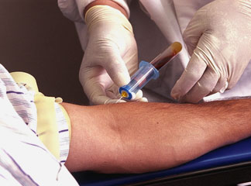
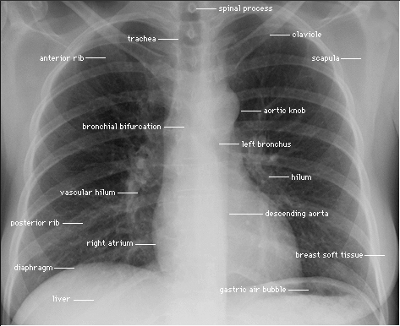
Clinical Trials Billing
Subjects frequently have certain medical tests completed, such as EKGs, blood test, chest x-rays and other imaging studies.
Notes:
Note: double click for each new test.
This type of intercompany transaction routinely occurs between the Hospital and an HSC clinical trial.
When subjects are enrolled in a clinical trial, they are frequently expected to have certain medical tests completed.
These tests are frequently paid for by the clinical trial, not their health insurance payor.
The types of medical work frequently included in clinical trials include EKGs, blood tests, chest X-rays, and other imaging studies.

Slide 23
Clinical Trials Billing
The clinical trial, not the patient is billed
Hospital guarantor number beginning with 9999 is assigned the clinical trial and used
A Referral Billing Questionnaire is completed before services can be provided at UH
The Referral Billing Questionnaire details what services can be provided and billed to the clinical trial
Notes:
Normally, when a patient has this work done per a physician’s order for their own benefit, the patient or his insurance company is billed. When the same patient is having this work done on behalf of a clinical trial, the clinical trial is billed instead.
To facilitate the invoicing to a clinical trial, the hospital creates a guarantor number that is unique to the clinical trail. A guarantor number tells the hospital who to bill for the services provided. The hospital utilizes the patient guarantor number assigned to the clinical trial when the clerk is notified that the patient is presenting for services related to a clinical trial. The patient’s billing is changed to go to the clinical trial instead of the patient’s regular payor’s guarantor number. Within UH’s patient system, all clinical trial guarantor numbers begin with 9999.
A “Referral Billing Questionnaire” needs to be completed before clinical trials can receive UH Services. This document specifies exactly what services and supplies can be billed to the clinical trial, identified the guarantor number for the clinical trial, and contact names and numbers at HSC, UH, and the Agency sponsoring the clinical trial. Every HSC department receiving bills for clinical trials from UH should have a copy of the Billing Questionnaire so that each invoice can be audited when received.

Slide 24
Clinical Trials Billing
Timely UH invoice review is critical
Incorrect invoices charges must be reversed from the clinical trial
Many payors (ie: patient’s insurance company) have 90 day windows during which billing must occur
UH bills charges from the prior month. Frequently less than 60 days remain once the department is invoiced for UH to invoice another payor
Notes:
The department is responsible for reviewing each invoice received from UH for accuracy. If any errors are found, the department must contact the Accounts Receivable Coordinator (Stacie Hurley SEHurley@salud.unm.edu / 505-272-5460) in order to request that a credit be issued.
One type of invoicing error occurs when the patient returns to UH for additional services for an injury or illness that is unrelated to the clinical trial. Unless the guarantor number is changed to the individual’s health insurance payor the patient’s clinical trial guarantor number may be billed.
Unless the HSC department with the clinical trial reconciles their clinical trial expenditures in a timely fashion, the Hospital may lose all opportunity to bill the patient’s insurance company. Contractually, a number of payor’s require invoicing within 90 days from date of service. If the Hospital is not informed by the that the original bill was in error and is not part of the clinical trial, the revenue may be permanently lost if the notification is beyond the 90 day billing window.
Since the hospital bills reflect charges from the prior month, the 90 day window is frequently only 60 days or less when the invoice is received by the HSC department. Rapid reconcilement is essential to prevent loss of UH revenue. For example, a date of service of August 1 may not be posted in Banner until mid to late September

Slide 25
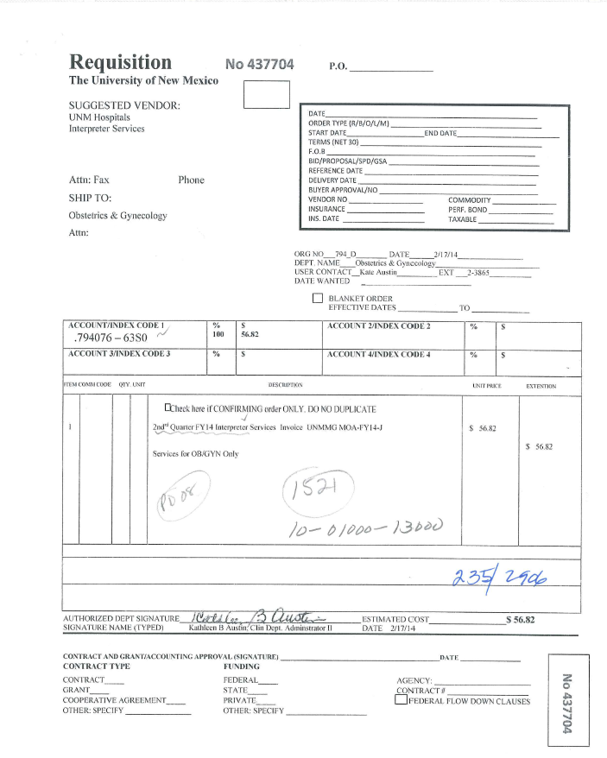
Internal Requisition- UH bills HSC
Notes:
An internal requisition is then issued as in the example above. The requisition number(1st click) and the index and account code(2nd click) to which charges are to be expensed are circled.

Slide 26
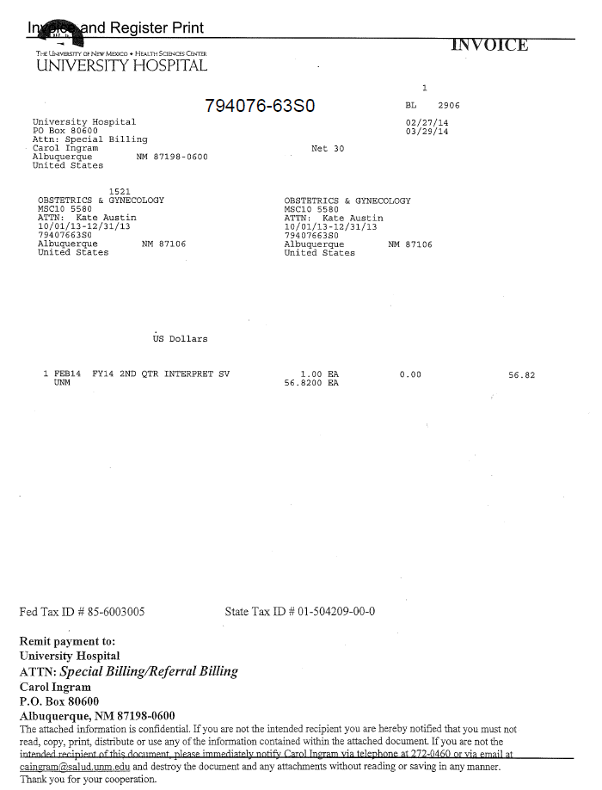
Invoice - UH bills HSC
UH’s Vendor Number
Index and account code for posting in Banner
HSC AR Coordinator processes payment to UH
Notes:
A February 2014 invoice from UH to HSC is provided in the example above. (click) Notice that The Banner index and account to be charged are on the invoice, as is the (click)UH vendor number. Although the invoice suggests that the department needs to (click) remit payment to UH, the Unrestricted Accounting office is responsible for the creation of the DPI payments to UH. The department contact person for HSC is located (click;underlined in blue) on the invoice. The UH Special Billings person is also listed on the invoice(click; also underlined in blue).
If the amount invoiced does not reconcile to the expense amount that the department is anticipating, it is the department’s responsibility to contacting HSC AR Coordinator in order to request processing of a credit adjustment.

Slide 27
General Guidelines
Internal Purchase Requisition are required
A UNM contact person will be on the invoice
Include your mail stop code
Notes:
When coordinating the procurement of services from any hospital department, the hospital department will require that the UNM/HSC department first get an internal Purchase Requisition issued. The hospital will not issue an invoice without an internal PR.
It is important that the appropriate individual be reference on the invoice in order for Unrestricted Accounting-HSC to properly route the invoice to the department. In many situations this information is not included and the invoices are forwarded to the appropriate department administrators for distribution.

Slide 28
Travel Reimbursements
UH Traveler submits receipts to UH
Hospital reimburses employee
Hospital bills HSC, using the internal Purchase Requisition generated when the agreement was reached.
Notes:
A UNM department may agree to reimburse UH for a variety of expense. For example, specialized training for a hospital employee may be requested by a physician that agrees to cover the conference and travel arrangements.
In this situation, the UH traveler must submit the receipts for reimbursement to UH for consideration. Each entity must reimburse according to the policies and procedures that govern their employee. In the above example, the Hospital will pay the actual travel expenses of the employees for whom an HSC department has agreed to reimburse certain travel expenses. The Hospital will then document those travel expenses and bill the HSC department, recouping their costs from the revenue their bill generates. On the UH financial statement, the travel expense will net to zero as the amount received from UNM will offset the expenditures. This is commonly referred to in the UH financial statements as “pass through” treatment. The travel expense would be reported appropriately in the HSC department.

Slide 29
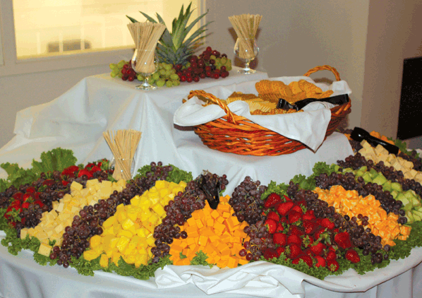
UH Catering
Internal Purchase Requisition Required
HSC Unrestricted Accounting reviews the invoices
Sufficient business purpose documentation must be retained by department per UNM Business Policy
Notes:
Many UNM/HSC departments utilize the UH Catering services to provide food service for various events. As with other types of transactions that involve purchasing from UH, an internal Purchase Requisition must be issued.
Unrestricted Accounting-HSC reviews the invoices that direct expenditures to food account codes in order to determine if the information provided is sufficient for audit purposes based on UNM Business Policy. If the information provided is not sufficient, a note is attached to the invoice requesting additional information from the department in order to substantiate business purpose and number/names of attendees.

Slide 30
Reconciliation Assistance
Unrestricted Accounting-HSC can provide reports with UH invoicing data. Reports can be generated by
Index
Organization Level 5
Contact the HSC AR Coordinator to request reports
Invoice copies can also be obtained from the HSC AR Coordinator
Notes:
HSC Financial Services has created a reporting database which can provide invoicing summary to assist departments in their reconciliation process. The database contains information on all UH invoicing processed in Banner Finance beginning in July 1, 2004.
UH Invoice Reports can be generated for review by specific index or by Organization Level 5, with sorting provided by index or account code. Appendix 1 provides a sample report by index for September 2009. Appendix 2 shows a sample report with an organization level 5 specified, sorted by index code. Departments can request UH Invoice Reports by contacting the HSC AR Coordinator with the parameters needed for review.
Copies of UH Invoices can also be requested by contacting the HSC AR Coordinator. Generally copies are provided within one business day of the request. Due to compliance issues, it is not possible to scan the invoices into a location that has campus wide access as the invoices may contain protected information.

Slide 31
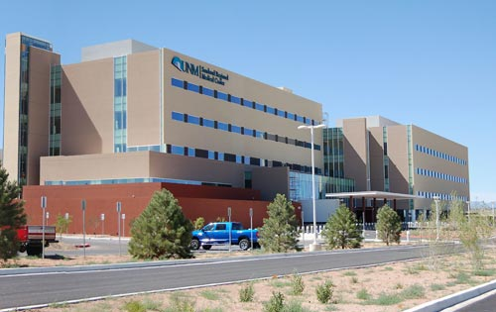
SRMC

Slide 32
When HSC Bills SRMC
Memorandum of Understanding (MOU)
Salary support
general support
Other Agreements
Medical Malpractice and other insurance
Legal services
Marketing campaigns
Recruiting and Relocation expenses
Notes:
UNM/HSC departments provide services and support to UH departments regularly.
The support frequently involves Salary Agreement Contracts for HSC employee is providing the hospital with their services, Memorandum of Understanding (MOU) for general support, Occupancy Agreements for space lease or flow through expenditures, such as utilities and insurance. All of these contract will now go through Contract Director.
Once an intercompany agreement has been reached in Contract Director the HSC AR Coordinator will prepare monthly invoices on behalf of the HSC departments that have entered into the agreements with UH.
At HSC, a Banner module called Non Student Accounts Receivable (NSAR) is used to produce and track these invoices. You will frequently hear this type of invoice referred to as a “Non Student AR” invoice, or NSAR invoice.

Slide 33
Identifying the Revenue
Revenue is recorded in the department index each time an invoice is generated
Banner form FGITRND supplies a detail listing of account detail
Account code 0360 – SRMC Revenue is used

Slide 34
When HSC bills SRMC Other Reimbursed Costs
Requires pre-approval from SRMC
Minimal activity at this time
Expenses recorded in index 331135
SRMC-HSC Reimbursements
HSC AR Coordinator “sweeps” expenses and invoices SRMC
Notes:
Troy Clark; SRMC CFO gives the pre-approval. (Only thing in there for this fiscal year is Legal Svcs; 63J0. Travel and Moving are budgeted, however.)

Slide 35
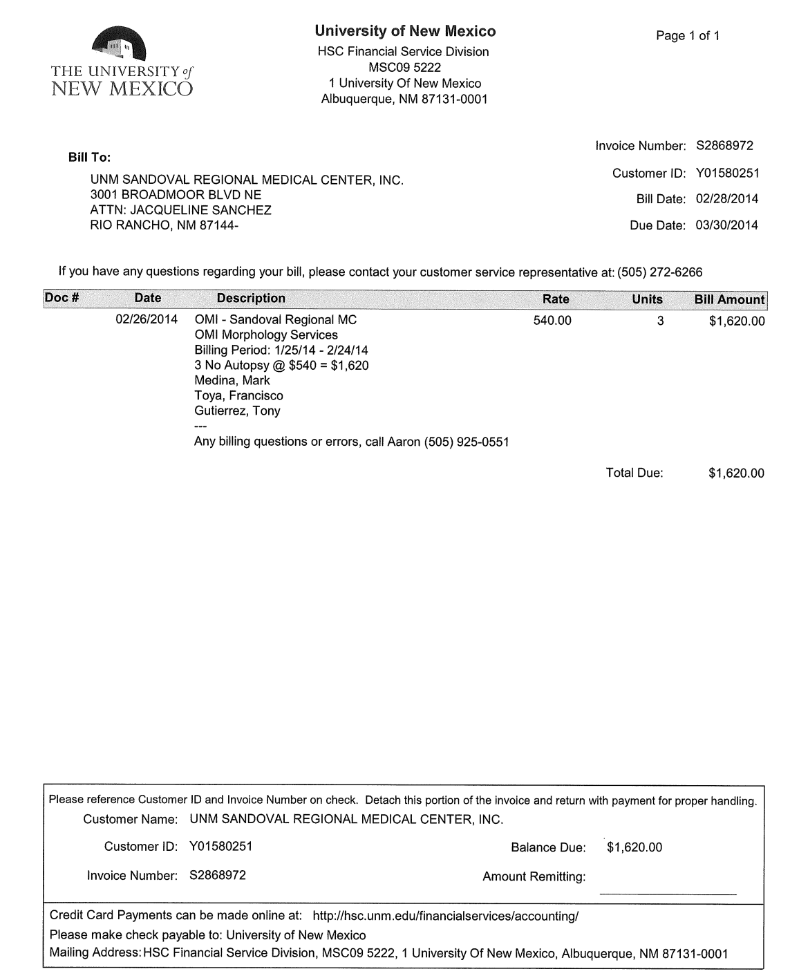
NSAR SRMC Invoice Example
Notes:
This is a copy of an NSAR invoice sent by HSC Finance on behalf of a Department to SRMC in February 2014.
Departments sometimes perform services for SRMC and these services are billed through the Non Student Accounts Receivable Module, as above.

Slide 36
When SRMC bills HSC
What they bill:
Facility Charges related to Clinical Trials and other research projects
X-rays
Blood tests
Lab work
Invoice should be sent to Financial Services for
processing
Very little activity at this time

Slide 37
Medical Group, Inc.
University of New Mexico Physicians

Slide 38
When UNM MG bills HSC
The UNM Medical Group (UNM MG) pays for expenditures within their accounting system on behalf of a HSC department.
UNM MG invoices HSC in order to be reimbursed for these expenditures.
Labor/Benefit Cost
UNM MG Employee working for HSC department

Slide 39
When UNM MG bills HSC
Data evaluated at HSC - UA and loaded into Banner by FSM
Expense items post to the index/account code on the invoice
Document number is “HSYXXXXX”
UNM MG sends invoice to HSC department
39
Notes:
The data file sent by UH is:
evaluated by Unrestricted Accounting-HSY in order to validate appropriate FOPAL element and account codes
and then the file is loaded into Banner Finance.
The expense items are directed to the index /account code combination indicated on the internal purchase order.
The UH invoice file is posted as a journal document, with the document number beginning “HSYXXXXX”.
39

Slide 40
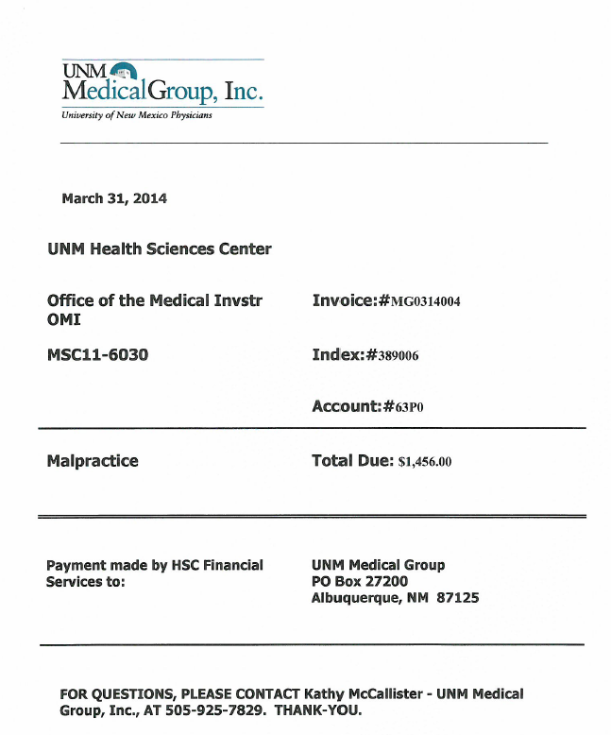
UNM MG and UNM
Notes:
This is an example of a Medical Group Invoice. Sent directly to the department,with copies on file at FSD

Slide 41
UNM MG bills HSC
Notes:
This screen was accessed by selecting FGIBDT in Banner, entering the index with a next block function to display results, and then selecting Options, and Transactions Detail Information on the selected account code. The highlighted line is the September Malpractice Insurance charge from the Medical Group. The invoice number is MG0314004. The document number is HSY14046. These are recorded as departmental expense in account 63P0, Professional Liability Insurance.
This screen shot is an example of UNM MG invoices that have been posted into Banner Finance.

Slide 42
Reconciliation Assistance
Unrestricted Accounting-HSC can provide reports with UNM MG invoicing data. Reports can be generated by
Index
Organization Level 5
Contact the HSC AR Coordinator to request reports
Invoice copies can also be obtained from the HSC AR Coordinator
Notes:
See earlier “Recon Assistance” slide.

Slide 43
When HSC bills UNM MG
Expenditures recorded in the UNM MG Agency Fund:
Salary and benefits
PCard Charges
UNM Employee travel reimbursement
Memorandum of Understanding (MOU)
Not frequently used

Slide 44
Reminders:
Unrestricted Accounting-HSC coordinates all intercompany invoicing
Incoming
Outgoing
Unrestricted Accounting-HSC processes all payments made to UH, SRMC and UNM MG
Unrestricted Accounting-HSC processes all payments received by UH, SRMC and UNM MG
UNM should not reimburse employees of UH, SRMC or UNM MG
Notes:
See earlier “Recon Assistance” slide.

Slide 45
NSAR Coordinator:
Stacie Hurley
272-5460
shurley@salud.unm.edu

Slide 46
What are your Questions?

