Slide 1

Report-to-the-Community

Slide 2

HSC Office of Community Affairs Background
Opened in June 2006
Ensure open communication for community members and groups
Primary interest in those that have greater difficulty in accessing HSC services and resources

Slide 3

Focus Areas
Support advisory process for community input
Promote system changes that eliminate barriers
Share data and collaborate in planning
Sustain relationships with community groups
Encourage leadership on tough issues

Slide 4
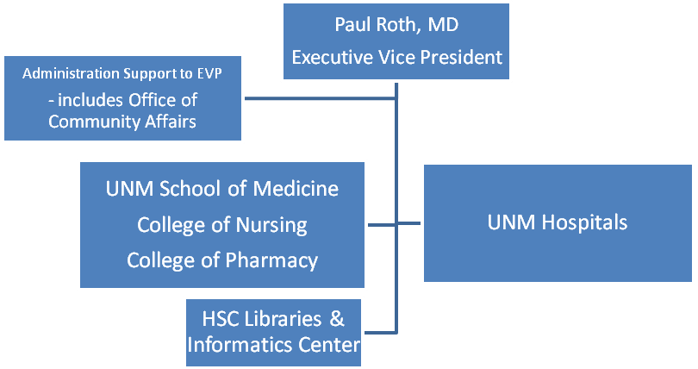
UNM Health Sciences Center

Slide 5
OCA Staff
Director Leah Steimel, MPH
Pathways Program Manager Daryl Smith, MPH
Patient Systems Specialist Ivette Cuzmar, LISW
Native American &
Pueblo Relations Greg Ortiz , Acoma Pueblo Leader
Community Relations Manager Alexis Padilla, PhD
Administrative Assistant Diana Baumgardner
Students Tennille Bernard and Christina Hoppe

Slide 6
History of Pathways
Past to Present
Beginning Stages
October 2007: “Pathways for Healthy Outcomes Production Model” presented at a community workshop
November 2007: Pathways Working Group formed to adapt the model for Bernalillo County
January 2008: In anticipation of November mil levy vote, County Comm. Archuleta brought advocates and HSC leaders together to discuss potential for patient navigator program funding
January 15, 2010
April, 2008: UNM Regents and Bernalillo County jointly commit to funding for eight years beginning in 2009 to support a Pathways program

Slide 7
Pathways Principals
Find and Engage at Risk Individual –
Care Coordination
Intervention - Confirm Evidence Based
Service
Measure – Health Improvement and
Cost Savings
Based on the above principles, the Pathways Working Group developed the following mission:

Slide 8
Pathways Mission
Improve the health of our county by:
Connecting underserved county residents with the health care system and supporting them as they navigate through it
Coordinating services for underserved residents to achieve positive individual-level health outcomes
Assuring collaborative planning and improvement of our health care system

Slide 9
History of Pathways
Past to Present
MOU
April 2008: UNM Regents and Bernalillo County jointly commit to funding (at least $800,000 for each year) for eight years beginning in 2009 to “develop a Program to improve access for the underserved of the County in collaboration with community resources”. This is where the funding for the Pathways Project comes from.

Slide 10
History of Pathways
Past to Present
Planning
September 2008 “Kick-off” Community Meeting to broaden involvement in developing Pathways model for Bernalillo County.
  Five subsequent half-day planning meetings with numerous community-based organizations across Bernalillo County to develop project outcomes

Slide 11
Community-defined Outcomes
People in Bernalillo County will self report better health
People in Bernalillo County will have a health care home
Health and social service networks in Bernalillo County will be strengthened and user friendly
Advocacy and collaboration will lead to improved health systems

Slide 12
History of Pathways
Past to Present
November 2008: Mil Levy bond issue passed and funding for Pathways was guaranteed thru 2017
January 2009: Program Manager for Pathways hired and Pathways Design Team formed
May 2009: Request for Proposals released

Slide 13
History of Pathways
Past to Present
A total of twelve (12) applications were submitted, of which eleven (11) were funded, comprising a total of fifteen community-based organizations.

Slide 14
Pathways Organizations
Addus HealthCare | East Central Ministries, Inc.
Hogares, Inc. | The Storehouse
A New Awakening New Mexico AIDS Services Adelante Development Center | Rio Grande Community Development Corporation South Valley Partnership: Casa de Salud
Cuidando Los Niños | South Valley Economic Development Center PB&J Family Services La Plazita Institute
Enlace Comunitario
First Nations Community HealthSource

Slide 15
Pathways Project Report
September– December 2009

Slide 16
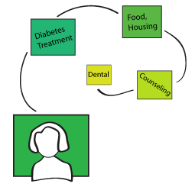
Pathways Client
Bernalillo County Resident
Difficult to Reach
  Low income
  Uninsured
  Unemployed
  Uses ER frequently
  Housing instability
  Not receiving services
  Hungry

Slide 17
Role of Community Health Navigators
Find most at-risk community members
Build trust
Assess and identify problem[s]
Guide Clients thru Pathways Steps
Complete Pathway/Achieve Meaningful Outcome
Document Information in Database

Slide 18
Risk Score Assessment
Transportation
General Health
Education
Social Issues
Employment
Children and Family Care
Medical Services
Health Limitations
Diabetes
Substance Use
Mental and Behavioral Health
Acute family Issues
Other Issues

Slide 19
Example of a Pathway

Slide 21
Health Care Home Pathway OUTCOME
Client has appropriate health coverage or
financial assistance program in place to
establish health care home and has seen a
provider a minimum of 2 times at their new
health care home.
Final Payment – Level 2 Benchmark

Slide 22
Pathways Clients
214 Clients *
This is 38% of expected for Year 1
  Education
    36% elementary school
    10% some college

Slide 23
Clients by Zipcode

Slide 24
Clients by Race/Ethnicity

Slide 25
Common Pathways

Slide 26
Other Pathways
Heat & Utilities 18
Transportation 16
Dental Care 14
Vision & Hearing 10
Diabetes 9
Income Support (ISD) 8
Child Care 7
Pharmacy/Medications 6
Pregnancy 5
Child Support 1

Slide 27
Completed Pathways as of 01/08/10
Domestic Violence 7
Health Care Home 6
Housing 4
Heat & Utilities 4
Food Security 3
Employment 3
Medical Debt 2
Depression 2
Child Care 2
Pharmacy/Medications 1
Behavioral Health 1
Pregnancy 1
Pathways Completed
in First Quarter = 37

Slide 28
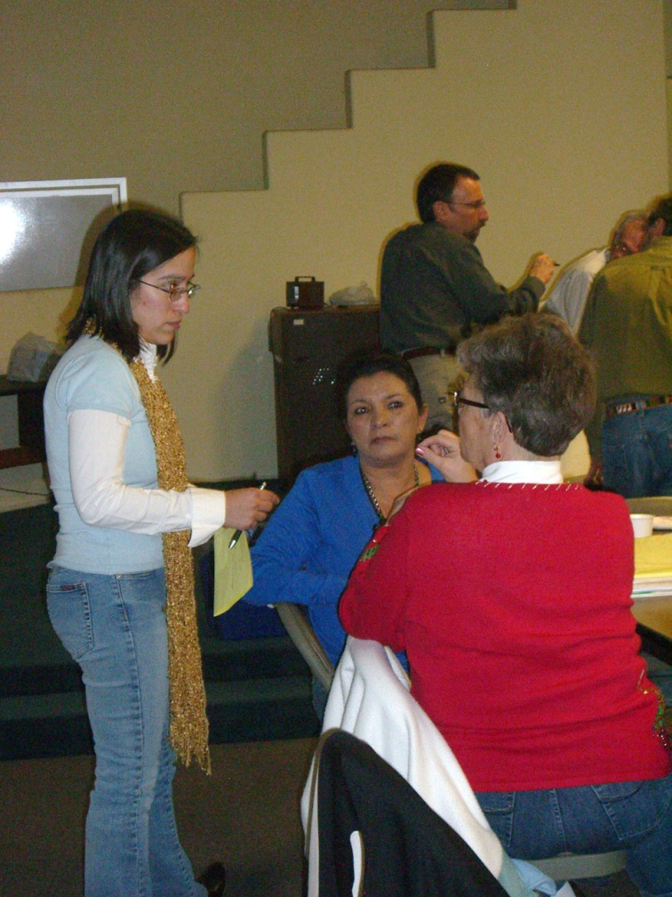
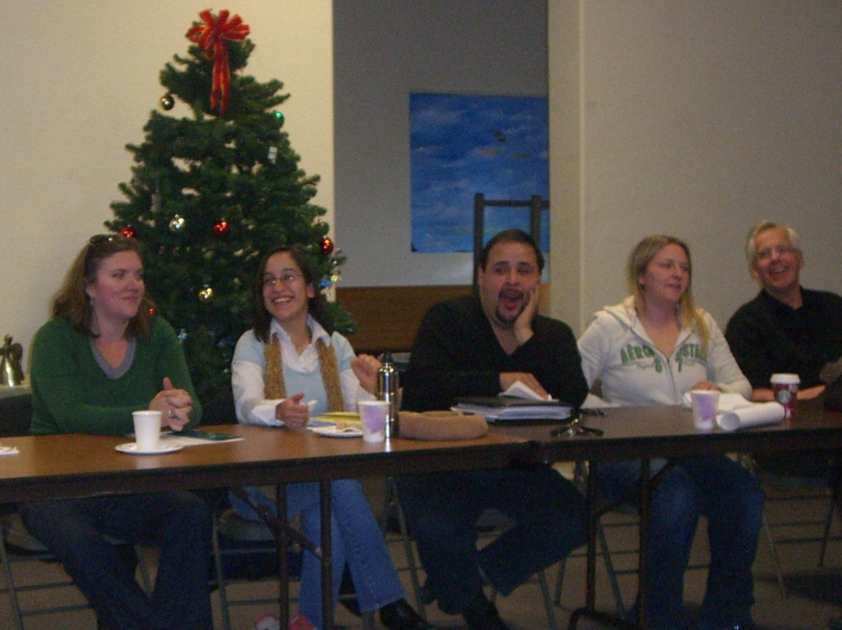
Barriers and Successes
Let’s hear from our Navigators!

Slide 29
Pathways Evaluation Plan
Contract with UNM HSC Institute of Public Health
Drs. Bill Wiese & David Broudy
September– December 2009

Slide 30
Multi-faceted evaluation
Program operation
Client outcomes and satisfaction,
Navigator involvement and capacity
Software for tracking clients and managing the project
Community health

Slide 31
Program Operation
Process evaluation
  Does the project follow plans?
  Do what it says it will do?
  Respond to changes
  Communicate internally and externally

Slide 32
Client Outcomes and Satisfaction
Do clients report improved health as a result of participation?
Are pathways being completed?
Are individuals satisfied with the program?
Are agencies (grantees) satisfied?
Is the program satisfied with performance of grantees?

Slide 33
Navigators
Are navigators working as expected?
Is there evidence that the capacity of navigators to meet client needs is increasing?
Are grantees successfully recruiting and retaining navigators?
Is training provided sufficient to meet program and agency goals

Slide 34
Software
Is the software developed adequate to
  Track and manage client needs
  Support payment and performance or grantees
  Provide data for reporting and evaluation
  Is software easy to use?
  Reliable?
  Is software developer responsive and sensitive to user’s needs.

Slide 35
Community Health
Is the community as a whole healthier because of Pathways?
Are barriers to obtaining services addressed and reduced
Are services needed by population served linked
Does the community perceive that PW is meeting expectations?

Slide 36
Health System
Do participating agencies (Including UNMH) feel connected with one another?
Are they better able to meet goals because of these connections
Are community organizations more responsive to clients because of Pathways.

Slide 37
Evaluation Methods
Participant observation in meetings with navigators and Pathways program managers
Observation of training
Hands on use of data system
Quantitative—how many clients, pathways completed, assessment scores
Community survey
Comparison of UNMH clients with/without Pathways
Qualitative—exit interviews with clients and agencies

