Slide 1
RAFT September 26, 2014
Moving to 1650 University
Presented by:
Laura Putz
Associate Controller
HSC Unrestricted Accounting

Slide 2
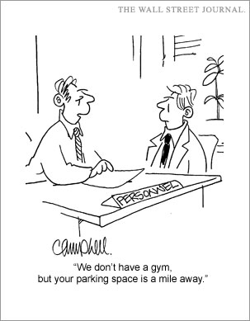
HSC Finance is Moving!
Our physical address will be: 1650 University Blvd, NE
HSC Marketing and Communications Building
Notes:
Per Bob, over lunch on 9/11, we will be moving on the “early December” dates. November could not be worked out.

Slide 3
1650 University Building
Notes:
North on University, on east side of street. 1650 University building (taken 9/5/14 by Terry. South side view)

Slide 4
HSC Finance is Moving!
Currently scheduled to move in late November
Offices will be closed for operations during the move
Tentatively scheduled for Thursday, November 20th through Monday, November 24th
Offices scheduled to reopen on Tuesday, November 25th
Financial Services Division offices impacted:
HSC Budget Office
HSC Contract and Grant Accounting
HSC PreAward/Sponsored Project Office
HSC Reporting
HSC Unrestricted Accounting
Schedule subject to change
Notes:
Per Bob, over lunch on 9/11, we will be moving on the “early December” dates. November could not be worked out.

Slide 5
Important Things to Know
Our hours of operation will be 8:00 am to 5:00 pm
Phone numbers and most Mail Stop codes will remain the same
HSC Budget Office: (changing to) MSC07 4340
HSC Contract and Grant Accounting: MSC09 5225
HSC PreAward/Sponsored Project Office: MSC09 5220
HSC Reporting: MSC09 5227
HSC Unrestricted Accounting: MSC09 5222
PLEASE use the correct mail stop code

Slide 6
Important Things to Know
Reserved Visitor Parking at 1650 University
HSC FSD will have several reserved spaces
Permit can be provided via e-mail
Ask at the front desk for a parking permit
Other Visitor Parking Available
1642 University (Elks Lodge) designated as general visitor
Visitor Permit Required – contact FSD Office to obtain
Can be provided via e-mail
Rover Pass
Rover Passes can be used with other valid parking permit at 1650 in any available, unreserved space
Refer to Rover Pass guidelines for details

Slide 7
Important Things to Know
Shuttle Bus Service
The shuttle bus to 1650 University (U Lot) departs from and returns to the to G-Lot Hub
Shuttle service is scheduled hourly
Departs G-Lot Hub: 23 minutes after the hour
Departs 1650: 30 minutes after the hour
Service may be expanded based on campus need
http://pats.unm.edu/UNM-Shuttles/index.html
http://pats.unm.edu/faqs/1650/
Notes:
Shuttles begin at 7:23 - - last shuttle 5:30 - - first shuttle time to change when fully occupied – probably in December

Slide 8
Shuttle Bus Trip Examples
Sample Passenger trip (Medical to 1650)
8:15am: depart Medical on Redondo Shuttle
8:19am: Arrive G-Lot Hub (island)
8:23am: Depart on “1650” bus (from “wall”)
8:29am: Arrive Bldg. 1650
Sample Passenger trip (Yale Mall to 1650)
8:15am: depart Yale Mall on Redondo Shuttle
8:23am: Arrive G-Lot Hub (island)[earlier arrival recommended]
8:23am: Depart on “1650” bus (from “wall”)
8:29am: Arrive Bldg. 1650
Sample Passenger trip (1650 to Medical)
7:30am: depart 1650
7:36am: Arrive G-Lot (at Med/Law stop on G-Lot island)
7:40am: Depart on Redondo Shuttle [earlier arrival recommended]
7:44am: Arrive Medical
Notes:
This is an hourly route, and began running September 22.
UNM parking=277-1938
Barbara Morck=277-1969

Slide 9
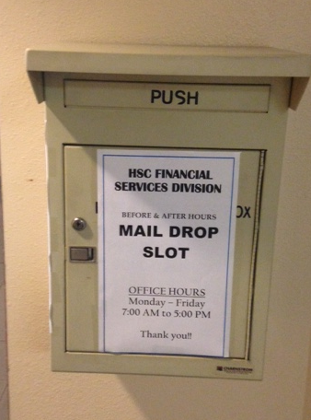
Express Courier Service
HSC “After Hours” Mailbox converts to “Express Courier Service” collection box
Located in HSSB, outside current location – Suite 102
Contents delivered directly to Financial Services Division daily
Multiple direct deliveries can be scheduled based on volume
Bypasses other stops

Slide 10
Petty Cash Processing
HSC Unrestricted Accounting
Option I: Approval by MC Unrestricted Accounting
Located on the third floor of the John and June Perovich Business Office, 1700 Lomas NE, Suite 3400 - Building 183
Petty Cash reimbursement requests are reviewed on Monday, Wednesdays and Friday’s from 1:30pm - 4:30 pm
Must “walk in” with form, cannot be mailed to Main Campus Unrestricted Accounting for processing
Cashier’s office is located on the first floor
of John and June Perovich Business Center
Notes:
We averaged less than 8/month last fiscal year (88 total in FY14)

Slide 11
Petty Cash Processing
HSC Unrestricted Accounting
Option II: Approval by HSC Unrestricted Accounting
“Walk in” with form at 1650 University, Suite 2700
See Shuttle Schedule
Reviewed Tuesdays and Thursdays from 8 – 11 am
Mail to MSC09 5222 or use Express Courier Service box and pick up when ready
See Shuttle Schedule
Pick up Tuesdays and Thursdays from 8 – 11 am
Notes:
We averaged less than 8/month last fiscal year (88 total in FY14)

Slide 12
Petty Cash Processing
HSC Contract and Grant Accounting
Option I: “Walk in” with form at 1650 University, Suite 2600
See Shuttle Schedule
Reviewed on Tuesdays and Thursdays from 8 – 11 am
Option II: Mail to MSC09 5225 or use Express Courier Service box and pick up when ready
See Shuttle Schedule
Pick up Tuesdays and Thursdays from 8 – 11 am
Notes:
Per Jason, the only change from the current process will be the number of days and hours.

Slide 13
Internal Purchase Orders
Blank Internal Purchase Orders Options
Option I: Call or email HSC Unrestricted Accounting Admin Assistant
Sean McDougle – 272-6266 or SMcDougle@salud.unm.edu
A supply will be sent to you via campus mail
Option II: Call or email Purchasing
Jennifer Trujillo – 277-2036 or jetrujillo@unm.edu
A supply will be mailed to you via campus mail
Notes:
We distribute about 1200 internal Pos /year, per Sean.

Slide 14
Internal Purchase Orders
Blank Internal Purchase Orders Options
Option III: Go to Purchasing Office to pick up
John and June Perovich Business Center, Suite 2600
Office Hours: Monday through Friday, 8:00 to 12:00 and 1:00 to 5:00
Option IV: Go to 1650 University to pick up
See Shuttle Schedule
Office Hours: Monday through Friday, 8:00 to 5:00
Notes:
We distribute about 1200 internal Pos /year, per Sean.

Slide 15
Deposit Bag (Money List) Processing
HSC Unrestricted Accounting no longer a “primary drop off” location
Option I: Contact the Cashier’s office to schedule pick up service
Supervisors of Cashiers: Amy Montoya – 925-9266
Can be scheduled for daily or as needed
Option II: Deliver Deposit Bag/Money List to the Cashier’s Office
John and June Perovich Business Center , Suite 1100
Office Hours: Monday through Friday, 8:00 am – 5:00 pm
Option III: Deliver Deposit Bag/Money List to HSC Unrestricted Accounting
See Shuttle Schedule
Office Hours: Monday through Friday, 8:00 am – 5:00 pm
Money Lists or loose checks must continue to be hand delivered; do not use inter office mail
Notes:
Per Michelle, we get maybe five checks a month from departments to add to our money list that they could have put on a money list of their own.

Slide 16
Alternate Delivery Methods
You can scan and email your PreAward documents to the PreAward department
Non-Standard Payment Forms – being converted to ePAF process. “Soft” go-live to begin November 2014. HSC campus wide implementation planned for February 2015.
Zero Pay DPEZ can be “sent” via PCard Workflow
Coming soon (we hope)…scan to review DPI process
Project in preliminary planning stage at this time

Slide 17
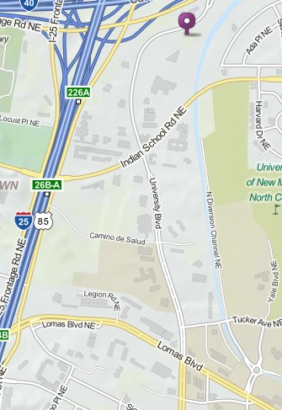
1650 University Blvd, NE
Location: Just North of Indian School Road on the east side of University Blvd.
Open House scheduled for:
Friday, December 5, 2014
Time: TBA
Watch for announcement in Public Affairs notices

Slide 18
HSC Communications and Marketing Center
HSC Financial Services Offices are moving to 1650 University Blvd NE before Thanksgiving
Processes for Petty Cash review, Internal Purchase Orders, Money Lists, and Pre Award documents are being slightly modified to accommodate the communities business needs
Shuttle Service and parking is available
Our commitment is to serve and support missions of the HSC community

Slide 19
Other 1650 Occupants
Project ECHO
HSC Communications and Marketing
COP - Poison Control and Drug Information
HSC Compliance and Privacy Office
Care NM
UNMH Clinical Education
UNMH Transcription
CON Research
UNMH Business Operations
Questions????

