Slide 1
The UNM HSC Research Mission
RAFT Session
26 September 2014
Richard S. Larson, MD, PhD
Executive Vice Chancellor
Vice Chancellor for Research

Slide 2




Achieving the “Virtuous Cycle”
Latest advances in care
Enhanced National Reputation
Workforce
Research
Education
Clinical
Improved Health Care
Infrastructure for Education & Research
UNM
HEALTH SCIENCES CENTER

Slide 3
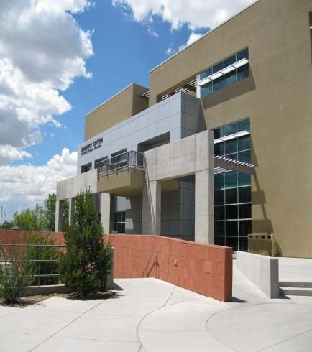
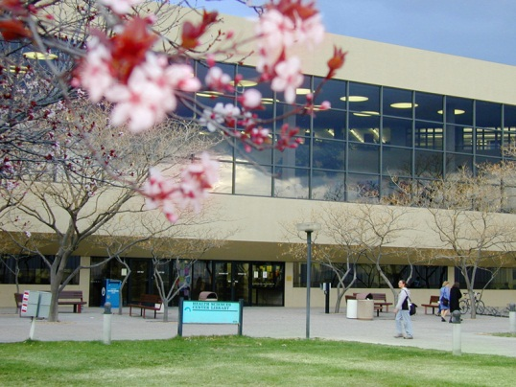
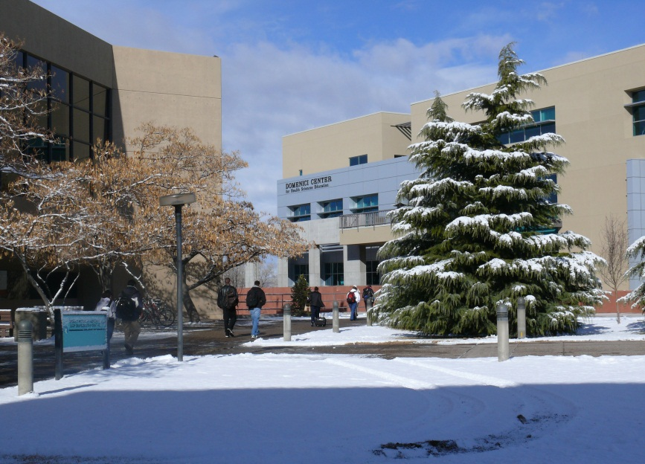
Growth of Health Research at UNM HSC
Growth of HSC Funding vs. Growth of NIH Funding
UNM HSC
2014:
$157 Million
NIH
Growth due to tactical success
Funded by Federal Government, Private Foundations and Private Companies
Most university funding has mimicked the NIH curve
UNM
HEALTH SCIENCES CENTER

Slide 4

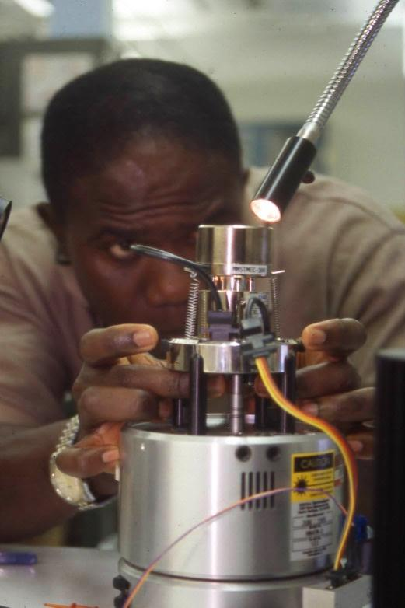

ENVIRONMENT CHALLENGES to the Research Enterprise
More Competitive
NIH Funding
Reduction in NIH Training Programs
Changing emphasis on type of research
Opportunity for larger university networks
UNM
HEALTH SCIENCES CENTER

Slide 5


STRATEGIC CENTER INVESTMENT
UNM
HEALTH SCIENCES CENTER

Slide 6
Creation of Signature Programs
Disease-focus
Trans-disciplinary, spanning across SOM Departments & HSC Colleges
Promoting collaborative (Networked), Non-market approach
Bench Bedside Community
Brian & Behavioral Illness
Corey Ford, MD, PhD &
Bill Shuttleworth, PhD
Cardiovascular & Metabolic Disease
Nancy Kanagy, PhD
Infectious Disease & Immunity
Thomas Byrd, MD
Environmental Health Sciences
Matthew Campen, PhD, MSPH
Child Health Research
Kristi Watterberg, MD
Cancer
Cheryl Willman, MD
CTSC Support

Slide 7


History of Strategic Center Investment
2000
The HSC targets the Cancer Center for National Cancer Institute designation.
2005
After 5 years of program creation, commitment and investment, the UNM Cancer Center is NCI Designated.
2005
The HSC targets obtaining a $30 million Clinical & Translational Science Center Award from NIH.
2010
HSC becomes one of 59 CTSA sites in the country. This new center speeds the movement of scientific advances into clinical care.
Clinical & Translational
Science Center
2010
The HSC Chancellor identifies the Brain and Behavioral Health Institute for development.
2012
We are on a path to build our clinical and research resources in neurological & behavioral health disorders.

Slide 8
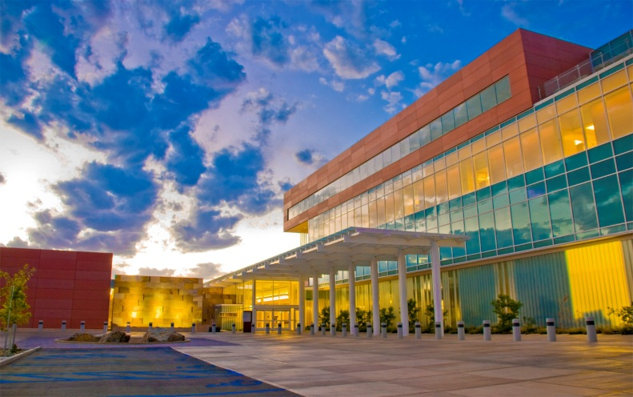
Cancer Center
National Cancer Institute designation in 2005, renewed in 2010
Leverages into many grants

Slide 9
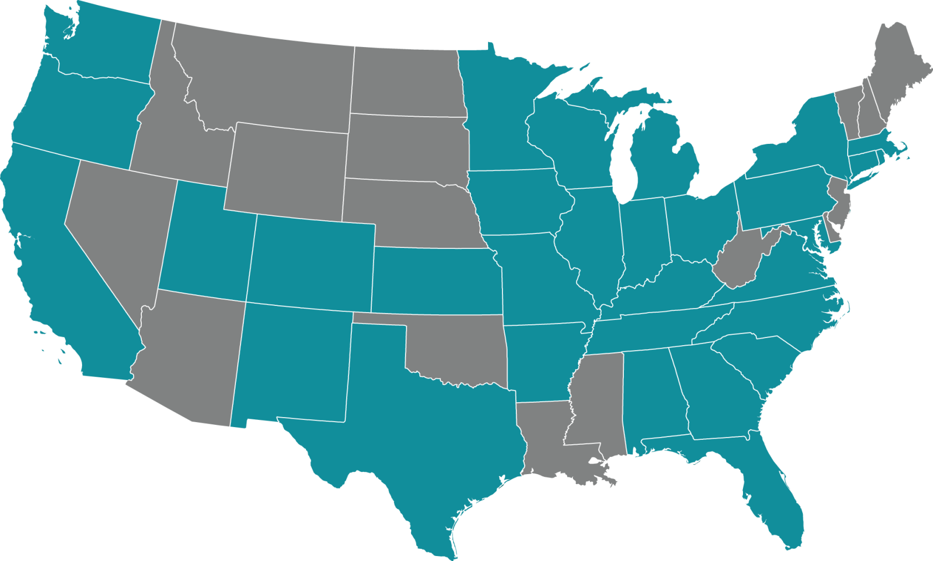

Clinical & Translational Science Centers
Clinical & Translational Science Centers
Positions us as nationally recognized
Builds collaboration network
      Pilot funding
      Education Programs
      Enhanced technology
      Enhanced component-led research

Slide 10
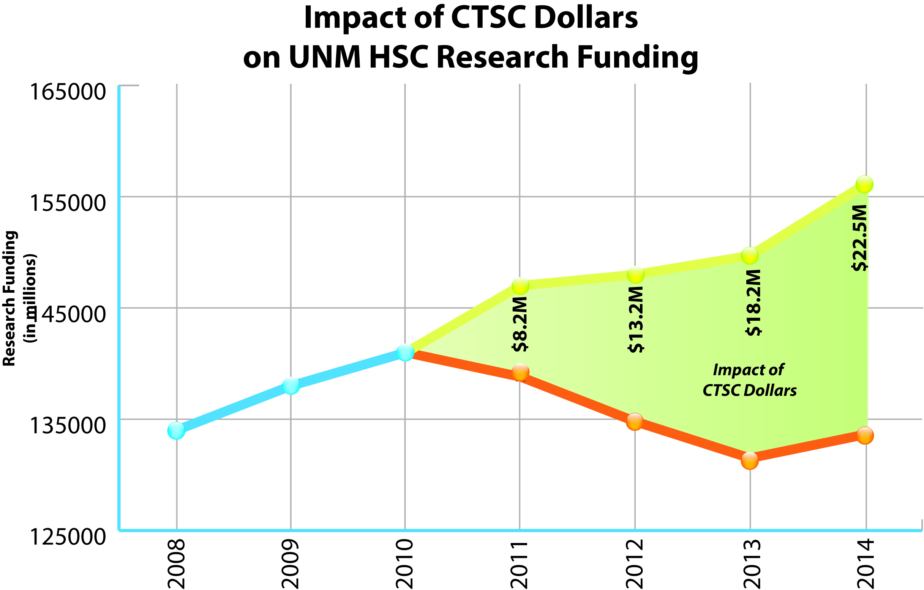
Promoting Clinical & Translational Research
CTSA Leveraged Funds
 | FY11 | FY12 | FY13 | FY14 | CUMULATIVE
CTSA | $4,584,421 | $4,584,421 | $3,849,555 | $4,156,692 | $17,175,089
CTSA Supplement | $0 | $136,554 | $233,053 | $0 | $369,607
CTSA Affiliated | $1,575,714 | $2,420,970 | $3,623,770 | $3,667,905 | $11,288,359
CTSA Required | $ 537,830 | $1,586,521 | $1,277,377 | $1,500,245 | $4,901,973
Return on Pilots | $1,491,368 | $4,477,648 | $9,250,004 | $12,199,428 | $27,418,448
Total | $8,189,333 | $13,206,114 | $18,233,759 | $21,524,270 | $61,153,476

Slide 11
Large Center or Programmatic Grants
Large Center Grants:
  University of New Mexico Clinical & Translational Science Center (PI:Larson)
  University of New Mexico Cancer Center Support Grant (PI:Willman)
  University of New Mexico Interdisciplinary HPV Prevention Center (PI:Wheeler)
  Center for Spatiotemporal Modeling of Cell Signaling (STMC) (PI:B.Wilson)
  SEER; Surveillance, Epidemiology and End Results – Option Year Two CORE (PI:Wiggins)
  Integrative Program CNS Pathophysiology Research (PI:Liu)
  NM Center for Advancement of Research, Engagement & Science on Health Disparities (PI:Williams)
  NM Inbre (New Mexico IDeA Networks of Biomedical Research Excellence) Tasks 1-8 (PI:Griffith)
  Prevention Research Center, CDC (PI:Davis)
  Fetal Alcohol Induced Behavioral Deficits: Mechanisms, Diagnoses and Intervention (PI:Savage)
  Structural Cell Biology of DNA Repair Machines (PI:Tomkinson)
  Bold Italics: Supported by Clinical and Translational Research
Programmatic Center Grants:

Slide 12
New Funding Opportunities
UNM
HEALTH SCIENCES CENTER

Slide 13
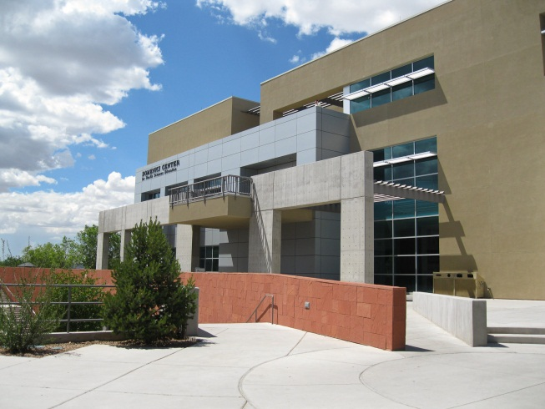

Identifying New Opportunities
New Federal Dollars
  PCORI ($160million)
  SBIR/STTR ($682million awarded by NIH, $1.04billion awarded by DOD)
Diversification of portfolio to include other federal sources (e.g. DOD, EPA, DOE)
Leveraging activities with national lab
Faculty K Awards
Formation of NIH partnerships?
Emphasis on new type of research (Health Outcomes, Cost Effectiveness, etc.)
ACA & CMS demonstrative project
SBIR/STTR
SMALL BUSINESS INNOVATION RESEARCH
SMALL BUSINESS TECHNOLOGY TRANSFER
UNM
HEALTH SCIENCES CENTER

Slide 14
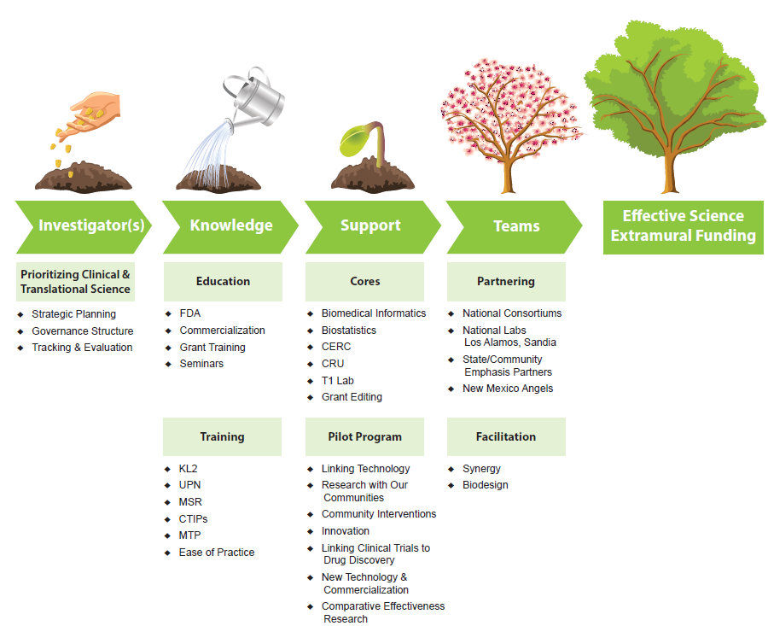
Infrastructure Support (All New)
UNM
HEALTH SCIENCES CENTER

Slide 15
Affordable Care Act
CUMULATIVE Activity since 5/31/11 through 6/30/2014
144 grants ($162 million) submitted
70 grants awarded for a total of $46 million so far (50% success rate)
UNM
HEALTH SCIENCES CENTER

Slide 16
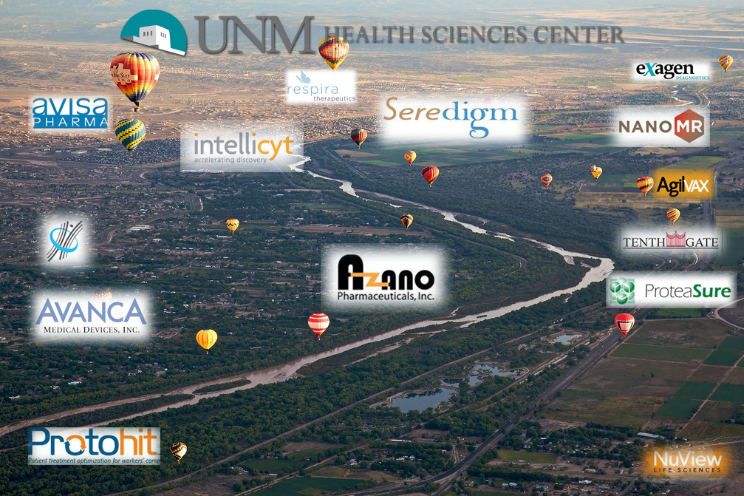






Commercialization
Since 2004, 31 new private companies were either spun off from the university or used university technology to start up
Greater Albuquerque population approximately 900,000
Blue Ring Energy Holdings
Christmas
Consortium
algorithmRx, LLC
Integrated Algal Products, inc.
Applied
Biophotonics
Capseda LLC
ENDOScreen
HealthCONNECTPro
FeldmaTECH, Inc.
Agren Pharma
Tyrosine
Pharmaceuticals, Inc.
Quatros
UNM
HEALTH SCIENCES CENTER

Slide 17
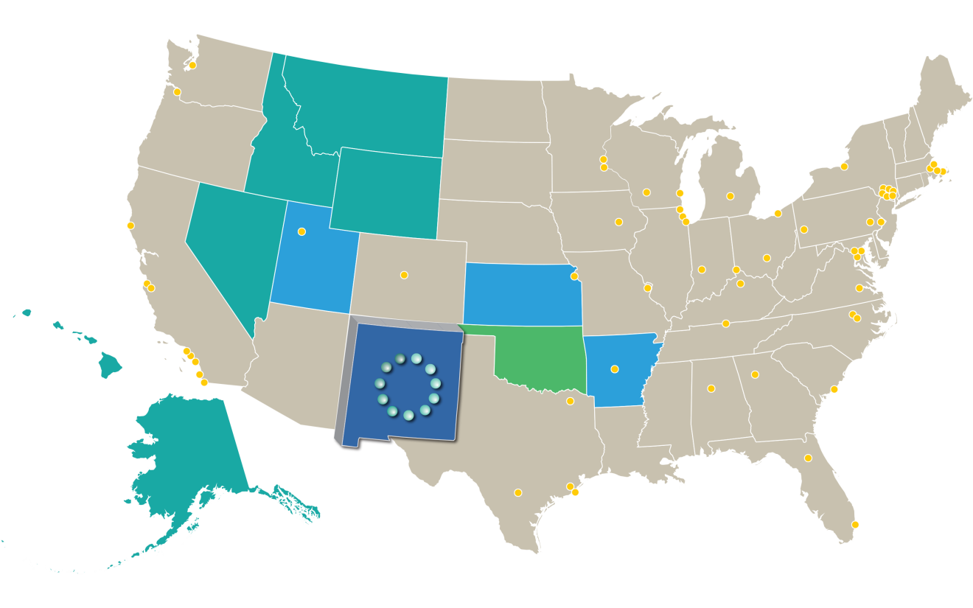
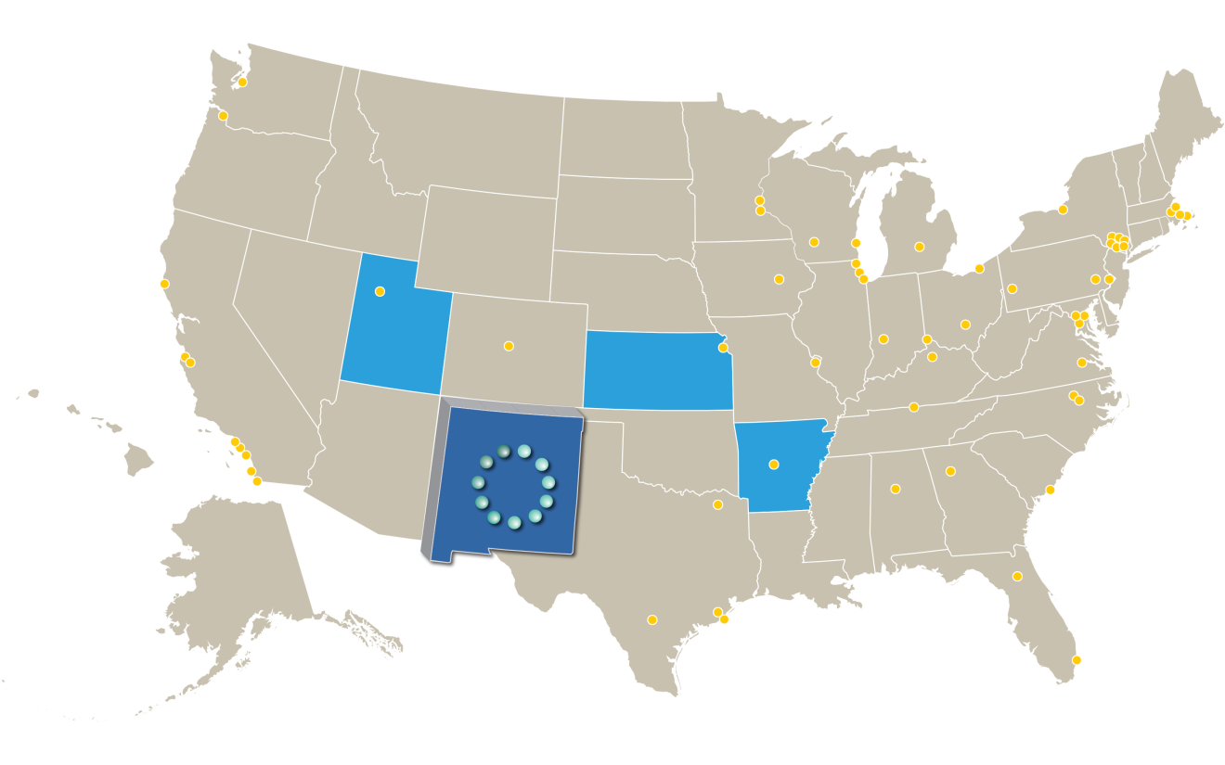
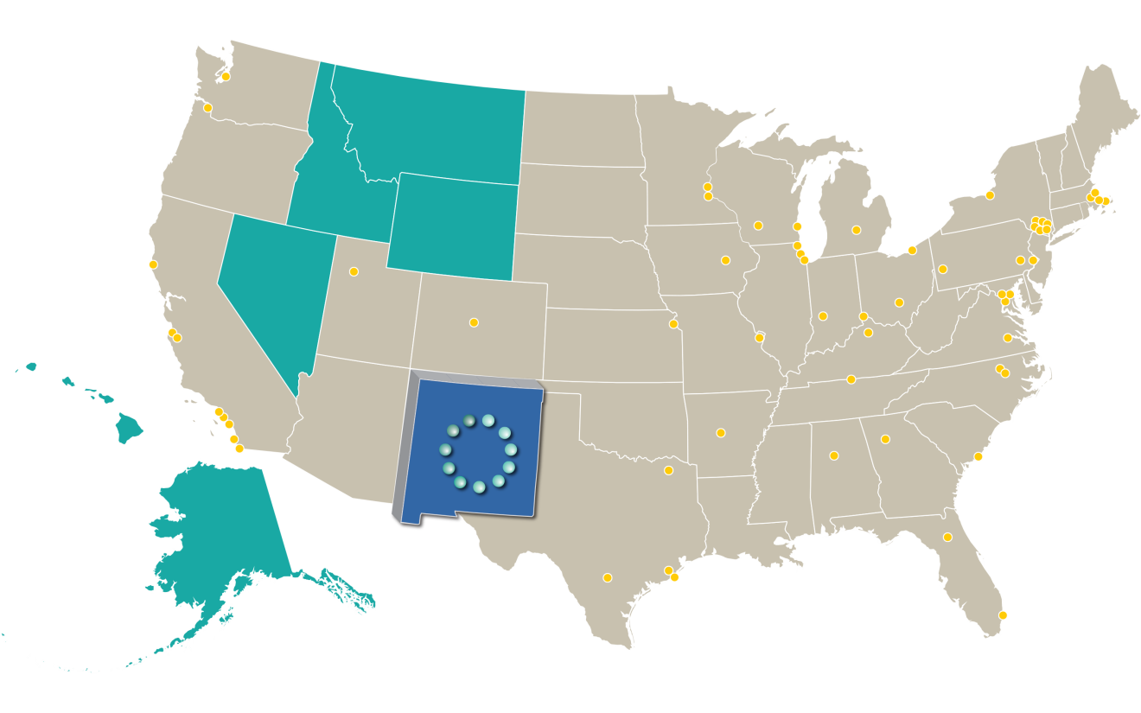
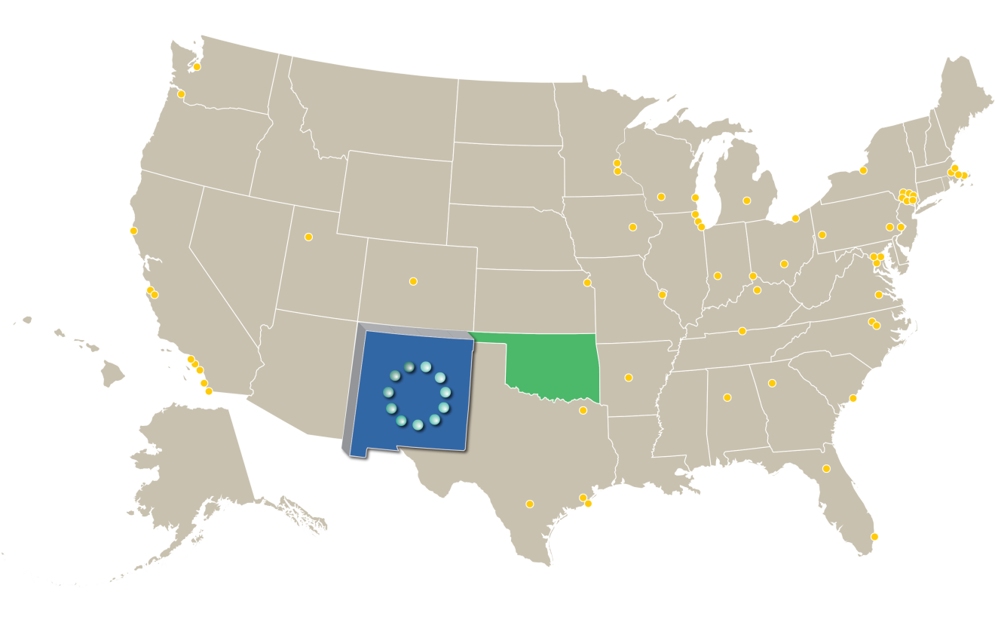
Regional Partnerships
Western States CTSA Consortium
K to R Program
Pilot program
Mountain West Consortium
Includes 7 IDeA states, 11 Institutions
Undergraduate Pipeline Program
K to R Program
Mini-sabbatical
Network of Shared Resources
$17.5 million Mtn West CTR-IN Funding
Regional Biostatistics Core
Oklahoma Consortium
Pilot program
UNM
HEALTH SCIENCES CENTER

Slide 18
Mountain West CTR-IN
Pilot Award Program
Scholar’s / Mini-Sabbatical Program
Advance to Funding Program
Regional VIVO / Research Networking
Regional Biostats Core
UNM
HEALTH SCIENCES CENTER

Slide 19
Questions?
Richard S. Larson, MD, PhD
Executive Vice Chancellor
Vice Chancellor for Research

