Slide 1
Chrome River Update
Laura Putz
RAFT Session
February 10, 2017

Slide 2
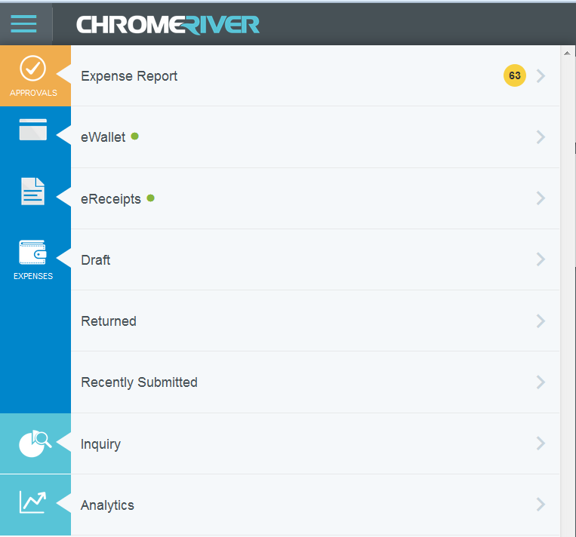

Slide 3
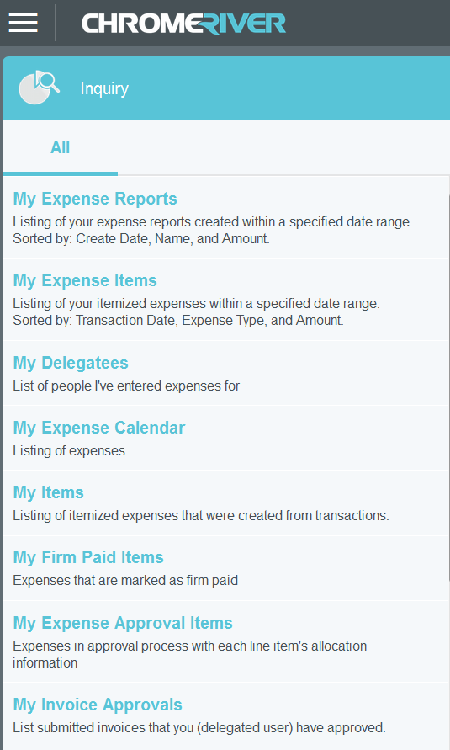
Inquiry Reports
Accessed via the hamburger icon
User specific reports

Slide 4
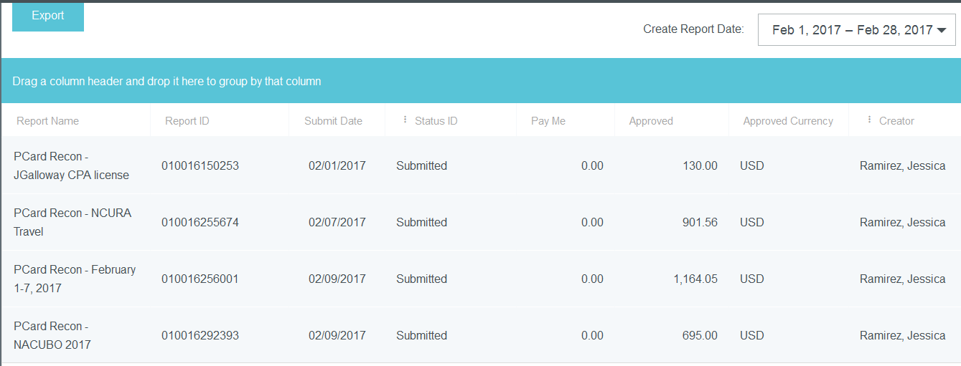
My Expense Report

Slide 5
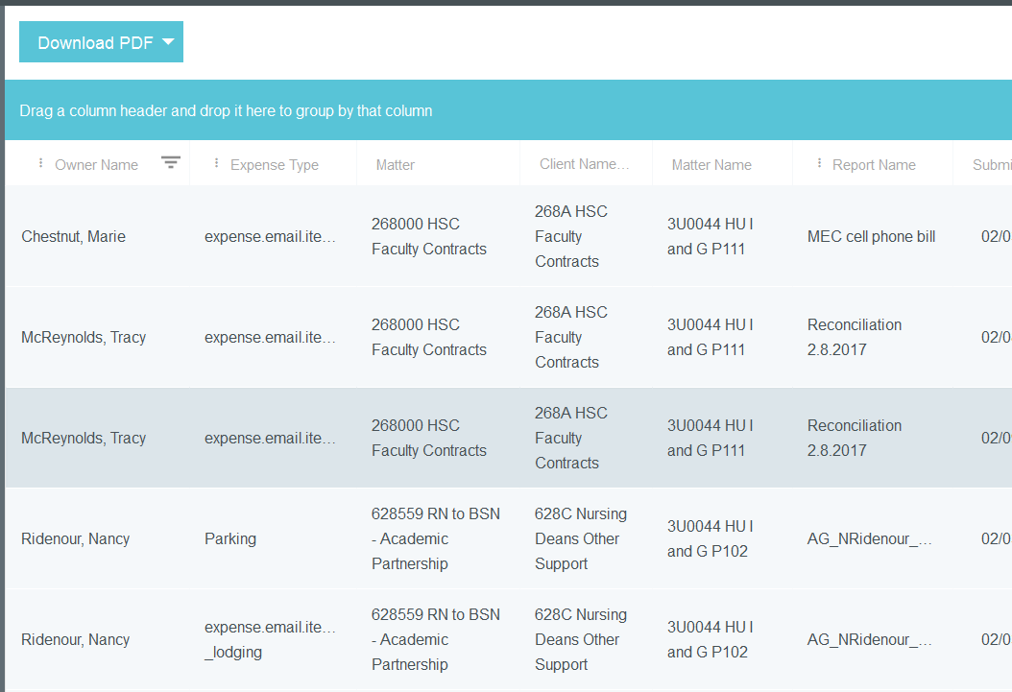
My Expense Approved Items

Slide 6
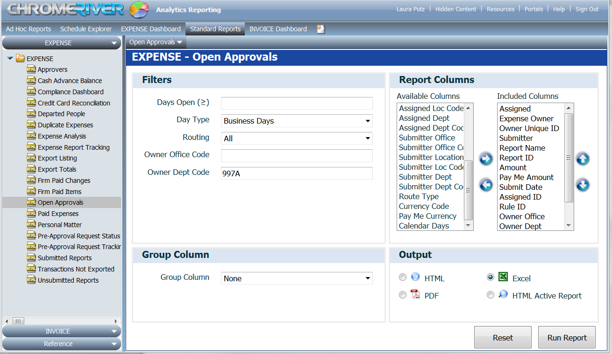

Slide 7
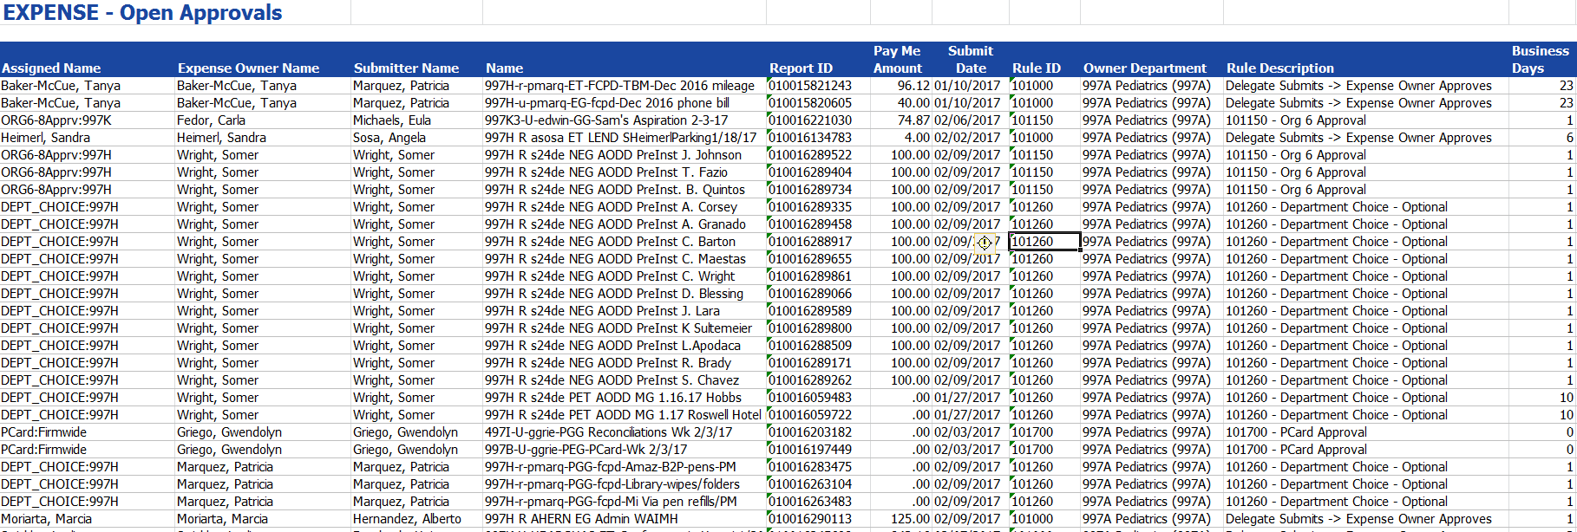
Open Approvals Report

Slide 8
