Slide 1
HEALTH SCIENCES CENTER
Contract and Grant Accounting Update
RAFT February 10, 2017

Slide 2
HEALTH SCIENCES CENTER
NIH Salary Cap Increase – no change as of 2.10.16
Effective January 10, 2016
Increased to $185,100 from $183,300
http://grants.nih.gov/grants/policy/salcap_summary.htm

Slide 3
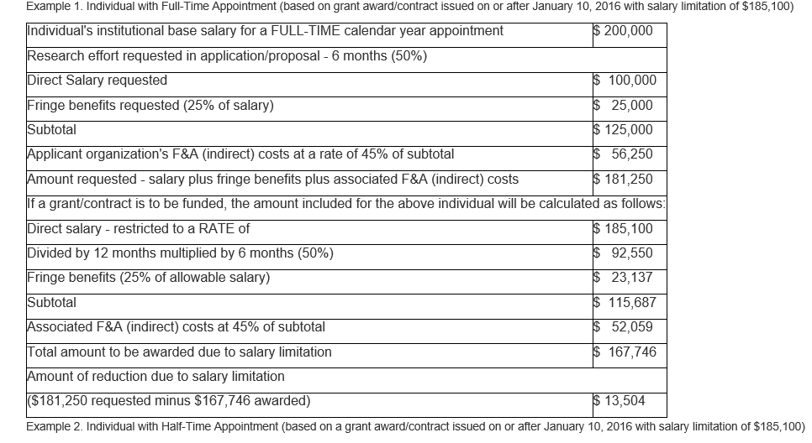
HEALTH SCIENCES CENTER

Slide 4
HEALTH SCIENCES CENTER
Ruth L. Kirschstein National Research Service Award Stipends
Effective to Kirschstein-NRSA awards made on or after December 1, 2016 for FY 2017 awards.
All FY 2017 awards previously issued using FY 2016 stipend levels will be revised to adjust stipends to the FY 2017 levels.
https://grants.nih.gov/grants/guide/notice-files/NOT-OD-17-002.html

Slide 5
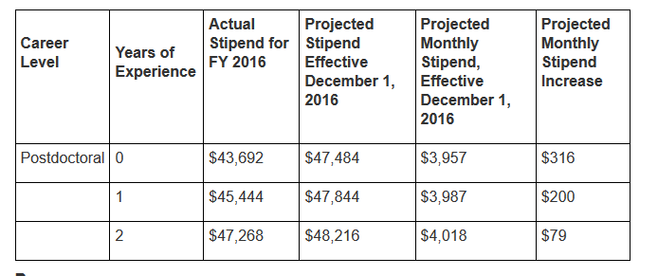
HEALTH SCIENCES CENTER

Slide 6
HEALTH SCIENCES CENTER
Effort Certification
Communication for the July through December 2016 Period (201602) coming soon. You should be receiving a Pre-review email February 17th.
MSU Update
Due to Preaward by February 15, 2017
Indexes will be active in Banner no later than March 1, 2017

