Slide 1
RAFTS Research Administration Forum and Training Session
HSC Sponsored Projects (SPO)/PreAward
February 10, 2017
Fitz Hall 303

Slide 2
Topics to Cover
Review of Conflict of Interest Department/HSC SPO Roles
SF424 Click- Going Live- Get Trained!
Additional forms to include with outgoing subawards on proposals

Slide 3
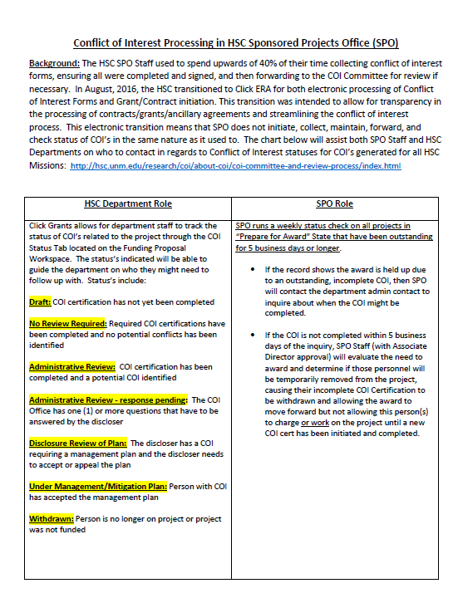
Conflict of Interest Department/HSC SPO Roles
Notes:
https://unmstage2.huronclick.com/GrantsCOIStage/Rooms/DisplayPages/LayoutInitial?Container=com.webridge.entity.Entity%5BOID%5B4527089A7AFBB84FBF74778B245DDA58%5D%5D&_webrlogoff=true

Slide 4
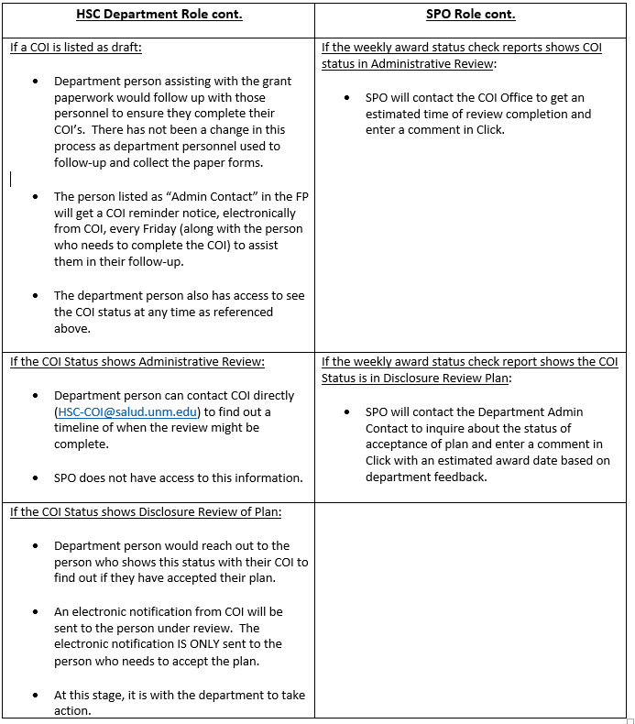
Click COI Status

Slide 5
Conflict of Interest Tab
Departments have the ability to check the status of their project’s Conflict of Interest disclosures in Click by using the “COI Status” tab.

Slide 6
SF424 Submission Through Click
Our next update to Click will give users the ability to complete and submit the SF424 forms directly to NIH through Click instead of using the SF424 PDF packet or Assist.
NIH Applications are the only ones being submitted via Click at this time.
Using the SF424 Application form in Click is not required. You will still be able to use NIH Assist. We will also accept SF424 PDF forms for the time being to assist in the transition.

Slide 7
SF424 Submission Through Click
Benefits:
Less errors! The application will be verified on the Click side before it’s submitted to NIH
Maps information over from your Click record onto the SF424, thereby reducing the amount of data entry
Easy access for the reviewer, PI and administrative assistants to the full version of the of the grant package as well as individual components
Prevents miscommunication or the accidental circulation of multiple versions of a single grant proposal.

Slide 8
SF424 Submission Through Click
Trainings on how to use the SF424 in Click will begin in March. The class will be mostly hands on to help you learn the new process.
Keep an eye out for emails letting you know when to register in Learning Central!
You will need to take the SF424 training class before you can submit an SF424 application through Click

Slide 9
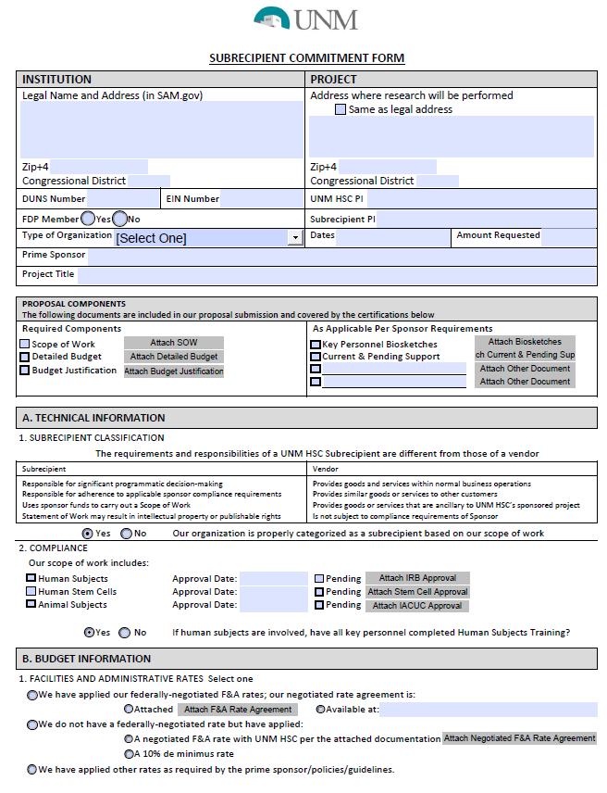
Subrecipient Commitment Form
Starting February 15th, SPO/PreAward will require two additional sets of forms be submitted with proposals which include outgoing subawards. These forms are available on the HSC SPO/PreAward website.
The Subrecipient Commitment Form will be required for all outgoing subawards on all proposals at the time of submission. This form helps departments and SPO gather basic subrecipient information in one centralized place.
Notes:
Eventually your username and password WILL be tied to your HSC account; for now, you will have to manually set your Click password.

Slide 10
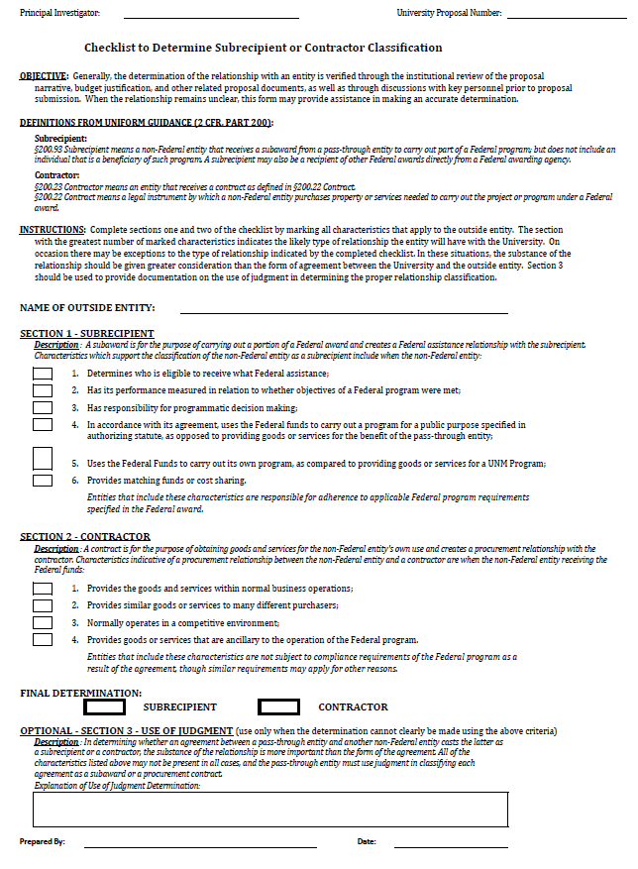
Subrecipient or Contractor Checklist
The Checklist to Determine Subrecipient or Contractor Classification will also be required; this will help SPO determine if a collaborator should be included in the proposal as a Subrecipient (subaward) or as a Contractor (vendor/PO)

Slide 11
Questions
Danielle Jones – x. 2-4076, dcrepella@salud.unm.edu
Aida Andujo – x. 2-1219, aandujo@salud.unm.edu
SPO Email – HSC-PreAward@salud.unm.edu

