Slide 1
MyReports Finance Project Update Presented by Nancy Middlebrook Naren Tarikere

Slide 2
Agenda
Introduction
Hyperion Countdown
MyReports Finance Update
Training
Support / Help
User Feedback
Questions

Slide 3
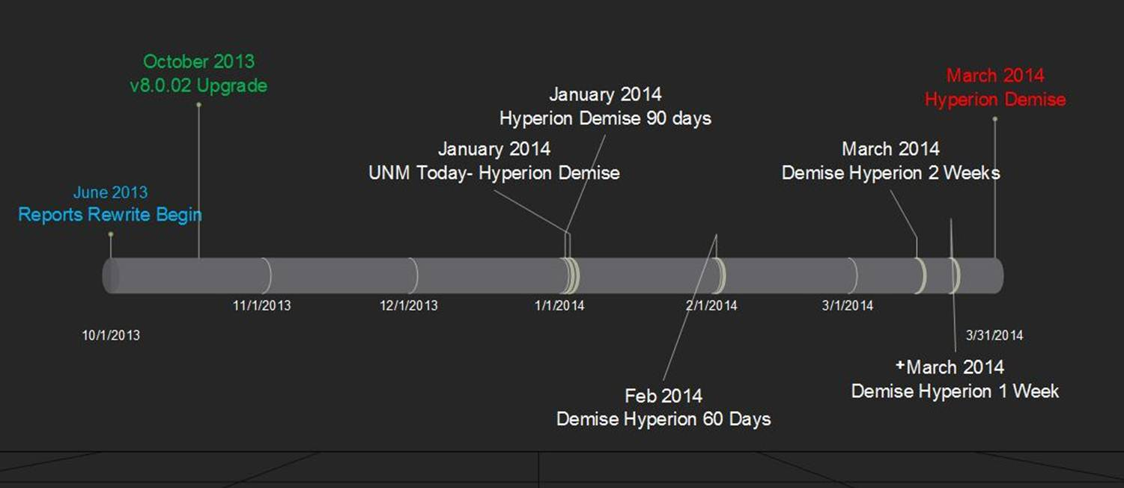
Hyperion Countdown

Slide 4
MyReports Finance Update
Report Conversion Update
Go to http://myreportsinfo.unm.edu → Finance → Report Conversion Status
Pending Reports (Hyperion Finance Production Folder)
FRH0001&2 Grant Ledger Detail and Summary (QA testing)
FBRHOO22 - UAP 7000 Deficit Compliance and Balance Reports (Report development in progress)
FBRHOZ02 UAP7000 Reserve Categorization Reports
FRH0004 - F&A Generated by PI
FRH0005 - Closeout Workflow for Funds Ending on Contracts and Grants
FBRHOZ01 Main and Branch Transfers Allocation

Slide 5
Training
Published Report Users
Introduction to the Finance MyReports Portal
Job Aids
Power Users
Online
Learning Central --> MyReports Writer - Finance (ONLINE COURSE FIN 200)
InfoAssist Advanced Topics
Instructor-Led
Learning Central --> InfoAssist - Finance Report Writer Training (COURSE FIN 502)
2/20/2014 @ 9:00 AM (EOD Room 1019)
3/24/2014 @ 2:00 PM (EOD Room 1019)
Send an email to fsm@unm.edu if you need additional classes by end of March

Slide 6
Support/Help
Published Report Users
Search https://fastinfo.unm.edu to find answers on Frequently Asked Questions.
Email fsm@unm.edu if you need further help
Power Users (Ad-hoc Report Writers)
Refer to documentation and training videos on the project site http://myreportsinfo.unm.edu
Pose a question on FocalPoint Discussion Forum and get answers from other InfoAssist report writers, encompasses IBI’s customer base.
Sign up for UNM’s POWER_USERS-L listserv via https://list.unm.edu → ‘Subscribe to a list’ and pose a question to the list.
Email fsm@unm.edu if you need further help

Slide 7
User Feedback
Provide feedback or request enhancements to reports on our website
http://fsm.unm.edu/forms.html --> Administrative Reporting Request Form

Slide 8
Questions?

