Slide 1
Click conflicts of interest
Coming soon

Slide 2
What does this mean for you?
Conflict of Interest disclosures will be entered directly into the Click system
When you submit a grant proposal or a protocol for review by the IRB, a certification request will be emailed to each member of the study team
When you receive the email, log into Click, review your disclosure to ensure nothing has changed (or update it if something has changed), click the certification and you’re done

Slide 3
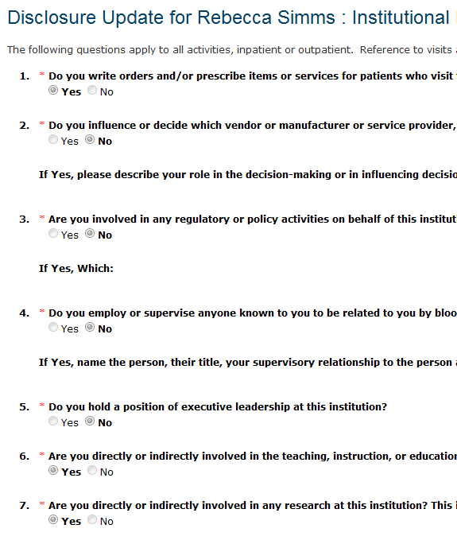
What will it look like?
Smartforms for Disclosure
In development now

Slide 4
What will it look like?
Certification request will appear in your Click COI inbox
Click on certification request to complete the process (review and certify)

Slide 5
When is it coming?
Current estimated go-live for Click COI is
December 2014
As we get closer to go-live, we will provide additional information about training opportunities that will be available.

