Slide 1
Healthcare Compliance: 2014
Stuart Freedman, MPH
HSC Chief Compliance Officer
Monica Wilson, JD, CHC
Manager, HSC Compliance

Slide 2
Topics Covered
Regulator Behavior
Compliance Response

Slide 3
Regulator behavior
How the OIG behaves and how HSC Compliance responds

Slide 4
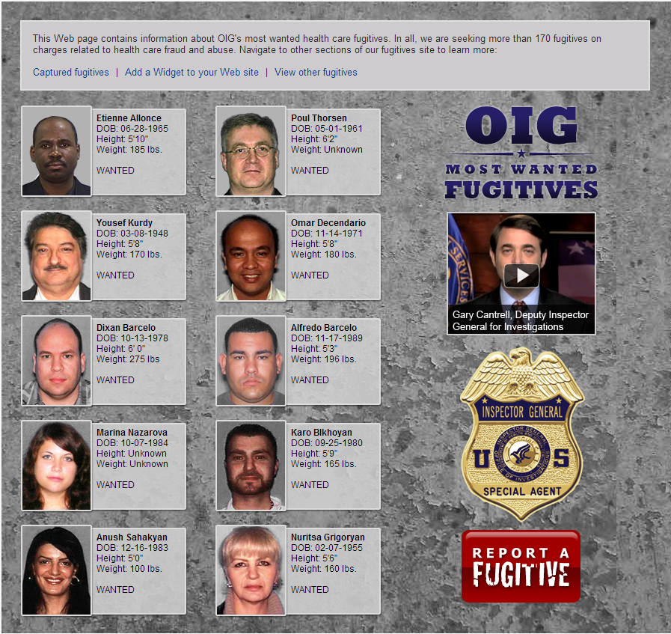

Slide 5
2013 Enforcement Numbers
$5.6B recovered
3,214 new excluded parties
960 criminal actions
472 civil actions
How did we get here?

Slide 6
OIG Motivations
Money
Protect the Medicare trust funds
Government budget
Medicare enrollment
Headlines
Demonstrate effectiveness

Slide 7
OIG Behavior
Looking beyond “fraud”
Quality
Waste and abuse
Exclusion authorities
Data analytics
Regulatory creep

Slide 8
Available Information
Statutes and regulations
Guidance documents
Corporate Integrity Agreements (CIAs)
Presentations at conferences
News reports and press releases

Slide 9
Protecting the HSC
How we respond to all of this

Slide 10
Achievements
HSC Code of Ethics and training
Awareness
Hired an Educator
New hotline and incident management system

Slide 12
Coming Soon
Consolidation
Investigation processes
Training calendar

