Slide 1
HEALTH SCIENCES CENTER
Contract and Grant Accounting Update
RAFT February 6, 2015

Slide 2
HEALTH SCIENCES CENTER
NIH Salary Cap Increase
Effective January 11, 2015
Increased to $183,300 from $181,500
http://grants.nih.gov/grants/guide/notice-files/NOT-OD-15-049.html

Slide 3
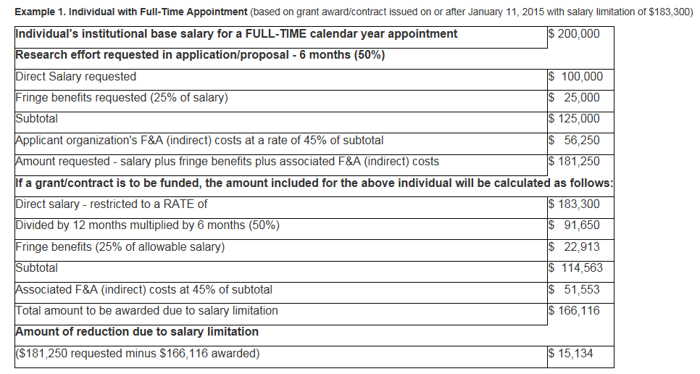
HEALTH SCIENCES CENTER

Slide 4
HEALTH SCIENCES CENTER
Ruth L. Kirschstein National Research Service Award Stipends
Effective to Kirschstein-NRSA awards made on or after October 31, 2014 for FY 2015 awards.
All FY 2015 awards previously issued using FY 2014 stipend levels will be revised to adjust stipends to the FY 2015 levels.
http://grants.nih.gov/grants/guide/notice-files/NOT-OD-15-048.html

Slide 5
HEALTH SCIENCES CENTER

Slide 6
HEALTH SCIENCES CENTER

Slide 7
HEALTH SCIENCES CENTER
Federal Contact and Sub Contracts – Minimum Wage Increase
Executive Order 13658
Effective January 1, 2015
Applies to new contracts and replacements for expiring contracts with the Federal Government
Minimum wage will be increased to $10.10

Slide 8
HEALTH SCIENCES CENTER
Close out monitoring of sub awards
Uniform Guidance Changes
Reviewing financial and programmatic reports as required by UNM. It is the responsibility of the PI to ensure the programmatic requirements are met prior to approving invoices.
Task Force
Closeout Workflow Changes

Slide 9
HEALTH SCIENCES CENTER
Effort Certification
Communication for the July through December 2014 Period next week
MSU Update
Due to Preaward by February 20, 2015
NSF Higher Education R&D Survey
http://ncsesdata.nsf.gov/herd/2013/
http://www.nsf.gov/statistics/2015/nsf15314/

