Slide 1
Building a Culture of Compliance – 2015
Stuart Freedman, HSC Chief Compliance Officer
HSC Compliance Office
Purvi Mody, Executive Director
Health System Internal Audit & Compliance

Slide 2
Following the rules
Doing the right thing

Slide 3
Doing the Right Thing

Slide 4
Doing the Wrong Thing

Slide 5
Employee Retaliation
At VA medical centers, whistleblowers say they still face retaliation.
Troy Thompson, a food service manager with the Philadelphia VA Medical Center, reported to his supervisor in 2012 that the hospital was not taking action on disciplinary issues and several violations of VA sanitation and safety policies, including a fly and pest infestation in the facility kitchen. That day, his boss put him on a detail of the pathology lab and began investigating him for eating and giving away four sandwiches that were to be thrown out because they were stale. (The sandwiches were worth a total of $5.)
As a result of the Office of Special Counsel investigation into multiple whistleblower complaints the Department of Veterans Affairs took the following actions with Mr. Thompson.
Thompson spent two years in the pathology lab. The VA eventually returned him to his job and rescinded the proposed firing. The VA has agreed to compensatory damages for Mr. Thompson.
VA whistleblowers, punished for revealing excessive opiate use and infestation, are finally exonerated. July 24, 2015. The Washington Post.

Slide 6
Why is a Culture of Compliance So Important?
Large organizations with effective programs:
Feel less pressure to compromise standards
Observe misconduct at lower rates
Report misconduct at higher rates
Experience less retaliation for reporting misconduct

Slide 7
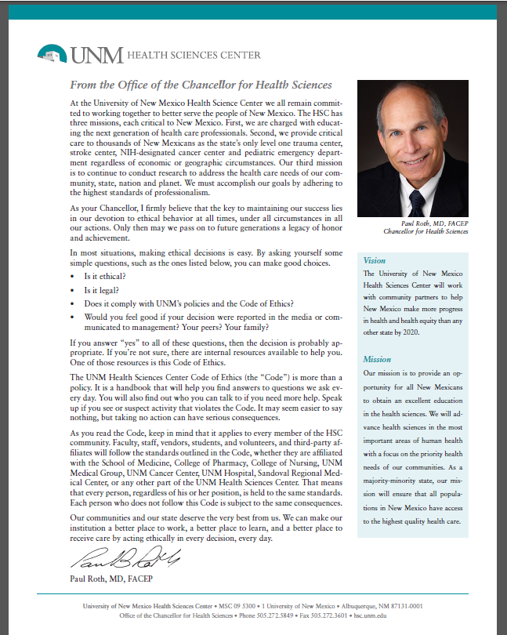
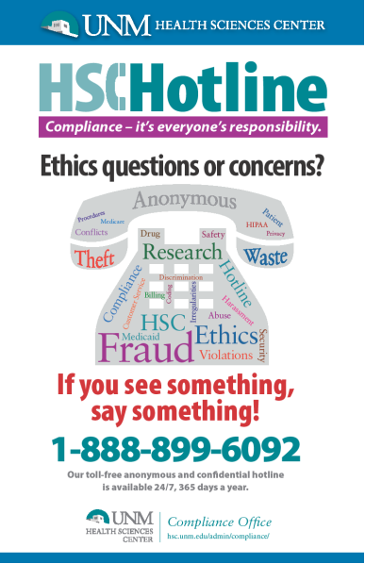
What Has HSC Compliance Done?
Projects identified by the AAMC Compliance Peer Review as National Best Practice:
HSC Code of Ethics
Health System Provider Compliance Committee
Other Major Projects:
Compliance Customer Satisfaction Survey
Community Engagement
Presentations/Events
Hotline Poster
Online Training Focus Group

Slide 8
HSC Compliance 2015 Work Plan
Update the HSC Compliance Code of Ethics
Standardize Compliance Training for New Employees
Establish a Front Line Supervisor and Clinician Competency Training Program on Professional and Business Ethics – Tone at the Middle
Provide in Person Compliance Training for Faculty and Staff Including the Use of the Hotline
Review and Enhance the HSC Compliance Metric Report for Senior Executives and the HSC Board

Slide 9
What is Tone at the Middle?
Tone at the Top
Tone at the Middle
Employees

Slide 10
Developing Tone at the Middle
Four key competencies for supervisors:
Identify ethical dilemmas
Listen to concerns
Access resources
Communicate about ethics

Slide 11
How is the UNM Health System Compliance Department Structured? What Entities Do We Oversee?
UNM Medical Group, Inc.
UNM Hospitals/SRMC
Two Internal Auditors
Compliance Educator

Slide 12
UNM Health System: Key Accomplishments and Future Plans
2015 Accomplishments Training & Education: Over 40 training sessions conducted on E/M, Modifiers, and Teaching Attestations totaling 724 providers, residents, and staff compared to 267 in FY 2014 and 808 in FY 2013 Resident training initiated in July 2014, 135 residents trained through June 30, 2015 with an average feedback score from participants of 4.5 out of 5 New physician education – initiated in July 2014, 43 clinicians audited and educated Auditing and Monitoring: Productivity in FY 2015 increased by 20% compared to 2014. Routine random audits of providers increased to 136 in FY 2015 from 55 in FY 2014. | Other: Web page (link) Quarterly Newsletter Exclusion Check Process Red Flag Process Staff Changes New Hotline System Plans for 2016: Performing a Risk Assessment Data Mining Revamping Audit Methodology Increased Focus on Teaching and Training - 1. new Employees and providers 2. Compliance training 3. Training BOD

Slide 13
OIG Compliance 101: Exclusion checks, Compliance with Fed regulations, Corporate integrity agreements
CMS Internet Only Manual: Billing Guidance
Privacy Matters
Health Systems Guidelines
New Mexico Department of Health Links
The Joint Commission Links

