Slide 1
Job End Date Project Lisa Gamboa HR Consulting Group Manager

Slide 2
Salary Planner Information Human Resources
Term Appointments
Effective March 12, 2015, there will be no job end dates loaded in Banner. For Exempt employees, the hard end dates will be on Default Earnings which will ensure the employee does not get overpaid. Non Exempt employees will not have end dates on the default earnings because of positive time entry.
All job end dates in Banner will be removed behind the scenes and no action is required from departments. Contract Begin and Contract End Dates will be populated in Banner. Additionally, the Default Earnings will be populated behind the scene for all Exempt employees.
Regardless if the job is extended past 6/30/2015, it will load in Salary Planner. Therefore, departments could work on the job and the position at the same time.
Departments no longer have to call in to remove future dated records in order to process EPAFs.
Term Extension EPAFs will be updated to capture enhancements
Email notifications and reports will remain the same

Slide 3
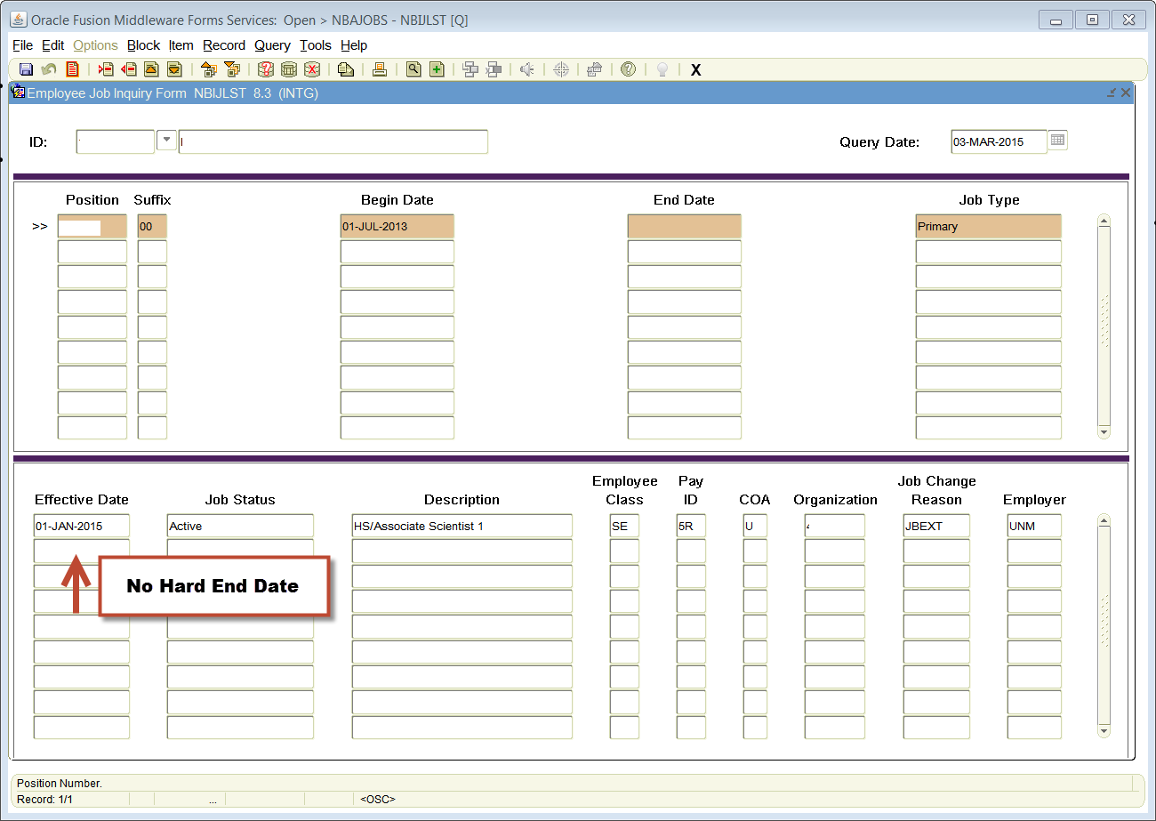

Slide 4
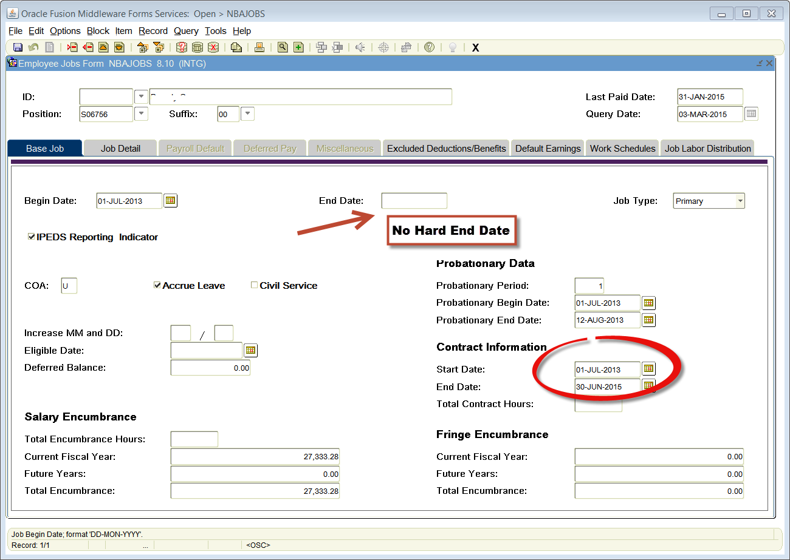

Slide 5
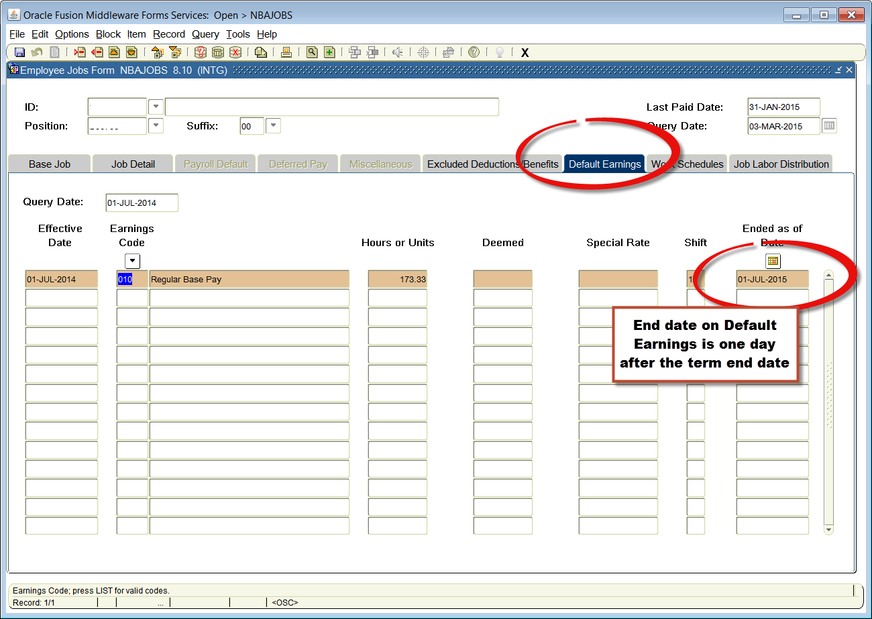

Slide 6
Term Extension EPAFs Lisa Gamboa HR Consulting Group Manager

