Slide 1
Research with the Human Tissue Repository
RAFT Session
April 10, 2015
Corey C Ford, MD, PhD
Sr. Associate Dean for Research

Slide 2
The HTR (and TASR)
HTR or Human Tissue Repository
TASR or Tissue Analysis Shared Resource
Jointly funded by Cancer Center and Dept of Pathology
Oversight by HTOC chaired by SADR
To Facilitate translational research for the HSC faculty
Purpose:
To greatly facilitate the careful acquisition, storage, and distribution of high quality human tissue samples to UNM researchers for use in scientifically estimable investigations while following appropriate ethical, scientific, and legislative principles and regulations.

Slide 3
History and process
In 2004, 6 month moratorium to disclose satellite tissue repositories
Policy completed 2007, updated 2012
Tissues are defined as body fluids, bone, and cellular constituents, including DNA, RNA, proteins
Does NOT include tissue taken for diagnosis (clinical pathology)
HIPAA compliance required
Users submit proposal to HTR for SRC review

Slide 4
Key resources for HTR access
Angela Meisner, MPH, Epidemiologist, with the New Mexico Tumor Registry
Liaison to the Scientific Review Committee (SRC)
awmeisner@salud.unm.edu
HSC Policy for Oversight of Human Tissue in Research
http://hsc.unm.edu/research/docs/oversight-for-human-tissue-in-research-policy_v03june2012.pdf
Inventory:
http://pathology.unm.edu/htr-tasr/inventory.html

Slide 5
Review criteria
Scientific merit
Expertise of research team
Availability of funding, physical and human resources
Evaluation of risk to subjects v. benefits
HTR director certification of availability and that tissue is or is not rare
Very quick turn around times are the rule

Slide 6
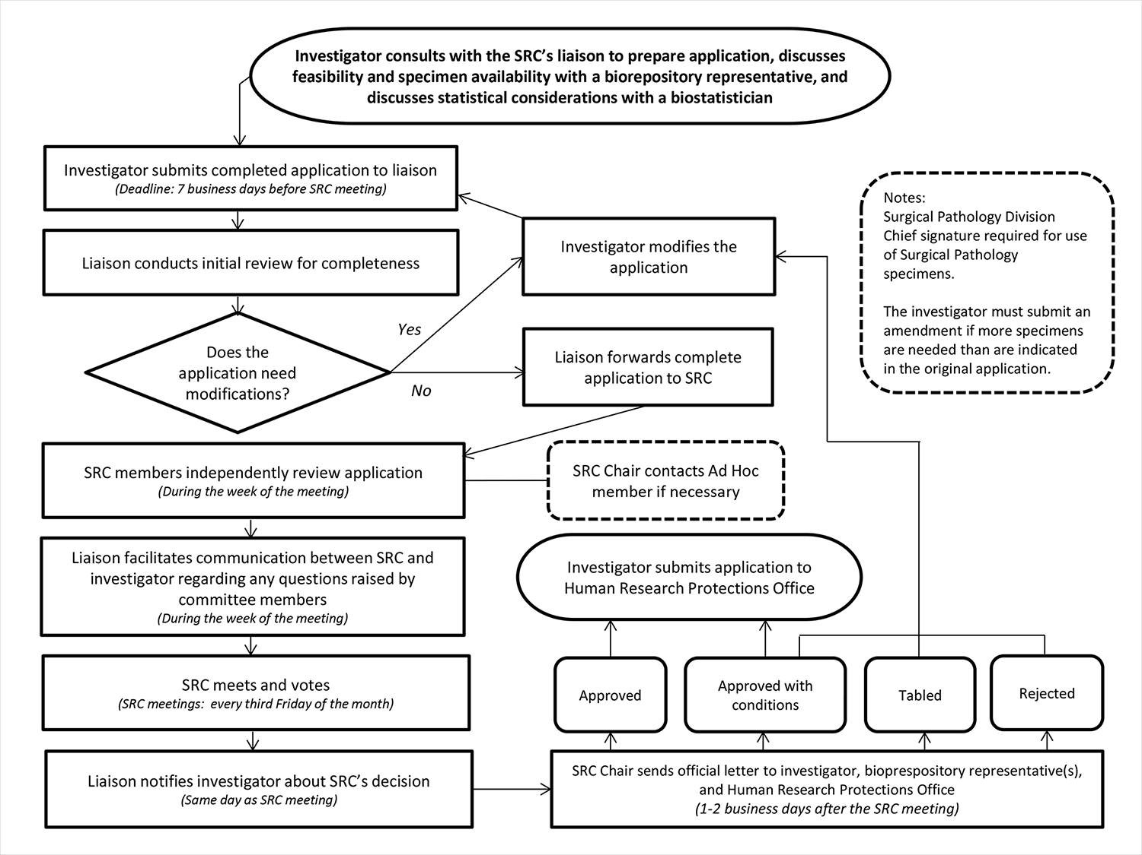

Slide 7
Important things to remember
All tissue must be stored in and under the care of the HTR
Not in a drawer, closet, shelf, refrigerator in an office or department
Tissue of any type cannot be given away to outside investigators or partners
No tissue can be sold to an outside entity
Outside collaborations require a formal agreement with HSC
All tissue use must include involvement of an HSC faculty investigator under an IRB and SRC approved protocol
These can be exempt or expedited approvals

Slide 8
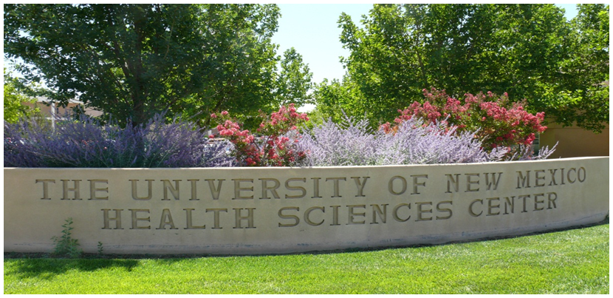
Corey C. Ford, MD, PhD
Senior Associate Dean for Research
UNM School of Medicine
505.272.6950
Questions???

