Slide 1
Kirschstein Fellow & Trainee Grant Tuition and Stipend Payments Guidance
Research Administration Forum Training - RAFT
September 26, 2014

Slide 2
Regulatory Guidance Criteria
RUTH L. KIRSCHSTEIN NATIONAL RESEARCH SERVICE AWARDS
http://grants.nih.gov/grants/policy/nihgps_2013/nihgps_ch11.htm#_Toc271265032
11.2.9.2 Stipends – Not provided as condition of employment.
Service can be a form of work that is taxable but is not necessarily employment.
Example – Scholarships with a past or future service component are taxable in the year in which they are received, and are counted as grants, not employment.
Other than non-need-based employment, an award that is contingent upon the student’s enrollment is generally treated as financial aid.

Slide 3
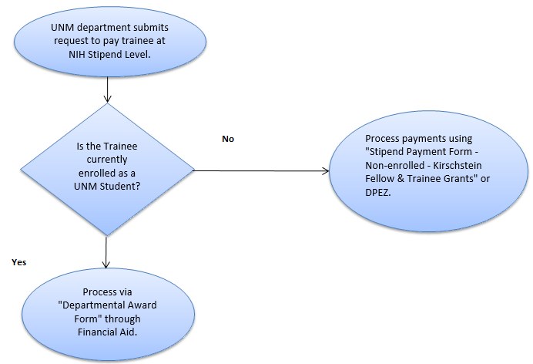
Kirschstein Fellow and Trainee Grant Tuition and Stipend Payment Flowchart

Slide 4
Kirschstein Fellow and Trainee Grant Tuition and Stipend Payment Flowchart
Departmental Award Form (SFA) – Tuition Remission is also included on this form. It is highly encouraged for tuition remission to be completed as soon as possible to avoid reduction of stipend payments.
Stipend Payment Form - This triggers reoccurring payments through A/P or DPEZ - Stipend Payment through A/P.

Slide 5
Kirschstein Fellow and Trainee Grant Tuition and Stipend Payment- Enrolled Student
If the Trainee is enrolled as a UNM Student – process payment using the “Departmental Award Form” through Student Financial Aid.
Departmental Award Form is completed by the Department Administrator or their designate.
Completed and approved form sent to appropriate HSC or Main Campus Financial Services Office through Workflow.
Financial Services Office approves form.
Completed form is forwarded to Student Financial Aid for processing by Financial Services and Department is copied.
Link to Departmental Award Form: http://scholarship.unm.edu/Forms/departmental-award-form.xls

Slide 6
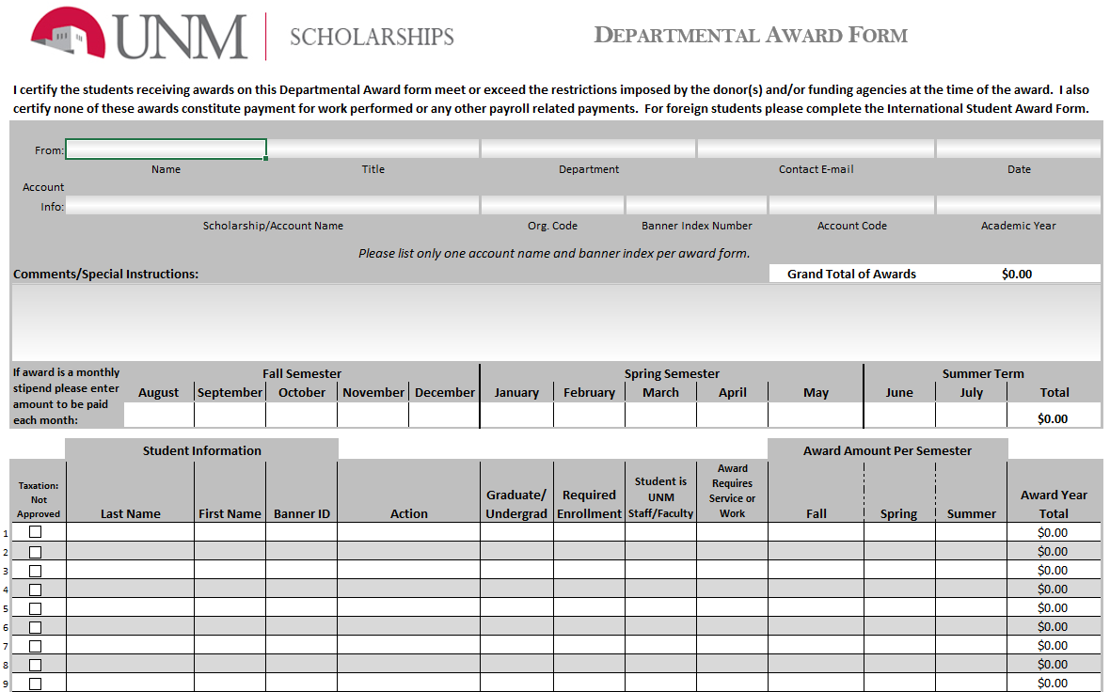

Slide 7
Kirschstein Fellow and Trainee Grant Tuition and Stipend Payment- Non-enrolled Student
If the Trainee is not currently enrolled as a UNM Student – process payment using the “Stipend Payment Form – Non-enrolled – Kirschstein Fellow & Trainee Grants Form” through Accounts Payable.
Stipend Payment Form is completed by the Department Administrator or their designate.
Completed and signed form sent to appropriate HSC or Main Campus Financial Services Office.
Financial Services Office approves form and creates the General Encumbrance.
Completed form is forwarded to Accounts Payable for processing of monthly reoccurring payments by Financial Services.

Slide 8
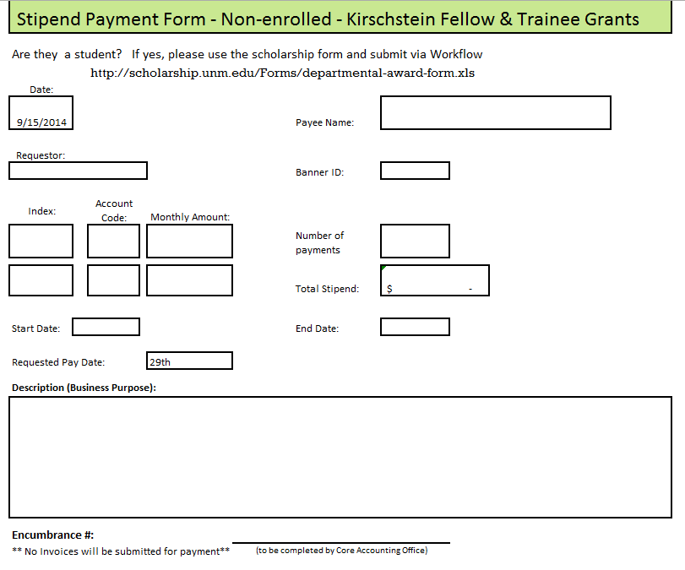

Slide 9
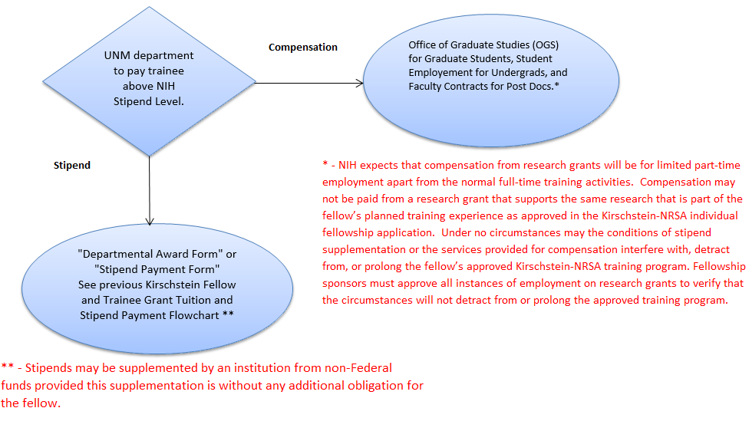
Supplementation of NIH Stipends Level

Slide 10
Questions?

Slide 11
Other Accounting Process Updates
Fee for Service/Deliverables - Gain Recognition
Uniform Guidance

Slide 12
Contact Information
HSC Contract and Grant Accounting
Jason Galloway
postaward@salud.unm.edu
505-272-9383

