Slide 1
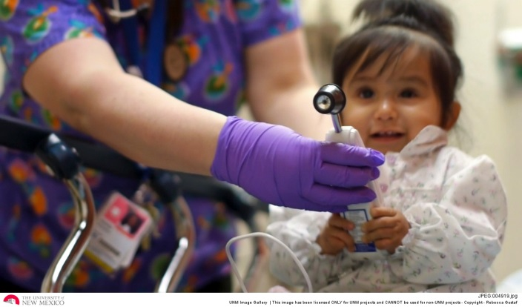
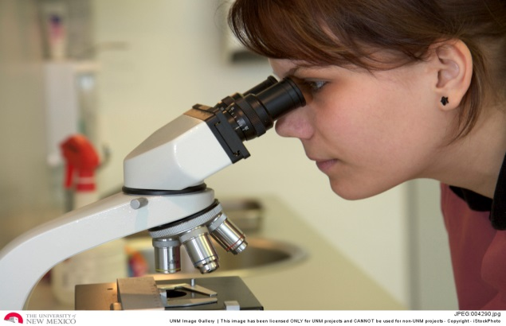
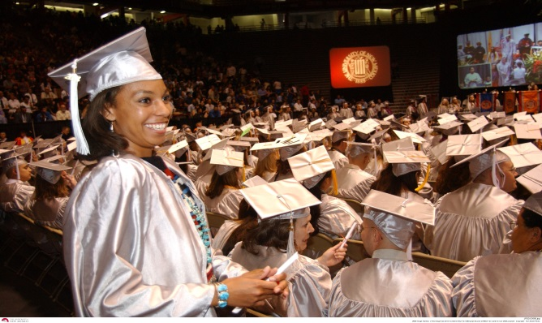
Outcomes of the Legislative Session Presentation to RAFT April 10, 2015
Vanessa K. Hawker, PhD
Chief Strategic Advisor
University of New Mexico
Health Sciences Center

Slide 2
New Mexico’s Legislative Sessions
Types of Legislation | 30 Day Sessions (Even Numbered Years) | 60 Day Sessions (Odd Numbered Years)
Appropriations Act (Budget Bill) | X | X
General Obligation Bonds (GOB) Capital Outlay (Building, Infrastructure, Equipment, Etc. |  | X
Severance Tax Bonds (STB) Capital Outlay | X | X
Substantive Legislation (New Mexico’s Laws) | X (if on the Governor’s ‘Call’) | X
Memorials | X | X
Resolutions | X | X

Slide 3
What do we do during the session?
Review all legislation as it is ‘dropped’
What to track for the HSC
Send out daily updates (M-F)
Ask for Legal Review
Respond to Fiscal Impact Report (FIR) requests
Assign, Review, Return
Prep subject matter experts and accompany them in the Roundhouse
Respond to Legislative queries
Keep up to date on legislation as it is amended
Assist with UNM Day and other events

Slide 4
2015 Session Statistics
Progression of Legislation | Total
All Bills, Memorials, Resolutions | 1,731
Bills Only | 1,365
Passed First Chamber | 702
Passed Second Chamber | 220
Sent to the Governor | 192
Vetoed (as of 4/9/2015) | 5
Signed (as of 4/9/2015) | 101
Awaiting Action (as of 4/9/2015) | 84

Slide 5
HSC FY16 Appropriation Changes
Request | Requested Change | Funded
Medical School I&G | $4,877,600 | $225,000 NR
Graduate Medical Education Residencies | $905,000 | $905,000
Office of the Medical Investigator – Utilities | $280,000 | $0
Center for Childhood Maltreatment | $779,000 | $0
UNM Pain Center | $1,908,200 | $50,000
New Mexico Health Workforce Analysis Program | $275,000 | $0
BA/DDS Degree Planning Funds | $440,000 | $0
Project ECHO | $3,210,000 | $150,000
Expanded Dental Hygienist | $762,000 | $0
School of Medicine Rural Medical Education | $302,500 | $0
Out of County Indigent |  | <$662,600>
3D Mammography |  | $250,000 NR
Center for Native American Health |  | $150,000 NR
Native American Suicide Prevention/Outreach |  | $200,000 NR
Health Education Building (Capital Outlay Request) | $8,000,000 | Bill Died

Slide 6
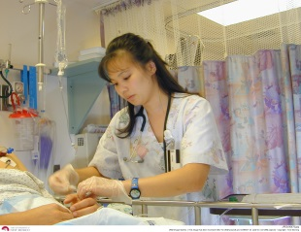
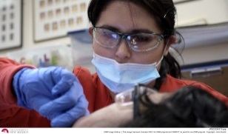
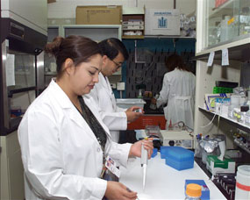
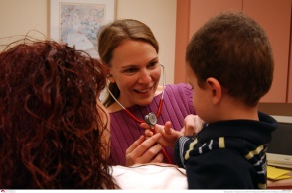
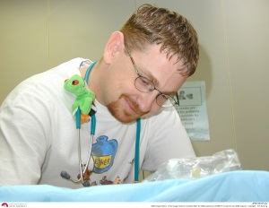
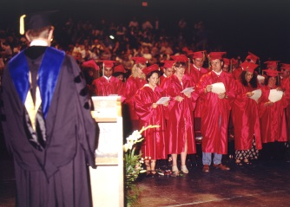
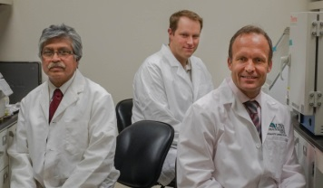
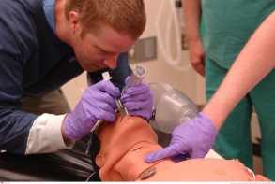
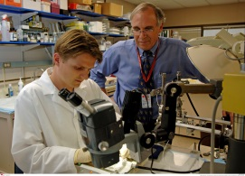
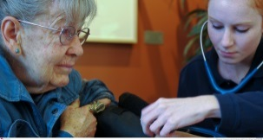
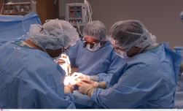
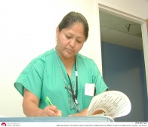
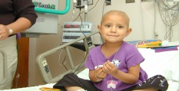
Questions?

