Slide 1
RAFT Session HSC 9-26-2014

Slide 2
Payroll Department Presenters
Larry Parks - Supervisor, Fiscal Services
Jinnie Welliver – ERP Functional Support Manager

Slide 3
Agenda
Labor Distribution changes for exempt employees using LoboTime
Review how to check if labor distribution has taken effect
High level tutorial on how to over-ride an index
How to avoid issues in the future
Q & A

Slide 4
Monthly Exception Time Overview
Timing is everything!
EPAF for a Labor Distribution within a current period…
GOOD
Instances have been reported that leave is sent to Banner with incorrect index
EPAF for a Labor Distribution for a prior period…
NOT SO GOOD
Need timely labor distributions in the month they should begin.
LoboTime will only back-date to the 1st day of the current month (pay period)

Slide 5
How to Avoid and Correct Issues
Timing is everything!
For example, September changes should be submitted in September.
Tools to help:
Contact your Supervisor or LoboTime Agent
Job Aid created with step-by-step instructions
FTMFUND in Banner or FUNDLIST in My Report
PHAREDS for completed payrolls

Slide 6
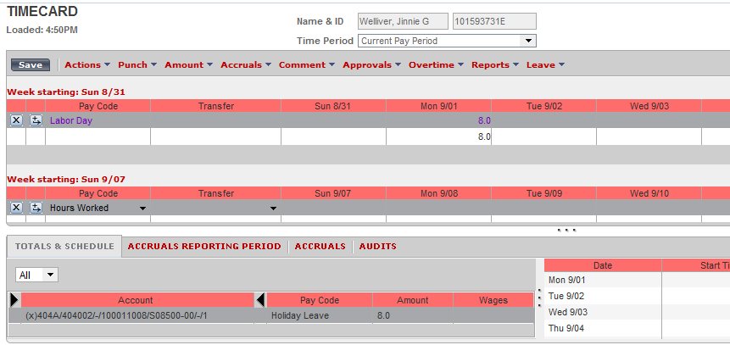
STEP 1: Check Index within Timecard

Slide 7
STEP 2 Check Fund in LoboTime

Slide 8
STEP 3 - Move Hours to New Index
“Move” from old index to new index within “Totals & Schedule”
Right click on the applicable row in the Totals & Schedule section > select “Move”

Slide 9
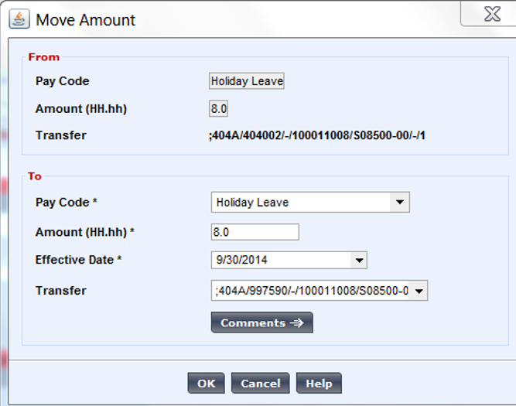
STEP 4 – Accuracy of Data
Select Earn Code > Enter amount > Confirm Effective Date is aligned with Banner > Enter New Index
New Index

Slide 10
STEP 5 – Validate

Slide 11
LoboTime Benefits
Exempt Leave Accruals
LoboTime balances are up-to-date and real-time
Banner shows one month behind
Banked Hours
LoboTime has projected balances for future requests
Banner shows one month of “banked” hours
Go GREEN
Electronic leave requests and approvals
No more paper leave reports

Slide 12
Q & A
Questions?

