Slide 1
HEALTH SCIENCES CENTER
Policy Update
RAFT November 10, 2016
Jason Galloway, Associate Controller Contract and Grant Accounting

Slide 2
HEALTH SCIENCES CENTER
Goals and Objectives
Update on Polices Posted for Campus Review
Where to find Polices Posted for Campus Review
Policies specific to UNM’s Chrome River Implementation

Slide 3
HEALTH SCIENCES CENTER
Policies Under Review and recently approved/changed are found under the “Recent News” section of the Policy website.
http://policy.unm.edu/

Slide 4
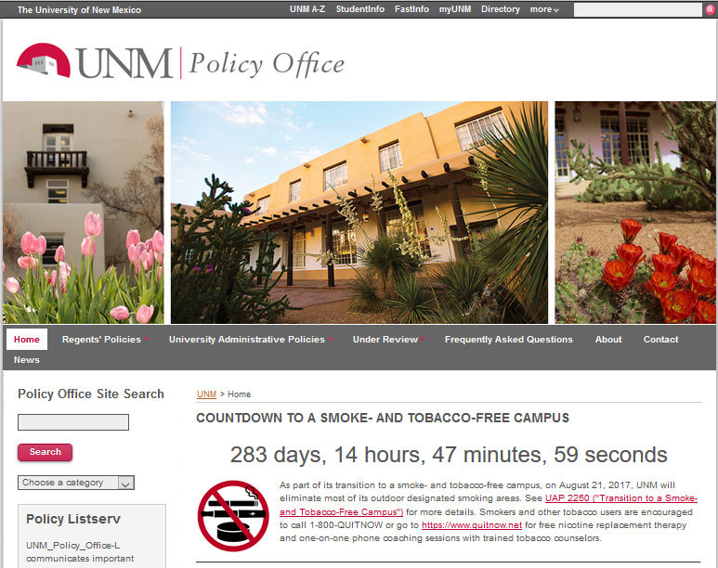

Slide 5
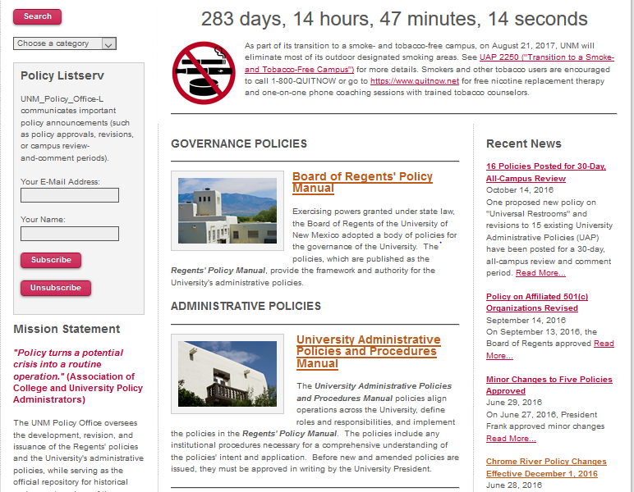

Slide 6
HEALTH SCIENCES CENTER
16 Policies Posted for Review:
UAP 1030 – Gifts to the University
UAP 2010 – Contracts Signature Authority and Review
UAP 2015 – Contract Management and Monitoring
UAP 2140 – Use and Possession of Alcohol on University Property
UAP 2180 – Foreign Nationals
UAP 2300 – Inspection of Public Records
UAP 2610 – Time and Leave Reporting
UAP 3200 – Employee Classifications
UAP 3225 – Separation of Employment
UAP 3230 – Performance Review and Recognition
UAP 3300 – Paid Time
UAP 3400 – Annual Leave
UAP 3410 – Sick Leave
UAP 3700 – Education Benefits
UAP 5300 – Universal Restroom Initiative
UAP 6130 – Emergency Control

Slide 7
HEALTH SCIENCES CENTER
Chrome River Policy Updates (Effective December 1, 2016):
UAP 2110 – Long Distance Telephone Calls
UAP 2170 - Honorarium Payments
UAP 2480 – Incentives for Program Participants
UAP 4020 – Moving Expenses and Relocation Allowance
UAP 4030 – Travel
UAP 4040 – Employee Recruitment Expense Reimbursement
UAP 4320 – Purchasing Goods Off Campus
UAP 4370 – Receiving and Paying for Off Campus Purchases with a Purchase Order
UAP 7210 – Petty Cash Fund

Slide 8
HEALTH SCIENCES CENTER
UAP 4020 – Moving Expenses and Relocation Allowance (Formerly Moving Expenses)
Payment Options:
Moving vendors paid directly by UNM
Employee receive reimbursement for standard moving expenses
Relocation Allowance – in lieu of requesting reimbursement for actual moving expenses or having UNM pay certain moving expenses
(Expenses are defined on Unrestricted Accounting – Main website)

Slide 9
HEALTH SCIENCES CENTER
UAP 4030 – Travel
Reimbursement Eligibility:
Travelers must be on official University business and travel at least fifty (50) miles away from their assigned work location. Previously twenty (20) miles.
Approval of Reimbursement Requests:
Dean, Director, Department Head or PI can delegate their authority to a person within the department with appropriate authority, such as department administrator or financial manager.

Slide 10
HEALTH SCIENCES CENTER
UAP 4030 – Travel
Per Diem Meal and Incidental Expenses:
For overnight travel, travelers may be paid 75% of the allowable per diem rate for the business destination, on both the day of departure and the day of return.

Slide 11
HEALTH SCIENCES CENTER
Questions
Jason Galloway
505-272-0163
jgalloway@salud.unm.edu

