Slide 1
Chrome River Expense Management
RAFT Session
November 10, 2016
Notes:
Welcome
Please leave computer off until after the PowerPoint presentation
Please hold questions until the end of the presentation (They may be answered during the presentation)

Slide 2
Today’s Topics
What is Chrome River
Approval Queues in Chrome River
Department Naming Conventions
Department Champions
Training

Slide 3
Chrome River
Chrome River Expense will replace current PCard Allocation and Reconciliation process
Chrome River will replace current DPEZ/DPI process
Expense Module
Employee
Student Reimbursement
Non-employee Reimbursements
Invoice Module
Third party payments

Slide 4
Types of Chrome River Reports
Expense Module Report Types:
PCard
PCard – Travel
Employee Travel
Employee Other
Student
Non-Employee
Invoice Module Report Types
Payment
Non-Traditional
PCard reconciliations,
Payments to Individuals, examples: Travel Reimbursements, Honoraria, etc.
Non-Procurement DPI Payments to Organizations, examples: Dues and Fees, Refunds, Monetary Awards, etc.
Notes:
These are the six types of Expense Reports in Chrome River.
The first 2 deal with PCard reconciliation,
Employee Travel is the most common report, and deals with all Employee reimbursements related to Travel.
Employee Other allows for Employee reimbursement (Goods) that are not travel related.
Student includes all student reimbursements
Non-Employee includes ONLY Travel related expense for non-employees, participant fees, and honorariums. All other non-employee payments (ie: vendors) will be paid using the Invoice module in Chrome River
There are two types of Invoice Reports in Chrome River:
Payment – non-procurement payments to companies, universities and government entities
Non-Traditional payment which replaces the Zpayment type. It is infrequently used across campus, but used frequently by specific department, such as payroll (garnishments) and PPD (utilities).

Slide 5
Crosswalk from Banner Processes to Chrome River
BANNER FORM | DESCRIPTION | CHROME RIVER | REPORT TYPE | PLATFORM
PCard FWAINVT Allocation | PCard Allocation & Reconciliation (now combined) | Expense | PCard | Mercury
PCard FWAINVT Allocation | PCard Allocation & Reconciliation for Travel | Expense | PCard Travel | Mercury
DPI/DP-EZ for UNM Employee | Reimbursement for Employee Travel | Expense | Employee Travel | Mercury
DPI/DP-EZ for UNM Employee | Reimbursement for Other Employee Expenses | Expense | Employee Other | Mercury
DPI/DP-EZ for UNM Student | Reimbursement for Students | Expense | Student | Mercury
DPI/DP-EZ for UNM Foreign Student | Reimbursement for Students | Expense | Student | Mercury
DPI/DP-EZ for US Individual or US Company | Travel Reimbursement for a non-Employee (Person) | Expense | Non-Employee | Mercury
DPI/DP-EZ for US Individual or US Company | Payments to US Entity | Invoice | Invoice | Platinum
DPI/DP-EZ for Foreign Individual or Foreign Company | Payments to Foreign Entity | Invoice | Invoice | Platinum
Notes:
From Banner to Chrome River:

Slide 6
A new methodology Going Simple with Chrome River
Electronic Approvals – No more Wet Signatures
Same Approval Routing for all
P-card Allocation and Reconciliation
Expense Module Reimbursements
Invoice payments to External Vendors
Use of Chrome River Reporting
Monitoring Expense reimbursement activity

Slide 7
Department Approval routing Current vs. Future
Current Electronic Banner Approvals
By Org - Level 3 thru Level 8
By $ Threshold (Level 10 & Level 20)
Future Chrome River Approvals
Required – Org Level Approver
Can use Org Level 3, 5 or 6
Optional – Department Choice Approver
Only available at Org Level 6
“Missing Receipt” Approver
Currently Org Level 3 Fiscal Agent
Can assign at Org Level 5

Slide 8
Identifying Chrome River Approver Criteria
Approver’s Criteria and Responsibility
Fiscal Review
Correct Index review
Budget Availability
Account code review
Business Operations Review
Expense follows University Policy
Expense follows Internal Department Policy
If restrictions, expense is allowable by Grant, Contract, or Donor Designation
Dean, Director, Department Head and PI delegation allowed. Accomplished via Chrome River Approval Group Update Form.

Slide 9
Identifying Chrome River Approver Criteria
Department Org Approver (Required)
If the ORG Approver can fulfill all fiscal, and operational responsibilities above, then “Department Choice” Approver is not necessary.
Department Choice Approver (Optional)
If fiscal and operational responsibilities are split, use the Department Choice Approver to accomplish all responsibilities

Slide 11
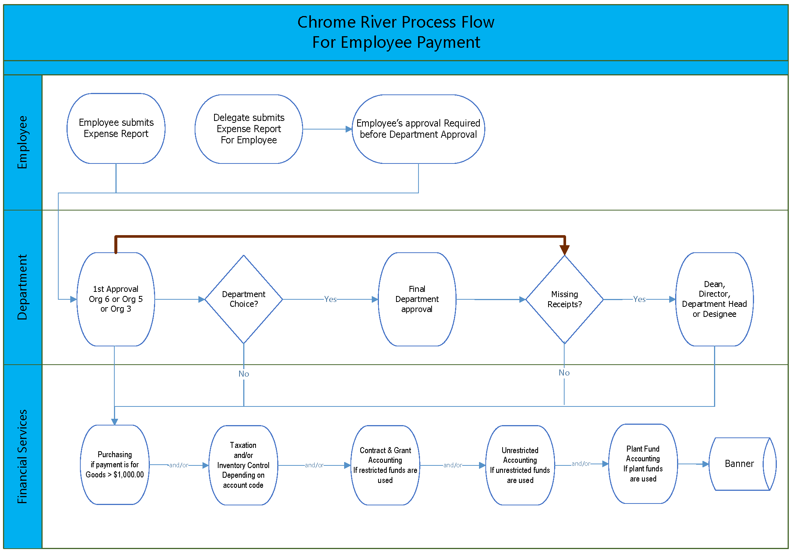

Slide 12
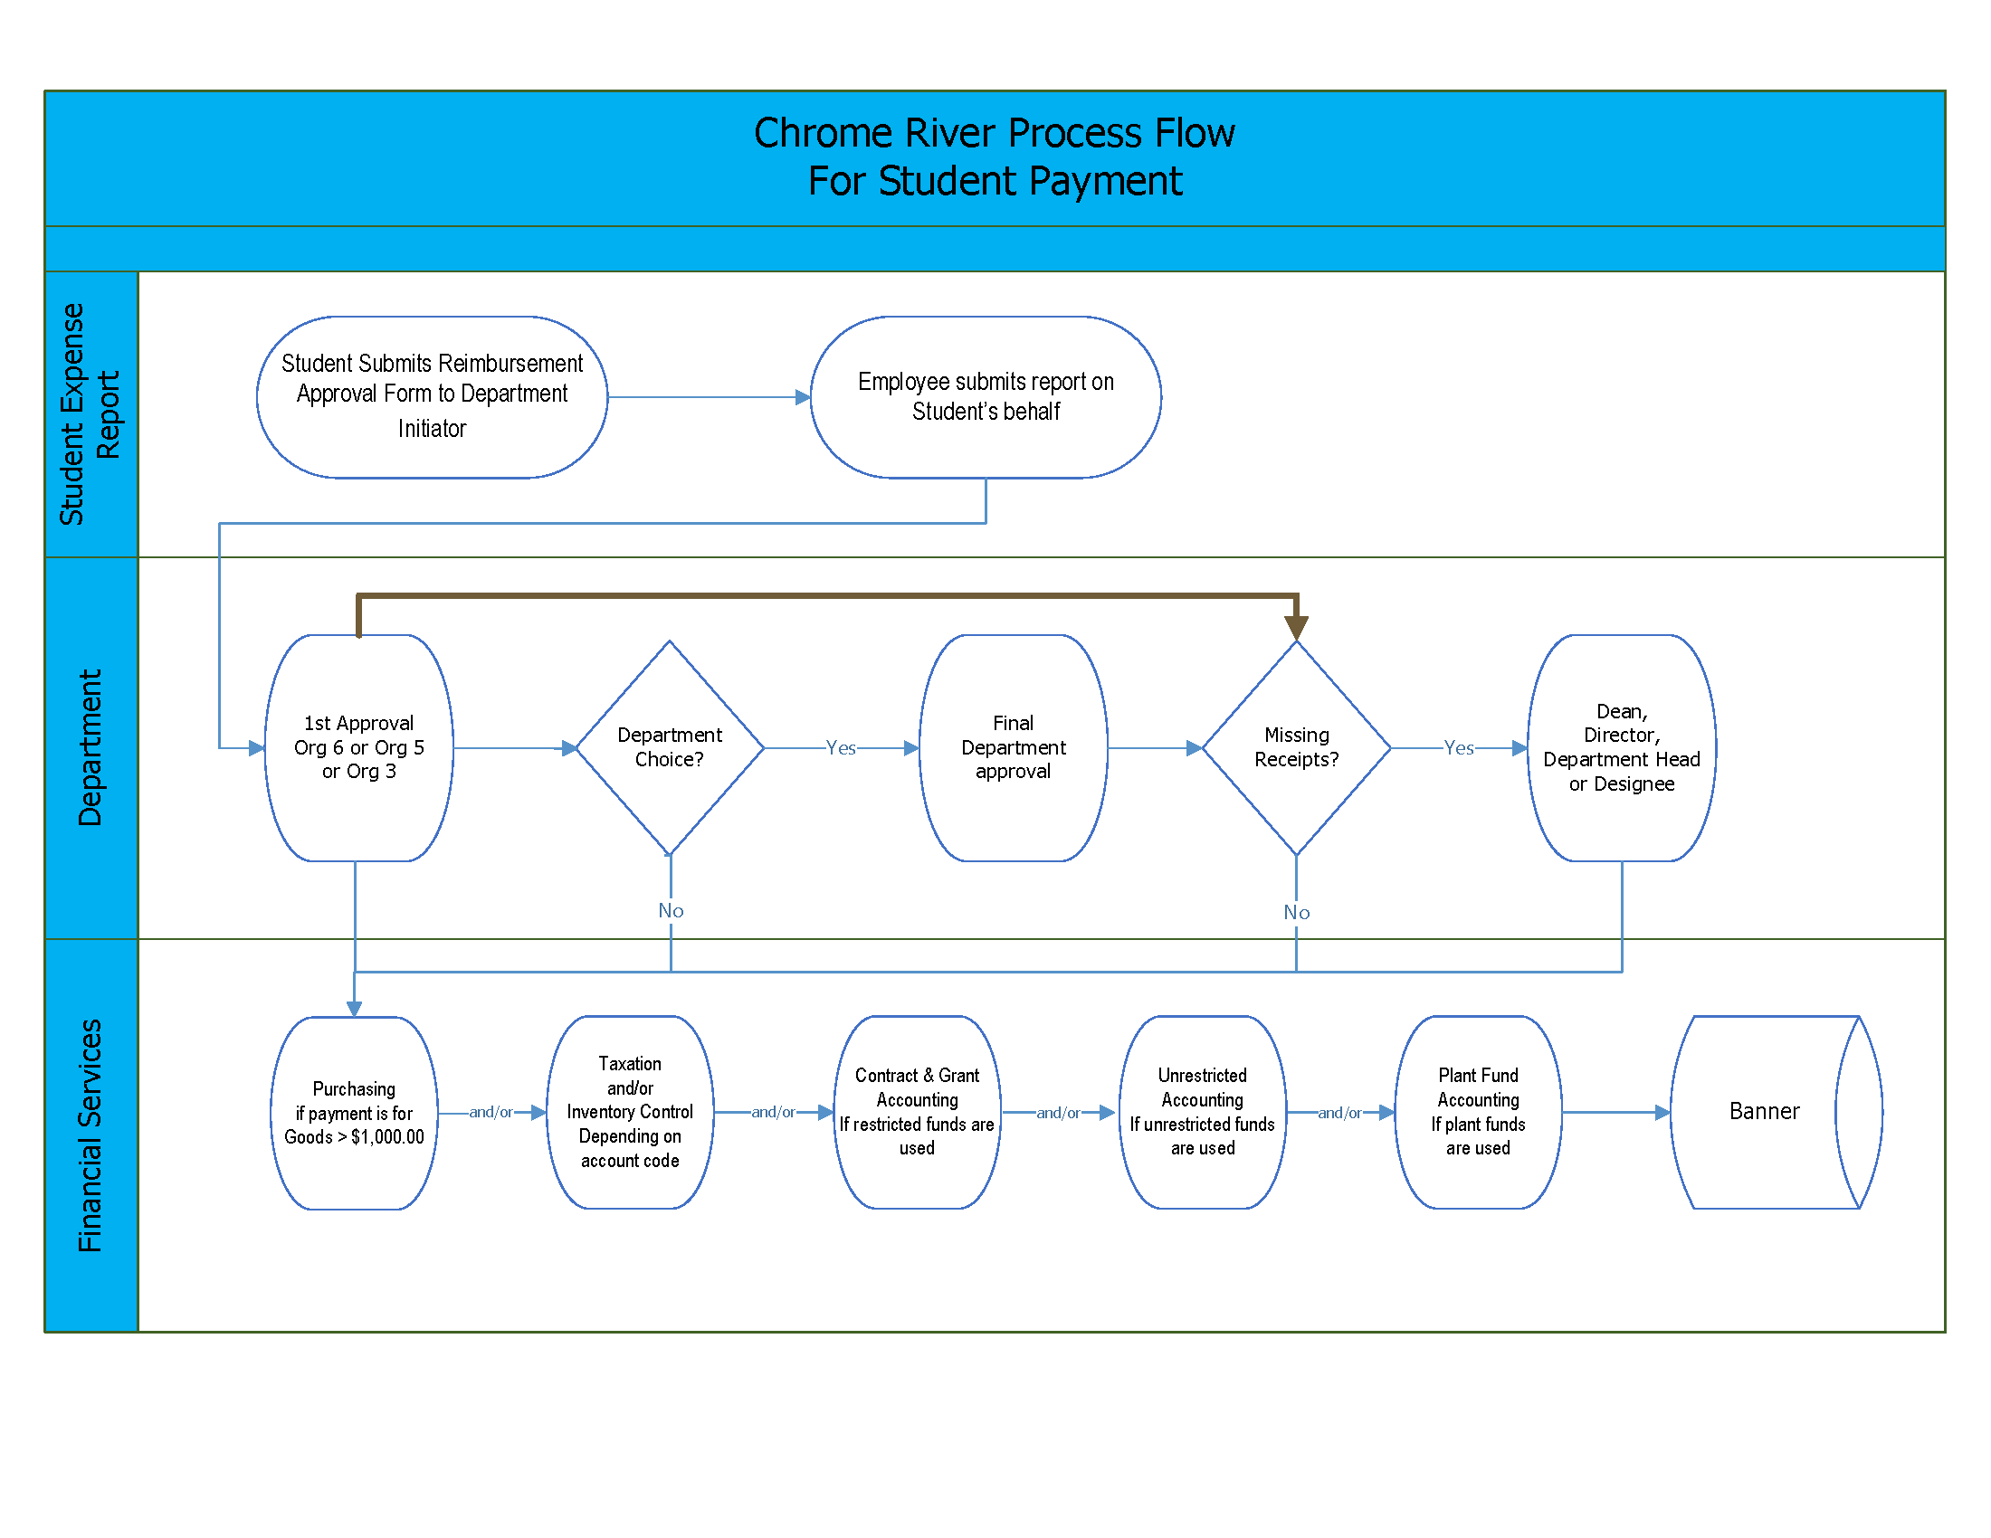

Slide 13
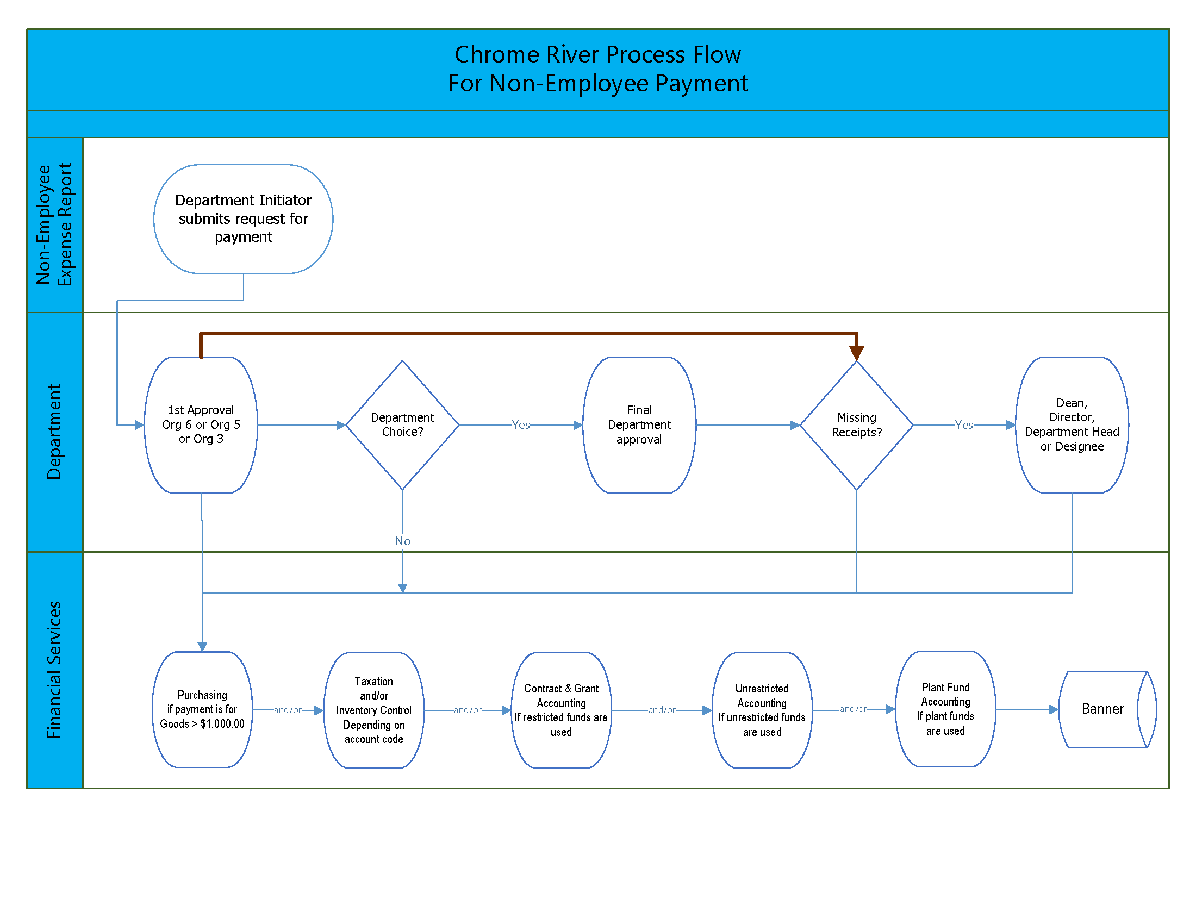

Slide 14
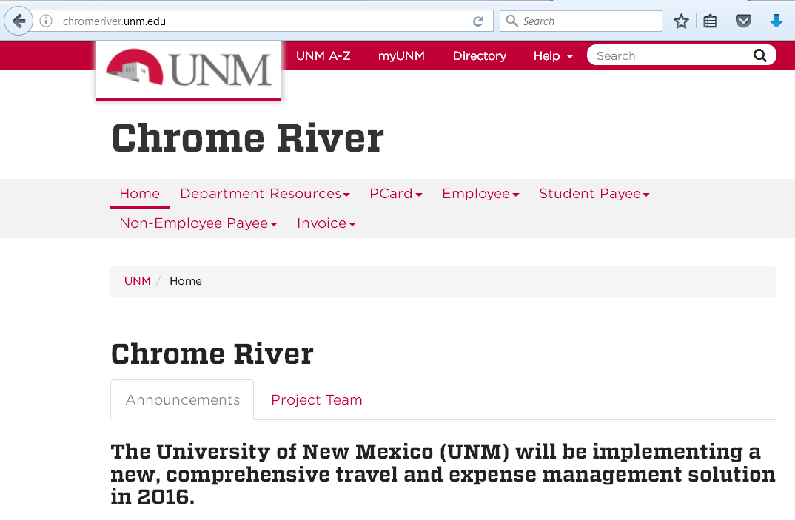
UNM Help
Must Log-in to Central Authorization Services (CAS) in order to access UNM Chrome River website.
Notes:
Log in to CAS to access the UNM Chrome River website
Not necessary if already logged into MyUNM

Slide 15
Important Dates
PCard Reconciliations
Last Bank of America PCard statement to reconcile
Statement dated December 5, 2016
Items prior to December 6, 2016 need to be allocated using FWAINVT no later than Tuesday, December 20, 2016
Banner Direct Pay Invoices
Must be completed by Wednesday, November 30, 2016
FZADPEZ form becomes query only as of 12/1/2016
Disapproved DPEZ/DPI documents after 11/30/2016 will need to be recreated in Chrome River

Slide 16
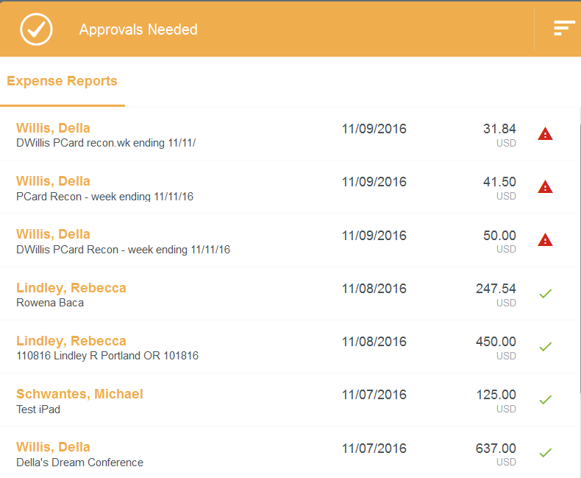
Expense Report Naming Conventions
Helpful information for future tracking
Beneficial information for reviewers
45 Character Limit

Slide 17
Expense Report Naming Conventions
Organization
Funding Type (Restricted/Unrestricted)
Initiator
Expense Type Codes
PCard - P
Employee Travel - ET
Other Employee - EG
Student Travel - ST
Student Other - SG
Non-Employee Travel - NET
Non-Employee Other - NEG

Slide 18
Department PCard Ideas
Last name of reconciler if not PCard holder, “PCard”, week ending xx/xx/xx
Putz – PCard – week ending 12/10/16
Brandt – PCard – week ending 12/11/16
Allison – PCard – week ending 12/12/16
Assign days of the week for staff to do their weekly reconciliation. If their day falls on a holiday, use the previous working day before (i.e. Friday for Labor Day) or the next available working day. (Monday for Thanksgiving and day after Thanksgiving)
Continue to request PCard Special Exceptions for necessary items. Email approval must be added to file when uploaded into Chrome River.
Email Receipts to Chrome River expensememo@chromefile.com System can match receipts with transactions to facilitate quick and easy reconciliations.

Slide 19
Travel Expense Report Ideas
Naming the report is CRUCIAL
If processing an expense report for UNM staff or faculty member to travel
Name of Conference, location, time period
AAMC – Seattle – 11/12-11/14/16
WGEA – Tucson – 4/1-4/5/17
If processing an expense report for anyone else to travel
Last name of traveler, name of Conference, location, time period
Student: Garcia, AAMC – Seattle – 11/12-11/14/16
Keynote Speaker: Weil, UNM convocation – 5/13-5/15/17

Slide 20
All Other Expense Reports
Naming the report is CRUCIAL
If processing an expense report for UNM staff or faculty member to be reimbursed for a purchase
Name of Vendor, description of purchase, date
Staples, office supplies, 11/15/17
Dion’s, Fall Festival, 10/31/17
If processing an expense report for anyone else to be reimbursed for a purchase
Last name of requestor, name of Vendor, description of purchase, date
Student: Garcia, Smith’s, Water for LC bowling, 3/31/17
Circuit Rider (not UNM faculty): Sanchez, SurveyMonkey, surveys for LCME, 2/1/17

Slide 21
Chrome River Champions
Department Champions are the FIRST level of support for their departments and/or colleges. Champions are a core group of UNM Employees who are part of a shared-support community that will be training, disseminating information, identifying issues and sharing resolutions with users in their department(s) as well as other Champions.
Department Champions have been involved in testing sessions and are assisting with EOD training sessions as either the trainer, prompter or facilitator.
Thank you!

Slide 22
Chrome River Training
Department Scheduled Training
Pediatrics
Pathology
Emergency Medicine
Internal Medicine
Neurology
Neurosurgery
Surgery
Cancer Center
Family and Community Medicine
SOM Education Offices
College of Nursing
College of Pharmacy

Slide 23
Chrome River Training
EOD Scheduled Training
Main Campus Location: Business Center Room 1007
HSC Campus Location: Med II Computer Classroom
Coming Soon……Training on Demand
Computer based training modules

