Slide 1
Physical Plant Department
Special Activities/ Movers Division
277-7246

Slide 2
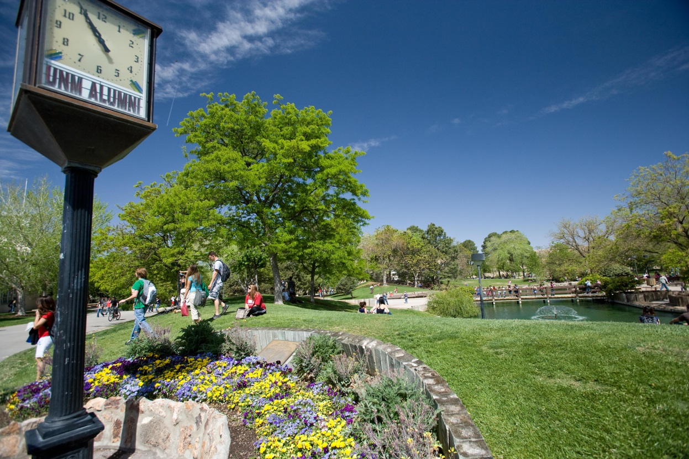
Willie West, Manager, Environmental Services

Slide 3
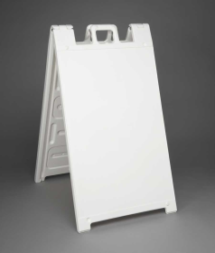
UNM Posting Guidelines
POSTING DO’S:
Utilize sidewalks exposed to regular foot traffic and weather exposure for chalking. Use non-permanent chalk.
Utilize outdoor & indoor campus kiosks for fliers.
(Postings are cleaned off once a month on exterior kiosks)
Utilize Sandwich Boards

Slide 4
UNM Posting Guidelines
POSTING VIOLATIONS:
DON’T: Chalk on buildings, underexposed sidewalks, vertical walls, balconies.
DON’T: Attach fliers or postings to structures, art installations, trees or other landscape materials, buildings, ramps, light poles, etc.
DON’T: Stake signs or posters into the ground.
DON’T: Use glue or adhesives to secure postings/flyers.

Slide 5
Outdoor Event Guidelines
Reserve space with appropriate organization/department.
Sponsoring organization is responsible for trash removal for events. Need a pick up? Give us a call!
Special Activities & the Grounds & Landscaping needs to be informed of ALL tents/canopies being setup on campus. Safety & Risk Services does too!
No vehicles on landscaped surfaces.
If you have questions or concerns about your event,
call us we can help!

Slide 6
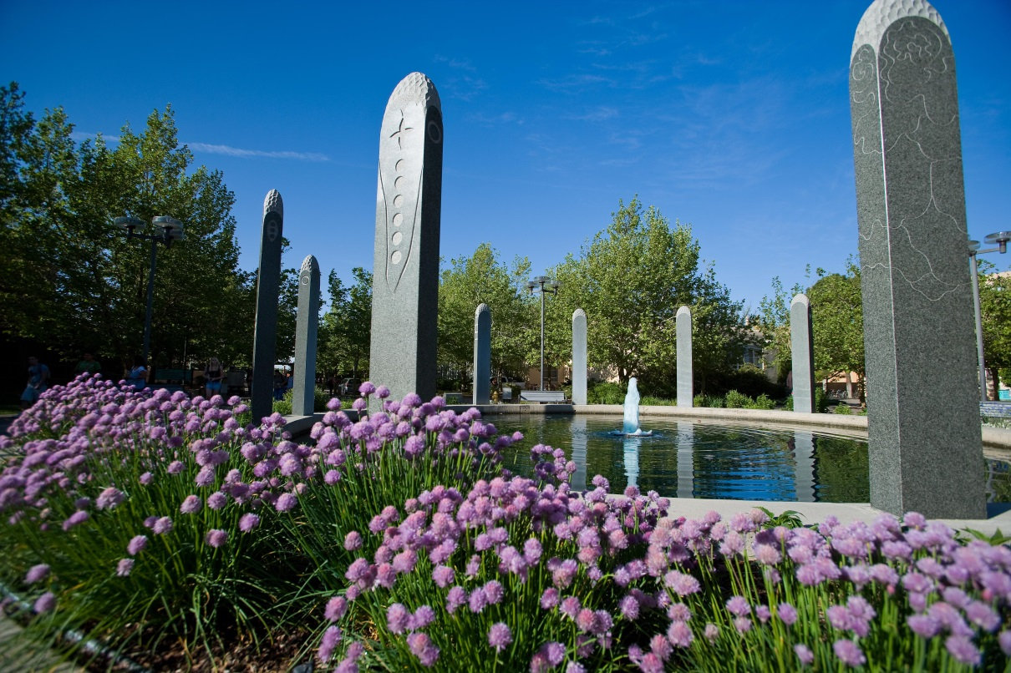
Jessica Regensberg Supervisor, Special Activities / Movers

Slide 7
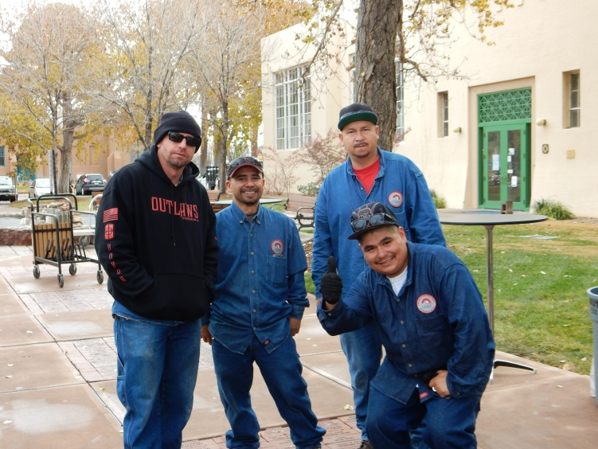
Special Activities
The PPD Special Activities division is responsible for supporting all special events and moving activities on:
UNM Main Campus
North Campus (HSC)
South Campus
We work very closely with many campus constituents, such as:
Office of the President
Student Activities Center
UNM Police
Athletics
Alumni Relations
Safety & Risk Services (SRS)
Parking & Transportation Services

Slide 8
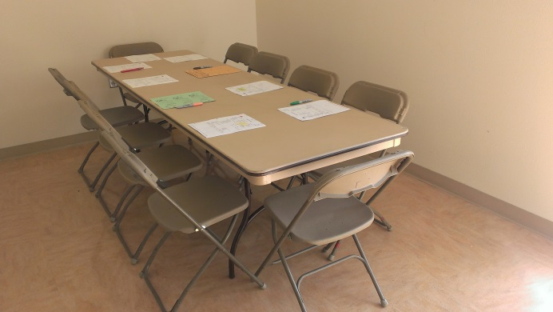
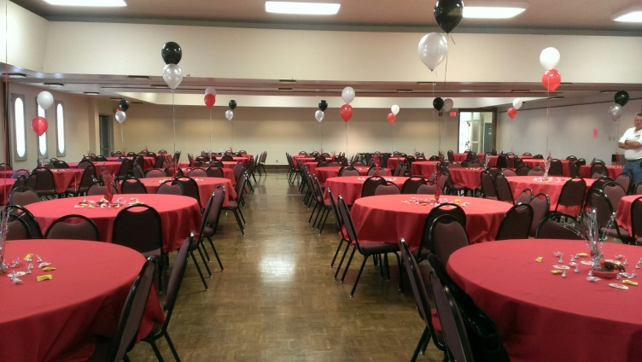
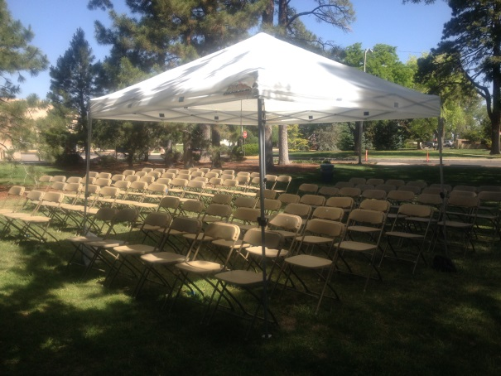
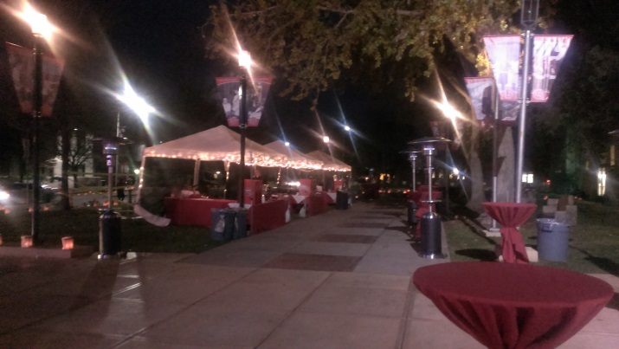
Equipment Rentals
We offer a complete line of competitively priced
equipment and event rentals for you to choose from.
Tables
Chairs
Podiums
Pop-up canopies
Stage rentals
Trashcans
Generators

Slide 9
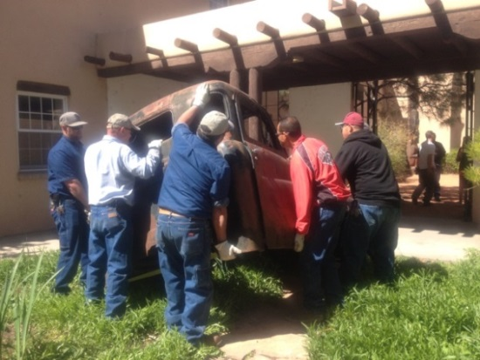
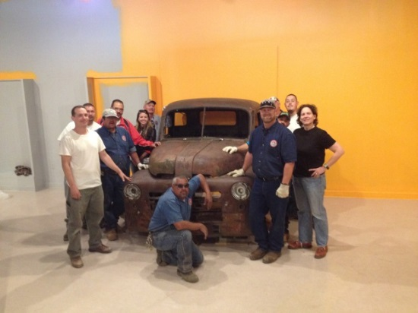
The PPD Movers
The PPD Movers are available to assist UNM Departments with on-campus office moves.
Moves should be scheduled, as soon as possible but preferably, a minimum of 2 weeks in advance.
I&G funded departments are not charged for labor or truck rental. Auxiliary departments are charged per PPD Equipment & Shop Rates. Please call for a quote!

Slide 10
Fridge & Freezer Disposal
PPD Special Activities will pick up your old, unwanted and broken refrigerators and freezers!
Complete and submit a disposal form request to Surplus Properties.
Once approved for disposal, submit a service request on the PPD iservice desk website for pick up.
We will then schedule and pick up your unwanted machine!
We do charge a nominal fee of $50.00 for disposal and
recycling of the unit.

Slide 11
PPD Work Control
Website: iServicedesk.unm.edu OR Call: 277-1600

Slide 12
Thank you for your time!
The PPD Environmental Services Department is dedicated to efficiency and professionalism, and we look forward to working with you on your next event or move.
Please remember that when you work with the PPD Special Activities division you are ensuring your department’s funds remain on campus and support the UNM community!

Slide 13
Contact Info.
Willie West
Manager, PPD Environmental Services
Office: 277-0615 WWest@unm.edu
Jessica Regensberg
Supervisor, PPD Special Activities
Office: 277-7246 JRegensberg@unm.edu

