Slide 1
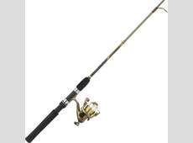
RAFT
Casting My Reports
Presented by: Laura Putz, Associate Controller
HSC Unrestricted Accounting
September 25, 2015

Slide 2
MyReports Has a New Feature

Slide 3
Scheduling Your Reports
You can now schedule reports
When they will run
How often they will run
To whom they will be delivered

Slide 4
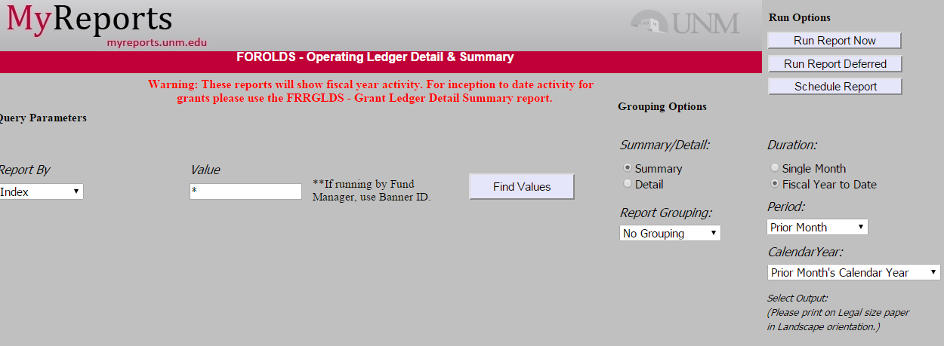
Report Scheduling – An Example:
Notes:
FOROLDS as an example

Slide 5
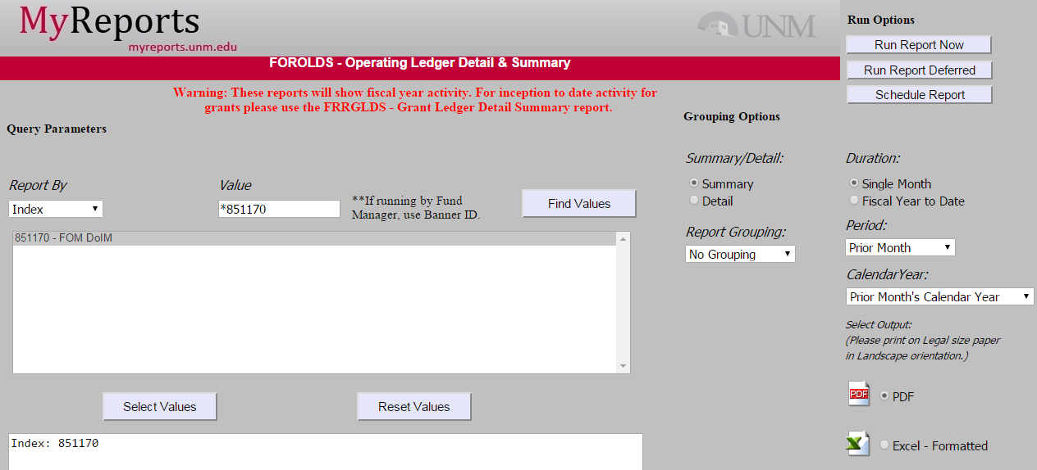
Report Scheduling
Notes:
FOROLDS as an example:
For one index, for prior month, to be run when month end has closed for reconciliation purposes. You can select either pdf or Excel. (html does not work)
When criteria are selected, select “Schedule Report”

Slide 6
Scheduler Icon – Other Dashboards

Slide 7
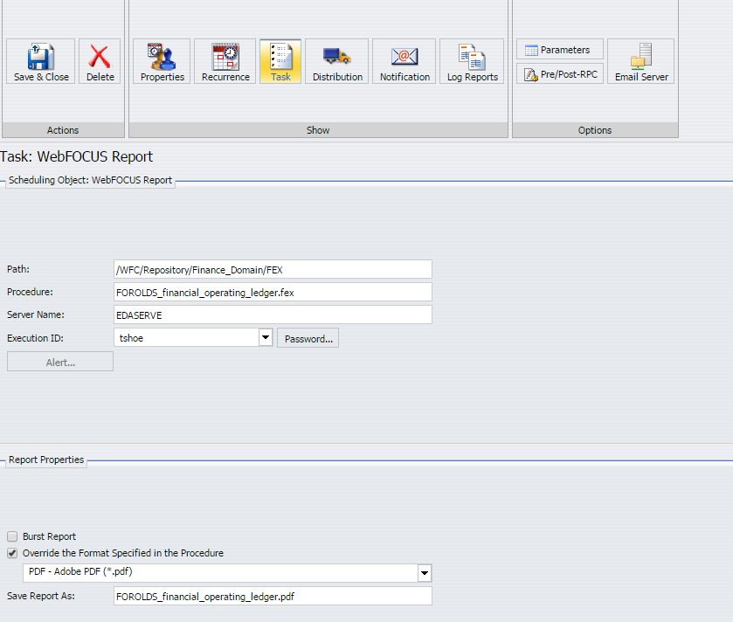
Report Scheduling
Notes:
FOROLDS as an example:
When “Schedule Report” is selected, this screen appears You must select How often you want the report to recur, who it is to be distributed to, and who to notify it has been run.

Slide 8
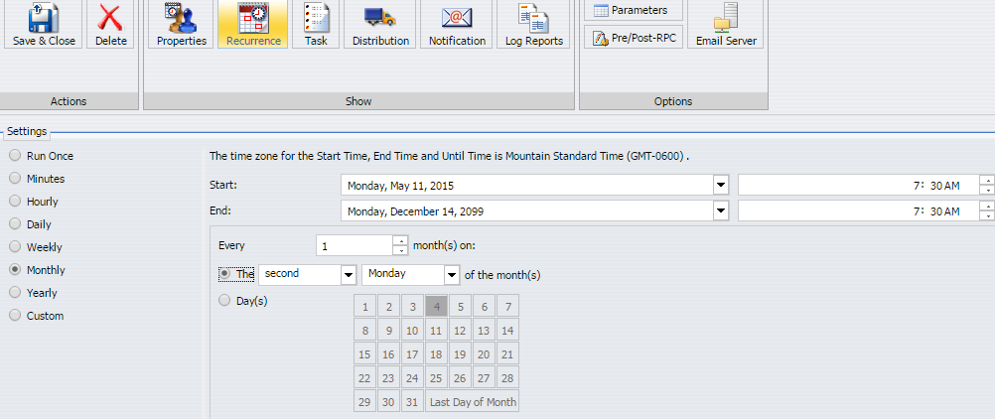
Report Scheduling - Recurrence
Notes:
FOROLDS as an example:
Recurrence monthly on the second Monday of every month.

Slide 9
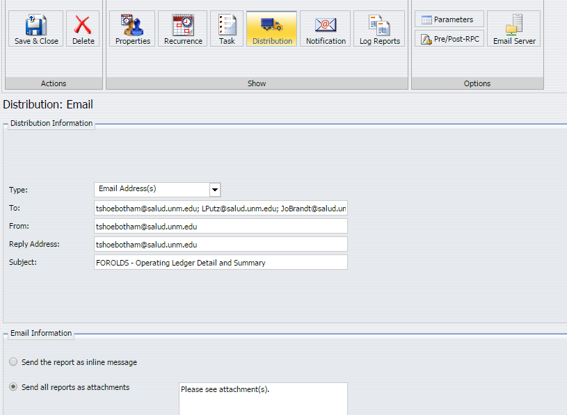
Report Scheduling - Distribution
Notes:
FOROLDS as an example:
Distribution
*You may select email addresses (shown here), or Distribution List or File, or Dynamic distribution list
*You may change the title of the report (the default is shown here)
*Generally, you will want to send the report as an attachment

Slide 10
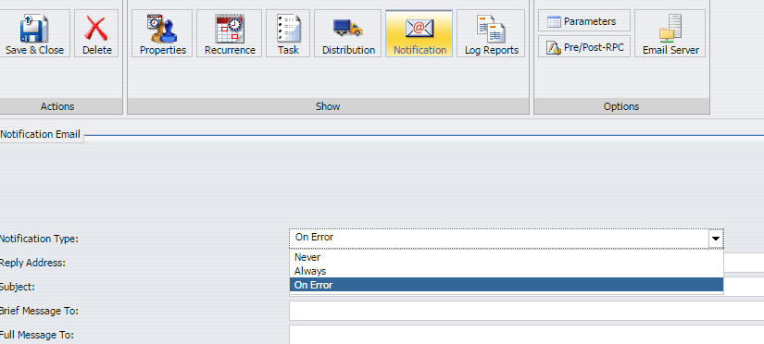
Report Scheduling - Notification
Notes:
FOROLDS as an example:
Notification
*You may select “never” “Always” or (the default) “on Error”

Slide 11
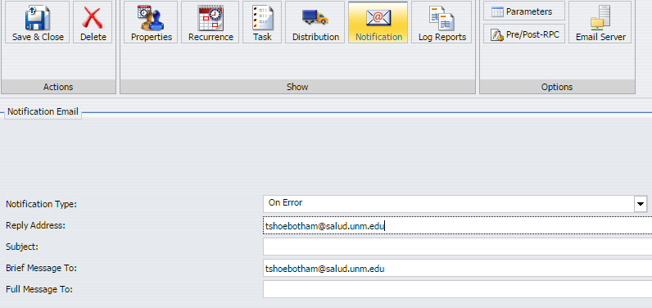
Report Scheduling - Notification
Notes:
FOROLDS as an example:
Notification
You must select a reply address (your email is recommended so you know if the report did not successfully run)
You must also select either a “Brief Message To:” or “Full Message To:” address
Save and Close the file

Slide 12
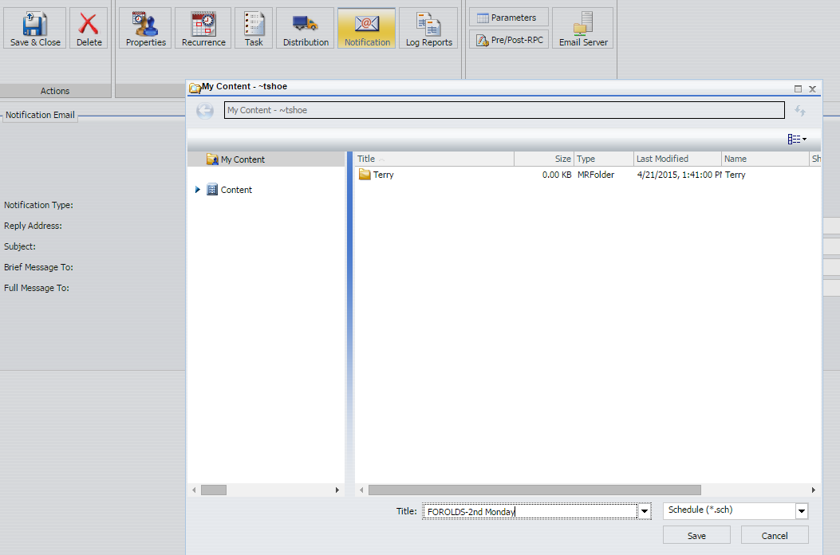
Report Scheduling - Location
Notes:
FOROLDS as an example:
Save the report in the next screen that appears. Your scheduled report will be saved in your “My Content” area of MyReports

Slide 13
Report Scheduling - Modification
Notes:
FOROLDS as an example: Here is the report in the My Content folder. By right clicking on the report you can run the report now. You can also change the title, or do the other items listed, including edit or delete the report.

Slide 14
Report Scheduling – A Powerful Tool
If you can run a report, you can schedule it to be delivered:
When you need it
To the people who need it
Schedule reports to run Monday – Friday between 7 AM – 7 PM
Report Caster Walk-In Help Sessions will be offered in the Perovich Business Center, Room 1007
Thursday, October 8, 2015 10:30am-12:00 noon
http://myreportsinfo.unm.edu/finance/index.html

Slide 15
Miscellaneous Announcements
DPI Routing – Foreign Payees
Foreign Student payee
Foreign Individual payee
Foreign Vendor
Any documents with a printed Taxation approval signature line on the DPEZ
Taxation Department - First Review
Mail Stop Code is MSC01-1260
Suite 3400, John and June Perovich Business Center
http://taxation.unm.edu/foreign-nationals-info/payments-to-foreign-nationals.html
Notes:
Submit Original Documentation

Slide 16
Miscellaneous Announcements
Federal Per Diem Rates
Changes effective October 1, 2015
Lowest rate changes to $51
NM All location rate changes to $51 (was 46)
High rate changes to $74
F&A Excludable Account Codes
FY16 is a “base year” for the Facilities and Administrative (F&A)
Excludable Account Codes
31B0 Food F&A Unallowable Gen
37Y0 Supply Costs F&A Unallowable
39Y0 Travel F&A Unallowable
6350 Promotional Exp F&A Unallowable Gen
69Y0 Professional Svcs F&A Unallowable
80A0 F&A Excludable Gen

