Slide 1
ASSIST 101 TRAINING
The entire ASSIST user guide can be found at https://era.nih.gov/files/ASSIST_user_guide.pdf

Slide 2
What is ASSIST?
ASSIST can be used to submit the SF424 form set electronically through Grants.gov to the NIH & other participating agencies.
Since the pdf version of the SF424 went away in 2018, this is a great alternative.
ASSIST can be used for single-project or multi-project applications.

Slide 3

If your department has a preference on what platform to use, always check with the department head before changing.
ASSIST can be used for any NIH submission unless the RFA states otherwise, and also for SAMHSA, AHRQ, and CDC applications.
Which application platform to use (ASSIST, Click, Work Space, etc) is largely a matter of preference.

Slide 4
How do I use ASSIST?
To use ASSIST, you must have an era Commons log in. If you do not have one, contact your grants specialist at SPO.
Log in with your era Commons credentials at the ASSIST homepage: https://public.era.nih.gov/assist
The entire ASSIST user guide is available on the homepage, on the right hand side.

Slide 5
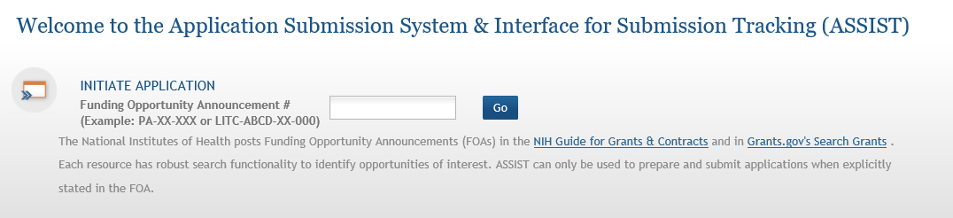
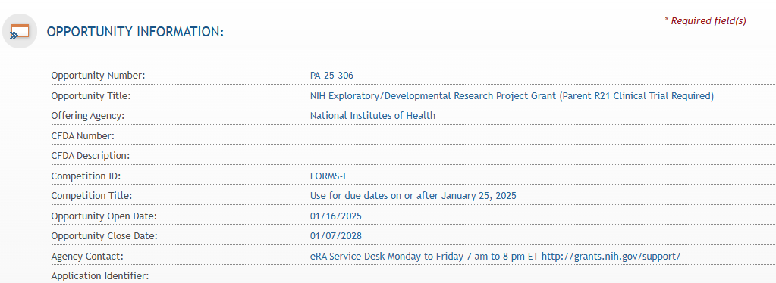
Getting Started
Once you have logged in, you will be prompted to enter the announcement number.
On the next page, details about the funding opportunity will show up.

Slide 6
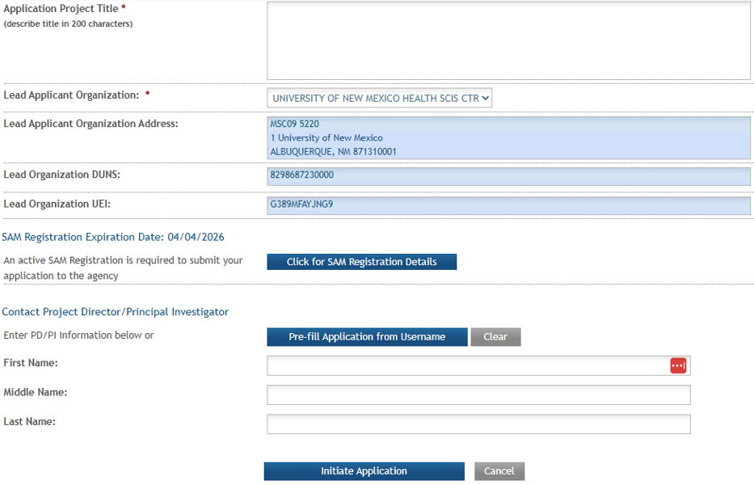
Filling In The Blanks
You will be prompted to fill out additional information
This will prefill as long as your era Commons ID is associated with UNM HSC
Type in the PI’s era Commons user name
Now we are ready

Slide 7
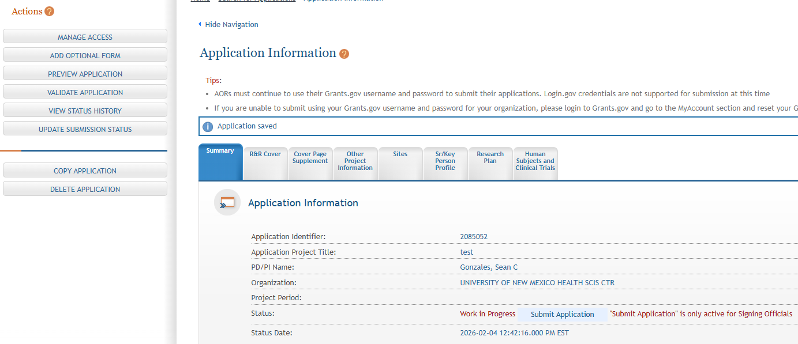
Now What?
Note this number in the click record
Because ASSIST & Click do not “talk” to each other, it is important to note in the click record the ASSIST number. Otherwise your grants specialist won’t know where it is.

Slide 8
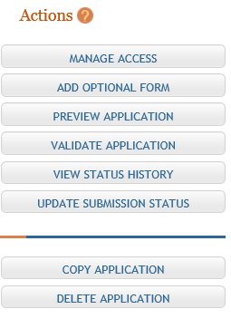
Actions Buttons
Give additional users access by entering their era Commons login name. See the ASSIST user guide.
Use this to add the budget form, inclusion enrollment report, etc. See the ASSIST user guide.
This generates a printable preview of the application. See page the ASSIST user guide.
Use this button at any time to check for errors. See the ASSIST user guide for required user access levels.
Tracks all status changes for application.
Used when PI is ready to have application submitted or if they want to abandon the application.
Can be used by SO or AO to copy the application’s structure & data for use in another application. See the ASSIST user guide.
This will permanently delete the application with no way of undoing it.

Slide 9
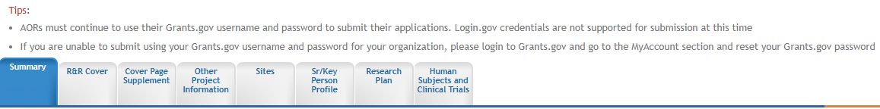
Action Tabs
Each tab across the top of the application offers access to a different section of the SF424 package
The tabs pictured above are what automatically populates.
The budget tab(s) & any additional tabs need to be added by using the “Add Optional Form” action button on the left side.
Please note, once you click on a tab, a new Action button will appear on the left side titled “Return to Application.” This will take you back to the main summary tab.

Slide 10
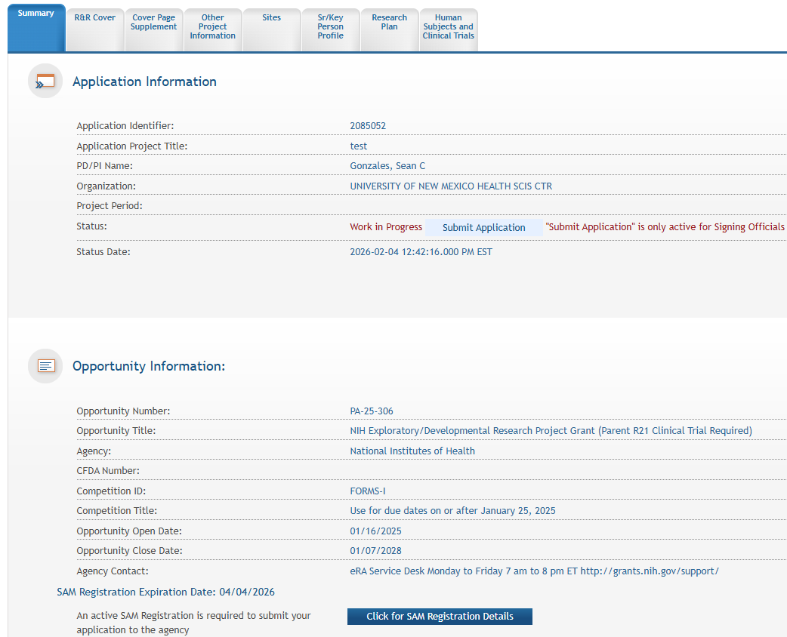
Action Tabs - Summary
Gives a general summary of the application, including status, PI name, FOA number, etc.

Slide 11
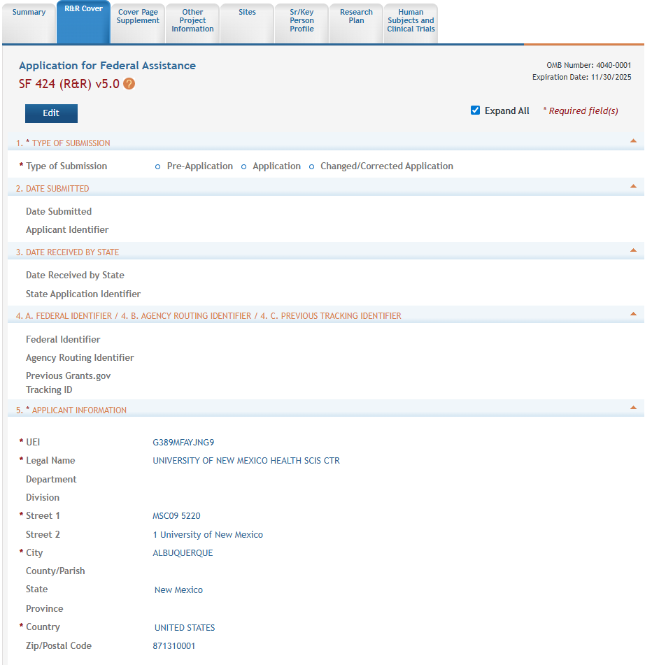
Action Tabs – R&R Cover
Numbers 1-21 on the R&R Cover tab are exactly the same as 1-21 in the SF 424 application pdf package.
Some of the information will auto-populate.
Make sure all required fields are completed.
Click here to edit numbers 1-21.

Slide 12
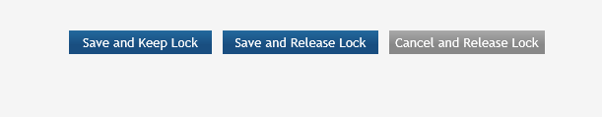
Saving Work in Each Tab
When you are in “edit” mode, the option to save is at the bottom of each action tab.
If you select “Save and Keep Lock” no one else will be able to edit the form until you go back in and select “Save and Release Lock.”

Slide 13
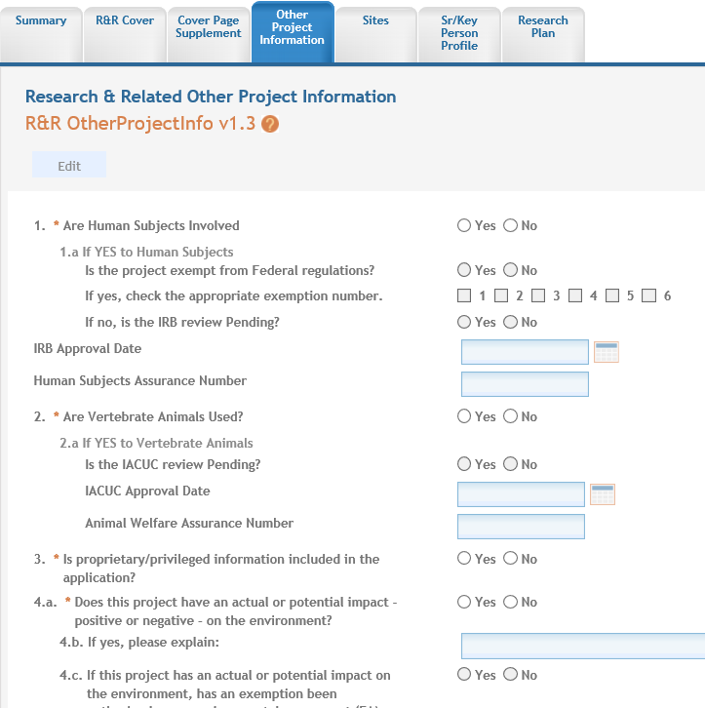
Action Tabs – Other Project Information
Page view in “edit” mode

Slide 14
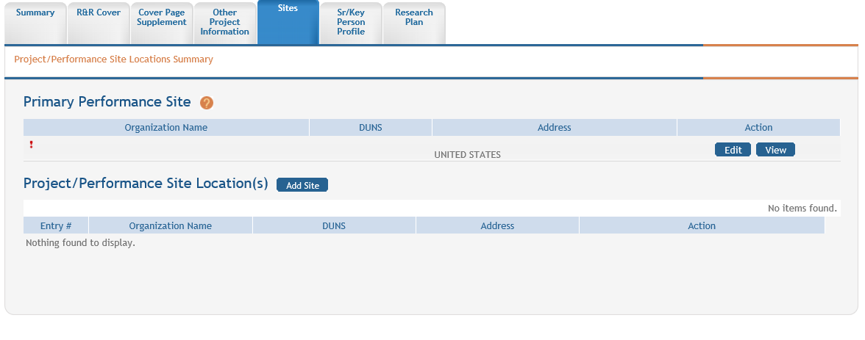
Action Tabs - Sites
Edit to add UNM HSC as the primary site.
To add additional sites like subawards.
If the grant meets the criteria for off campus work, list the off campus site as the primary performance location.

Slide 15
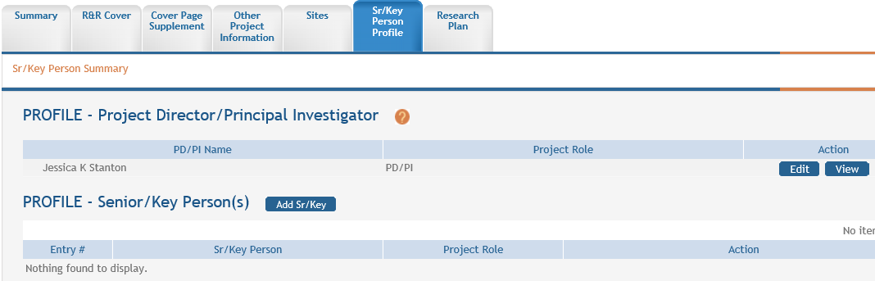
Action Tabs – Senior/Key Person Profile
The role of the PI is auto-populated from their era Commons user name, however you may need to edit or update some of their information.
Click here to add additional key people
Click here to edit PI information

Slide 16
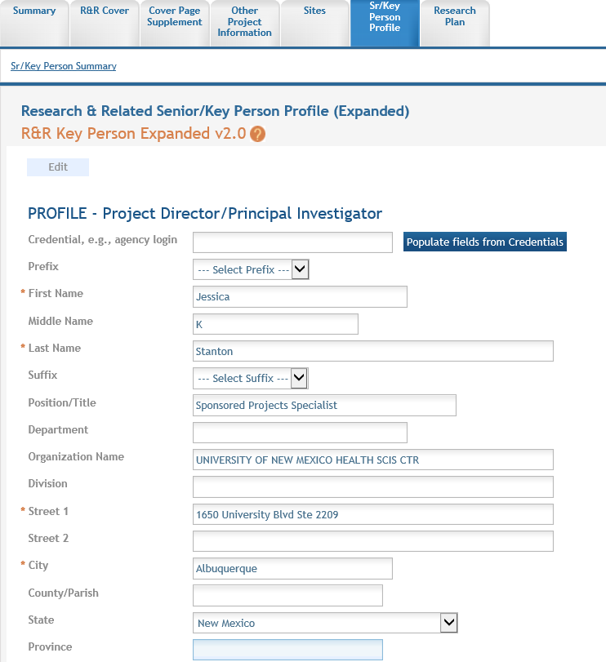
Action Tabs – Senior/Key Person Profile
Type in the person’s era Commons user name & press populated fields from Credentials to auto fill in more information.

Slide 17
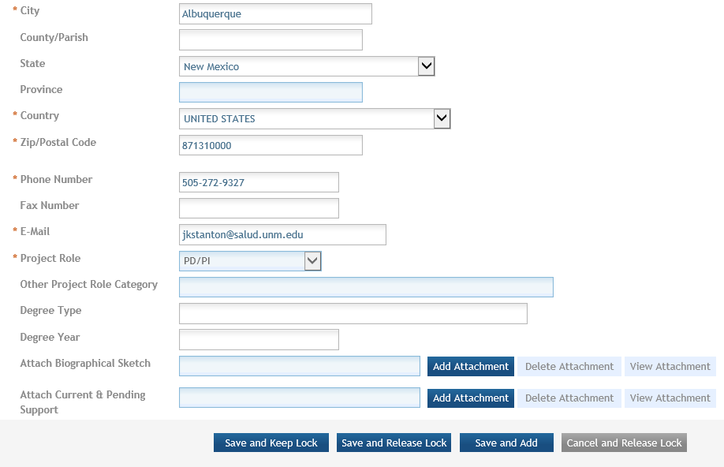
Action Tabs – Senior/Key Person Profile
All zip codes must have four digit suffix
NOTE!
All attachments must be in pdf format.

Slide 18
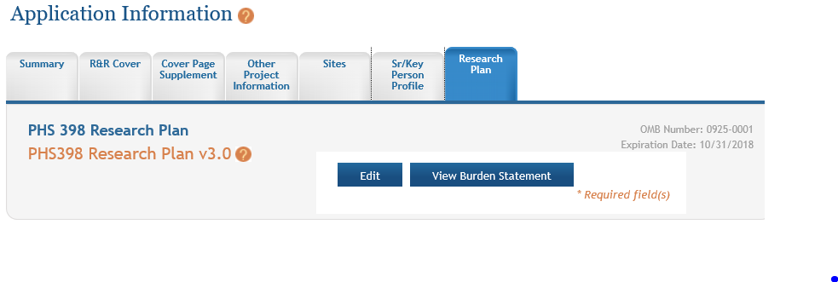
Action Tabs – Research Plan
This page is exactly like the PHS 398 Research Plan in the SF424 pdf package once you press the “edit” button.

Slide 19
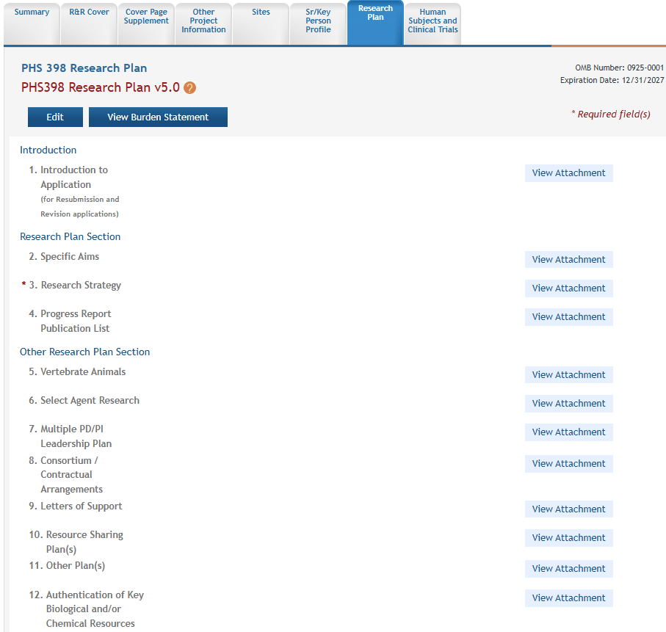
Action Tabs – Research Plan
What is required on this page will depend on your RFA or announcement.

Slide 20
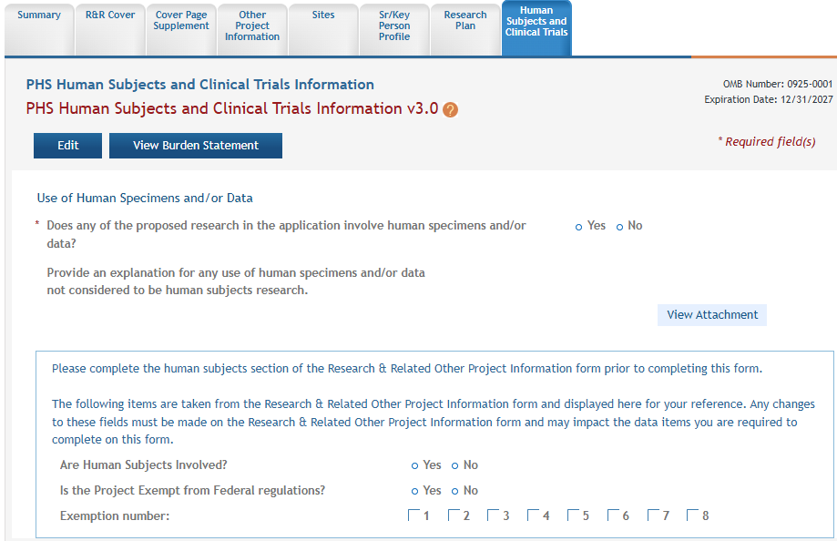
Action Tabs – Human Subjects and Clinical Trials
What is required on this page will depend on your RFA or announcement.

Slide 21
Action Tabs - Budgets
Depending on your RFA or announcement, you may use a modular budget, or a R&R Budget.
If you are using a modular budget & have a subawardee, you do NOT need to add the R&R Subaward Budget. Having a Modular and a R&R will cause an error that won’t allow the application to be submitted.
Budget information can be found in the ASSIST user guide.

Slide 22
Final Thoughts
Because the ASSIST training guide is over 350 pages, we suggest using the ctrl + F feature to quickly search out word phrases.
Be sure to give your grants specialist the ASSIST record number via click or through email.
The 10 and 5 business day deadlines still apply.
Always feel free to contact your grants specialist with any questions you may have or help you may need!

