Slide 1
Grants.gov Workspace

Slide 2


What is Workspace?
Applicants can apply for grants using Grants.gov Workspace, which separates the application package into individual forms. Applicants can create a Workspace, complete the individual PDF forms, and submit their application workspace package.
One of the primary benefits of Workspace is the ability to separate individual PDF forms that make up the traditional application package. This allows multiple team members within an organization to access and edit forms at the same time. Applicants can also reuse saved Workspace forms when applying for new funding opportunities.

Slide 3
Do I have to use Workspace?
Workspace replaced the SF424 PDF packet as of December 31, 2017.
BUT, Workspace isn’t your only choice when it comes to NIH grant submissions:
ASSIST will still be supported for NIH grant submissions.

Slide 4
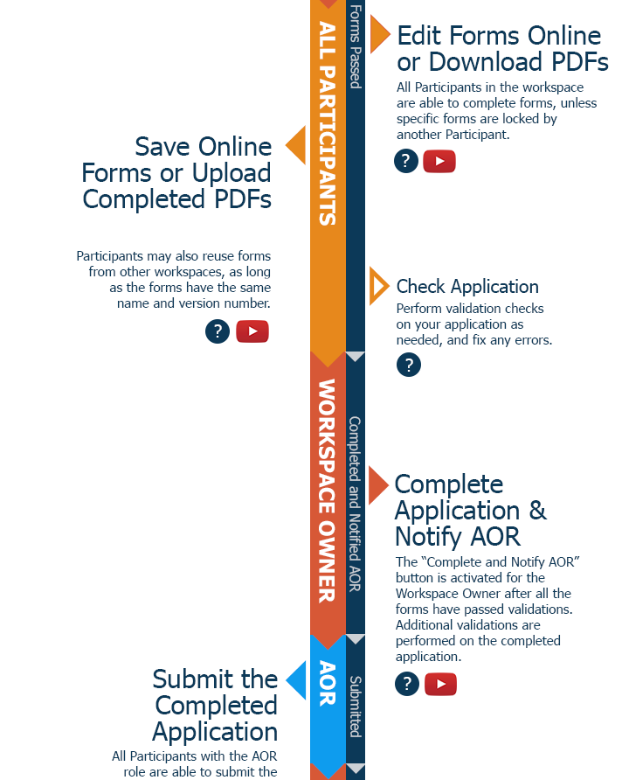
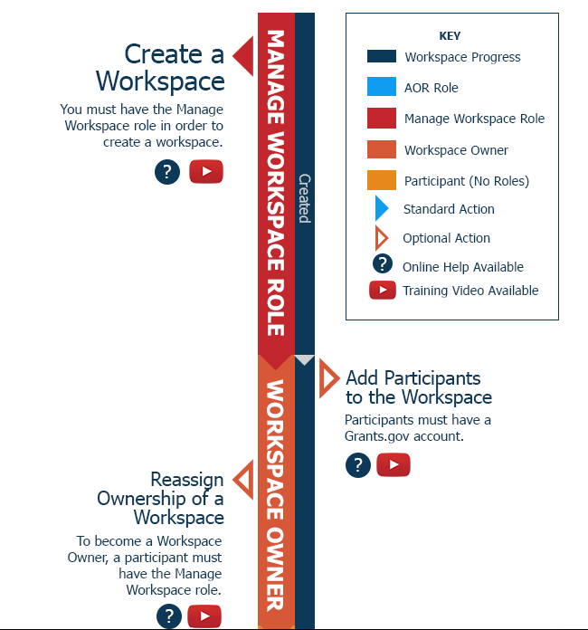
How Does Workspace Work?

Slide 5


Using Grants.gov Workspace
You will need to create a Grants.gov Account/User Name if you do not already have one
Go to https://www.grants.gov/web/grants/register.html
Select
Complete the registration form using UNMHSC’s UEI #G389MFAYJNG9
What type of Workspace access will you need? Watch the video and find out!

Slide 6
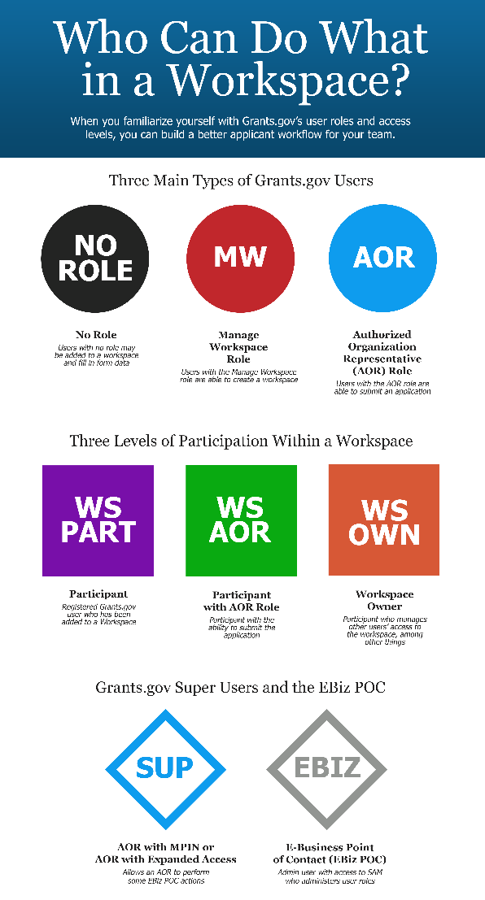
Using Grants.gov Workspace
PIs and Department/Study Staff can request to have the “Manage Workspace” role or have no role assigned.
The Workspace Owner has the “Manage Workspace” role, which enables a user to create new workspaces.
Participant with the Manage Workspace role may have the Workspace Owner access level assigned to them
If an individual has no role assigned, they will be limited within Workspace to filling out application forms
If you are requesting the “Manage Workspace” role, you MUST send an email to HSC-PreAward@salud.unm.edu detailing your request.
PreAward/Sponsored Projects Staff hold the “EBIZ” or “AOR” role. Your SPO Grants Specialist should be assigned to your projects by the Workspace Owner (see Slide #9 for “How to Add Participants to your Workspace”)
Additional Information- https://www.grants.gov/web/grants/applicants/workspace-overview/workspace-roles.html

Slide 7
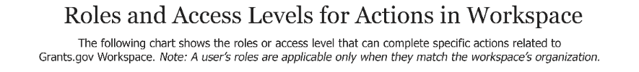
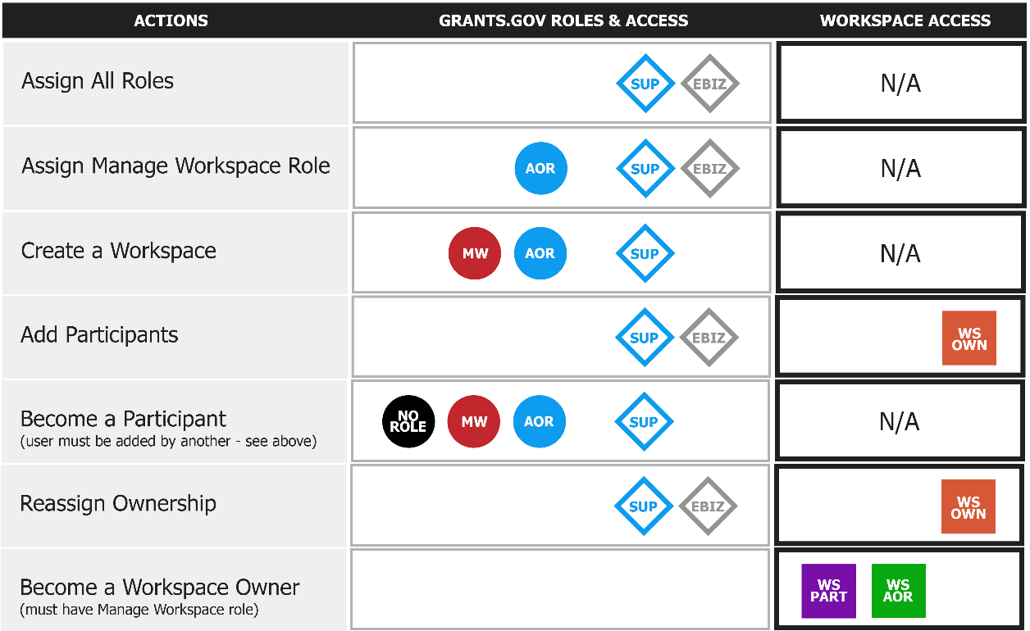

What can my role do?

Slide 8
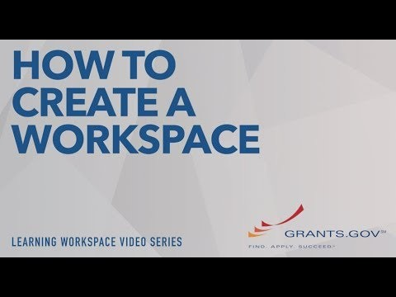
Create Your Workspace
Once you’ve decided on your role, it’s time for the Workspace Owner to create the Workspace.
Additional Information- https://www.grants.gov/web/grants/applicants/workspace-overview/step-1-create-a-workspace-package.html

Slide 9
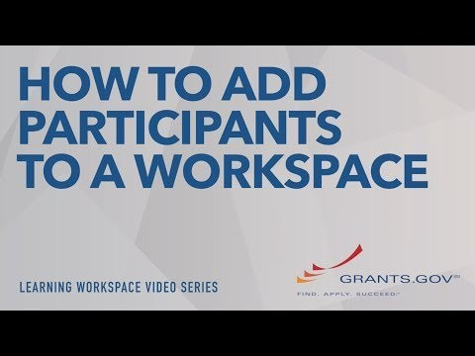
How to Add Participants to Workspace
Congratulations! You’ve created your Workspace. Now it’s time to add participants to your Workspace.
This will enable multiple team members to work on the application simultaneously.
You can add outside (Non-UNMHSC) Grants.gov users to your Workspace. This is especially important for any sub- recipients you may have on your project, as they will need to fill out their sub-forms through Workspace as well.

Slide 10
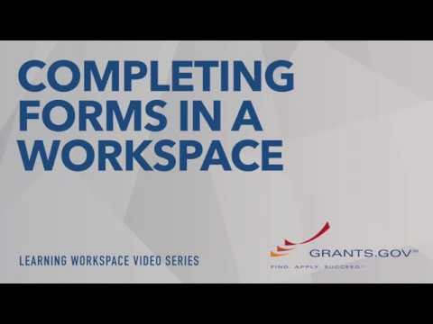
How to Complete Forms in Workspace
How do you complete forms in Workspace? Your team has three options:
Complete the forms online
Download a PDF, complete the form, and upload the completed PDF into Workspace
Reuse a form from a previous Workspace
Additional Information- https://www.grants.gov/web/grants/applicants/workspace-overview/step-2-complete-a-workspace-package.html

Slide 11
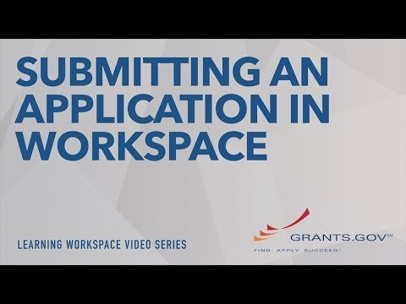
How to Submit Your Application
Once you are done with your Workspace application, it’s time to check for errors and send to your SPO Grants Specialist
You will need to “Complete & Submit to AOR” in order for your SPO to review and submit your application
Standard timelines apply: You must submit to your SPO by the deadlines listed on our website http://hsc.unm.edu/financialservices/preaward/index.html
Additional Information- https://www.grants.gov/web/grants/applicants/workspace-overview/step-3-submit-a-workspace-package.html

Slide 12
Need Help?
Contact your SPO Grants Specialist:
Team Silver: Susan De Los Santos- sdelossantos@salud.unm.edu
Team Silver: Kelsie Benson kbenson@salud.unm.edu
Team Teal: Jessica Stanton- jkstanton@salud.unm.edu
Reminders
You will need to create a Grants.gov Account/User Name if you do not already have one
See Slide 5 for instructions.
If you are requesting the “Manage Workspace” role, you MUST send an email to HSC-PreAward@salud.unm.edu detailing your request in addition to creating your Grants.gov account.

