Slide 1

HSC Sponsored Projects/ Department Training Click-Agreements

Slide 2
Welcome to Click
What will we be learning today?
  Click Workflow
  Navigating the Click Workspace
  Creating a New Agreements Submission
  Submitting For Review/Negotiation
  Creating a Follow-on Submission
  How to get Click help

Slide 3
Roles Available in Click-Agreements
Role | Description
Research Coordinator (PI) | Given to the PI. Allows the PI to create submissions, create follow on submissions, view documents, and view the reports tab.
Study Staff (PI Assistants) | Given to individuals who assist the PI with submissions. Allows staff to create submissions, create follow on submissions, view documents, and view the reports tab.
Sponsored Project Officer, PreAward / SPO | Used only in the Central Office and allows overwrite access and creation of all features

Slide 4
Before You Get Started…
Click works best in Chrome.
Be sure that pop-ups are allowed in your browser
How to get accounts:
  Email Sean Gonzales at sgonzales@salud.unm.edu, and include your name, email address, and Click role, and Banner ID.
  PIs or their Study Staff may email PreAward directly to have an account created

Slide 5
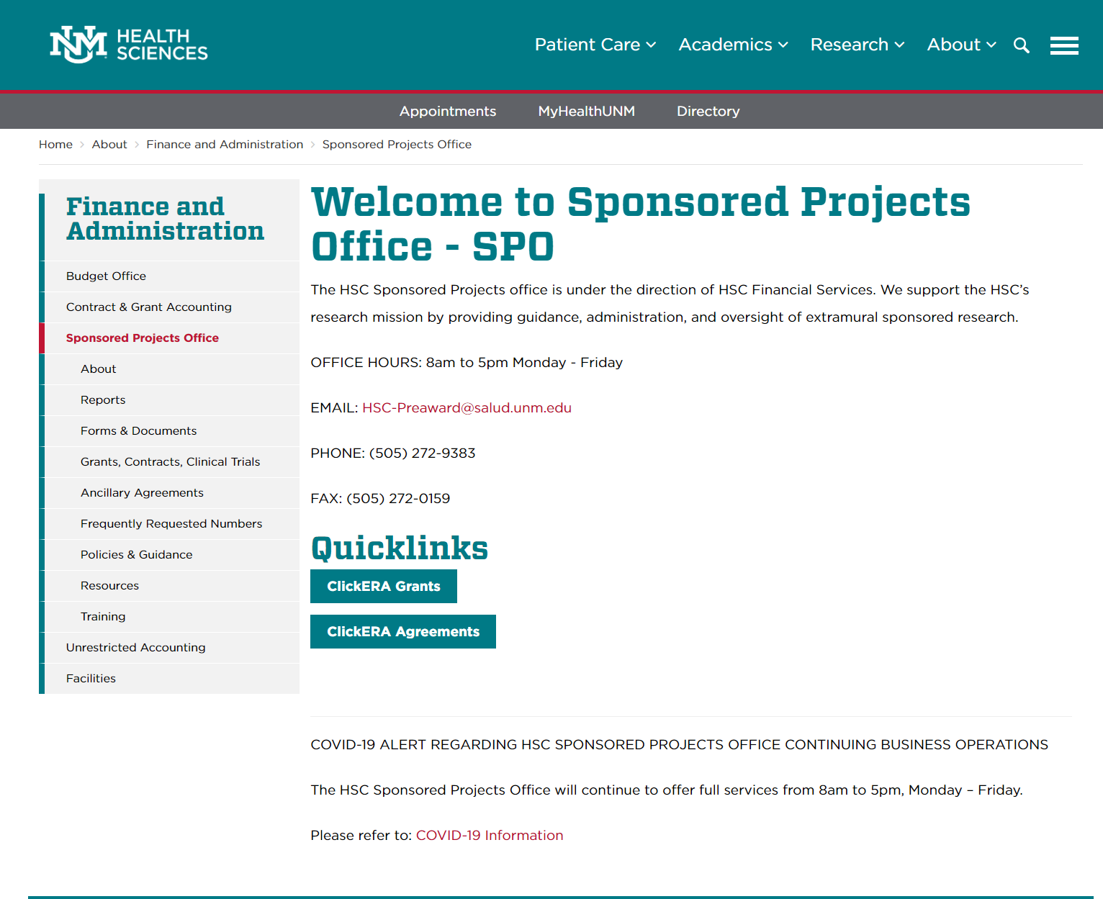
Logging In
You can reach the CLICK site from the SPO/PreAward website: https://hsc.unm.edu/about/finance/sponsored-projects/
Select “ClickERA Agreements”

Slide 6
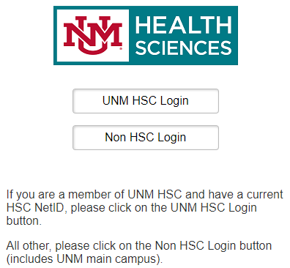
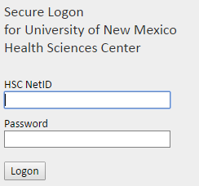
Logging In
Enter your User Name and Password here:
This login screen can also be reached directly at: https://era.health.unm.edu/Agreements
If you have problems logging in, please contact the administrator below:
  Sean Gonzales, SGonzales@salud.unm.edu, 505-272-3495

Slide 7
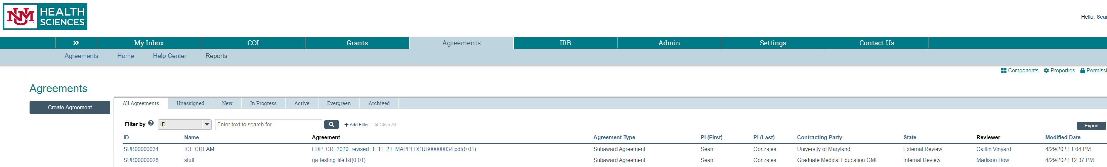
Navigating the Workspace
After logging in, users you can Navigate to Agreements by click the Agreements tab.

Slide 8
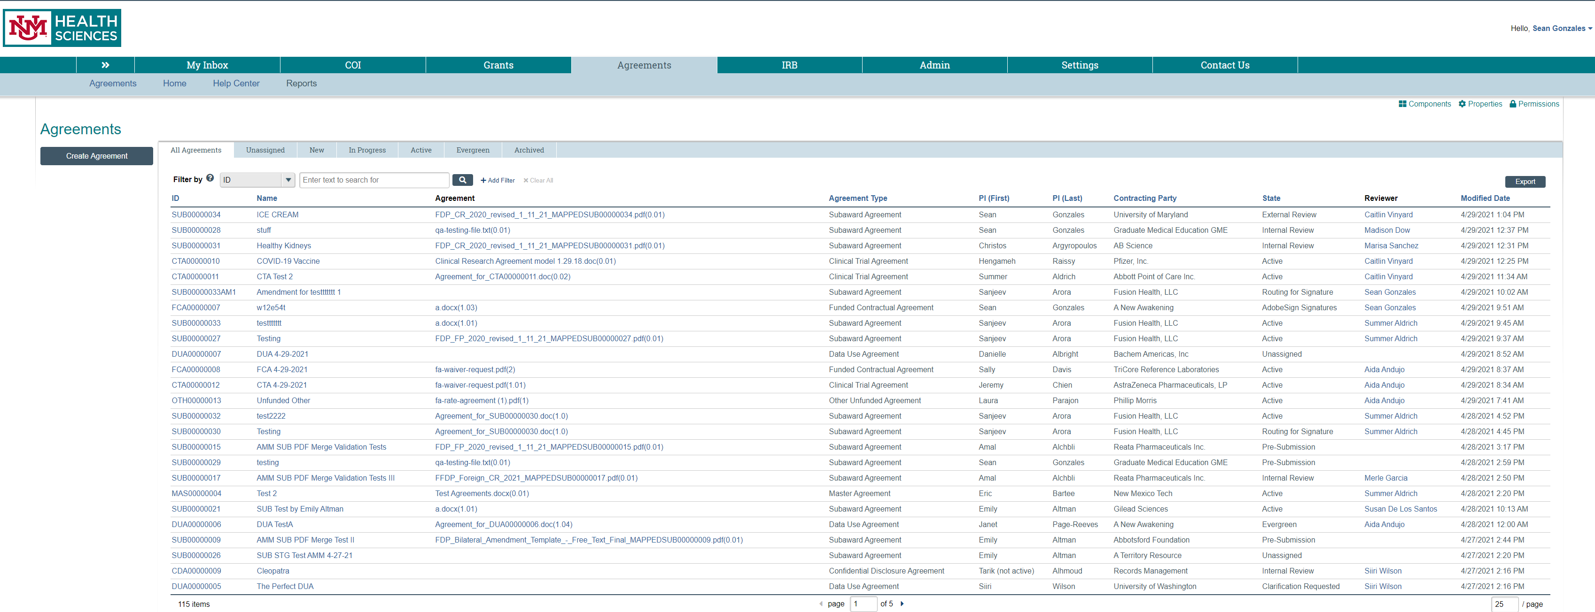
Navigating the Workspace
The Agreements tab is where PI’s and their study staff can create unfunded (ancillary) agreements and Subaward agreements. Much like the Grants system, agreements will allow you to track and find agreements related to you or your submissions.

Slide 9
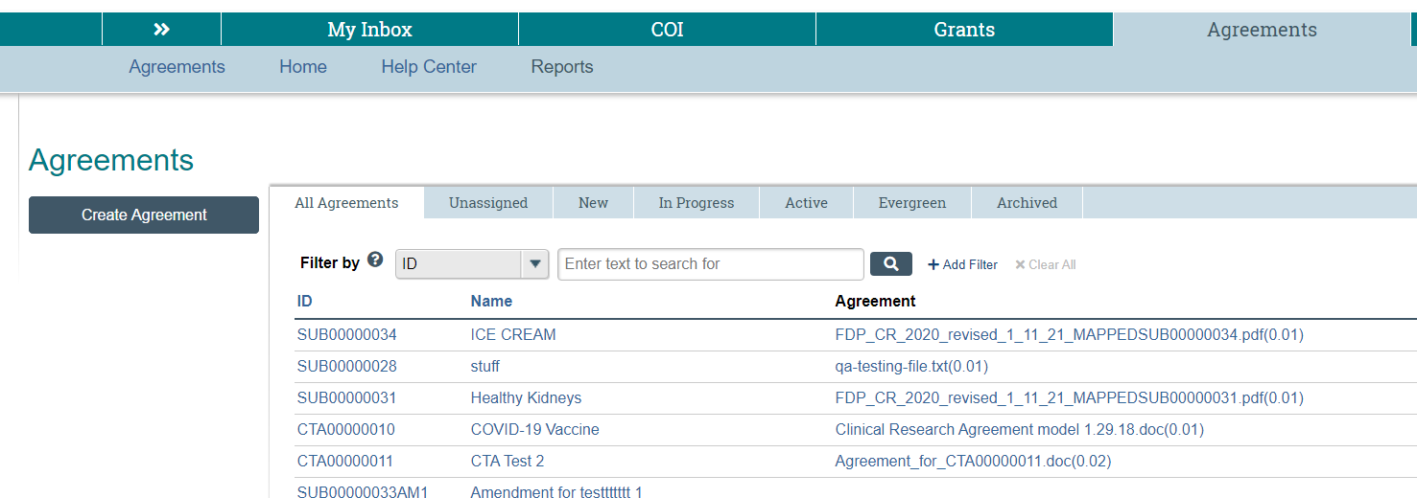
Navigating the Workspace
To search for an existing record, use the search box to filter results.
Choose the drop down list to see your searchable fields
Choose the drop down list to see your searchable fields
Click on “Add Filter” to add additional search fields. You can then add rows to the Advanced Search until you have all the desired search fields.
“%” indicates a wildcard

Slide 10
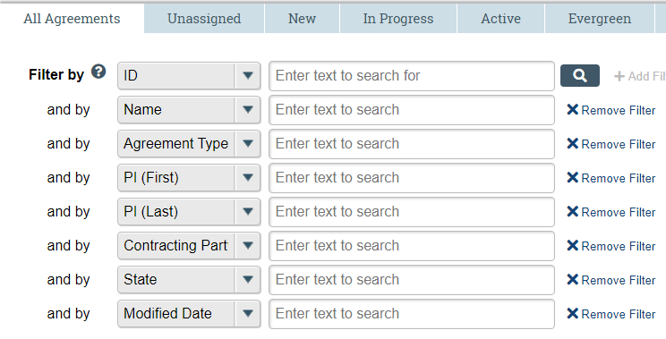
Navigating the Workspace
Having trouble finding your record? Modify the search by adding or removing additional fields.

Slide 11
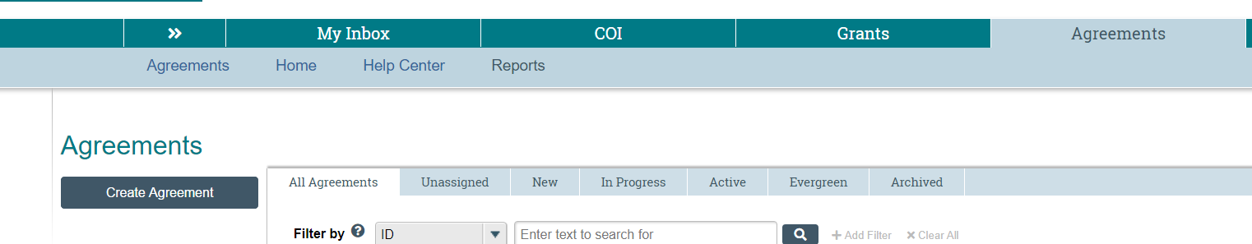
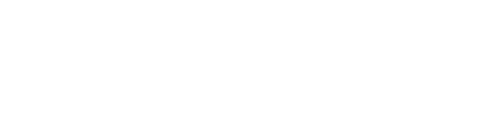
Creating a New Agreement
From the Agreements tab, select “Create Agreement”

Slide 12

Creating a New Agreement
From the Agreements tab, select “Create Agreement”
Only select “For an Unfunded (Ancillary) Agreement (Material Transfer Agreement, Confidentiality Agreement, Data Use Agreement, etc.) and Subaward agreements.
DO NOT select “Create Agreement” if your project is a:
  Is a Grant
  Funded Contract or CTA
  Supplement
  Competitive Renewal (an application for a new cycle of funding, e.g., years 6-10 on an NIH R01)
  Departments will still use the Grants system for the Initiation of Funded Agreements. SPO will select and fill out forms for funded agreements In the Agreements module and negotiate them using the agreements module.

Slide 13
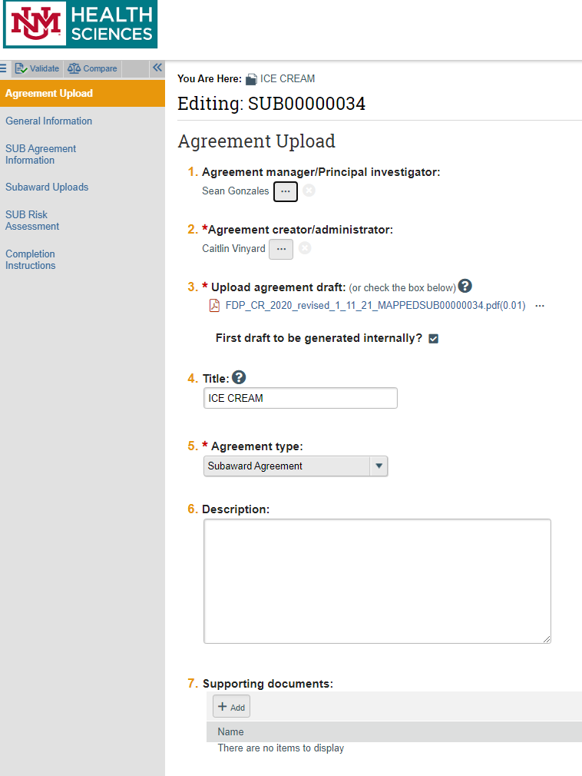
Creating a New Agreement Record
Clicking on “Create Agreement” will generate a new Agreement Record and display this first page of the smart form:
Agreement Upload
You can use the validation tool to make sure all mandatory fields are filled
Mandatory fields are marked with a Red Asterisk
You can use the compare tool to see all previous versions to the forms (tracking changes).
You can Navigate all smartforms using the navigation bar to the left
Notes:
Move to next screen, then expound

Slide 14
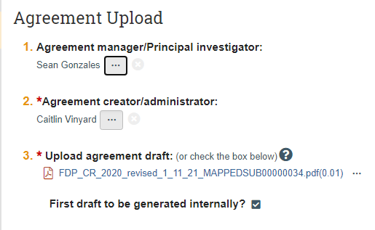
Creating a New Agreement
If the contracting party has provided an agreement, then you add it to the upload draft. If they have not, then check the box below it saying that the “First Draft will be generated internally

Slide 15
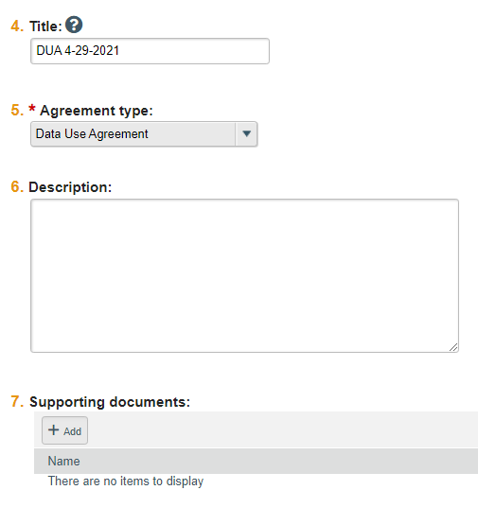
Creating a New Agreement
Add the Agreement Name.
*Note* For Subaward Agreements be sure to add the related Grant “FP Number” in front then add a dash, and then the subawardee name, and then the title (i.e. FP1921 – University of Washington – Making the World a better place).
Select the Agreement Type (remember they have to be the unfunded type or a subaward(e.g. MTA, DUA, CDA, OTH(other), or SUB)). KEEP IN MIND THAT PAGES 1 AND 2 OF ALL AGREEMENTS WILL LOOK THE SAME. THE PAGES AFTER THOSE ARE SPECIFIC TO THE AGREEMENT TYPE.
Add the Agreement Description
Add any and all supporting documents (much like Grants, this system will be a document resource for you)

Slide 16
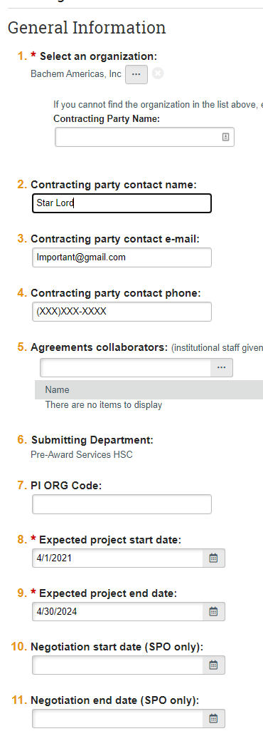

Creating a New Agreement
If you cannot find the sponsor you need, simply enter their information here and click “SAVE”. An email will be sent to SPO/Pre-Award to update the system.
Be sure to enter as much information as you can as this will be useful for contacting the contracting party
Be sure the submitting department is correct. This can be edited.
Be sure to make everyone in the institution who will be working on the agreement “Agreements Collaborators”(including yourself). This will be especially important if the person is not in your department as we are adjusting security parameters for department personnel to be able to see all records in their department. If the person is not in your department, but need to see the record, then this is the only way to allow access. This also gives edit rights and makes sure important emails from the system to be sent to staff.
Make sure to fill out expected start and end dates.
Always Click “Save” first, and then click “Continue”.

Slide 17
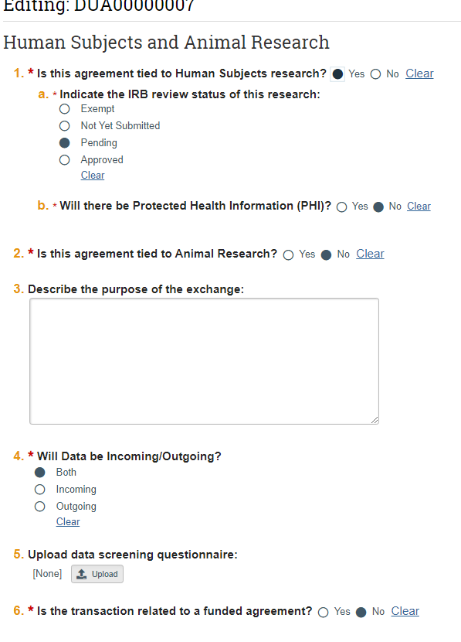
Creating a New Agreement (DUA Branching)
Be sure to correctly fill out the human subject page

Slide 18
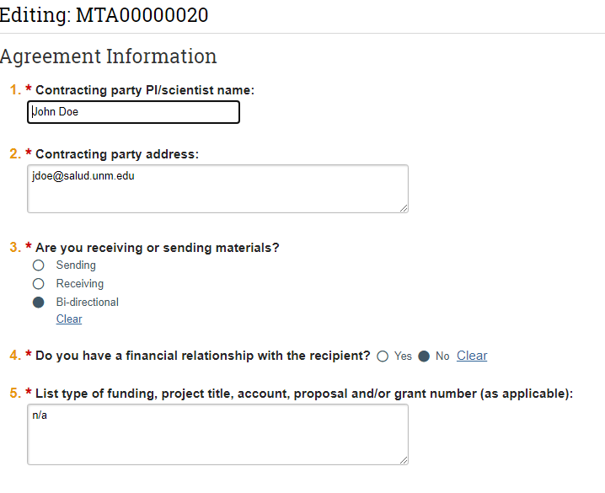

Creating a New Agreement (MTA Branching)
Contracting Party Physical Address is added here (not an email). ☺
Be sure to answer these correctly, because they decide the branching of the smartforms (on a related note NO MORE MTA UPLOAD FORM, HOORAY!).

Slide 19

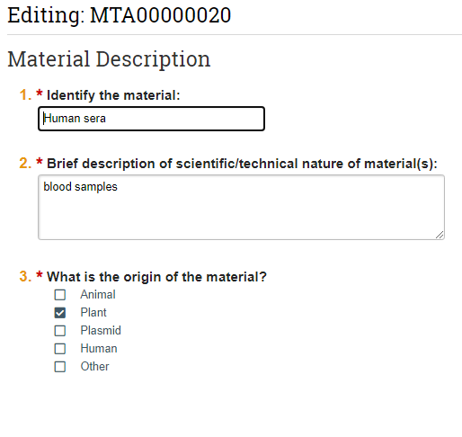
Creating a New Agreement (MTA Branching)
Notes:
NOTE: Adding a staff member here adds them to the database but DOES NOT give them an account or role

Slide 20
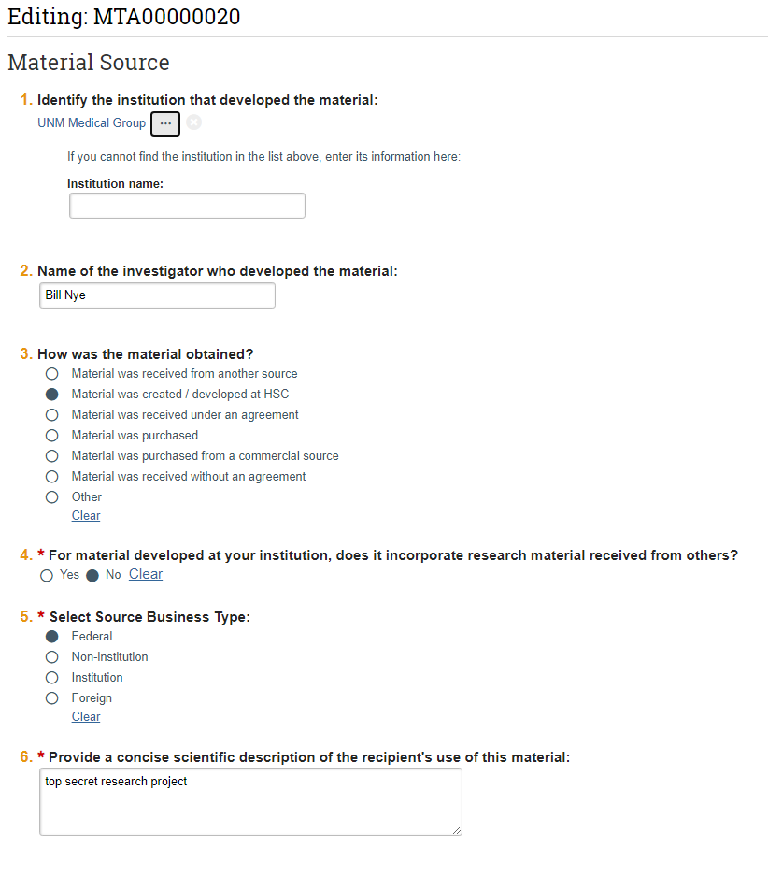
Creating a New Agreement (MTA Branching)
Be sure to be concise as possible as the MTA upload form has been done away with.

Slide 21
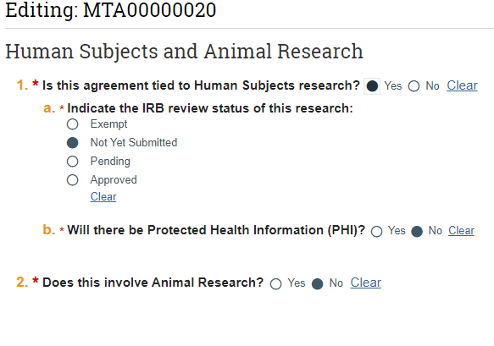
Creating a New Agreement (MTA Branching)

Slide 22
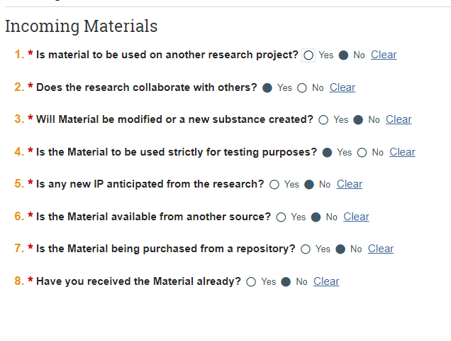
Creating a New Agreement (MTA Branching)(Incoming)

Slide 23
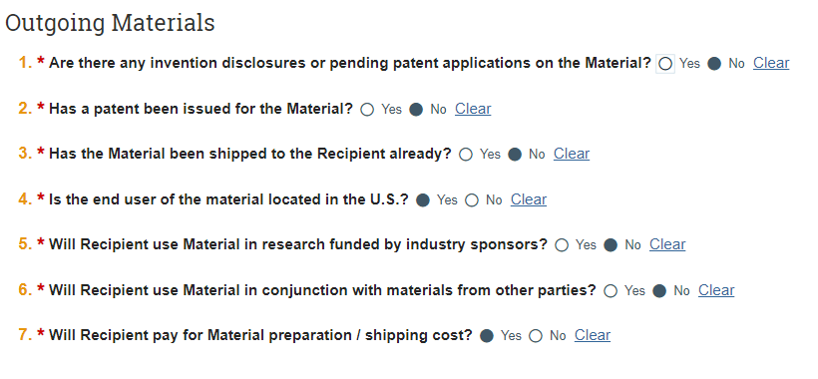
Creating a New Agreement (MTA Branching)(Outgoing)

Slide 24
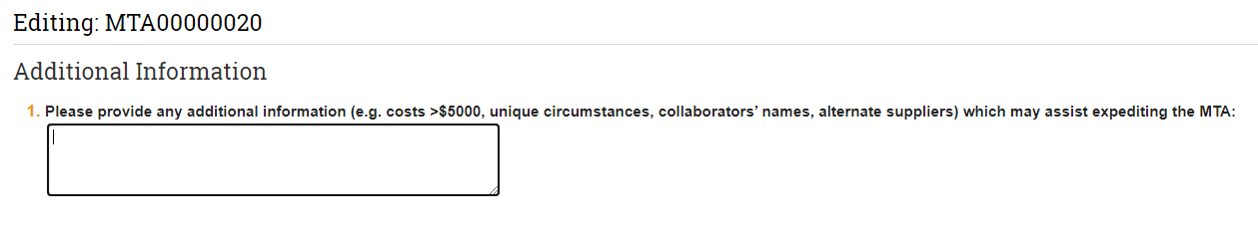
Creating a New Agreement (MTA Branching)
Be sure to add ANY additional information you would think is helpful.

Slide 25
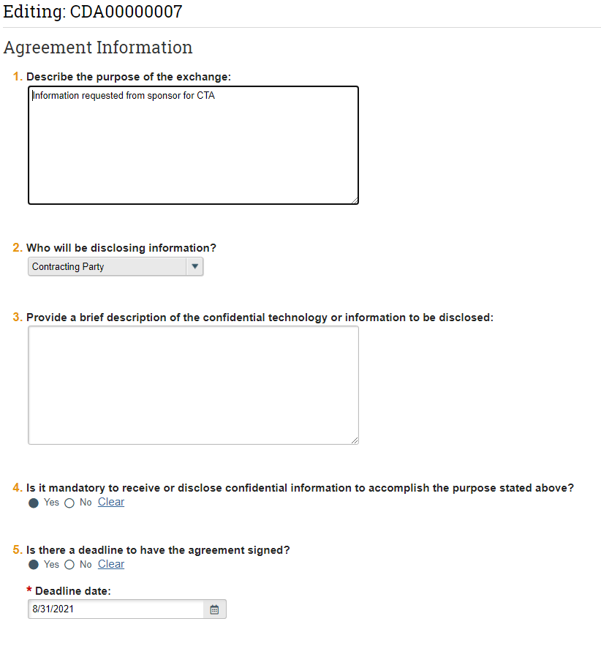
Creating a New Agreement(CDA Branching)
Be sure to be as accurate as possible with over disclosing.

Slide 26
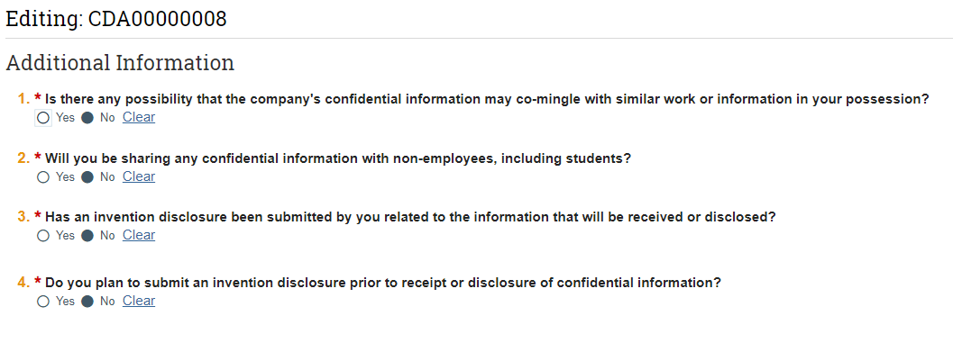
Creating a New Agreement(CDA Branching)

Slide 27
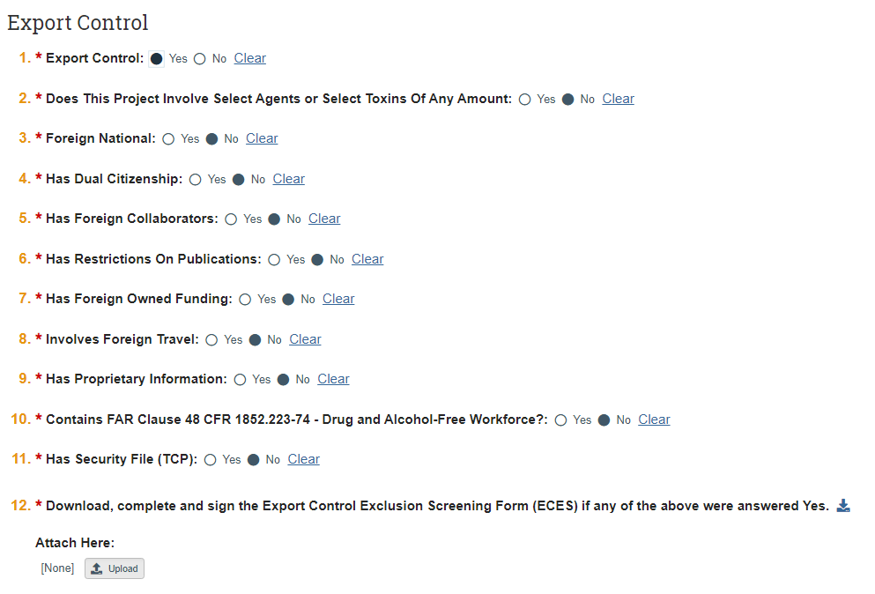
Creating a New Agreement
All of our submissions have export control screening. If you answer yes to any of these questions, then you will need to download an export control screening form, fill it out and attach it.

Slide 28
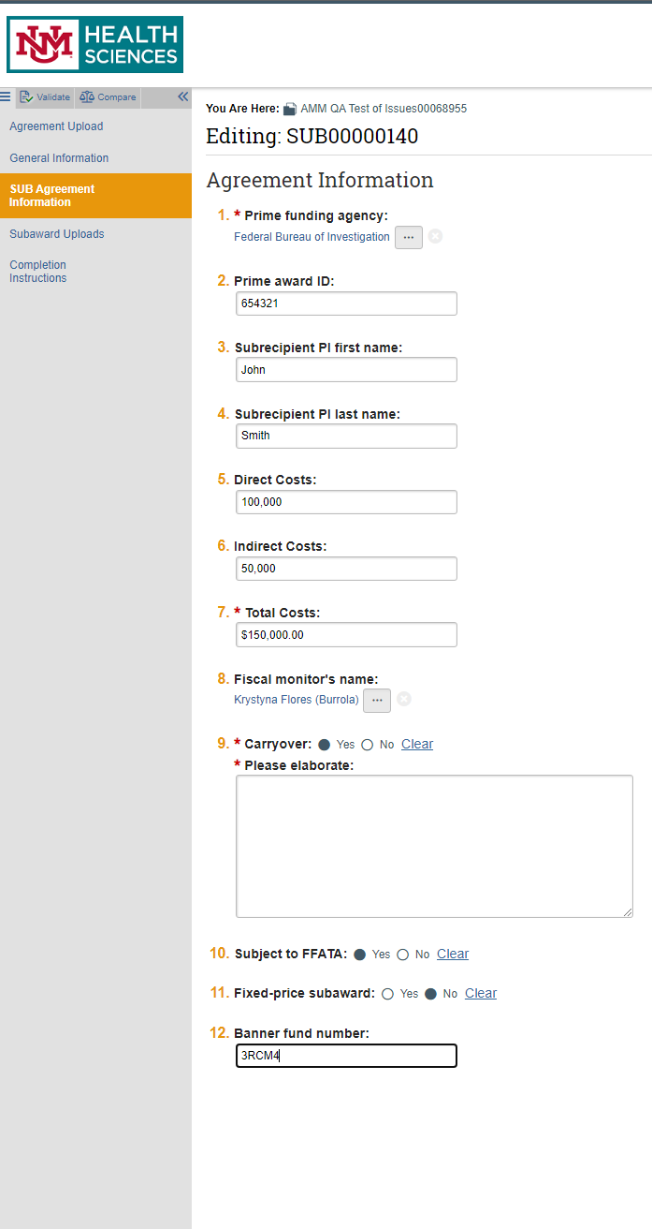
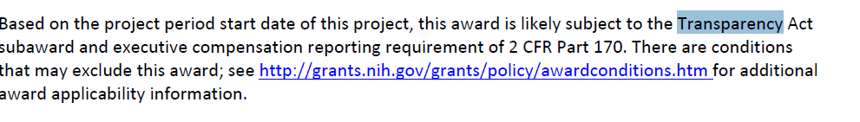
Creating a New Agreement
(Subaward Branching
Be sure to fill out all of this information. The PRIME award ID and whether it is subject to FFATA(how to find FFATA explained below) , The Fiscal Monitor and banner fund number will be the same as for your Grant record related to this agreement.
If there is Carryover or “Carry forward”, then please elaborate as to why as it is UNMHSC policy to not allow automatic carryforward and any carryforward needs justification. This box will only appear if “yes” is selected for question 9.
FFATA (Federal Funding Accountability and Transparency Act) information can be found in the NOA(Notice of award) in the Grants module. It can either say Subject to FFATA, Subject to Federal Funding Accountability and Transparency Act, or subject to the transparency act. I recommend downloading and opening the PDF, pressing CRTL + F on your keyboard and typing in “subject to”, and then seeing all of the items that your award is subject to. If you do not see anything that looks like example to the right or what has been mentioned, then odds are your grant or contract isn’t subject to FFATA.
If the banner fund number isn’t available in the grants record, then your Subawards specialist will fill this out when the number becomes available.

Slide 29
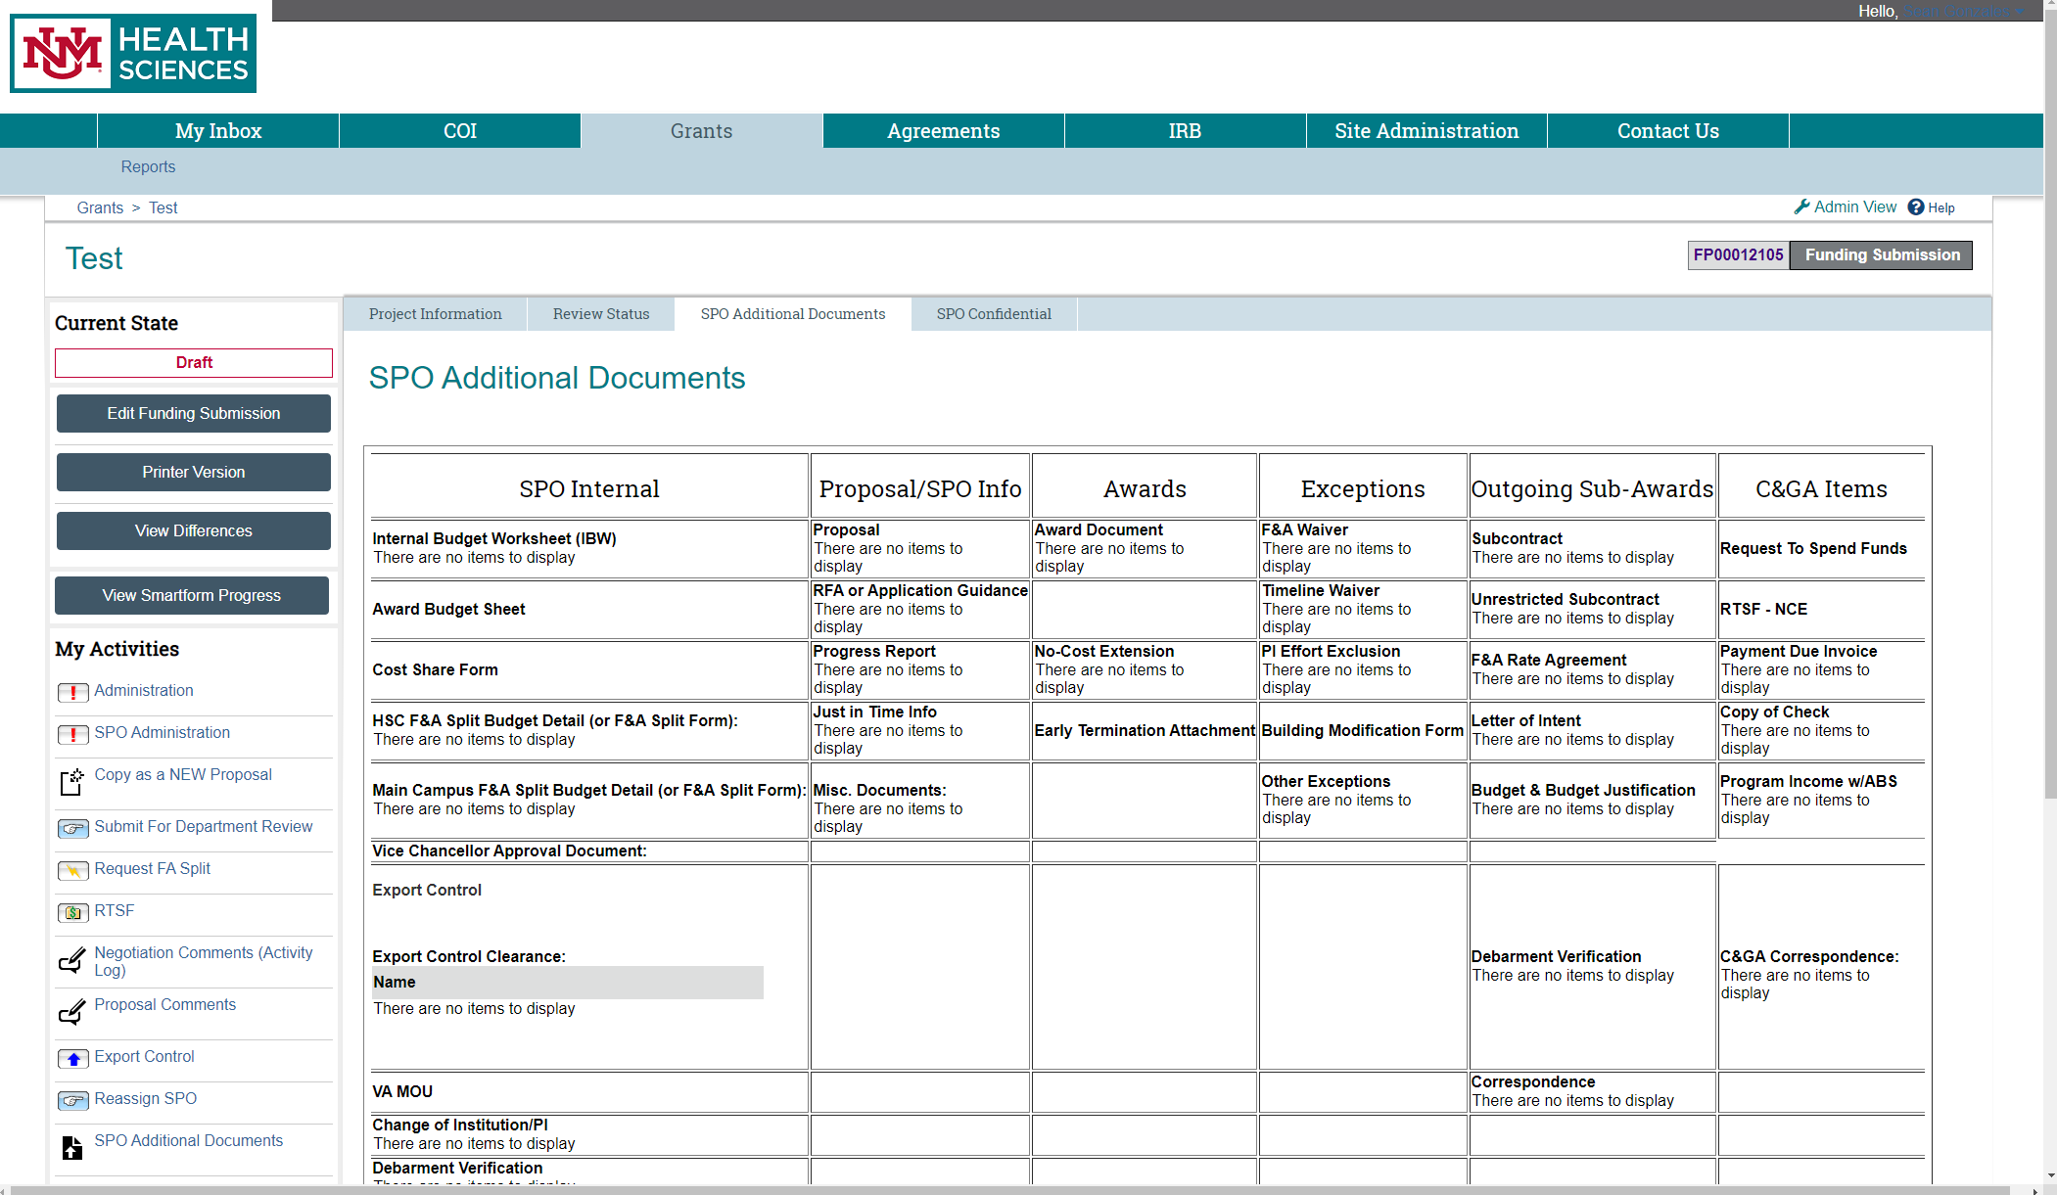
Where Do I Find the Prime Agreement/Award?
The Prime Agreement or Award can be located in the Grants Module-> In the Awarded Record-> Under SPO Additional documents.

Slide 30
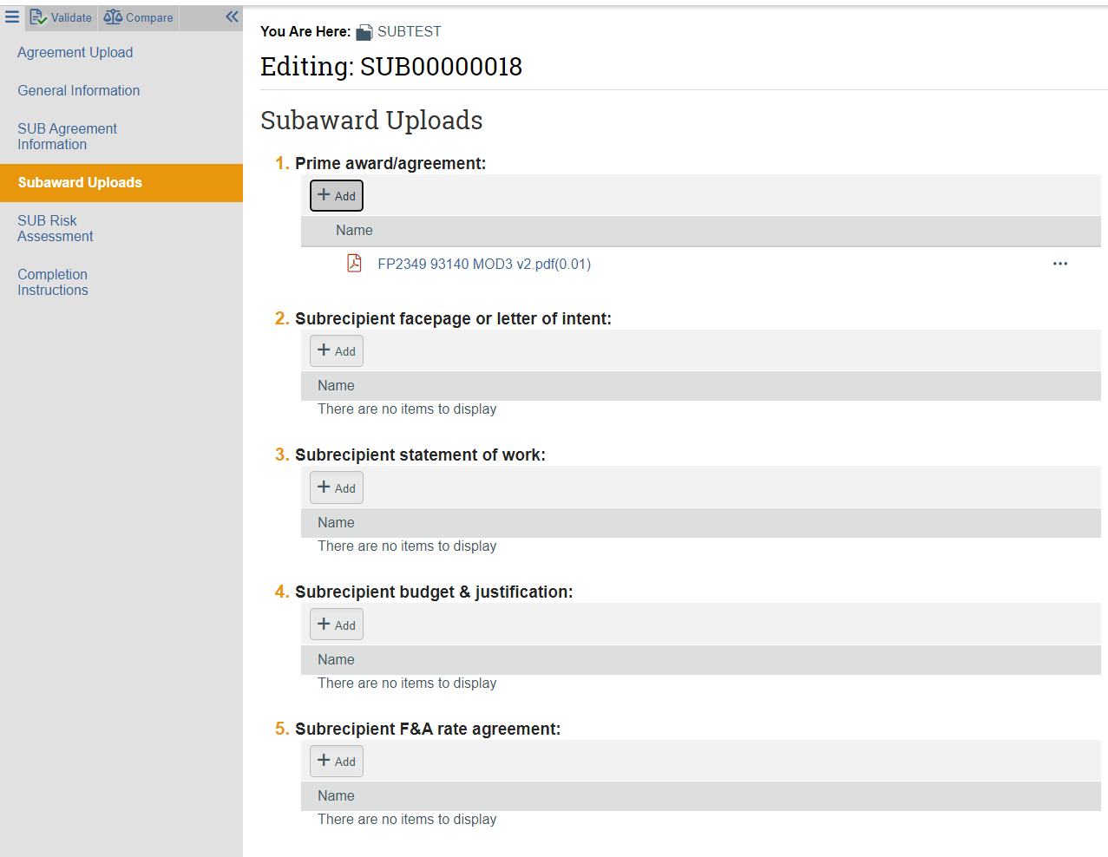
Creating a New Subaward Agreement - Documents
Be sure to add as many of the uploads as possible
Upload the prime agreement here. If this a new year of funding, then ALWAYS add the NEW prime award for that year.
If you cannot find the document it is asking for or the subk specialist has always acquired the doc for you, then leave it blank. If SPO has questions, then we are happy to ask

Slide 31
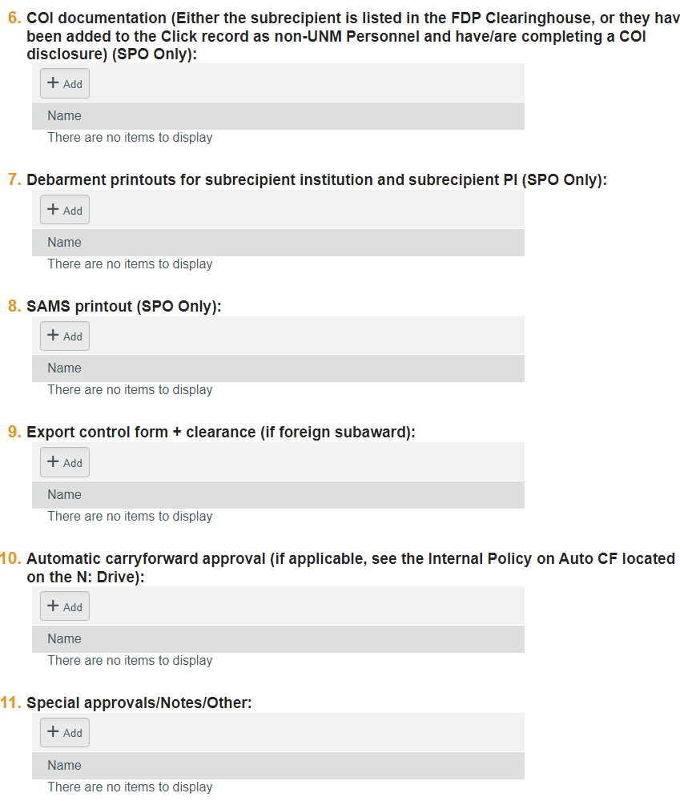
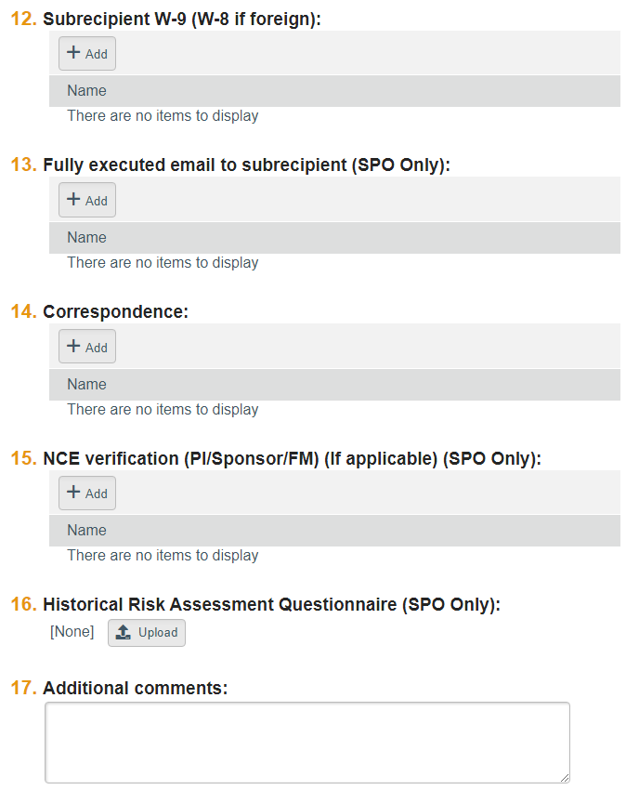
Creating a New Subaward Agreement – Documents Cont’d
If this is an amendment, and there is no change in scope of work, then you can add this into the comments here. You can also add any pertinent information regarding the uploads here whether it is a new agreement or an amendment.
Do Not upload anything into the Historical Risk Assessment questionnaire. If SPO decides there should be something here, then we will upload info here.
*NOTE* - For amendments do not delete “old files” you can add new ones with the date and SPO will determine whether certain docs need deleting.

Slide 32
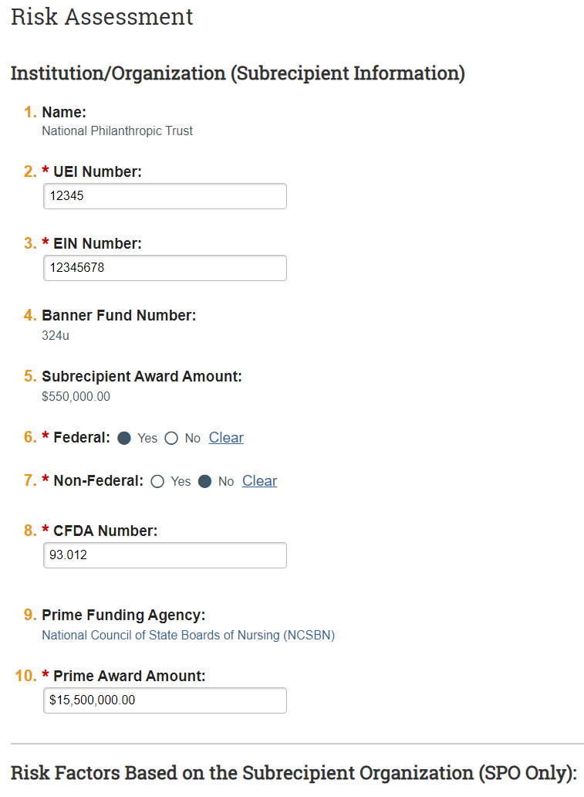
Creating a New Subaward Agreement (Risk Assessment)
If this is a Federal Award, then be sure to mark Federal and Fill out the CFDA Number(This can be found on the prime award you downloaded from the grants record).
Be sure to fill out all of the info in this area.
DO NOT fill out any information below here on the Risk Assessment. The information below is “SPO Only”.

Slide 33
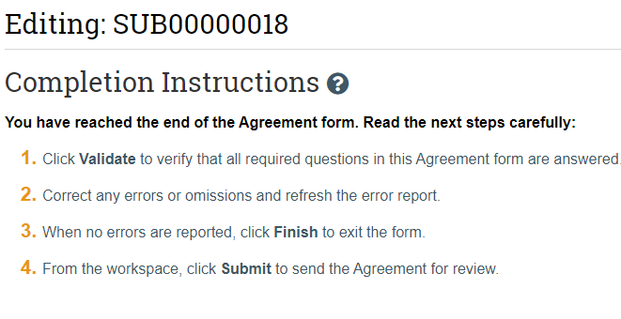

Creating a New Agreement
Whew, now we are done with the smartforms! Be Sure to click “Finish”!

Slide 34
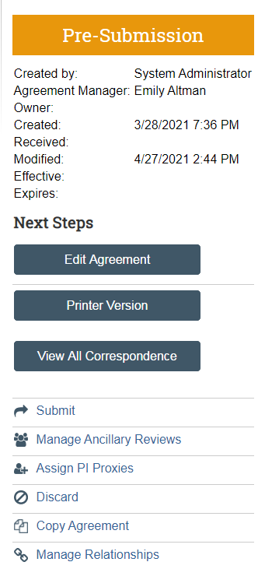
Creating a New Agreement
1)This is the manage relationships activity. This will allow you to connect your agreement to a funding proposal (FP in the Grants module)(REQUIRED FOR A SUBAWARD) or an IRB record. From the IRB platform you can relate IRB proposals to Funding Proposals and Agreements, and From Grants you can relate Funding Proposals to IRB Proposals and Agreements.
2)From here you will submit your record and it will be picked up by your assigned SPO person. Or you can do any of the other activities here. Keep in mind that if you discard a record, then it cannot be brought back.

Slide 35
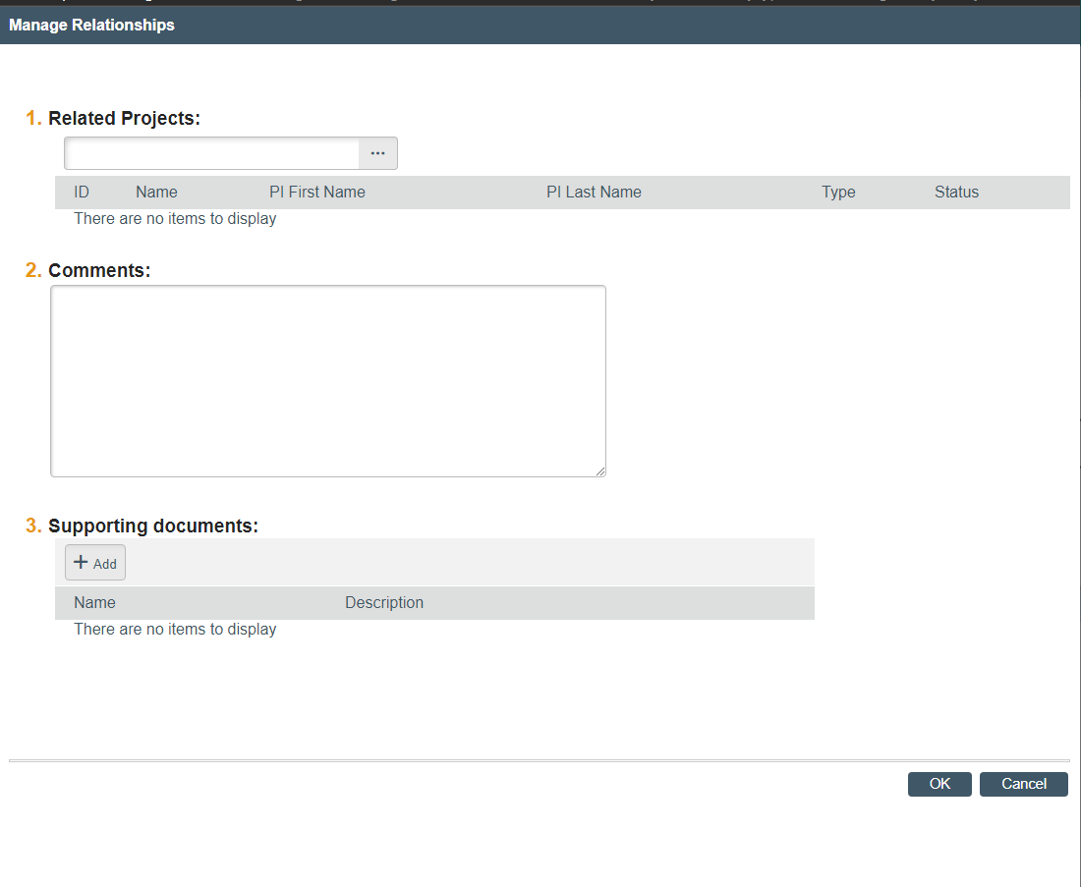
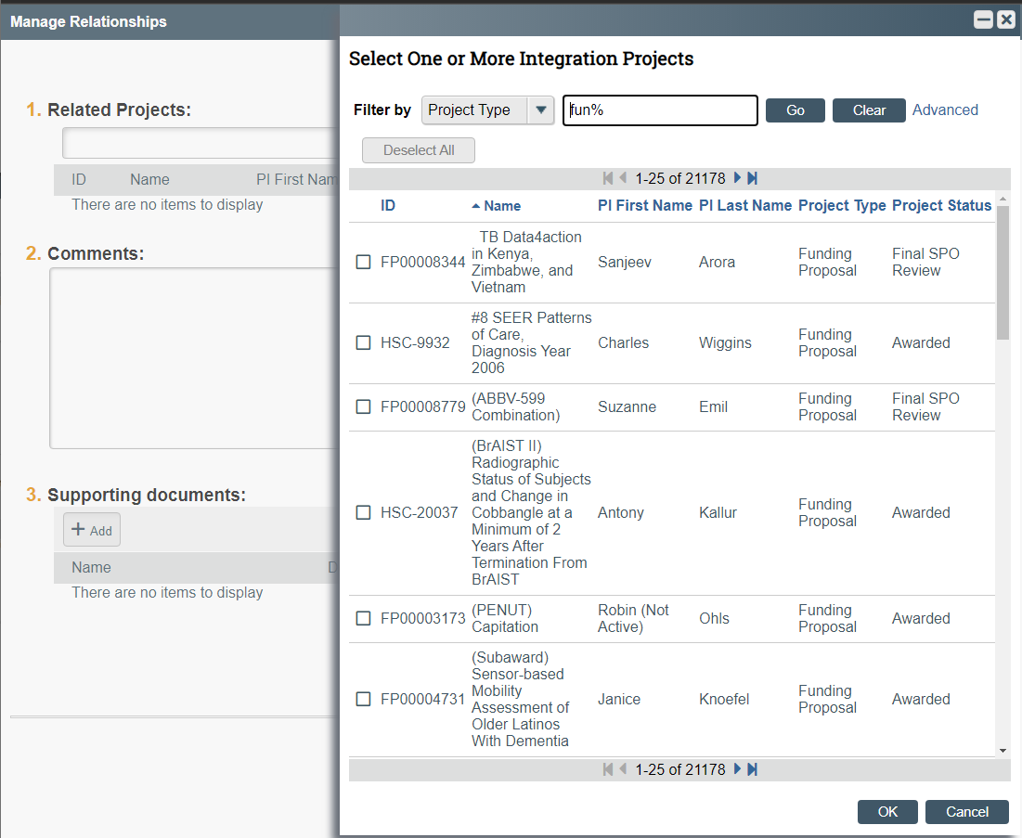
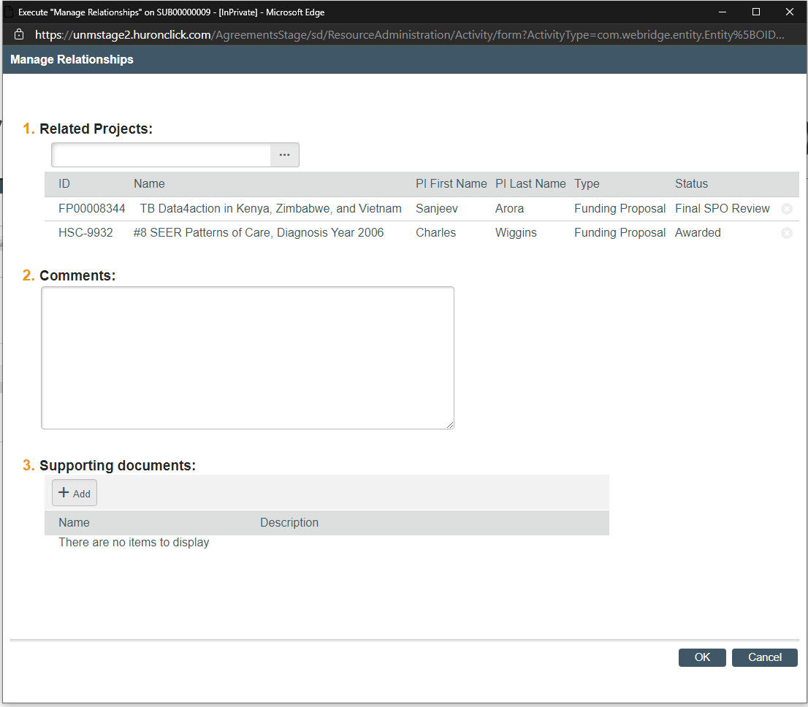
Managing relationships
Once Manage Relationships is Open you can click the ellipses button and find the correct related submissions and add them. Click ok and then click ok again on the bottom righthand corner. (Note: Always connect the Subaward to the most recent Grant number( So if its an amendment connect it to the new non-compete continuation if it is a new year.)

Slide 36
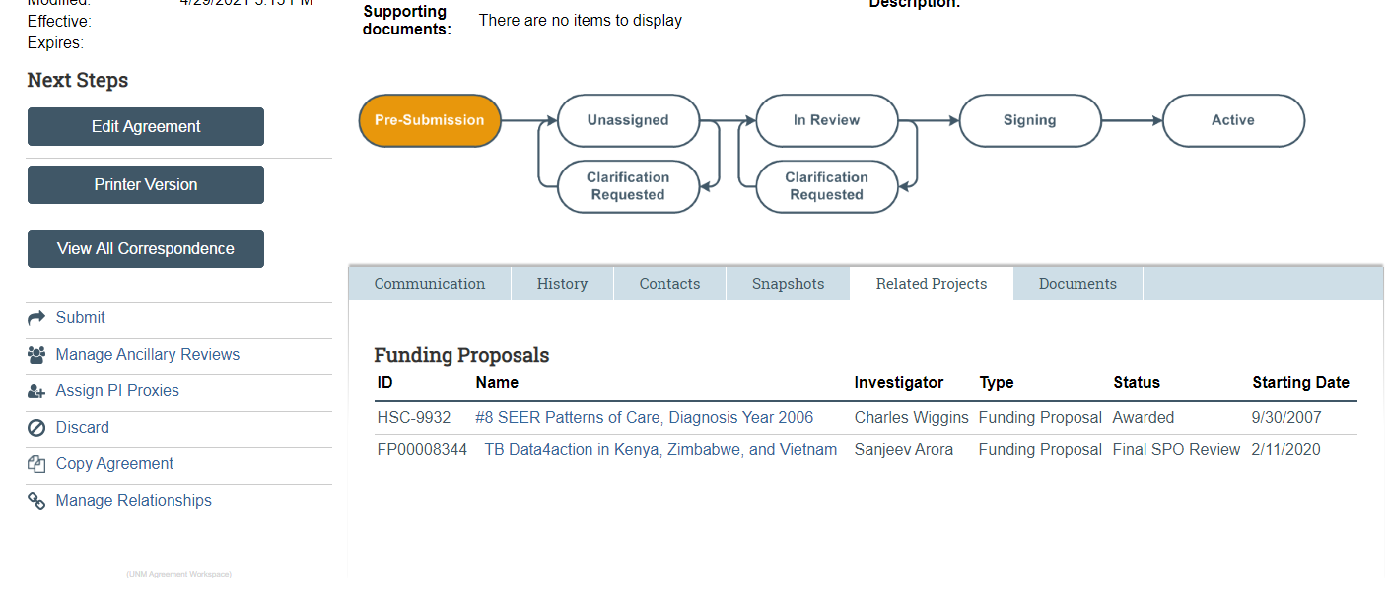
Finding Relationships
To find your related projects all you have to do is click the related projects tab at the bottom. The name is clickable and if you have access to the record in the other system, then you will be able to go to it.

Slide 37
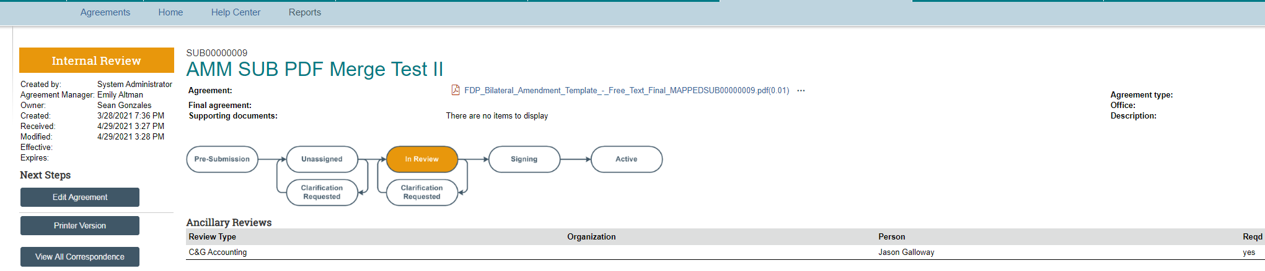
Where is my agreement?
At the top left-hand corner, you can see what state your agreement is in (internal, External, signing etc). You can see a general state graphic in the middle of your screen. You can also see if other departments are reviewing (legal, etc….) your document internally to see who is or was reviewing your document. To see more detailed comments etc…. Go to history. SPO will also use the Ancillary reviews for the Admin on the department side to review the final draft. When they do you will receive an “ancillary review” email. You will go into the record and do an ancillary review of the draft.

Slide 38
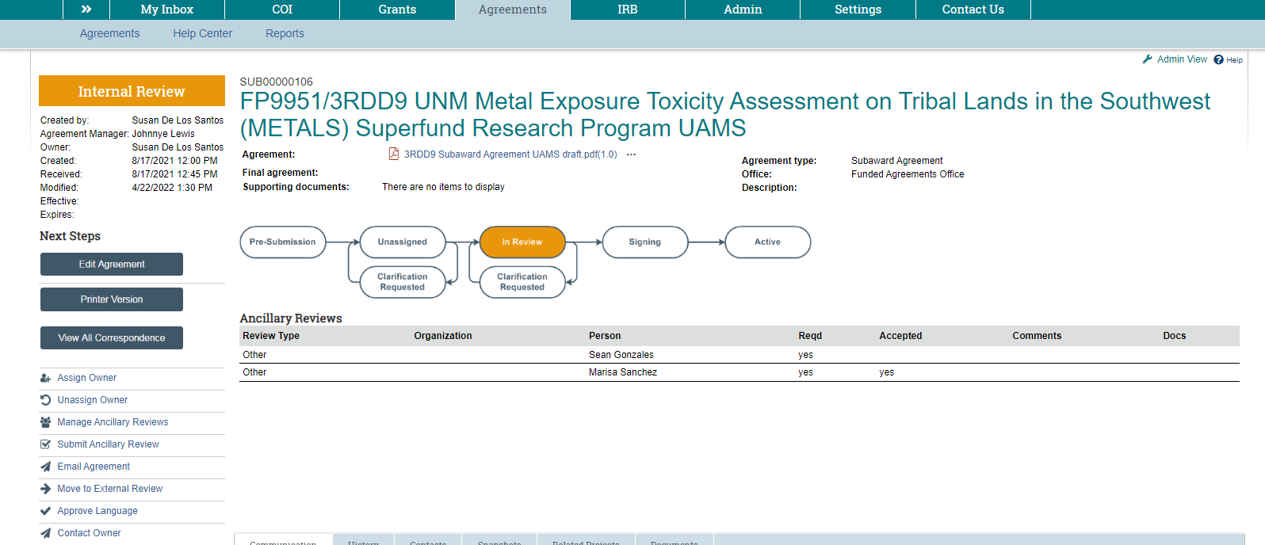
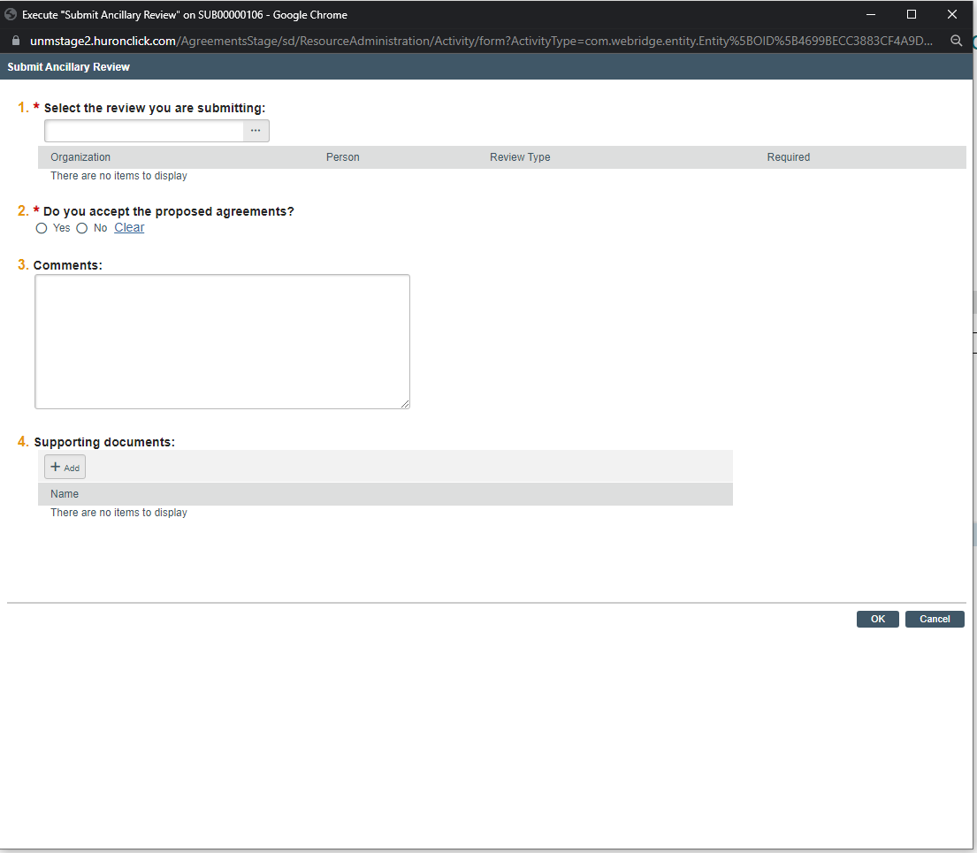
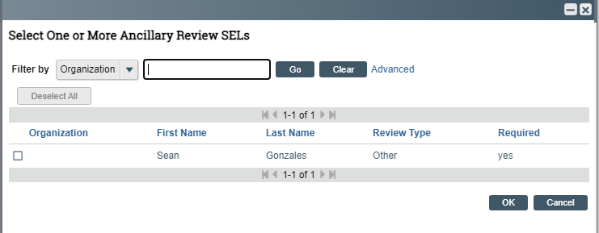
Draft Review
You can find the agreement for review in the top center of the page
Select your review and a window will open. Find your name and check the box, then click ok.
Once you have reviewed the agreement, you can click the “submit ancillary review” button. The it opens a window like the one to the right.
Check Yes or no as to whether you accept the draft.
Add any comments or documents pertaining to your review.
Once everything is complete, then click ok.

Slide 39
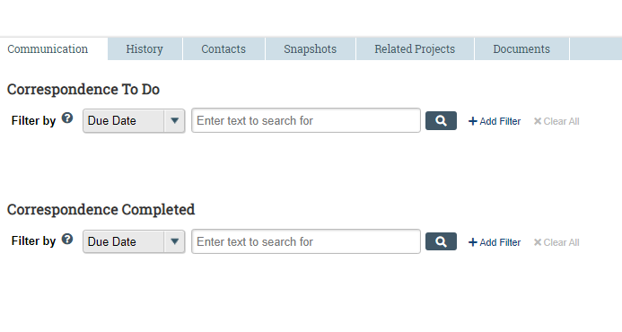
Sub Tabs
Shows Communication
Shows History, State Changes, comments, etc…
Shows Documents uploaded
Shows Snapshots of changes made
Has a list of the contacts that were added.

Slide 40
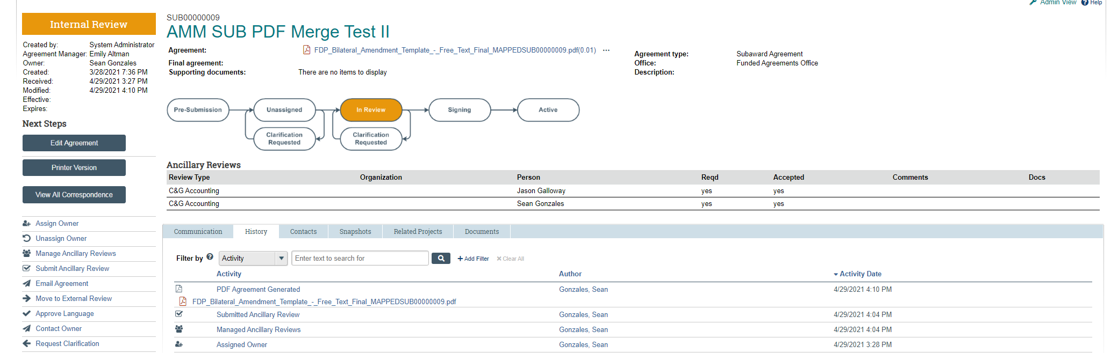
Clarification requested?
If SPO needs clarification, then we will send back with a note of what we are missing through the system.

Slide 41
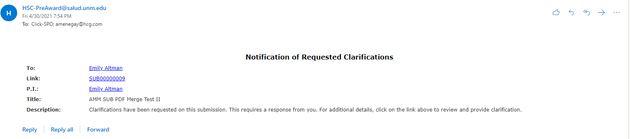
Clarification Requested?
An Email will go out and the PI can click into the email using the link

Slide 42
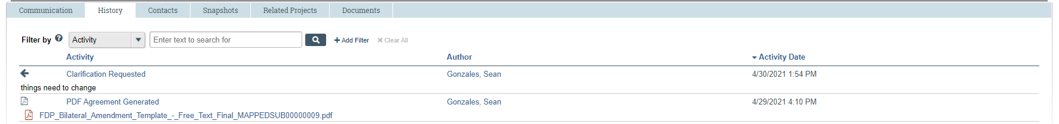
Clarification Requested?
You will see in the history tab what changes need to be made and you can either go in and make them or clarify what the SPO Officer needs clarified

Slide 43
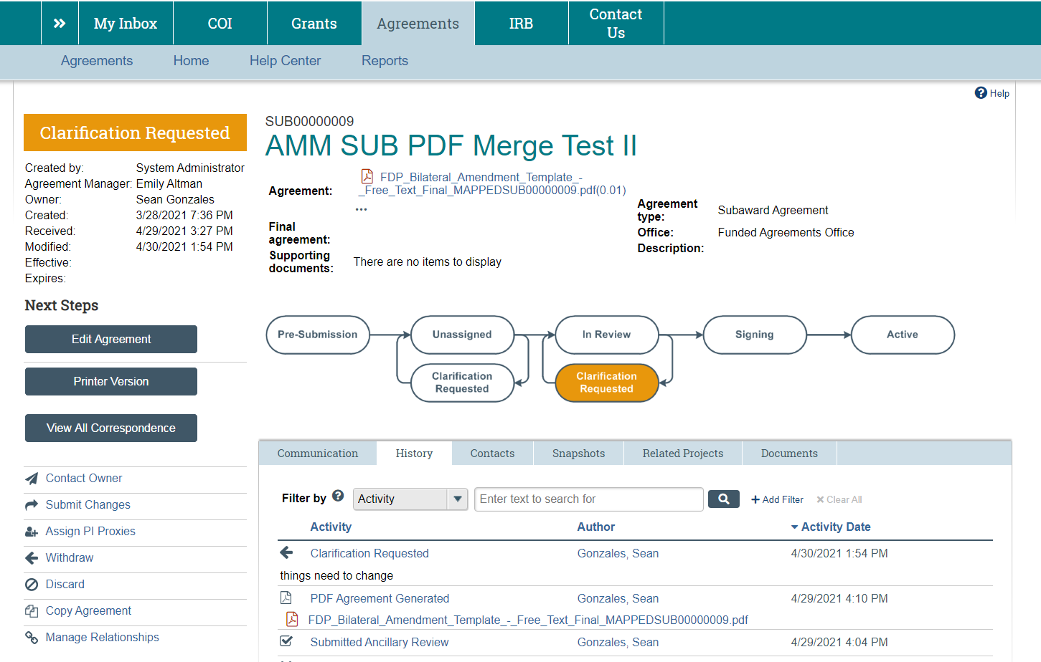
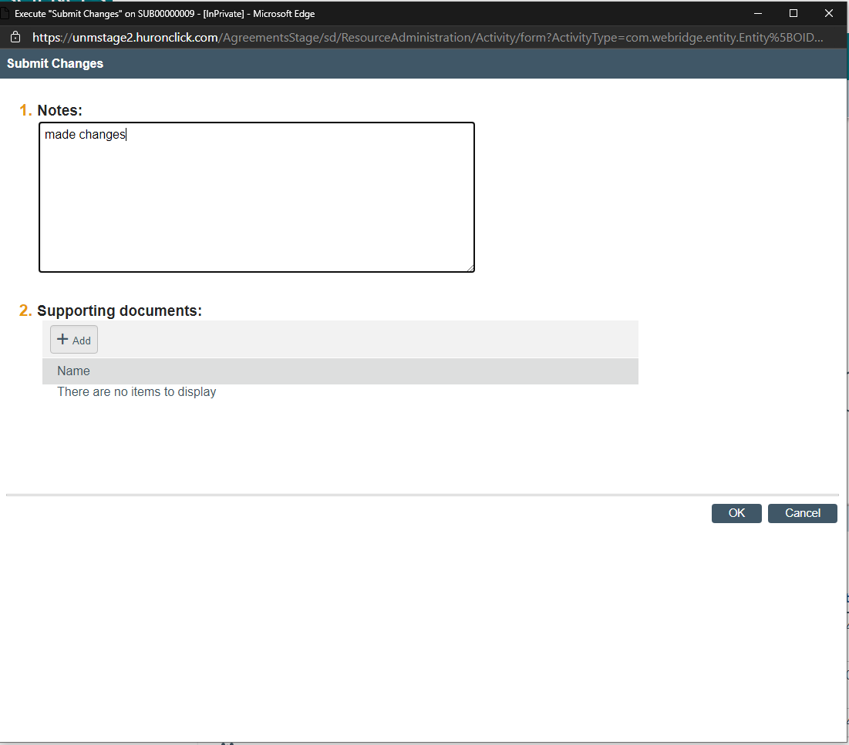
Clarificationn Requested?
You will then submit changes and add any comments. Then click ok.

Slide 44
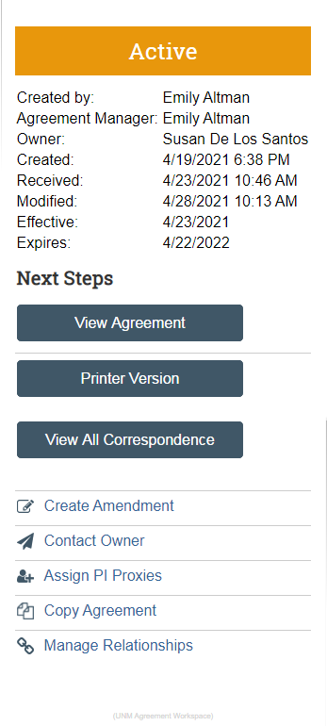
Your agreement is active. What do you do?
If your agreement is ending or something needs to change with it, then you can create an amendment.
You can contact the SPO Specialist to see if there is an issue.
You can assign PI proxies for people that will be handling this on your behalf.
You can copy the agreement if there is a similar one you’re doing.
You can Manage Relationships if there are other agreements, IRB’s, or Funding Proposals that are Related.

Slide 45
Amendments
If you hit create amendment, then much of the information from the parent is going to carry over. Remember much like grants continuations amendments can only be created from a “Parent Record”.
This is for any amendment you will be doing (e.g. year 2 etc… (be sure to initiate this at the RPPR stage for continuations), more money, change in terms, etc…).

Slide 46
Need Help?
Contact Sean Gonzales to schedule on-site assistance or if you have system problems, or email HSC-Preaward@salud.unm.edu:
  Sean: Sgonzales@salud.unm.edu, 505-272-3495
  And, as always, call or email your Sponsor Projects Officer for help!

