Slide 1
HSC sponsored projects/ Department Training-Click Grants
A Note Before We Get Started
I cannot see when you raise your hand when I am in Presentation mode. So, if you have a question then you can either:
Unmute and ask the Question(I do not mind being interrupted ☺), or
If your question can wait until the end, then put it in the chatbox.

Slide 2

HSC sponsored projects/ Department Training Click era

Slide 3
Welcome to Click
What will we be learning today?
Click Workflow
Navigating the Click Workspace
Creating a New Funding Submission
Submitting for Department Review/Department Approvals
Generating COIs
Request to Spend Funds
F&A Splits
Creating a Follow-on Submission
Creating a No Cost Extension request
Creating a Competitive Renewal Submission
Creating an Ancillary Agreement Submission
How to get Click help

Slide 4
Roles Available in Click
Role | Description
Research Coordinator (PI) | Given to the PI. Allows the PI to create submissions, submit request to spend funds, request no-cost extensions, view documents, and view the reports tab.
Study Staff (PI Assistants) | Given to individuals who assist the PI with submissions. Allows staff to create submissions, submit request to spend funds, request no-cost extensions, view documents, and view the reports tab.
Department Approver /Chair | Given to the individuals who will be approving the project. Allows DA’s to view the submission and Approve, Disapprove, or Reassign Approvers
Sponsored Project Officer, PreAward / SPO | Used only in the Central Office and allows overwrite access and creation of all features
An individual may have multiple roles depending on his or her department’s needs.

Slide 5
Before You Get Started…
Click works best in Chrome.
Be sure that pop-ups are allowed in your browser
How to get accounts:
Email Sean Gonzales at sgonzales@salud.unm.edu, and include your name, email address, and Click role, and Banner ID.
If you already have an account for COI certifications, we will add the appropriate grant role to your existing account.
PIs or their Study Staff may email PreAward directly to have an account created

Slide 6
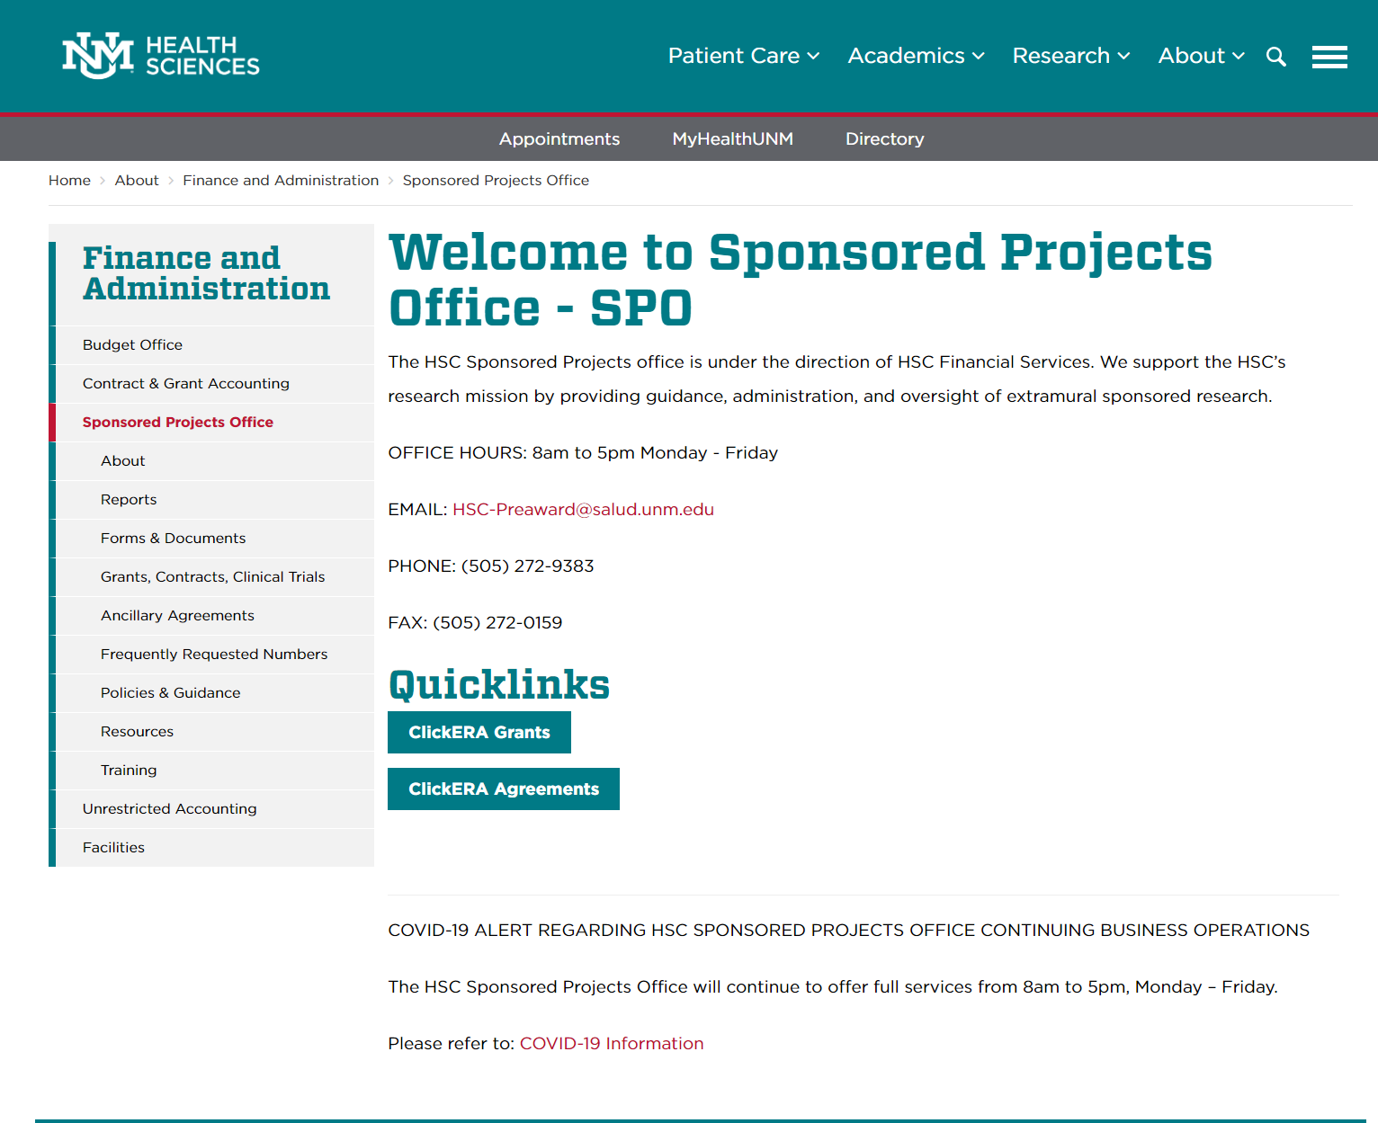
Logging In
You can reach the CLICK site from the SPO/PreAward website: https://hsc.unm.edu/about/finance/sponsored-projects/
Select “ClickERA Grants”
Notes:
https://unmstage2.huronclick.com/GrantsCOIStage/Rooms/DisplayPages/LayoutInitial?Container=com.webridge.entity.Entity%5BOID%5B4527089A7AFBB84FBF74778B245DDA58%5D%5D&_webrlogoff=true

Slide 7
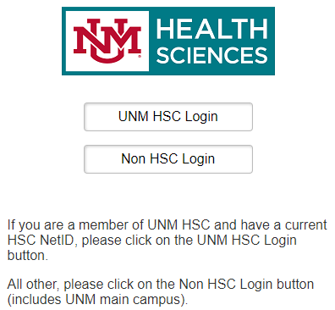
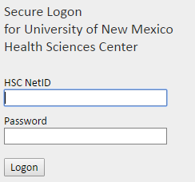
Logging In
Enter your User Name and Password here:
This login screen can also be reached directly at: https://era.health.unm.edu/GrantsCOI/
If you have problems logging in, please contact the administrator below:
Sean Gonzales, SGonzales@salud.unm.edu, 505-272-3495
Notes:
Eventually your username and password WILL be tied to your HSC account; for now, you will have to manually set your Click password.

Slide 8
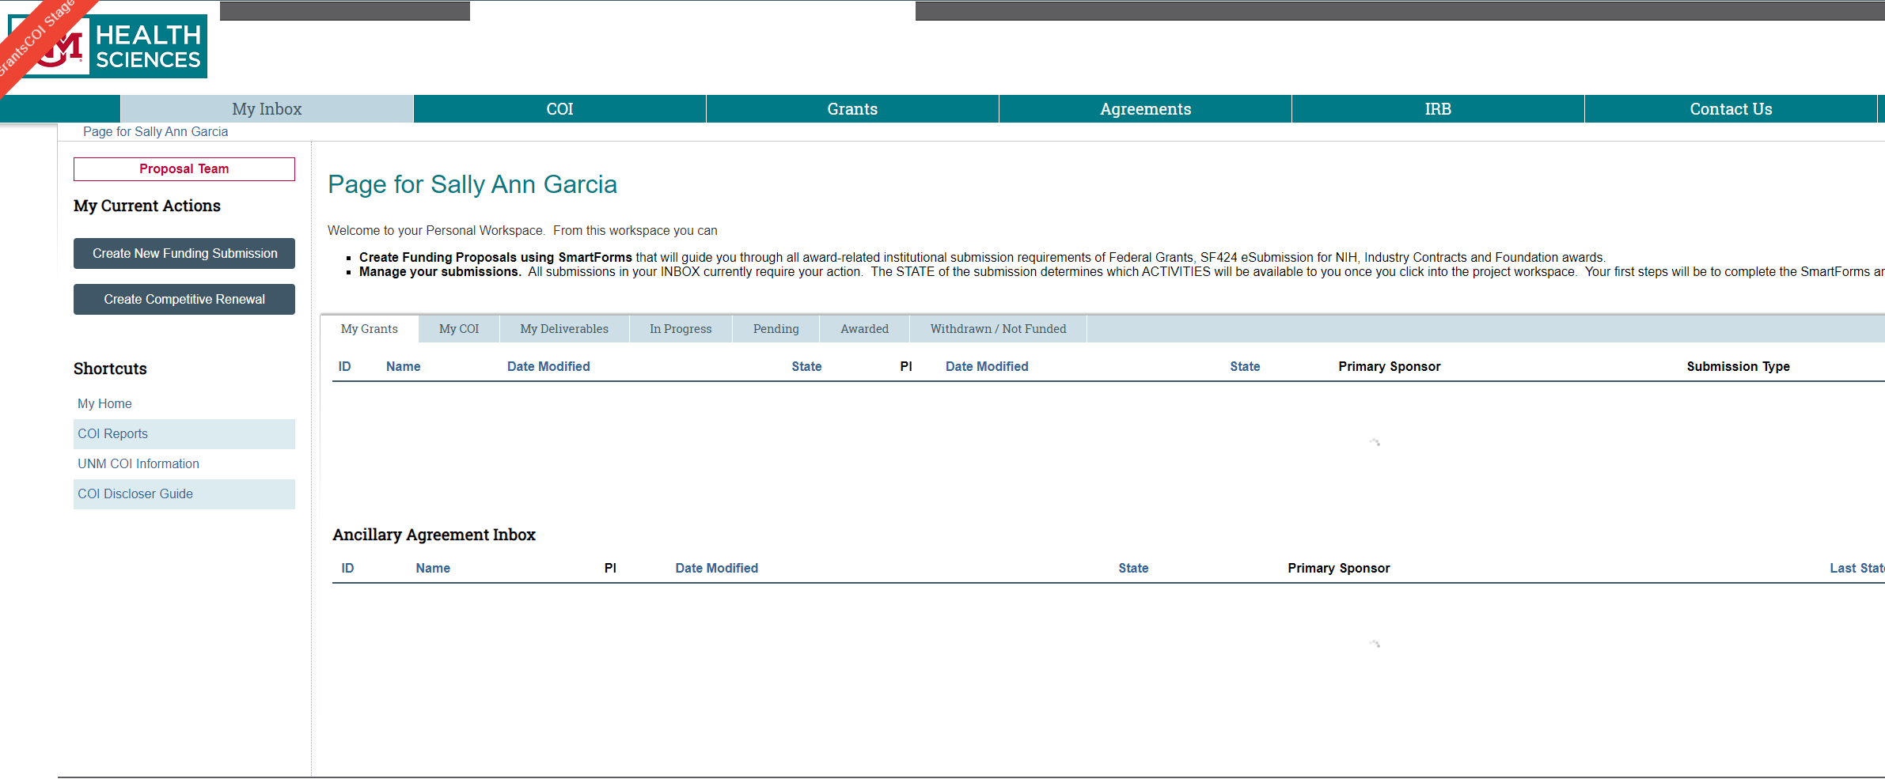
Navigating the Workspace
After logging in, users will be directed to their Inbox in the CLICK workspace. This workspace will show a snapshot of the user’s most recent projects.

Slide 9
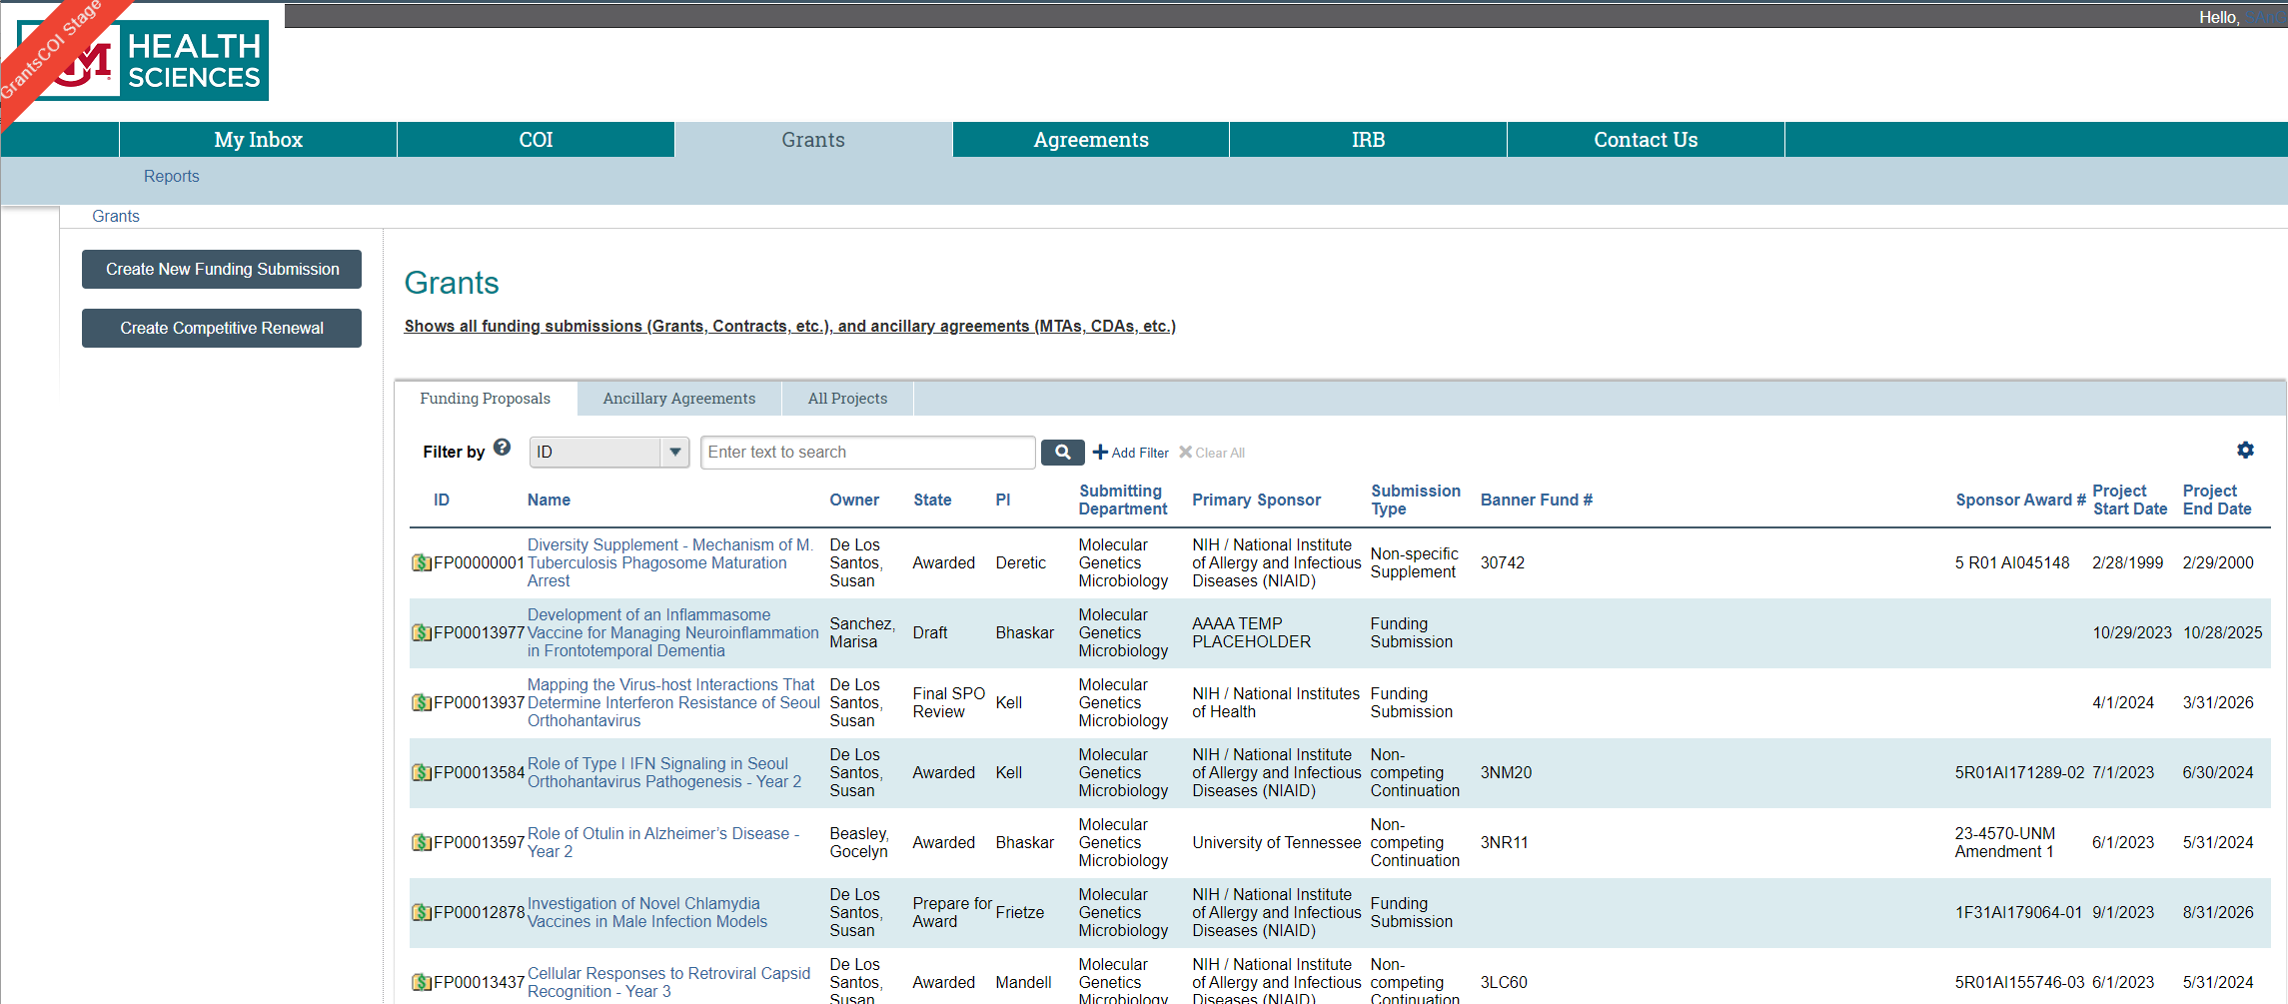
Navigating the Workspace
The Grants tab is where funding submissions can be searched for and created:

Slide 10
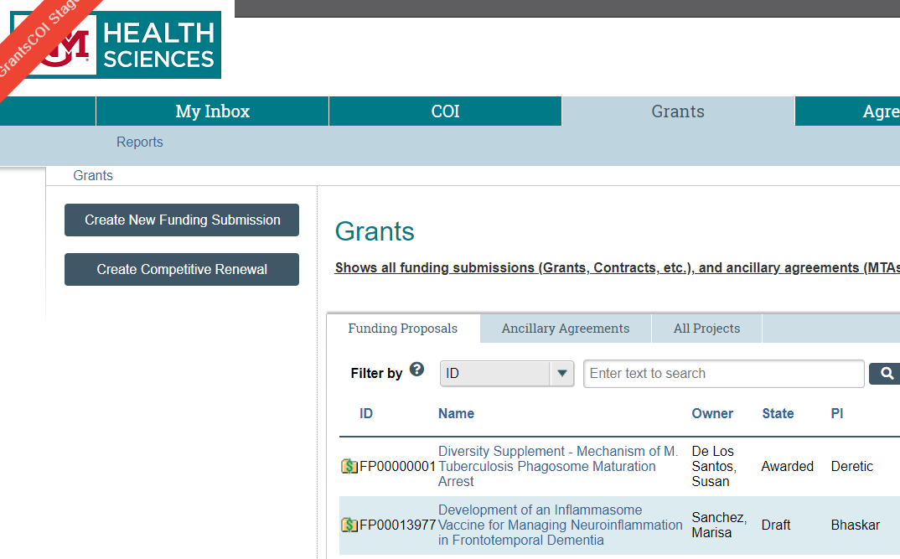
Navigating the Workspace
To search for an existing record, use the search box to filter results. Choose to search Funding Proposals, Ancillary Agreements, or both.
Choose the drop down list to see your searchable fields
Choose the drop down list to see your searchable fields
Click on “Advanced” to add additional search fields. You can then add rows to the Advanced Search until you have all the desired search fields.
“%” indicates a wildcard
Notes:
You can have up to 12 filters

Slide 11
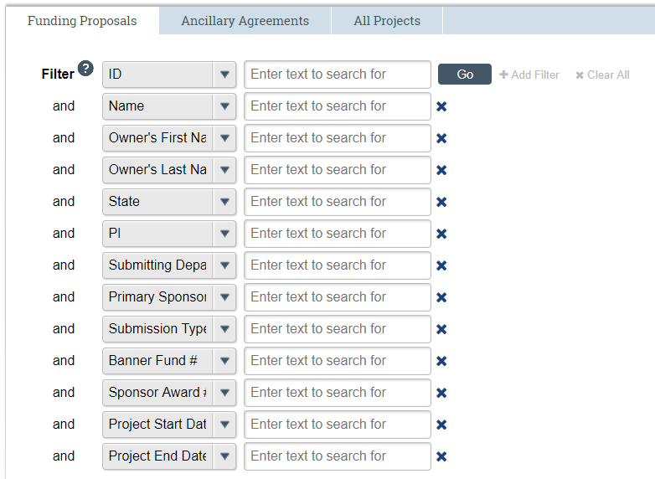
Navigating the Workspace
Having trouble finding your record? Modify the search by adding or removing additional fields.

Slide 12
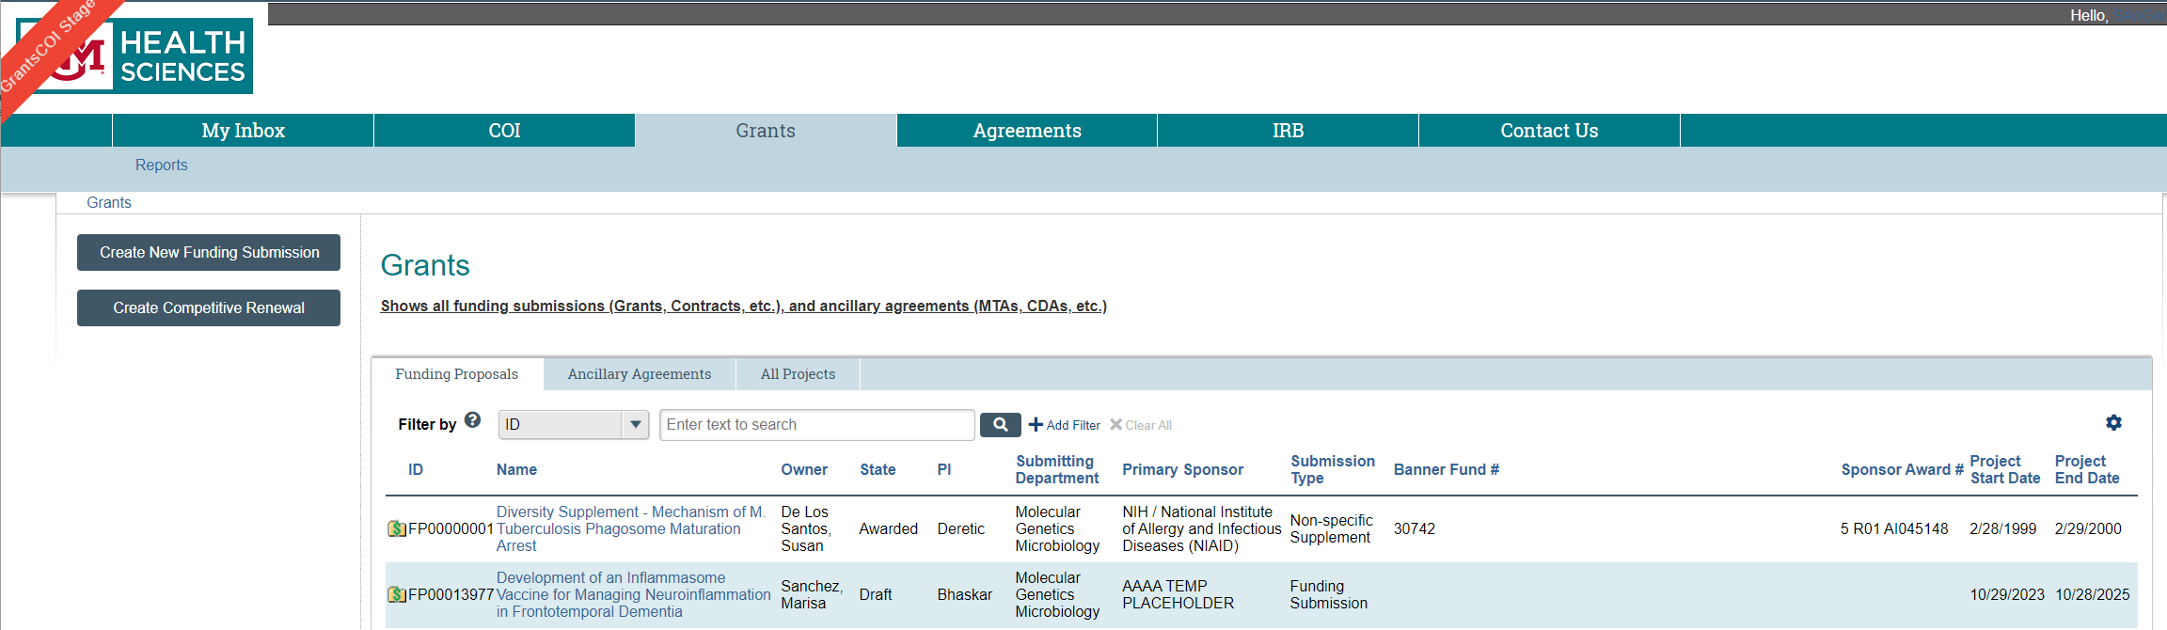

Creating a New Funding Submission
From the Grants tab, select “New Funding Submission”
Only select “New Funding Submission” if this is a brand new project that does not have existing history.
DO NOT select “New Funding Submission” if your project is a:
Non-competing Continuation
Supplement
Competitive Renewal (an application for a new cycle of funding, e.g., years 6-10 on an NIH R01)
Ancillary Agreement (Material Transfer Agreement, Confidentiality Agreement, Data Use Agreement, etc.)
Once you’ve selected the type of submission to create, it cannot be changed. An entirely new record must be completed.
Notes:
OCCS negotiated agreements are ALWAYS New Funding Submissions because of the way they are set up and tracked in Post Award

Slide 13
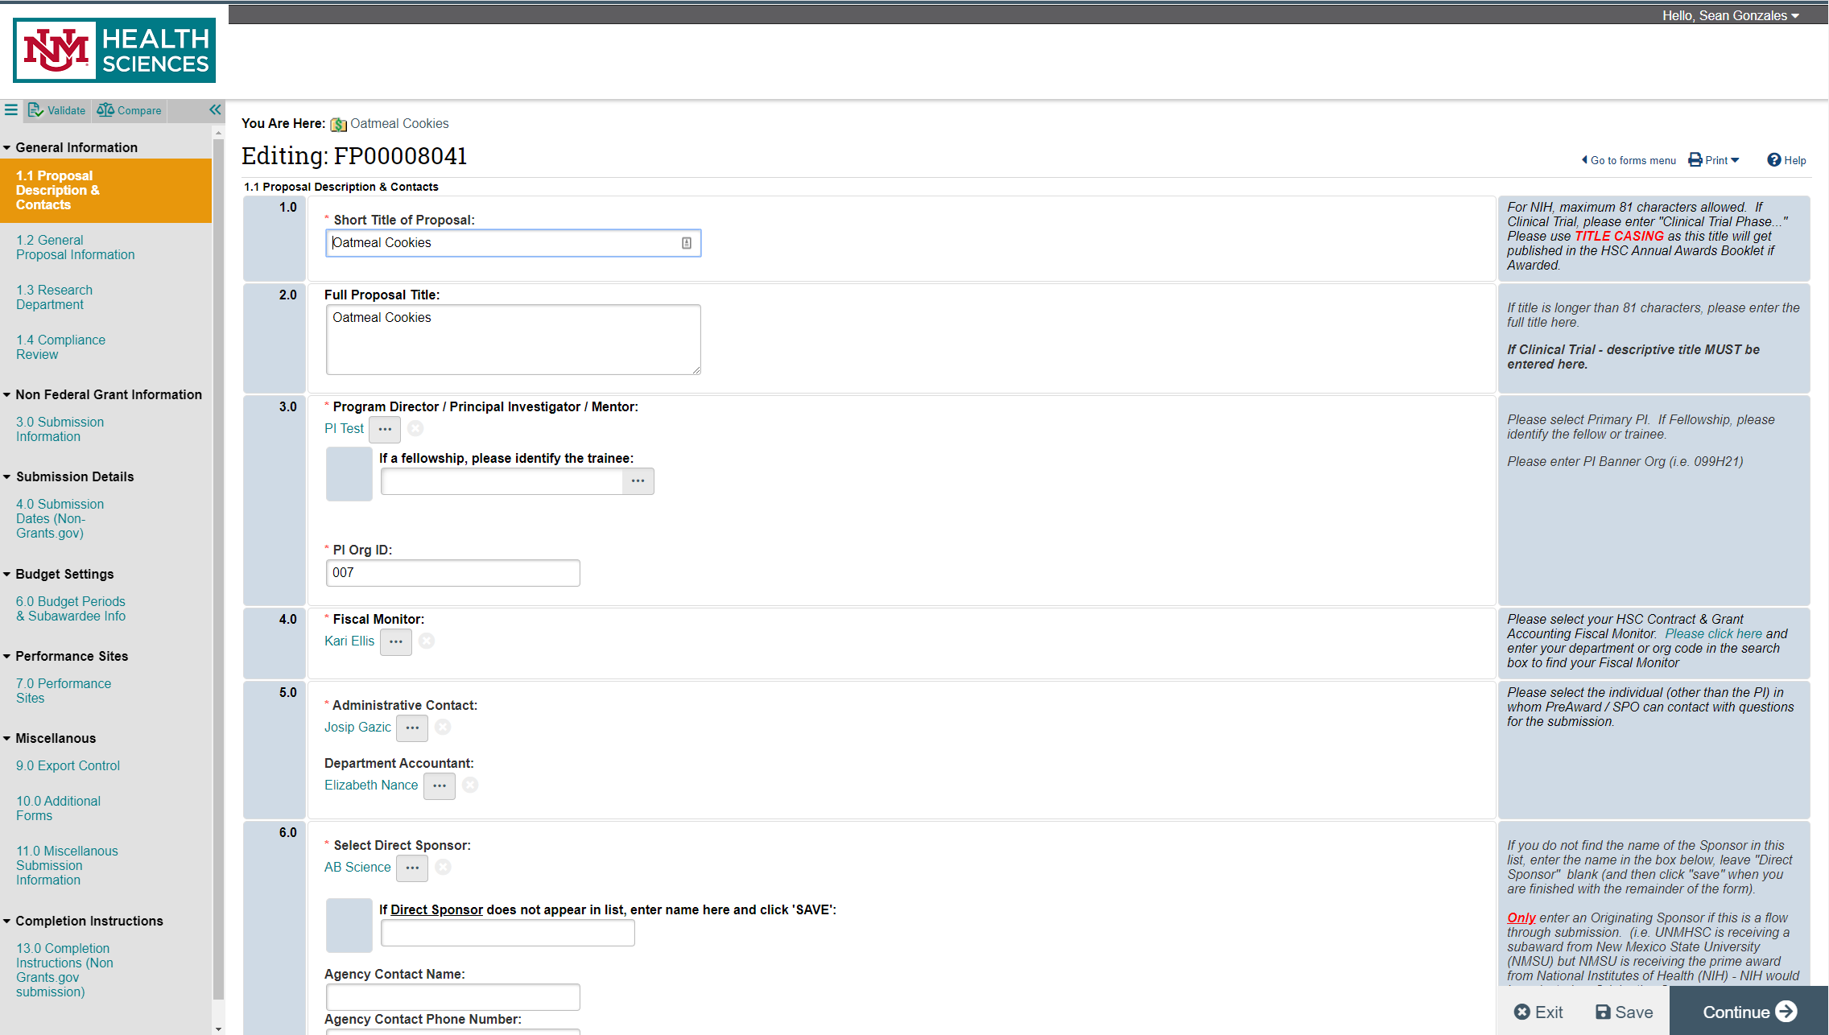
Creating a New Funding Submission
Clicking on “Create a New Funding Submission” will generate a new funding proposal record and display this first page of the smart form:
1.1 Proposal Description & Contacts
You can use the validation tool to make sure all mandatory fields are filled
Mandatory fields are marked with a Red Asterisk
You can use the compare tool to see all previous versions to the forms (tracking changes).
You can Navigate all smartforms using the navigation bar to the left
Need quick help answering a question?
Look at the side bar!
Notes:
Move to next screen, then expound

Slide 14
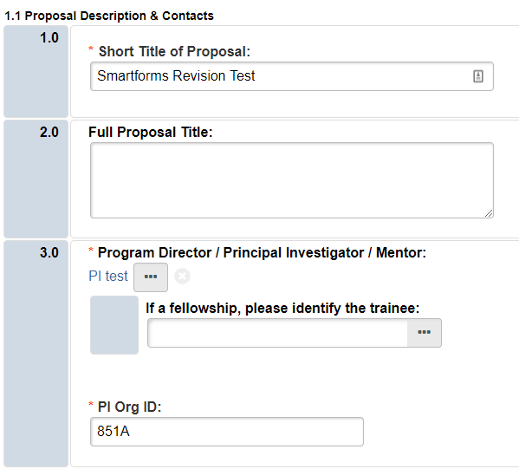
Creating a New Funding Submission

Slide 15
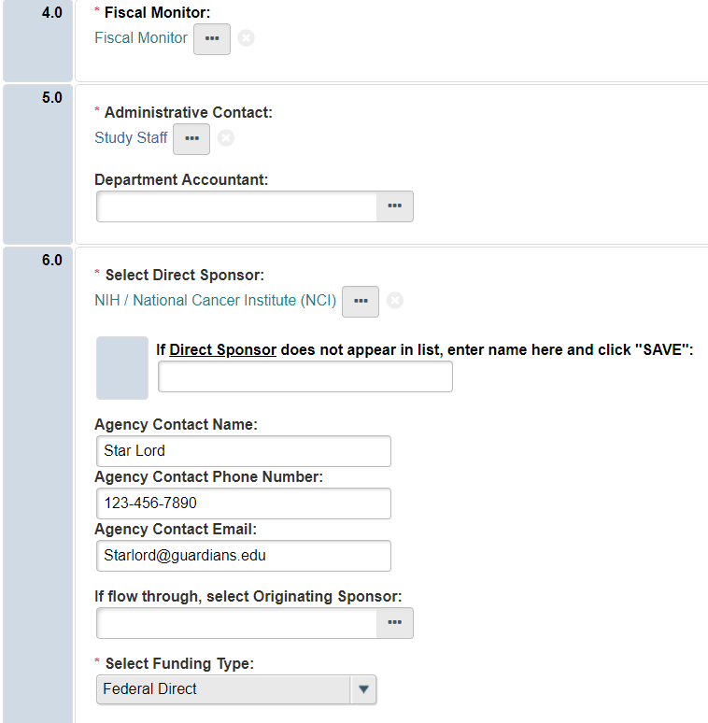
Creating a New Funding Submission
If you cannot find the sponsor you need, simply enter their information here and click “SAVE”. An email will be sent to SPO/Pre-Award to update the system.
Notes:
Can only have one Admin contract
Show how to search Sponsor database with wildcards
You may have to search for a sponsor several different ways
If funding is starting out from a sponsor other than our direct sponsor (IE, subawards) be sure to select Originating Sponsor
How to decide Funding Type? Is it federal money? From another university? Non-profit? Pharma?
Check out the user guide, contact SPO with questions

Slide 16
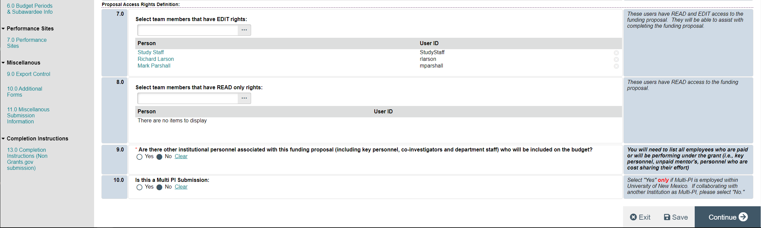
Creating a New Funding Submission
Be sure to give “Edit” rights to everyone who will be working on the proposal. This is especially important if the person is not in your department. If the person is not in your department, but need to see the record, then this is the only way to allow access.
Click “Save” first, and then click “Continue”.
Notes:
Team members must have training + login + role in order to have EDIT or READ only rights.
COI personnel These also need to match the personnel listed on the project’s IRB submission.

Slide 17
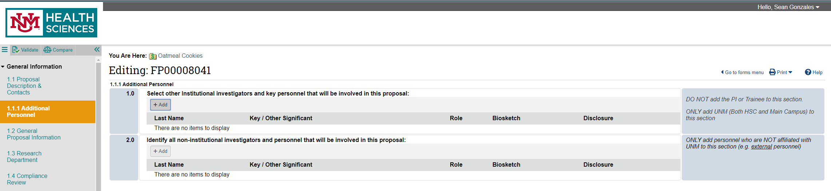

Generating COI’s
UNM HSC Employees are entered here
Non-UNM personnel and Main Campus Personnel (if they do not have an HSC ID) are entered here. These include all sub-award personnel and consultants.
Add ALL personnel, both UNM and non-UNM, except the PI.
Everyone’s a Lobo, except when you’re not! Be careful to separate UNM and non-UNM personnel.

Slide 18
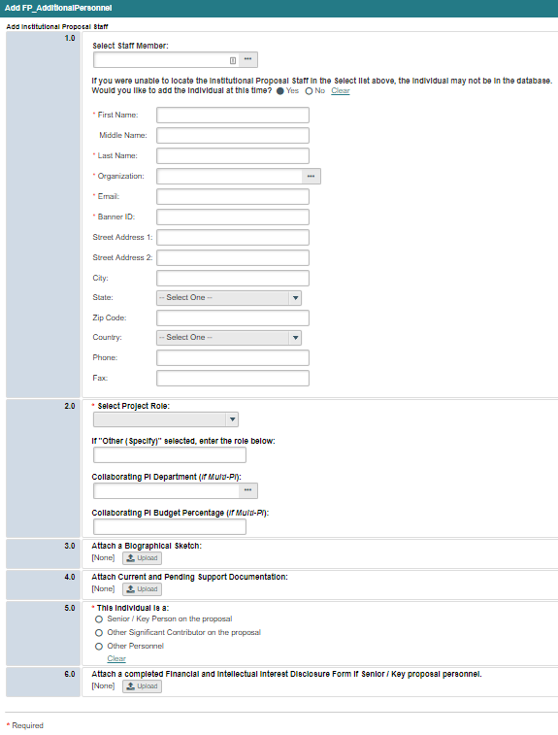
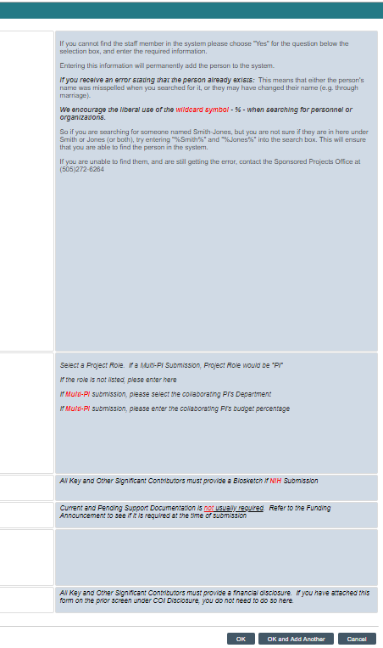

Creating a New Funding Submission
Adding Institutional Staff- AKA, UNM personnel
Search for staff members by name. If you are unable to find your staff member, select “Yes” and these fields will appear for you to enter the staff member information.
Notes:
NOTE: Adding a staff member here adds them to the database but DOES NOT give them an account or role

Slide 19
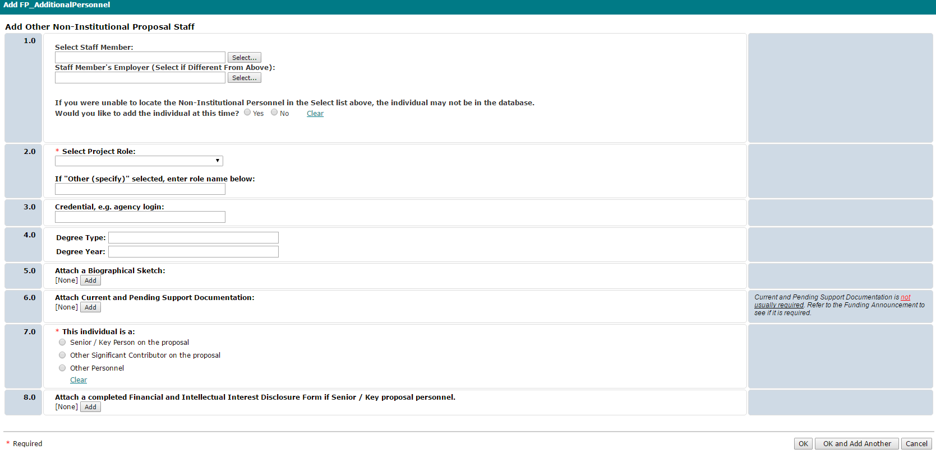


Creating a New Funding Submission
Adding Non-Institutional Staff- Subawardees, Consultants, etc.
Search for Non-UNM Personnel by name. If you are unable to find your “Other” staff, select “Yes” and fields will appear for you to enter information.

Slide 20
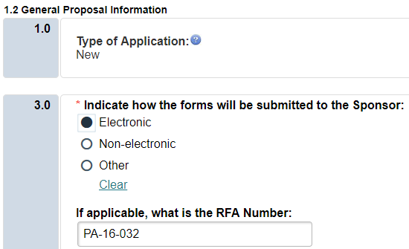
Creating a New Funding Submission

Slide 21
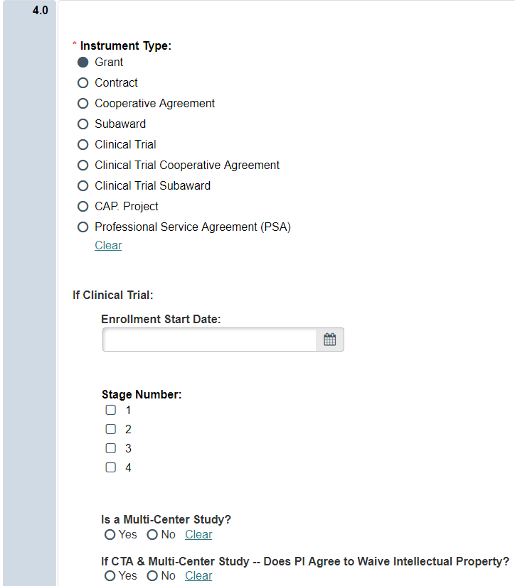
Creating a New Funding Submission

Slide 22
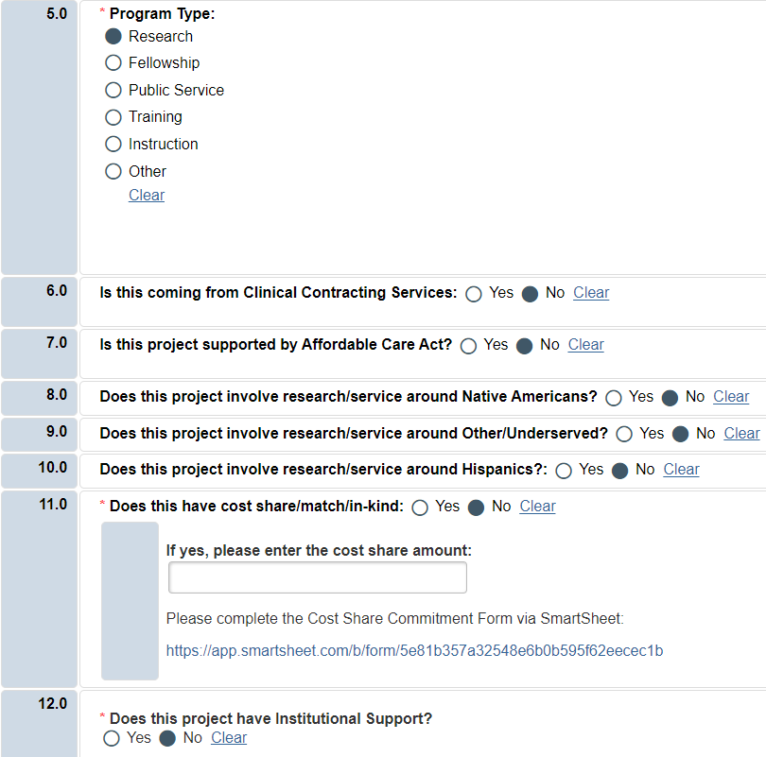
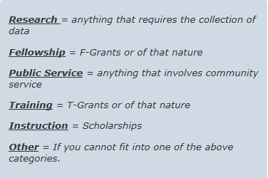

Creating a New Funding Submission
Use the definitions in the side bar to determine Program Type. If you have questions, please feel free to contact SPO/Pre-Award for clarification.
If the proposal has cost share, then please complete the costshare commitment form by following this link.

Slide 23
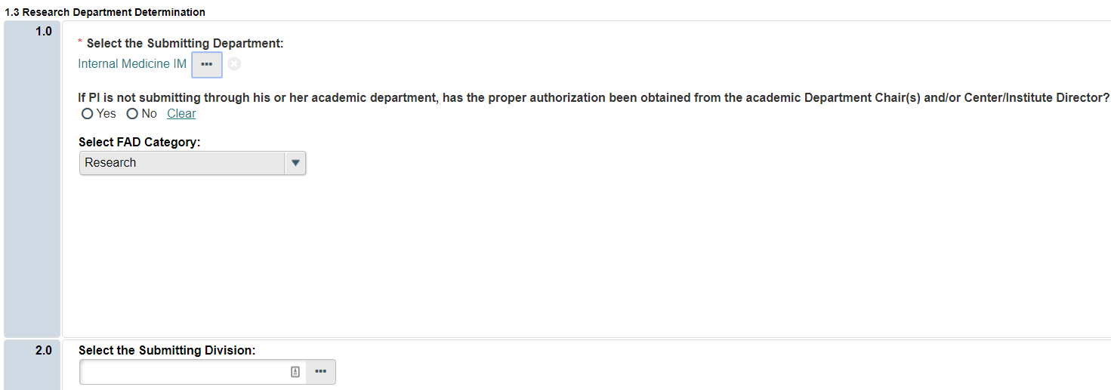
Creating a New Funding Submission
The Submitting Department will auto-populate based on the PI’s Click record; however it can be updated by clicking “Select…” if necessary.
Notes:
If submitting through a Center/Institute, you’ll need an MOU or other appropriate documentation.
This isn’t uploaded in the Click record but needs to be maintained by your department.

Slide 24
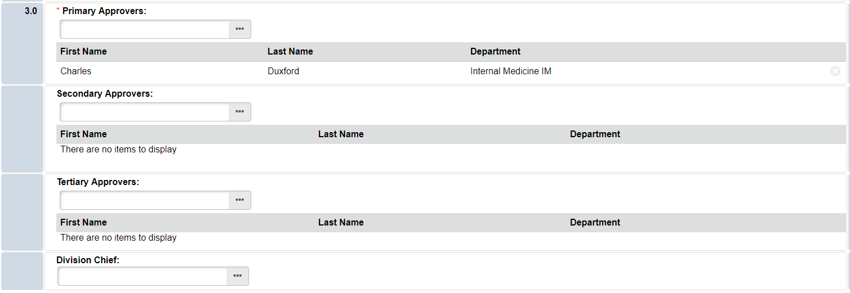

Creating a New Funding Submission
3rd
The approval function allows for departments to select individuals who will review and approve each funding submission. The number of approvers is at the discretion of individual departments and only a primary approver is required.
2st
1st
Please note! If you enter Secondary and Tertiary Approvers, the proposal will have to route through ALL queues before being sent to SPO/Pre-Award for review. This is also the case if you enter multiple “Primary Approvers”- everyone must approve before it is sent to SPO.

Slide 25
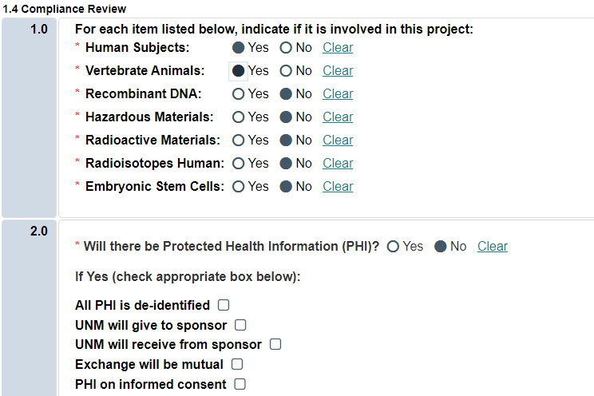
Creating a New Funding Submission
Human Subjects Research and Laboratory Animal Research branching Smart Forms are created when these questions are answered “Yes”. Additional compliance information will be required on the following screens.

Slide 26
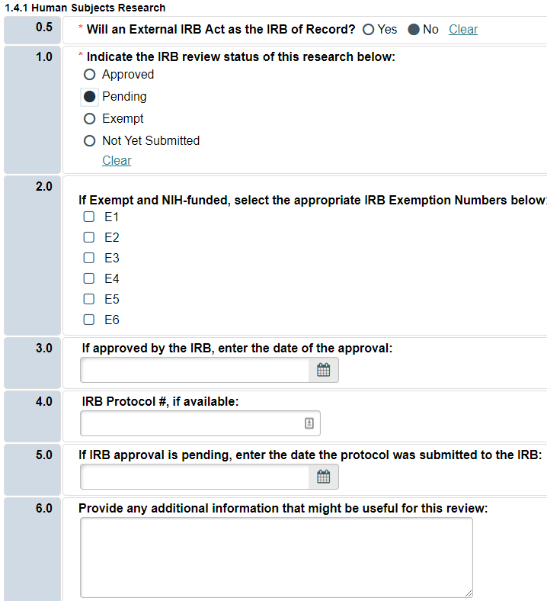
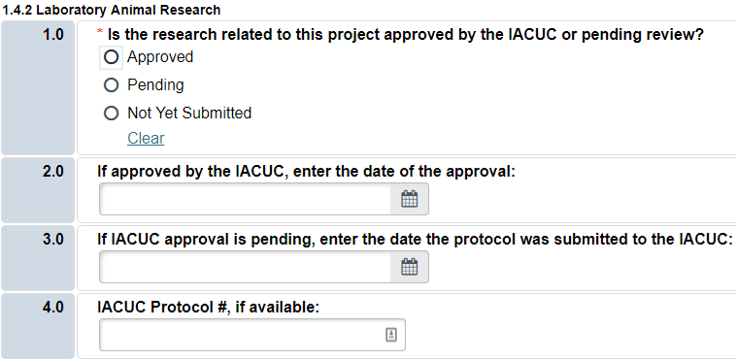
Creating a New Funding Submission
These screens can be updated throughout the proposal and review process as new information regarding protocol numbers, approval dates, etc. becomes available.

Slide 27
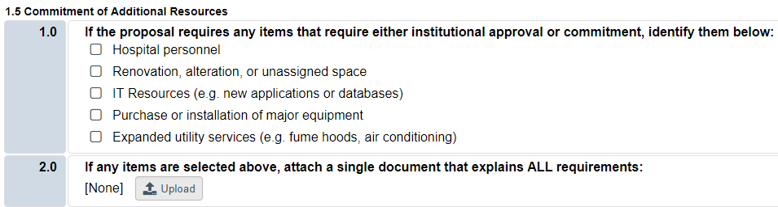
Creating a New Funding Submission

Slide 28
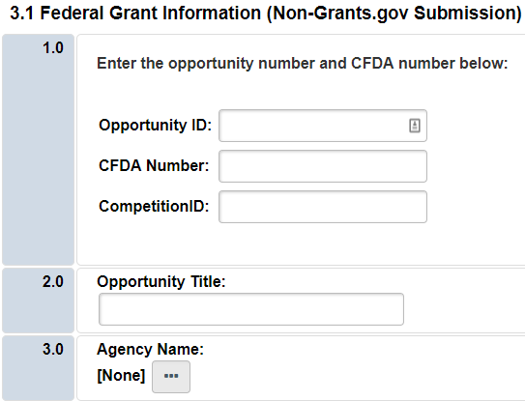
Creating a New Funding Submission
Choose the Opportunity ID if Applicable (e.g. PA-16-161)

Slide 29
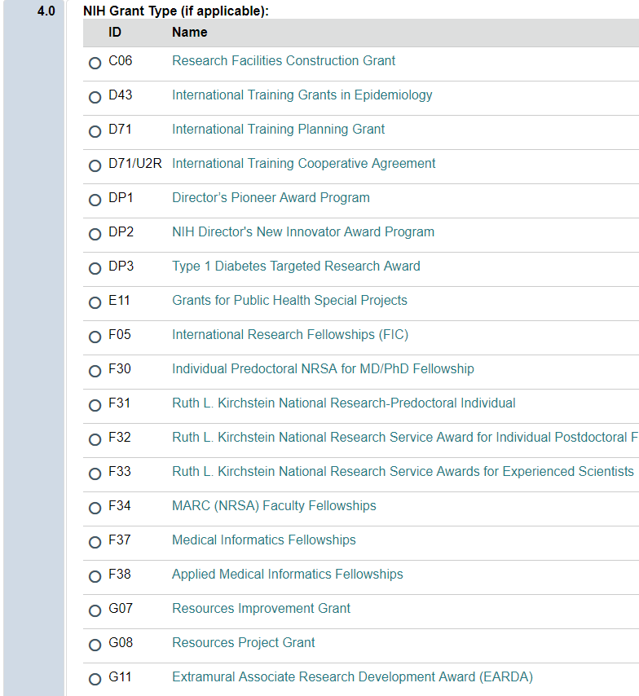
Creating a New Funding Submission
If NIH Choose the NIH Grant Type.

Slide 30
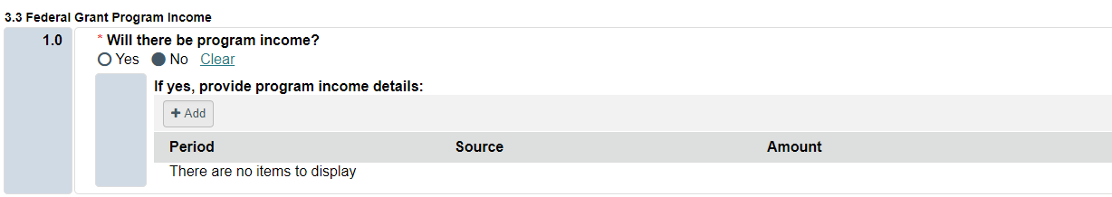
Creating a New Funding Submission

Slide 31
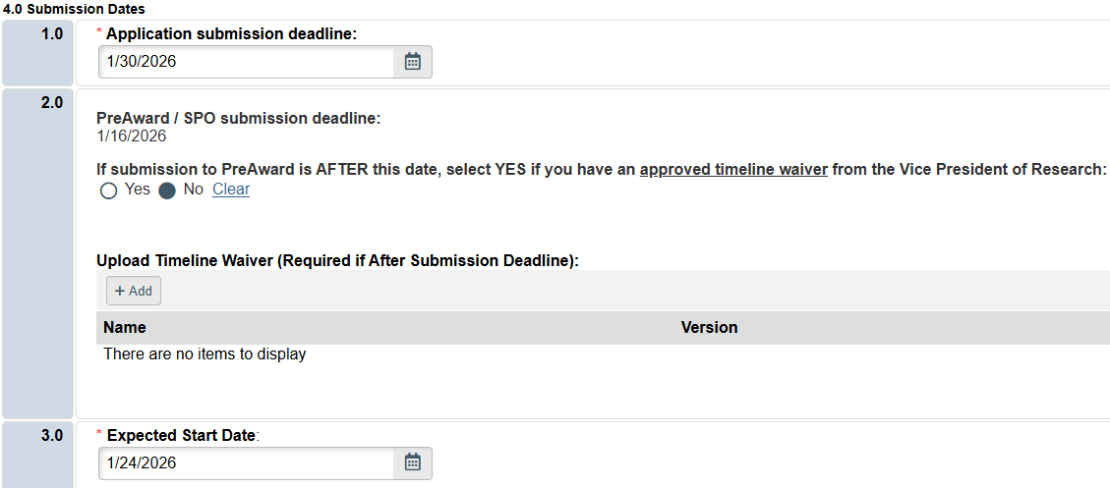
Creating a New Funding Submission
Click requires that the “Application Submission Deadline” be BEFORE the “Expected Start Date”
If you are submitting your proposal to Pre-Award AFTER the standard due dates (10 business days prior on NIH proposals, 5 business days prior on non-NIH proposals) the system will require you to upload a timeline waiver from Dr. Larson.
Notes:
There are instances where there is no firm application submission deadline, or the expected start date has already past. This is fine; just enter a “submission” date that is before the start date.

Slide 32
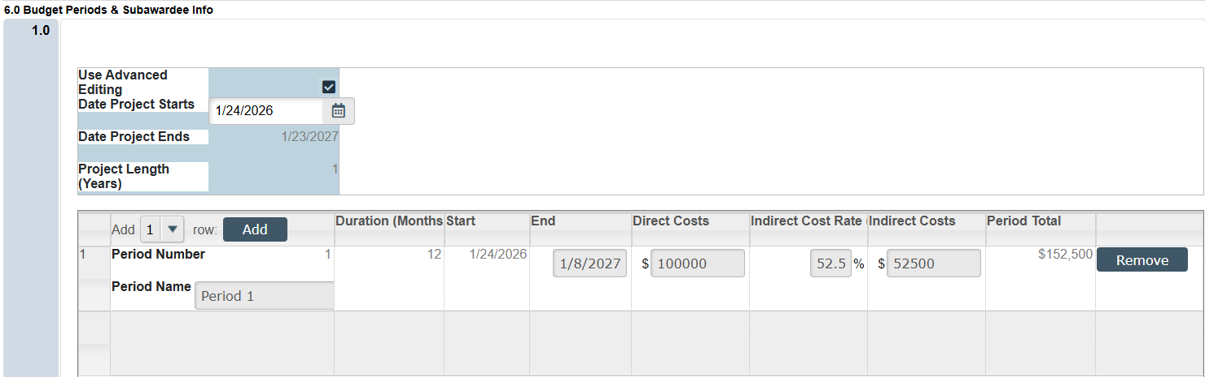
Creating a New Funding Submission
Be sure to check the sidebar for instructions regarding how many budget periods to include
To begin entering budget information you MUST click in the shaded area in the “Use Advanced Editing“ section, and THEN click the checkbox
Indirect costs will NOT auto-calculate and must be manually entered.
Period Total will auto-calculate.
If your totals are not calculating, click “save” for an updated screen.
Rows can be added by selecting the number of additional rows and clicking “Add”
Be sure to verify the start and end dates for each period. If you have a budget period that is longer than 12 months, you must add another period.

Slide 33
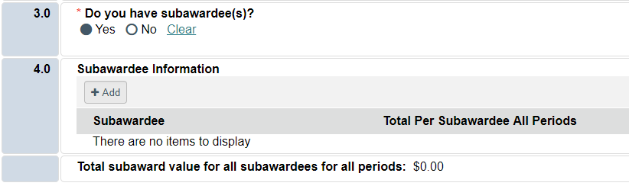
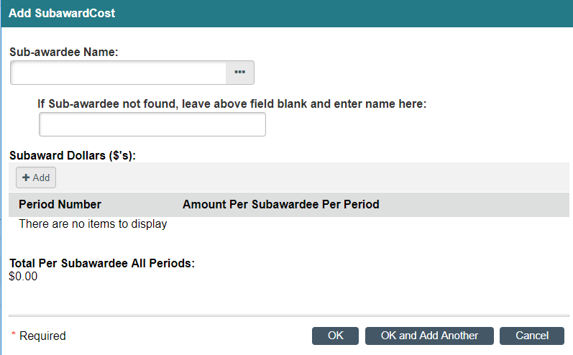
Creating a New Funding Submission
If you have sub-awardees, additional information should be included on the budget page.
Select “Add”
Begin typing your sub-awardee name and select
If it does not appear, type it in the blank field.
Select “Add” to input budget information.
Add more sub-awardees using “OK and Add Another”
Once finished, select “OK”

Slide 34
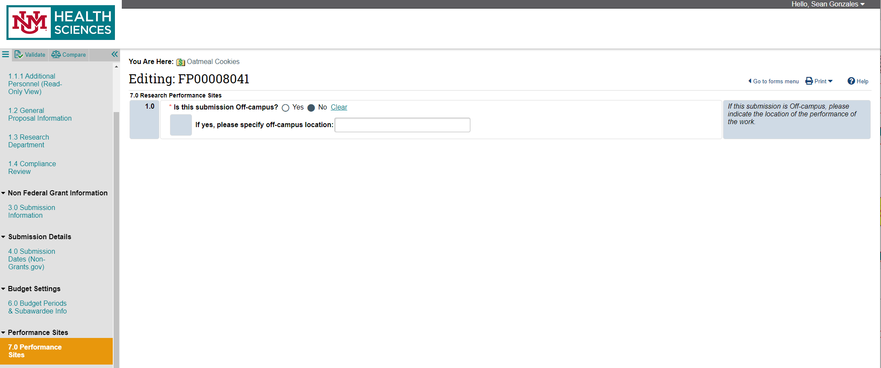
Creating a New Funding Submission
If you are using the Off-Campus F&A rate, you MUST specify the off-campus location.

Slide 35
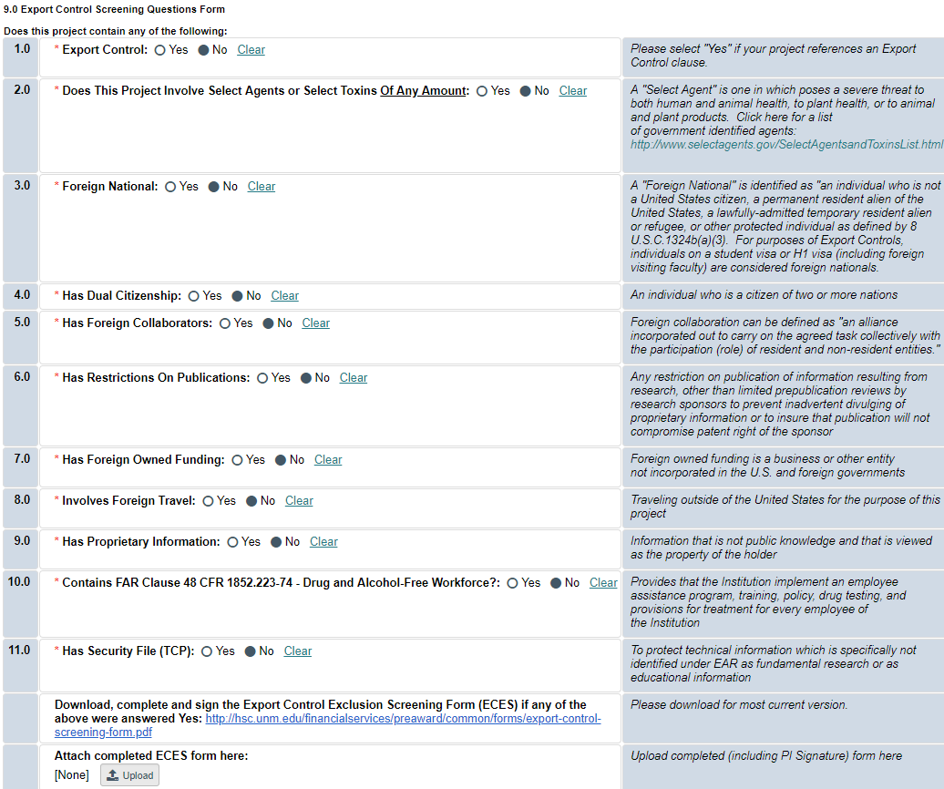
Creating a New Funding Submission
If any of the Export Control Screening questions are answered “Yes”, upload the completed and signed Export Control Screening Exclusion form. The completed form can be uploaded here by clicking “Add”. You can access the latest version of the form by clicking on the link and downloading it from the SPO/PreAward website.

Slide 36
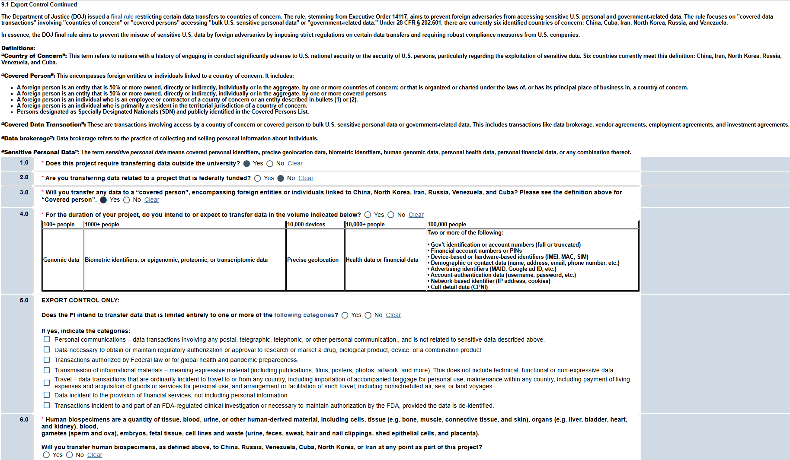
Creating a New Funding Submission

Slide 37
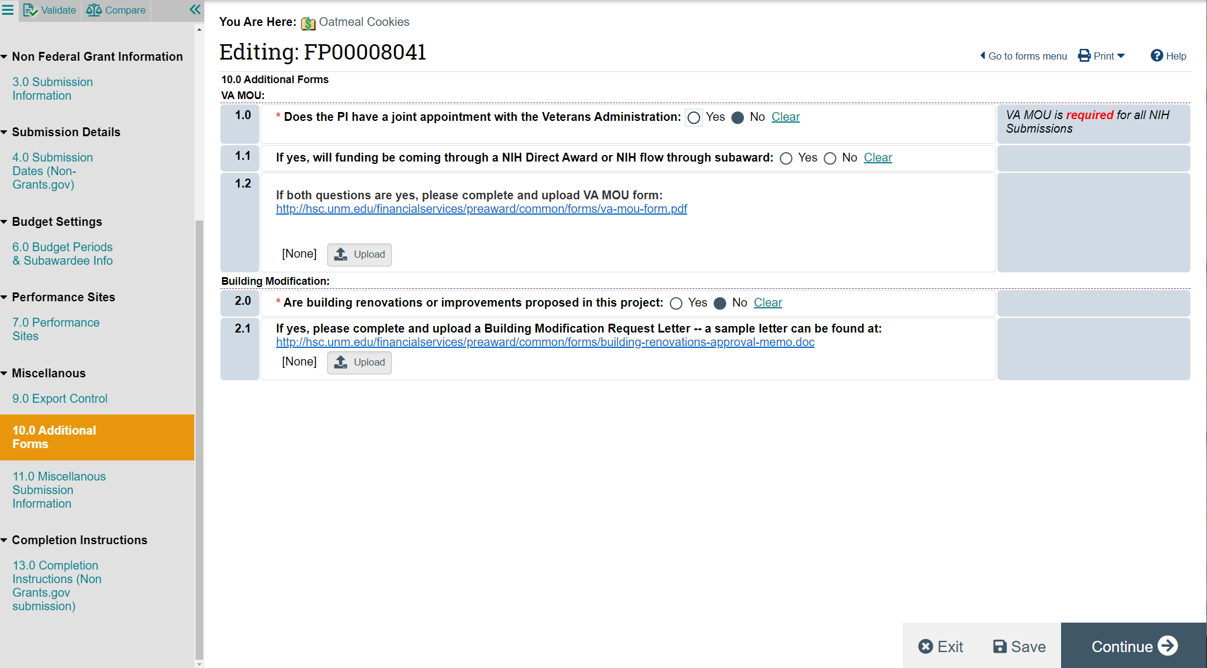
Creating a New Funding Submission

Slide 38
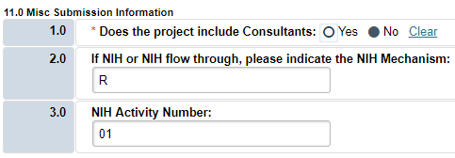
Creating a New Funding Submission
If you are unsure whether or not your proposal includes Consultants, please refer to the SPO/Pre-Award website for additional information (http://hsc.unm.edu/financialservices/preaward/contracts-grants/sub-awards/index.html) or contact your SPO/Pre-Award officer for clarification.
If your Direct or Originating Sponsor is NIH, 2.0 and 3.0 are required.
Notes:
Show error if sponsor is NIH but no mechanism is chosen

Slide 39
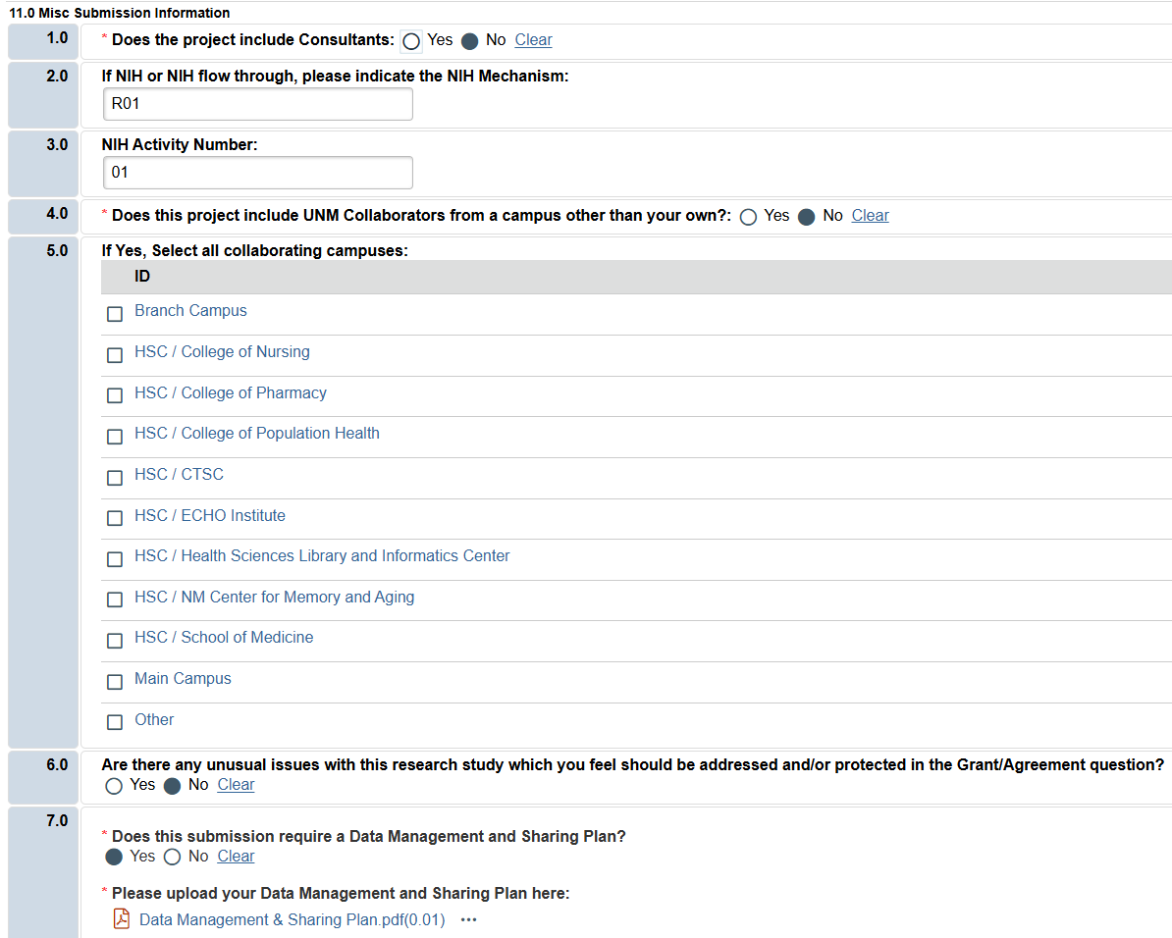
Creating a New Funding Submission
If your proposal includes HSC colleges other than your own or main campus activities, be sure to include all campuses here.

Slide 40
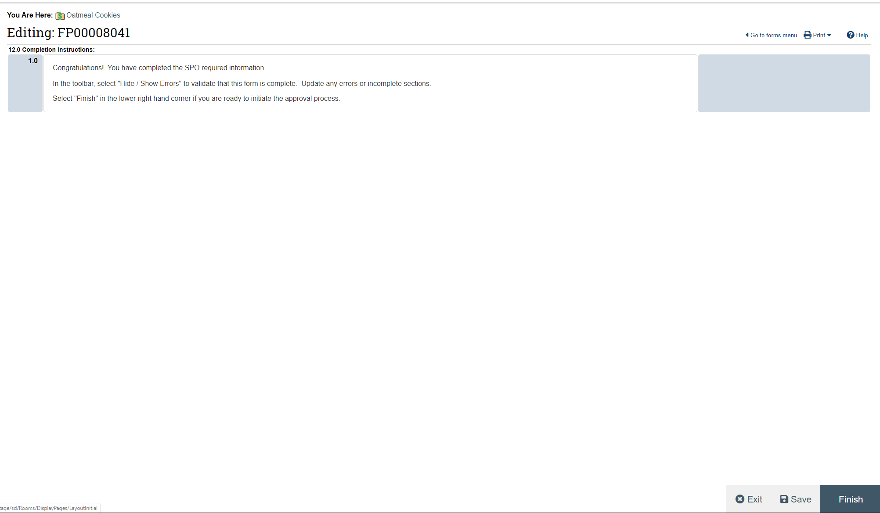

Creating a New Funding Submission
Hooray! You’ve completed the Smart Forms. Don’t forget to click “Finish” as the final step!

Slide 41
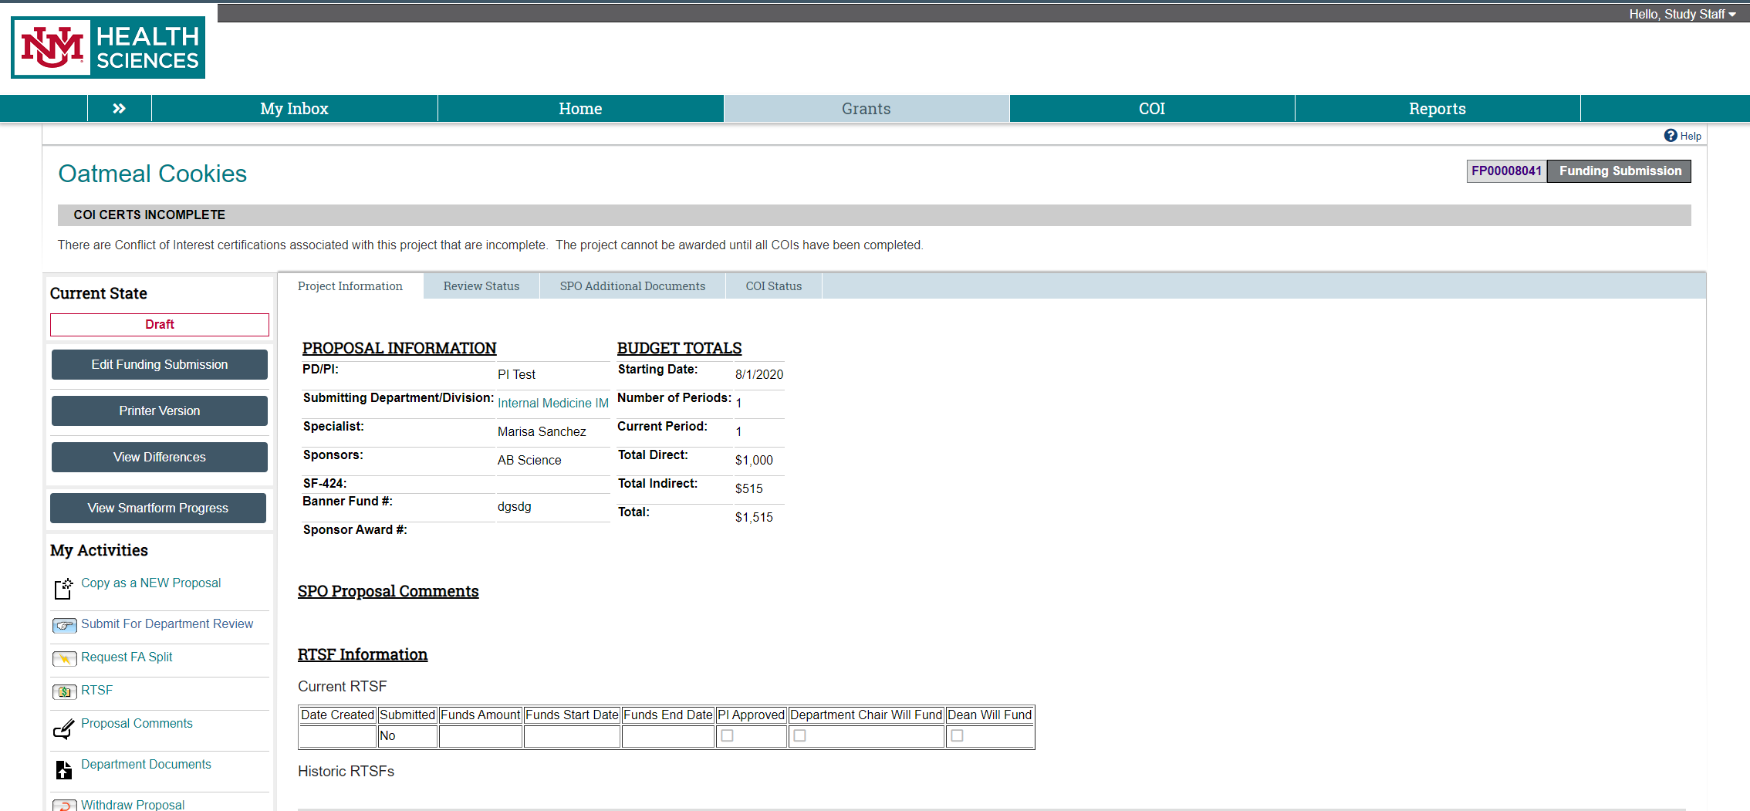
Draft State
Please be sure to use the proposal comments activity to add the ASSIST or Grants.gov record number. You can also use this to add any other proposal inforantion that may have not been covered in the smartforms.

Slide 42
Draft State
After completing the Smart Forms, you will be taken to the Proposal Workspace. Notice that the current state is “Draft”
For a quick way to review your proposal, check out the “Printer Version”
Upload your application materials with the “Department Documents” activity. Anything uploaded into the confidential tab will not be viewable after you click “ok”!!!

Slide 43
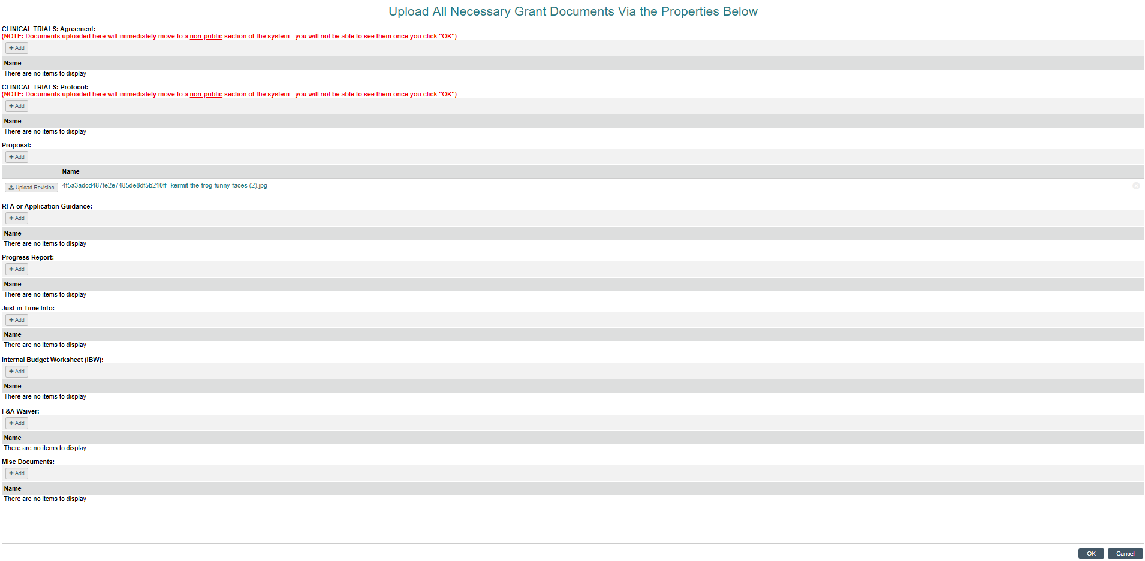
Draft State
*Documents Checklist For Submission:
RFA or Application Guidance – This goes under the “RFA or Application Guidance” upload area.
The Proposal should be into a submission portal and that should be noted in the proposal comments (as outlined in the previous slide). If the proposal is not available to SPO for a specific submission portal or it is being turned in via email, then the proposal is required as an upload here for SPO to review BEFORE it is submitted to the sponsor under the “Proposal” upload space. If this is a contract, then the incoming contract can be uploaded into this space.
IBW – The internal budget worksheet or an equivalent is required for submission to the sponsor in order for SPO to check the accuracy of your submission’s budget.
If the F&A rate does not follow the standard rate and the Sponsor has the lowered F&A rate outlined on their website or RFA, then an F&A waiver is to be filled out from the Department Dashboard that is linked to on our SPO website
Any LOI, Subaward LOI’s, Subaward forms, SOWs, subaward SOWs, Subaward budget justifications/budgets…etc need to be uploaded to the “MISC Documents” BEFORE submission.
If you get a Just in time request, then be sure to upload Just in time info into the “Just in Time” document upload.
If this is a Non-Competing Continuation (NCC), then be sure to upload the Progress report information into the “Progress Report” upload area.
If this is a clinical trial, then be sure to upload the clinical trial agreement and the clinical trial protocol into the first 2 upload areas respectively. These documents go to a non-public upload area and will not be readily available for view by anyone but SPO.
Upload your application materials in the appropriate section and click “OK”

Slide 44
Draft State
When your application is finalized, select the “Submit for Department Review” Activity

Slide 45
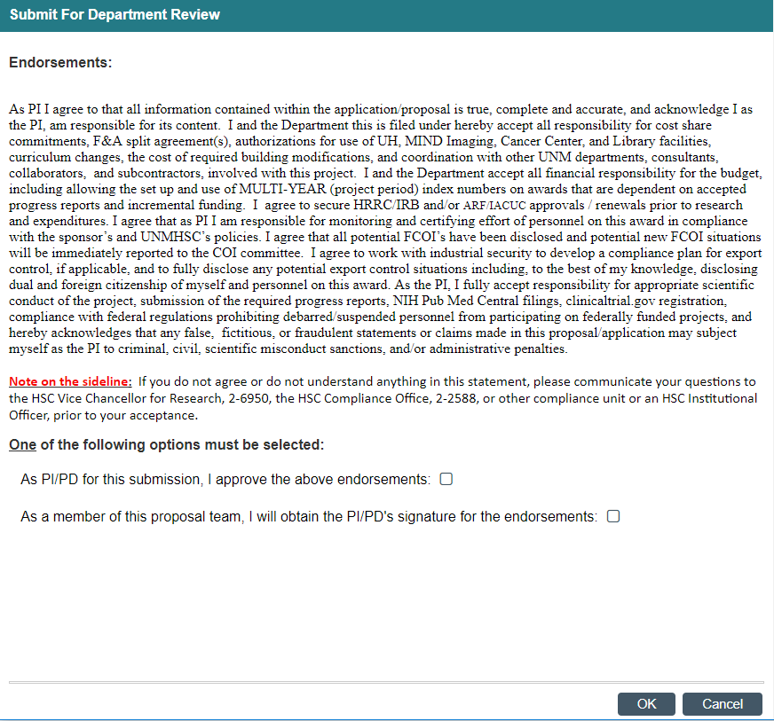
Submit for Department Review
When the PI is ready to Submit to Department for approval, PI or Study Staff will be required to agree to endorsements regarding the validity of the proposal. This is similar to what the PI agrees to when signing the Proposal Data Sheet.
Select “PI” or “Proposal Team” and then click the “OK” button

Slide 46
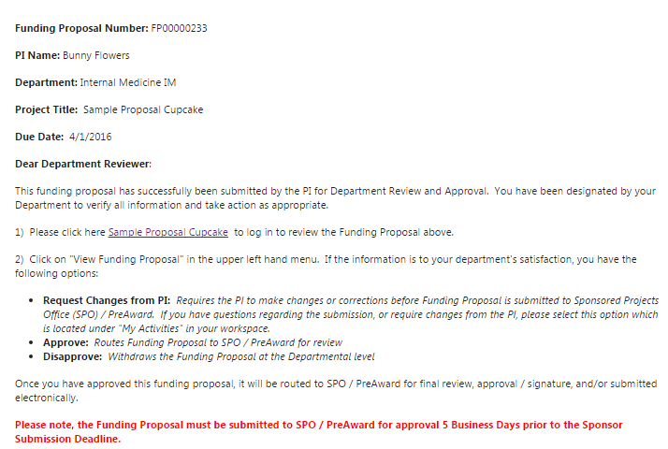
Notification to Department Approvers
Click on the link to be taken to the proposal pending for review and approval. The Department Approver may also log into Click, and search by the FP#.
After the PI/Study Staff route the proposal for Department Review, the designated Department Approver will receive this email notification

Slide 47
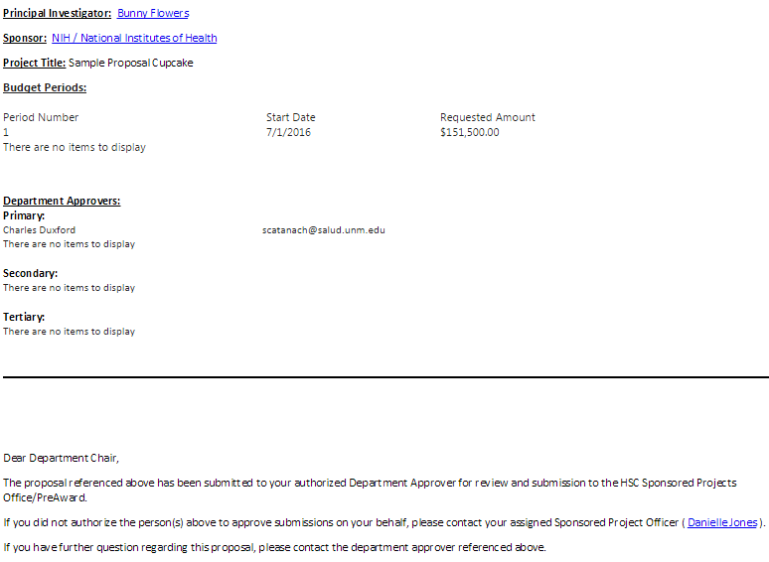
Notification to Department Chair
If the Department Chair is not the Primary Approver, s/he will also receive a notification email when the proposal is submitted for Department Review.
This email is for FYI purposes only.

Slide 48
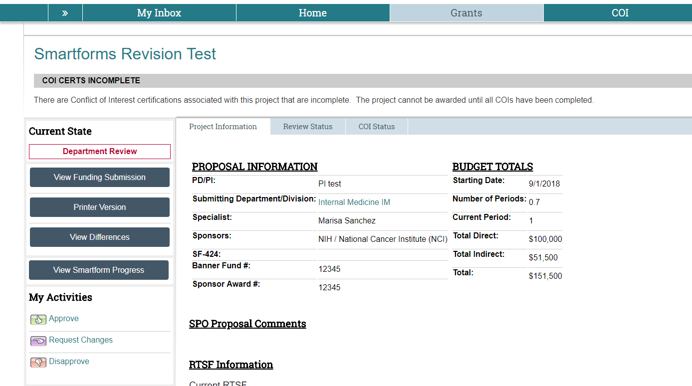
Department Approver
The Department Approver can view the Funding Proposal/Smart Forms here

Slide 49
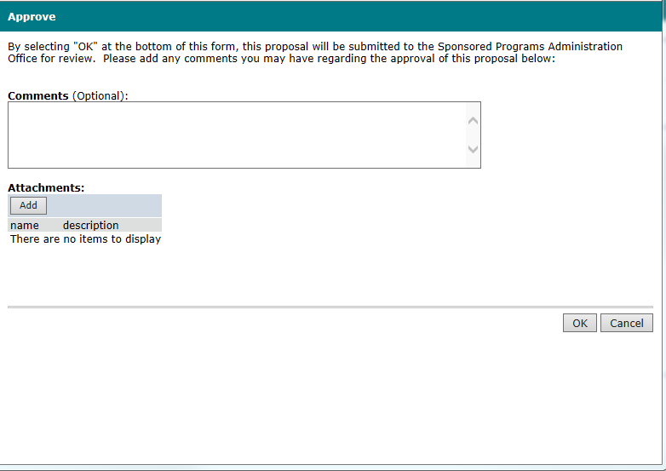
Department Approver
At this point the Department Approver is Approving the record. Essentially they are verifying that the information is correct.
If there are multiple approvers, then they will all need to approve.
The comment box is for the approver to make any necessary notes for SPO to see.
Once approved it is routed to SPO for review.

Slide 50
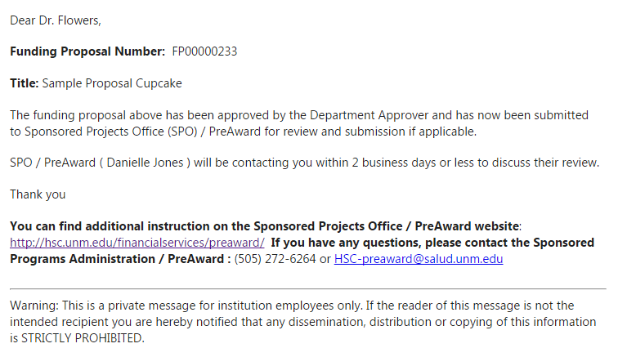
Notification to PI
Once the department approver(s) have submitted the proposal to SPO/ Pre-Award, the PI will receive this notification.

Slide 51
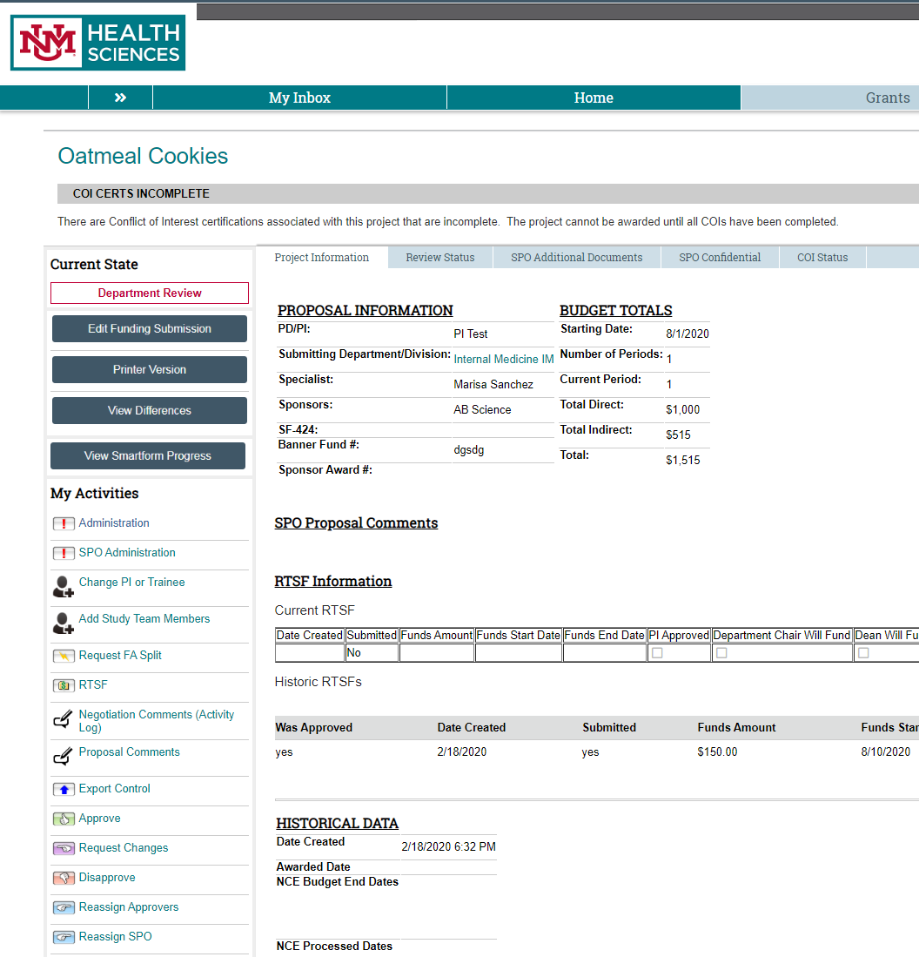
SPO Review
If SPO has changes to request, they will return the proposal back to the PI/Study staff.

Slide 52
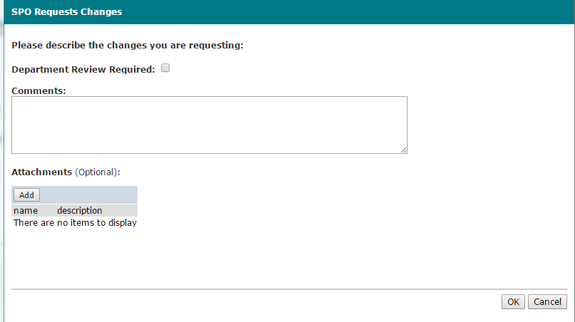
SPO Review
SPO/Pre-Award can require that the Department Reviewer approve again, but it is not mandatory.

Slide 53

SPO Review
If SPO returns the proposal for changes, the PI will receive this email.

Slide 54

SPO Review
The requested changes can be made and the proposal routed back to SPO by the “Submit Changes to SPO” button.

Slide 55
Conflict of Interest Disclosures
COIs are generated when the proposal is submitted for Department Review. All personnel working on the project- including subaward personnel, consultants and/or students- need to complete a COI
Click on the “COI Status” tab for additional information

Slide 56

Conflict of Interest Disclosures
If the “Project State” is Draft, the PI/Staff member has not yet completed their COI Disclosure.

Slide 57


Adding Personnel
You can update the project personnel at any time by clicking on “Add Study Team Members”. This will generate COI disclosures for any new team members.
To Add study personnel click the Add Study Team Members in My Activities.
A pop up should appear and you’ll choose institutional or non-institutional personnel (be sure to click OK once all personnel are added).

Slide 58

Adding Personnel
Another Pop-up will occur. Please be sure to complete the asterisked information and then click OK or OK and Add Another

Slide 59

Removing Personnel
To Remove study personnel click the Add Study Team Members in My Activities.
A pop up should appear and you’ll choose the X next to the name you want to remove and then Click OK.

Slide 60

F&A Splits
When the project is Spread across more than 1 campus(e.g. SOM, College of Nursing, etc..) a F&A split is required. This Activity initiates the F&A Split and has replaced the forms. If this includes a main campus Split, then please visit the Main campus FA split smartsheet as Main Campus FA Splits are not done through the click system anymore. https://app.smartsheet.com/b/form/8853f33c5b434590977e2449bd31c429

Slide 61

Creating a New Funding Submission
A pop-up window will appear for you to enter all of your F&A Split info:
Remember, you will enter information for ALL splits on this screen, both HSC & Main Campus

Slide 62

Creating a F&A Split
Enter your Start & End Date
We highly recommend you use the entire project period

Slide 63
Creating an F&A Split
Remember: Your justification must make it clear how the direct costs categories are going to be distributed between each school/campus
Upload your budget breakout & justification

Slide 64
Creating a F&A Split
Click on “Add Schools” to add all schools and campuses that are part of the split

Slide 65

F&A Splits
Select the appropriate school or campus from the dropdown, then enter the amount of direct costs that organization will be receiving.
NOTE: This must match what is listed in your uploaded budget justification(s).

Slide 66
F&A Splits
The system will calculate your percentages based on the breakout you’ve entered and what’s on your Smartform budget screen.
Once you’ve entered your information for all schools/campuses, you’re ready to submit!
Must match $’s in budget (direct costs)

Slide 67


Review Status of Your F&A Split
Your F&A Split request will be routed for approvals.
You will receive an email if any changes are requested, or any clarifying information is required; otherwise, you will receive a notification when your request is approved.
You can check the status of your request by going to the “Review States” tab on the main page of your FP:

Slide 68

Request To Spend Funds
The first step in starting a Request to Spend Funds is to make sure you have an open record in Click. This record must match the dates that you are requesting to spend funds in.
Unless you are processing a No-Cost Extension RTSF, you will need a record in one of the following states:
Draft
Department Review
SPO Review
Final SPO Review
Pending Sponsor Review
Prepare for Award
Award QC
If you are processing a No-Cost Extension RTSF, you will need to find your current Awarded record
Need help finding the right record?
Contact Pre-Award!

Slide 69

Request To Spend Funds
After you find your open record (or create a new record!) you will click on the “RTSF” Activity:

Slide 70

Request To Spend Funds
A pop-up screen will appear where you will enter the project
Funds Start Date: The anticipated date the funds will start
Funds End Date: The anticipated end date that you will require the stated funds
Type of Award: Indicates whether the project is a grant or type of contract
Amount Requested: The estimated amount you will require during the period stated
PI Justification: The reason for the RTSF Request – if a MSU or NCE, will indicate that here
Department Chair (or Designated First Level Approver): Enter the first level approver here. Some Departments have delegated the Chair authority to the Department Administrator – this decision will be up to your Chair. Please keep in mind, the person indicated here will need to log in and approve the RTSF after the PI Approves.
DEAN (or Designated Second Level Approver): You will enter your Dean in this section. If the Chair Approves but doesn’t have the funding, the decision will move to the next level of approval, which is the Dean. In most cases, the approval does not reach this point.
In rare cases, your Chair & Dean may be the same person.

Slide 71

Request To Spend Funds
Once you have completed the information, click “Ok”
The PI will receive this notification to log in and approve the request

Slide 72

Request To Spend Funds
After logging in, the PI will click on the “RTSF – PI Approval” Activity

Slide 73

Request To Spend Funds
A pop-up screen will appear for reviewing the project information.
If all the information looks accurate, select “Yes” and “Ok” to Approve. Once you select OK, a notification will be sent to the Department Chair/Delegated Approver to log in and review/approve the project.
If any information looks inaccurate, select “No” and “Ok” and the request will be routed back to the study staff for re-work

Slide 74

Request To Spend Funds
After you click “OK” the following notification will be sent to the Department Chair/Delegated Approver:

Slide 75

Request To Spend Funds
The Department Chair/Delegated Approver has 3 options:
To guarantee expenditure funding if the project is not received (the RTSF will be routed to Pre-Award for approval)
Approve the request, but ask the Dean to fund expenditures if project funding is not received (the RTSF will be routed for Dean approval)
Disapprove the request (the project will be withdrawn from the system and the RTSF will have to be re-initiated)

Slide 76

Request To Spend Funds
If the Department Chair/Delegated Approved chooses to route for Dean approval, the Dean will receive the following notification:

Slide 77

Request To Spend Funds
The Dean has 2 options:
To guarantee expenditure funding if the project is not received (the RTSF will be routed to Pre-Award for approval)
Disapprove the request (the project will be withdrawn from the system and the RTSF will have to be re-initiated)

Slide 78

Awards
Yay! Your Award has arrived! Now what?
Award Email notification to PI and Administrative Contact
A separate email is also send to Contract & Grant Accounting for index setup

Slide 79

Award Workspace
Click the “SPO Additional Documents” to see uploaded documents, including the award document.
In the “Awarded” state, your available activities are listed here.
Notes:
CTAs and other confidential documents will not be visible

Slide 80
Creating a Follow On Submission
Non-competing continuations and supplements are created as “Follow-on Submissions”
Select “Create Follow-on Submission” from the “My Activities” list
Please note: All follow-on submissions MUST be created from the Parent Year record for the grant cycle. You will ONLY create follow-on submissions on a “New” or “Competitive Renewal” record type.
Notes:
Remember, no OCCS negotiated contracts!
Non-specific supplements- F&A rate adjustments, continuing resolution, etc.
Specific supplements- Administrative, diversity

Slide 81


Submission Type

Slide 82

Creating a Follow On Submission
Clicking on “Create a Follow-On Submission” will generate a new set of smart forms that are mostly pre-filled with information from the parent record.
Be sure to review all the data to make sure that the title/dates/PI, etc. are correct.

Slide 83

Requesting a No Cost Extension
From the Proposal Workspace, select “Request NCE”

Slide 84

Requesting a No Cost Extension
Notes:
Remember, this is the request to PreAward to process an NCE for this project

Slide 85

Requesting a No Cost Extension
Email notification to PI and Administrative Contact

Slide 86

Requesting a No Cost Extension
Email notification to SPO/Pre-Award

Slide 87

Requesting a No Cost Extension
Before SPO/Pre-Award can process an NCE request, new COI disclosures must be completed

Slide 88

Requesting a No Cost Extension
Be sure to Update your personnel and Initiate COI’s by clicking yes on the asterisked button. Then Click OK.

Slide 89

Requesting a No Cost Extension
Email notification to Contract & Grant Accounting
A separate email is sent to PI, Admin contact

Slide 90


Creating a Competitive Renewal Submission
From the Grants tab, select “New Competitive Renewal”
What is a Competitive Renewal? Previous years of funding for the project have elapsed. Competing for additional years of funding to continue original project

Slide 91

Creating a Competitive Renewal Submission
Once you create a “New Competitive Renewal” record, the Smart Forms will be generated as usual, with only a few small changes on page 1.2, General Proposal Information:

Slide 92
Need Help?
Check out the Click User Guide!
Contact Sean Gonzales to schedule on-site assistance.
Sean: Sgonzales@salud.unm.edu, 505-272-3495
If you have system problems, please contact one of the administrators below:
Sean Gonzales, Sgonzales@salud.unm.edu, 505-272-3495
And, as always, call or email your Sponsor Projects contact for help!

