Slide 1
Onboarding
ENMRSH Inc.

Slide 2
Process
During training QAM is the immediate supervisor until they are from released from training to their assigned supervisor. They will complete the following:
  4-6 weeks of training and shadowing with QAM
    If additional support is needed, staff may remain in training for additional time
  Shadowing assigned peer
  Childcare Observations
  Complete online trainings
  Review Video examples
Supervisor is identified and transition process is begun
  Supervisor and QAM meet to discuss completed training and need of continued training
Released from training permanently to their supervisor
Staff completes orientation with HR, and an email is sent to QAM and DECP informing staff will be available to meet with QAM after orientation.
QAM sends email/ phone call confirmation to technology confirming HR sent new hire email in order to set up phone, door code, and email.
Admin Supervisor adds new staff to FIT database.
Technology sets up FIT Kids login for new staff.
After orientation, staff meet with QAM for Early Childhood Orientation in which the following are conducted:
  Reviewing training plan and schedule
    They receive their planner, training binder, desk supplies, and contact information for QAM
  Tour of the building
  Introductions to co-workers
  Collection of transcripts (official copy)
  Application for DS License
  Assignment of desk

Slide 3
Tools
Training Plan Tracking
Training Binder and EI Practices Binder
Childcare Observations Form
Peer Shadowing Observation Form
Observation of Home Visit Form (SSOOPPRR)
Online trainings
Video

Slide 4
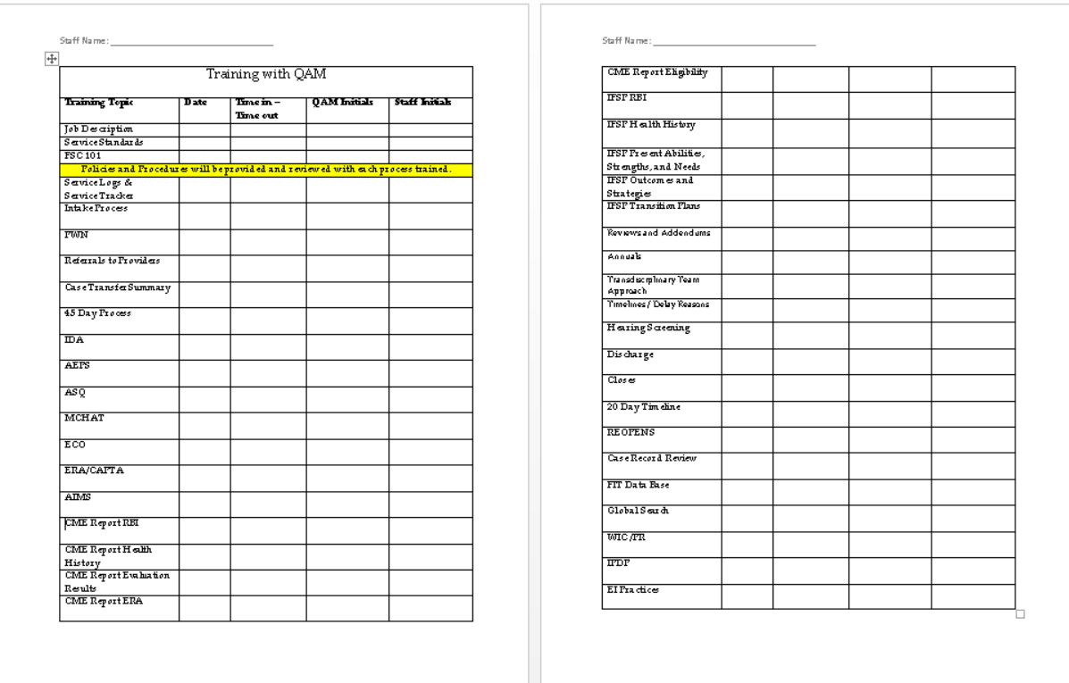
Training Plan Tracking:
Training With QAM

Slide 5
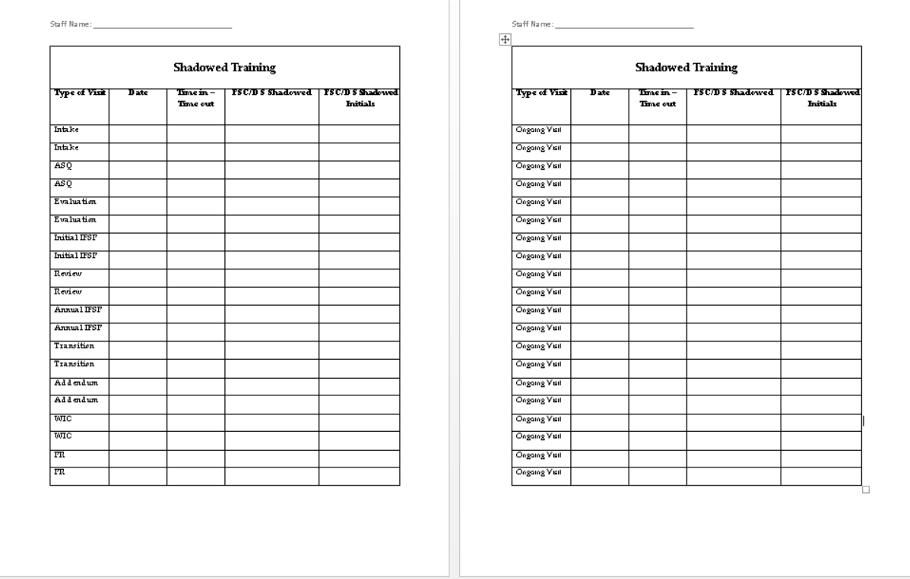
Training Plan Tracking:
Peer Shadowing

Slide 6

Training Plan Tracking:
Online Training and Videos

Slide 7


Training Binder and EI Practices Binder
Service Standards
Service logs
45 day
Intake
PWNs
CME
IDA
AEPS
ECO
IFSP
AIMS
MCHAT
ERA
Transitions
Annuals
Reviews
Subsequent Enrollments
TTA
Close/Discharge
Case Record Review
Transfers
Global Search
FIT Database
Hearing
Timelines
Training binder includes explanations of processes with examples and policies and procedures for:
EI Practices binder includes materials for the Foundations of Relationship Based Early Intervention, Family Guided Routines Based Intervention, SSOOPPRR indicators, TTA, and Key Principles.

Slide 8
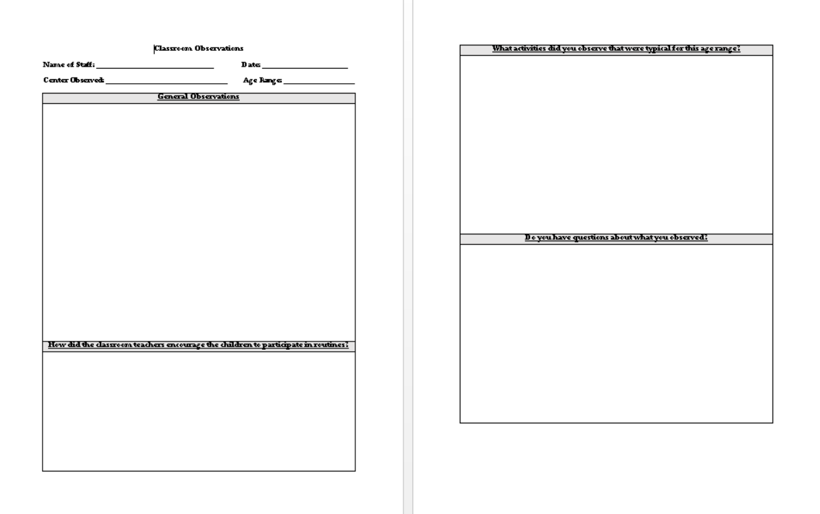
Childcare Observations Form

Slide 9
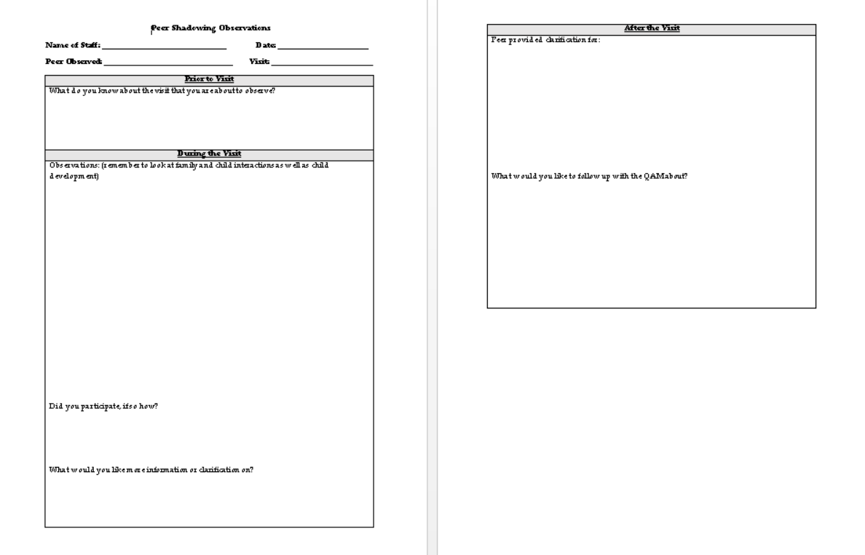
Peer Shadowing Observation Form

Slide 10
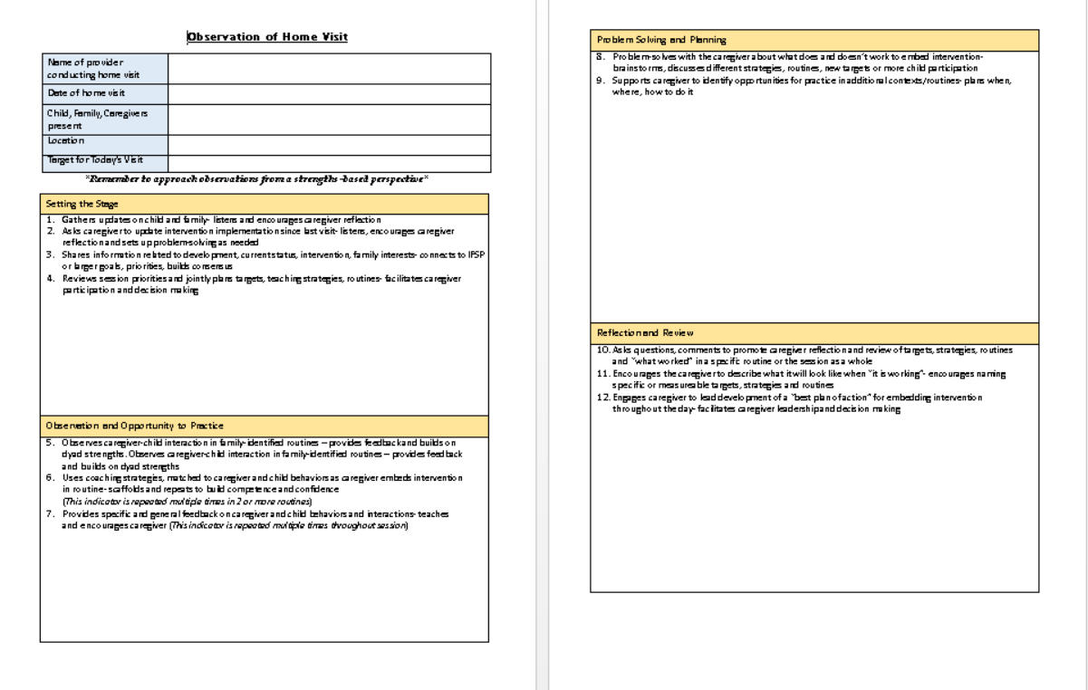
Observation of Home Visit Form (SSOOPPRR)

Slide 11
Online Trainings
MOODLE
  FIT C Orientation
  Foundations of Relationship Based Early Intervention (complete workbook and coaching)
  Child Development: Discovery, Unfoldment, and Variations
  HVT - Foundations of Relationship-Based Home Visiting
  IFSP Module 1
  IFSP Module 2
  IFSP Module 3
  The Developmental Evaluation: Evaluation as Intervention
  Early Childhood outcomes System
  HVT - Child Development, Birth to Three: A Family Story
  IDA Online Training will be completed once new staff have observed an IDA
  Service Coordination PT 1 and 2
  Introduction to Autism Spectrum Disorders
Child Abuse, Neglect, and Exploitation Training: through NMSU
MCHAT Webinar through CDD
Hearing Training Sessions 1-4 through Infant Hearing

Slide 12
Videos (online and agency exemplars)
FIT Library
ECTAC Center videos
University of Florida FGRBI videos
RBI videos
MCHAT webinars
Hearing webinars
Childcare interventions
Telehealth

