Slide 1
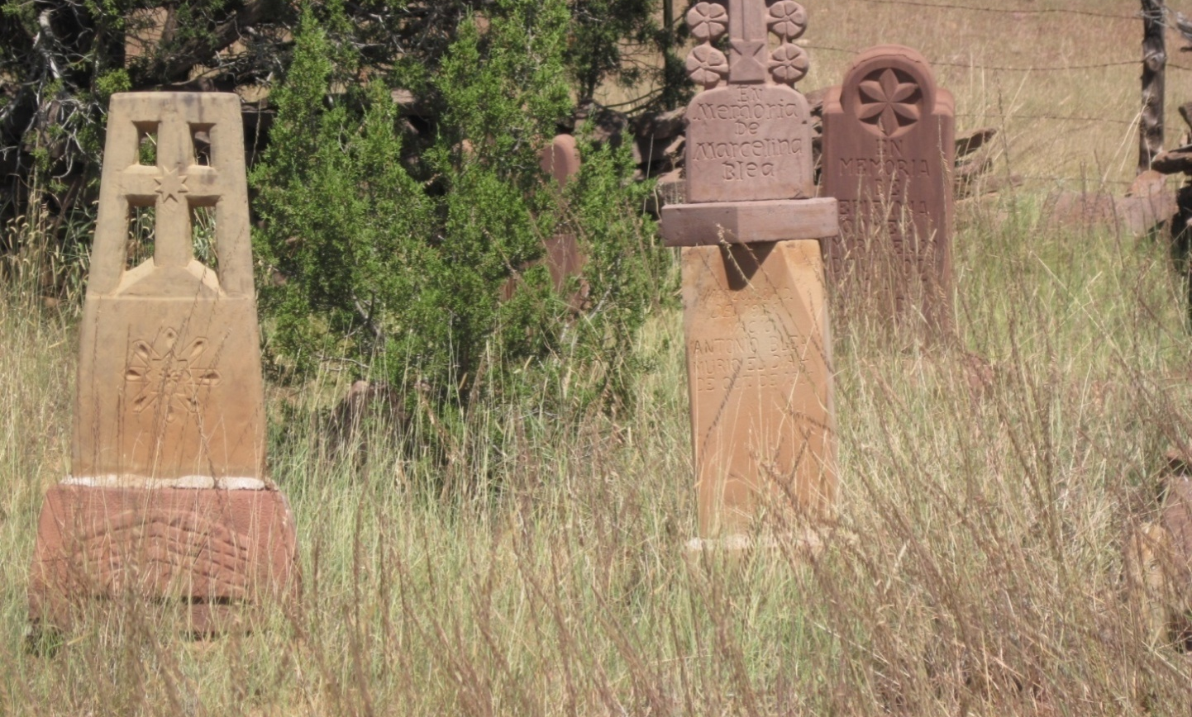
No More Children Dying
Unnecessarily
Home Visiting Regional Meeting
November 14, 2023
Lance Chilton, MD

Slide 2
Objectives:
1. Home visitors and others will be able to discuss diseases they would have seen visiting babies 100 years ago, before effective vaccines were available.
2. Attendees will be able to list three characteristics of a discussion they might have with a vaccine-hesitant parent.
3. Attendees will be able to discuss the measures taken by experts and government agencies to assure the safety of vaccines.

Slide 3

Dr. Chilton states that he has no conflicts in giving this talk

Slide 4
SAVE THE HUMAN and DOLLAR COST!
How cost-effective is childhood immunization?
Disease | Cases Prevented | Deaths Prevented | Direct Costs Saved, Million $ | Societal Costs Saved (Direct + Indirect), Million $
Diphtheria | 275 028 | 27 503 | 3654 | 39 296
Tetanus | 169 | 25 | 12 | 45
Pertussis | 2 950 836 | 1062 | 4443 | 7017
Hib | 19 606 | 741 | 1810 | 3756
Polio | 67 463 | 800 | 2898 | 7259
Measles | 3 835 825 | 3106 | 3762 | 8862
Mumps | 2 312 275 | 12 | 1411 | 2374
Rubella | 1 981 066 | 15 | 187 | 721
Congenital rubella syndrome | 632 | 70 | 133 | 257
HepB | 239 993 | 3514 | 240 | 1770
Varicella | 3 942 546 | 73 | 373 | 1598
HepA | 153 164 | 36 | 52 | 114
Pneumococcus-related diseases^{b} | 2 323 952 | 5056 | 965 | 2696
Rota | 1 582 940 | 19 | 327 | 595
Total | 19 685 495 | 42 032 | 20 267 | 76 360
For just one year’s births of 4.2 million children
Benefit to cost ratio
Direct savings only: 3.0 : 1
Total societal savings: 10.1 : 1
42,032 DEATHS
THAT’S $20 BILLION and $76 BILLION!
Zhou F et al. Economic Evaluation of the Routine Childhood Immunization Program in the US, 2009. Pediatrics, 2014. 133:577.

Slide 5
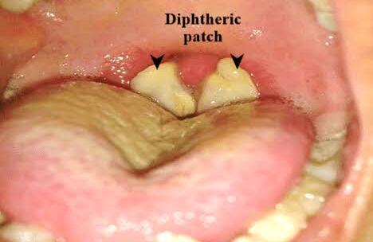
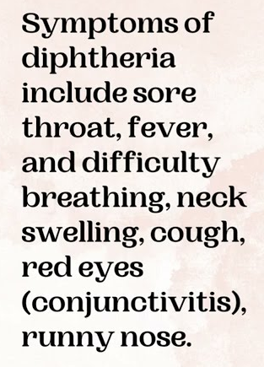
Diphtheria
myocarditis, and death

Slide 6
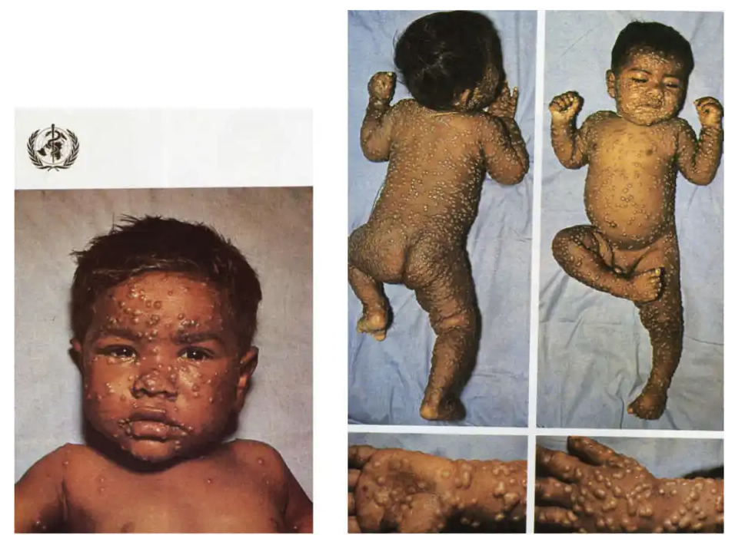
Smallpox

Slide 7
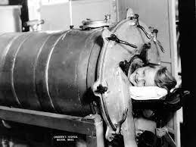
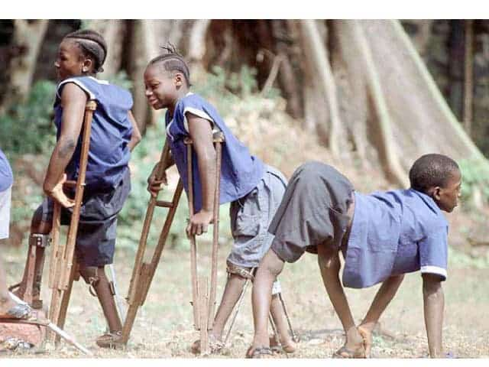
Can we get rid of polio?

Slide 8
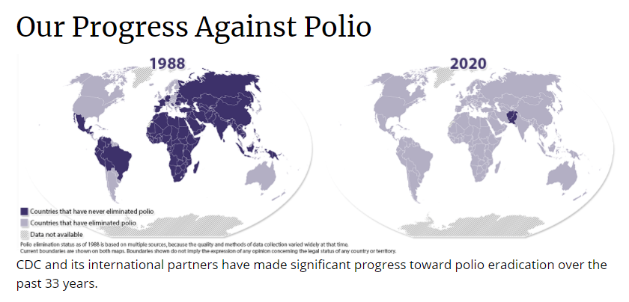
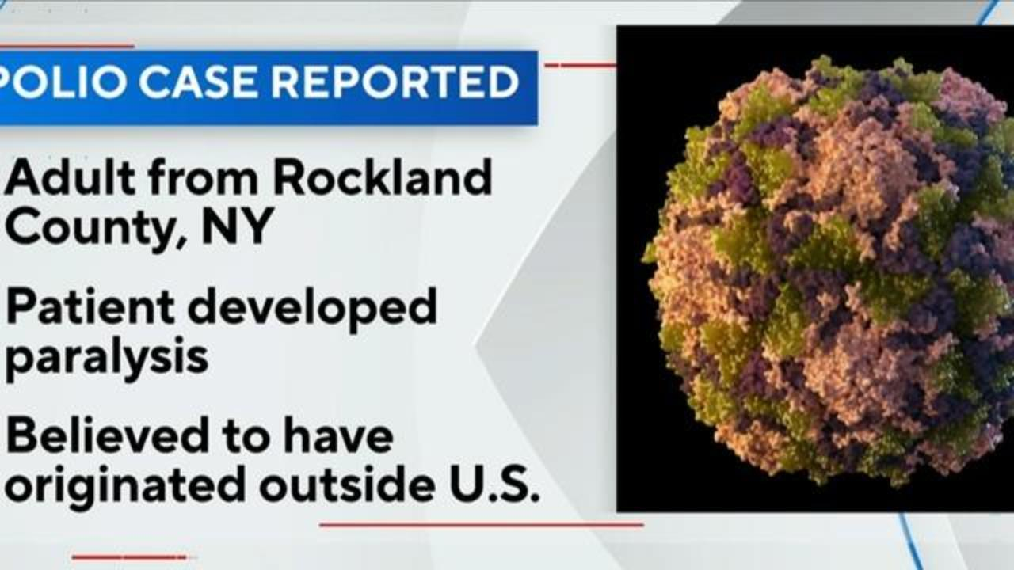
Yes!
...but
2022

Slide 9
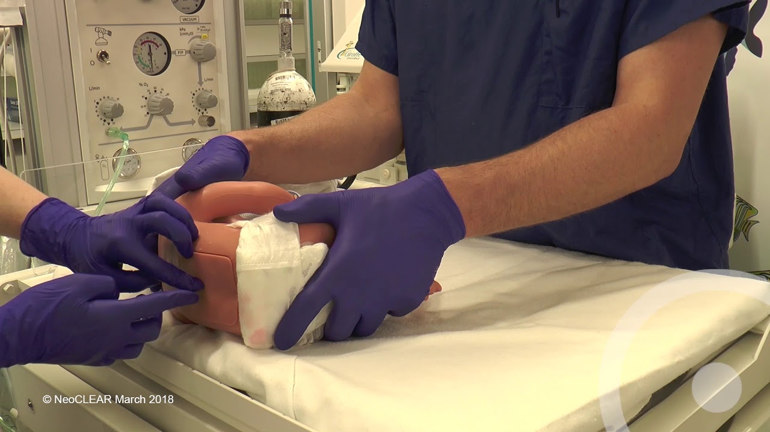
Meningitis
Diagnosis by spinal tap
Treatment by antibiotics
But wouldn’t be better to get rid of it?

Slide 10
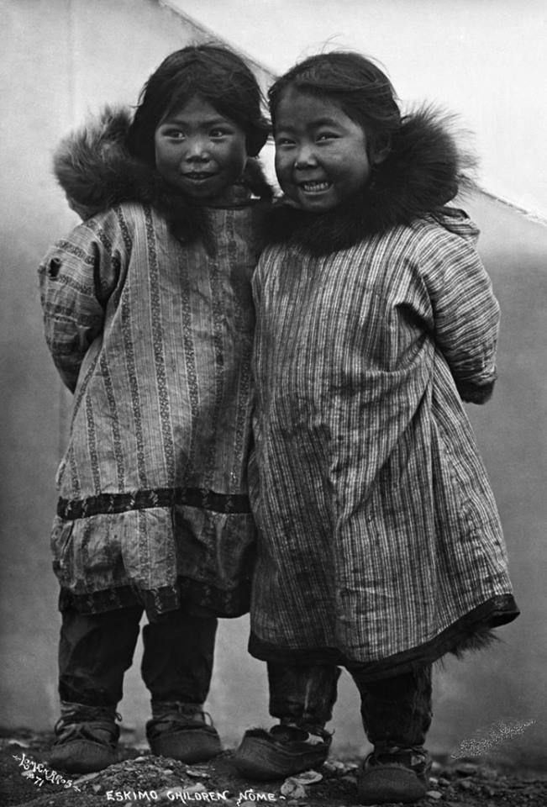
Can we get rid of meningitis?
Meningitis in children is usually caused by these germs:
Pneumococcus
Haemophilus influenzae
Meningococcus

Slide 11
Yes, we can!
Meningitis in children is usually caused by these germs:
Haemophilus influenzae
Pneumococcus
Meningococcus
Vaccines to prevent it:
  Haemophilus influenzae, 1987
  Pneumococcus, 2000
  Meningococcus, 2005

Slide 12
Why is that important?
Meningitis in children causes severe consequences:
Death in 1-5%
Loss of intelligence in 10%
Deafness in 10-40%
Language disorders in 15%
Etcetera

Slide 13
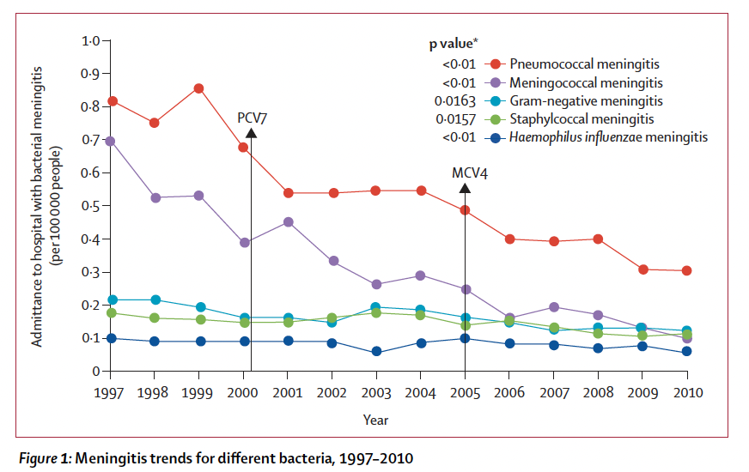
Have all those vaccines against meningitis worked?
From the 1980s (prevaccine era) to 2005 (vaccine era), the incidence of vaccine-preventable invasive Hib disease decreased by ≥99.8%, and the associated mortality rate decreased by ≥99.5%. In parts of the world where the vaccine is not in regular use, morbidity and mortality rates of Hib disease remain high.

Slide 14
SAVE THE DOLLAR COST!
How cost-effective is childhood immunization?
Disease | Cases Prevented | Deaths Prevented | Direct Costs Saved, Million $ | Societal Costs Saved (Direct + Indirect), Million $
Diphtheria | 275 028 | 27 503 | 3654 | 39 296
Tetanus | 169 | 25 | 12 | 45
Pertussis | 2 950 836 | 1062 | 4443 | 7017
Hib | 19 606 | 741 | 1810 | 3756
Polio | 67 463 | 800 | 2898 | 7259
Measles | 3 835 825 | 3106 | 3762 | 8862
Mumps | 2 312 275 | 12 | 1411 | 2374
Rubella | 1 981 066 | 15 | 187 | 721
Congenital rubella syndrome | 632 | 70 | 133 | 257
HepB | 239 993 | 3514 | 240 | 1770
Varicella | 3 942 546 | 73 | 373 | 1598
HepA | 153 164 | 36 | 52 | 114
Pneumococcus-related diseases^{b} | 2 323 952 | 5056 | 965 | 2696
Rota | 1 582 940 | 19 | 327 | 595
Total | 19 685 495 | 42 032 | 20 267 | 76 360
For just one year’s births of 4.2 million children
42,032 DEATHS
THAT’S $20 BILLION and $76 BILLION!
Zhou F et al. Economic Evaluation of the Routine Childhood Immunization Program in the US, 2009. Pediatrics, 2014. 133:577.

Slide 15
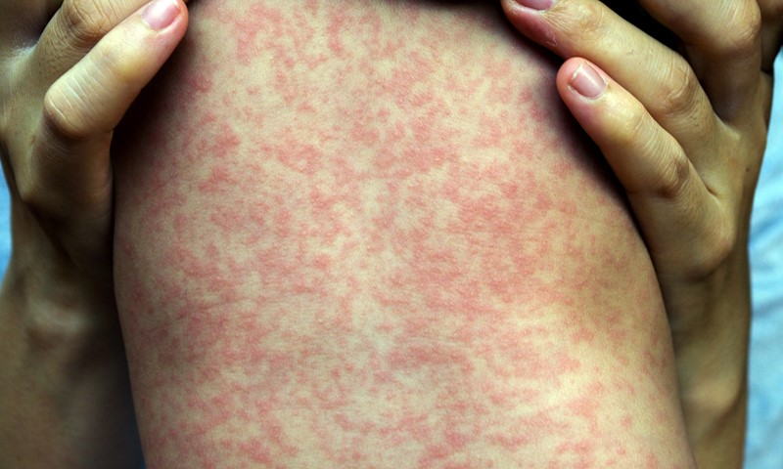
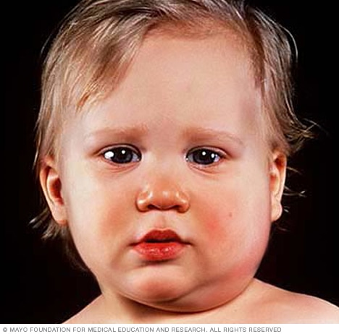
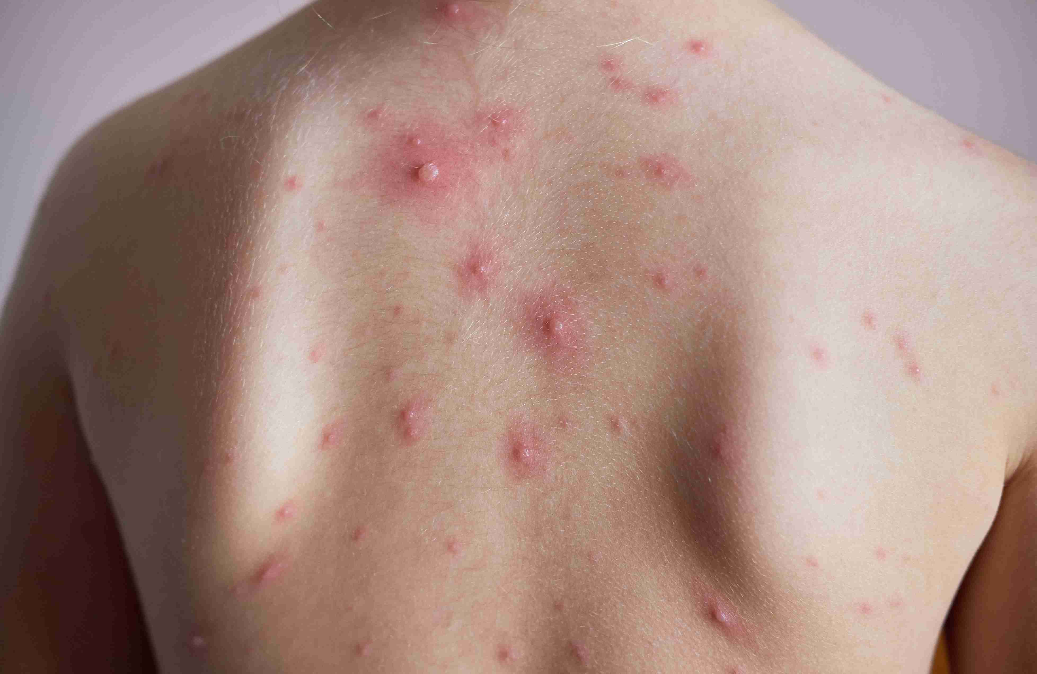
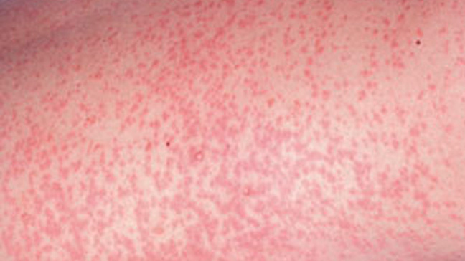
MEASLES
MUMPS
CHICKEN POX = VARICELLA
RUBELLA

Slide 16
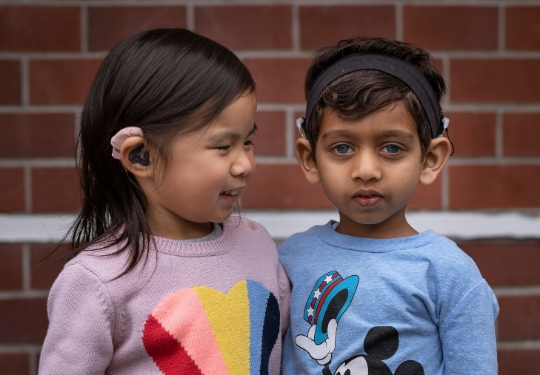
Hearing Loss Connected with Congenital Rubella Syndrome

Slide 17
SAVE THE DOLLAR COST!
How cost-effective is childhood immunization?
Disease | Cases Prevented | Deaths Prevented | Direct Costs Saved, Million $ | Societal Costs Saved (Direct + Indirect), Million $
Diphtheria | 275 028 | 27 503 | 3654 | 39 296
Tetanus | 169 | 25 | 12 | 45
Pertussis | 2 950 836 | 1062 | 4443 | 7017
Hib | 19 606 | 741 | 1810 | 3756
Polio | 67 463 | 800 | 2898 | 7259
Measles | 3 835 825 | 3106 | 3762 | 8862
Mumps | 2 312 275 | 12 | 1411 | 2374
Rubella | 1 981 066 | 15 | 187 | 721
Congenital rubella syndrome | 632 | 70 | 133 | 257
HepB | 239 993 | 3514 | 240 | 1770
Varicella | 3 942 546 | 73 | 373 | 1598
HepA | 153 164 | 36 | 52 | 114
Pneumococcus-related diseases^{b} | 2 323 952 | 5056 | 965 | 2696
Rota | 1 582 940 | 19 | 327 | 595
Total | 19 685 495 | 42 032 | 20 267 | 76 360
For just one year’s births of 4.2 million children
42,032 DEATHS
THAT’S $20 BILLION and $76 BILLION!
Zhou F et al. Economic Evaluation of the Routine Childhood Immunization Program in the US, 2009. Pediatrics, 2014. 133:577.

Slide 18

Discussion with vaccine-uncertain parents
Listen first
Determine concerns and level of concerns
Offer to give information
Have facts on hand, especially about vaccine safety

Slide 19

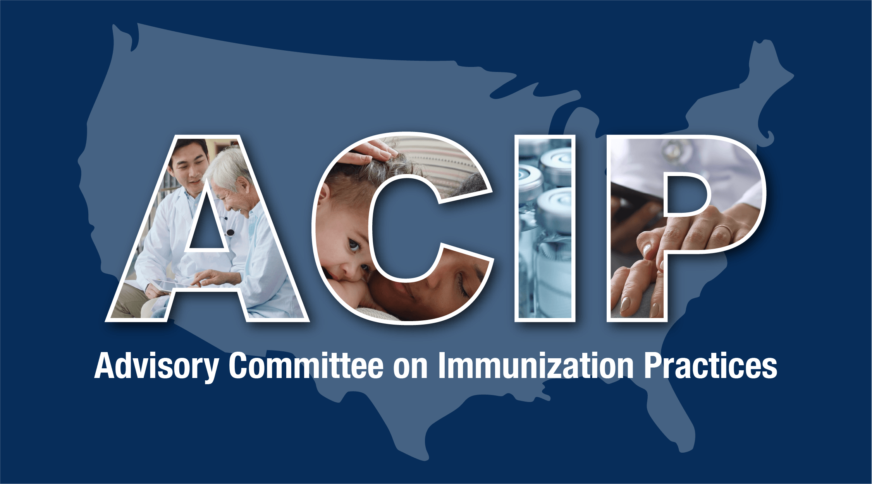

Phases of Assuring Vaccine Safety
Drug Company Pre-Licensure Studies
  Phase 1: animals
  Phase 2: small human studies, dose adjustment
  Phase 3: large human trials for determining efficacy and safety
  Phase 4: post-marketing

Slide 20
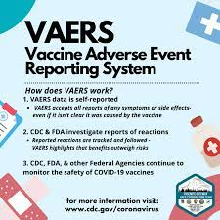
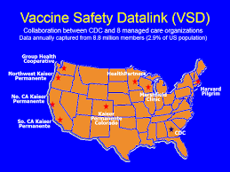
Post-Marketing Large-Scale Studies

Slide 21
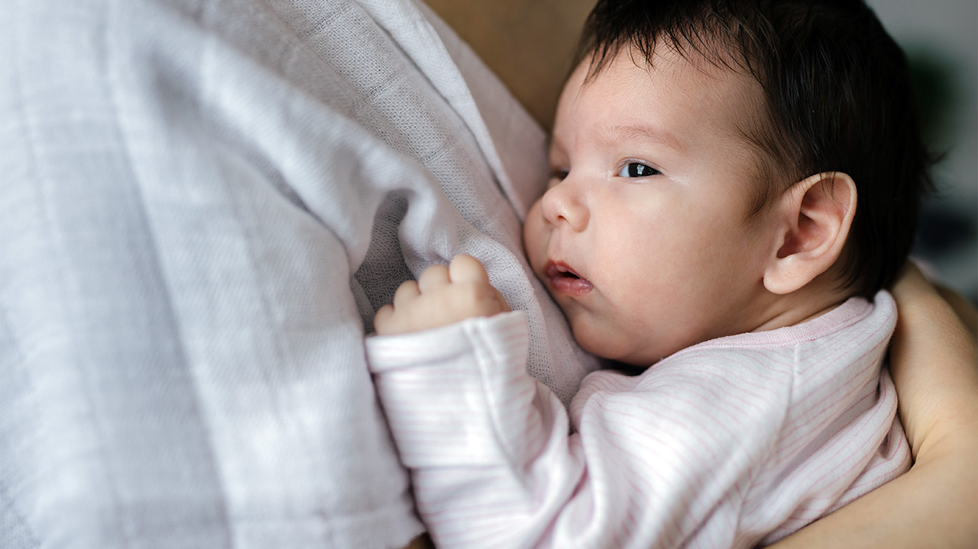

Immunizations are free for
all New Mexicans up to age 18!
Immunizations are for babies, but not just babies!

Slide 22
Universal Purchase Vaccines for Children:
Best for
Children and Parents
Department of Health
Practitioners
Small Business
Now in 15 states, including New Mexico!

Slide 23

Pediatricians and
Home Visiting Programs – Natural Partners!

Slide 24
With vaccines, with home visitors, with child health practitioners...
We can prevent problems!

Slide 25
Can we prevent the big killers of adults?
Cancer?
  Prevent substance use, especially tobacco
  Vaccines! So far:
    Hepatitis B vaccine
    Human papillomavirus vaccine
Violence and accidental death?
Heart disease and stroke?
  No vaccines yet...
  Good diet
  Exercise
  Prevent substance use, especially tobacco
For all three, prevent
adverse childhood experiences!

Slide 26
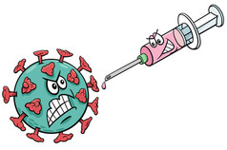
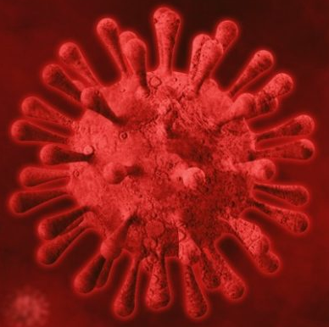
Is there a shot for
Adverse Childhood Experiences?
And what are ACEs, anyway?

Slide 27
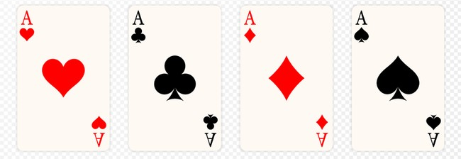
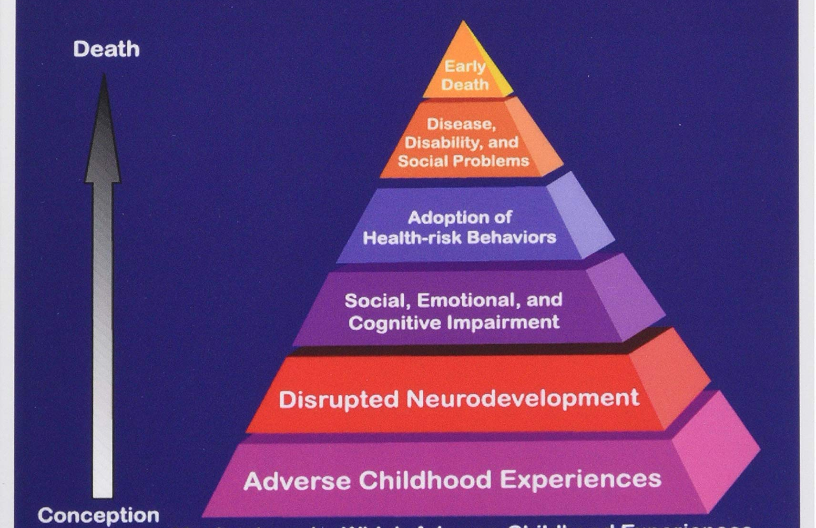
Adverse Childhood Experiences = ACEs
ACEs
Abuse or neglect: Emotional, physical or sexual
Family separation: incarceration, divorce
Family mental disorder or substance abuse
Domestic violence
Poverty: Lack of food, shelter, clothes
Bullying

Slide 28
American Academy of Pediatrics Policy Statement summary:
High-quality home-visiting services for infants and young children can improve family relationships, advance school readiness, reduce child maltreatment, improve maternal-infant health outcomes, and increase family economic self-sufficiency. The American Academy of Pediatrics supports unwavering federal funding of state home-visiting initiatives, the expansion of evidence-based programs, and a robust, coordinated national evaluation designed to confirm best practices and cost-efficiency. Community home visiting is most effective as a component of a comprehensive early childhood system that actively includes and enhances a family-centered medical home.

Slide 29


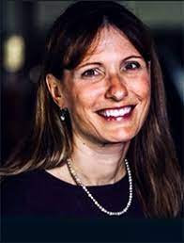
Child health providers
appreciate home visitors!...
Alexandra Cvijanovich, MD
President, New Mexico Pediatric Society
June 2021
Lance Chilton, MD
President, New Mexico Pediatric Society
2000-2002
Janis Gonzales, MD
Chief Health Officer, ECECD

Slide 30

Lance Chilton
lchilton@salud.unm.edu...
or right now

