Slide 1



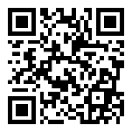
Give it your best shot! Effectively and efficiently communicating with vaccine hesitant parents.
David Higgins, MD, MPH, MS
General Pediatrician and Public Health and Preventive Medicine specialist
Research Fellow
Adult and Child Center for Outcomes Research and Delivery Science
University of Colorado School of Medicine, Children’s Hospital Colorado
medschool.cuanschutz.edu/ACCORDS

Slide 2
Disclosures
No financial disclosures or conflicts of interest.

Slide 3
Objectives
By the end of this talk, audience members will:
Gain knowledge about the background, history, and epidemiology of vaccine hesitancy.
Gain knowledge about evidence-based communication strategies to increase childhood vaccine uptake.
Learn new ideas about communicating with vaccine hesitant parents to promote effective and efficient communication.

Slide 4
Outline
Background
Evidence regarding clinician communication for vaccine acceptance
Strategies for vaccine communication
Example cases: Practice!

Slide 5
Background

Slide 6

How effective is the vaccine in these vials?
0%
“Vaccines don’t save lives. Vaccinations save lives!”

Slide 7
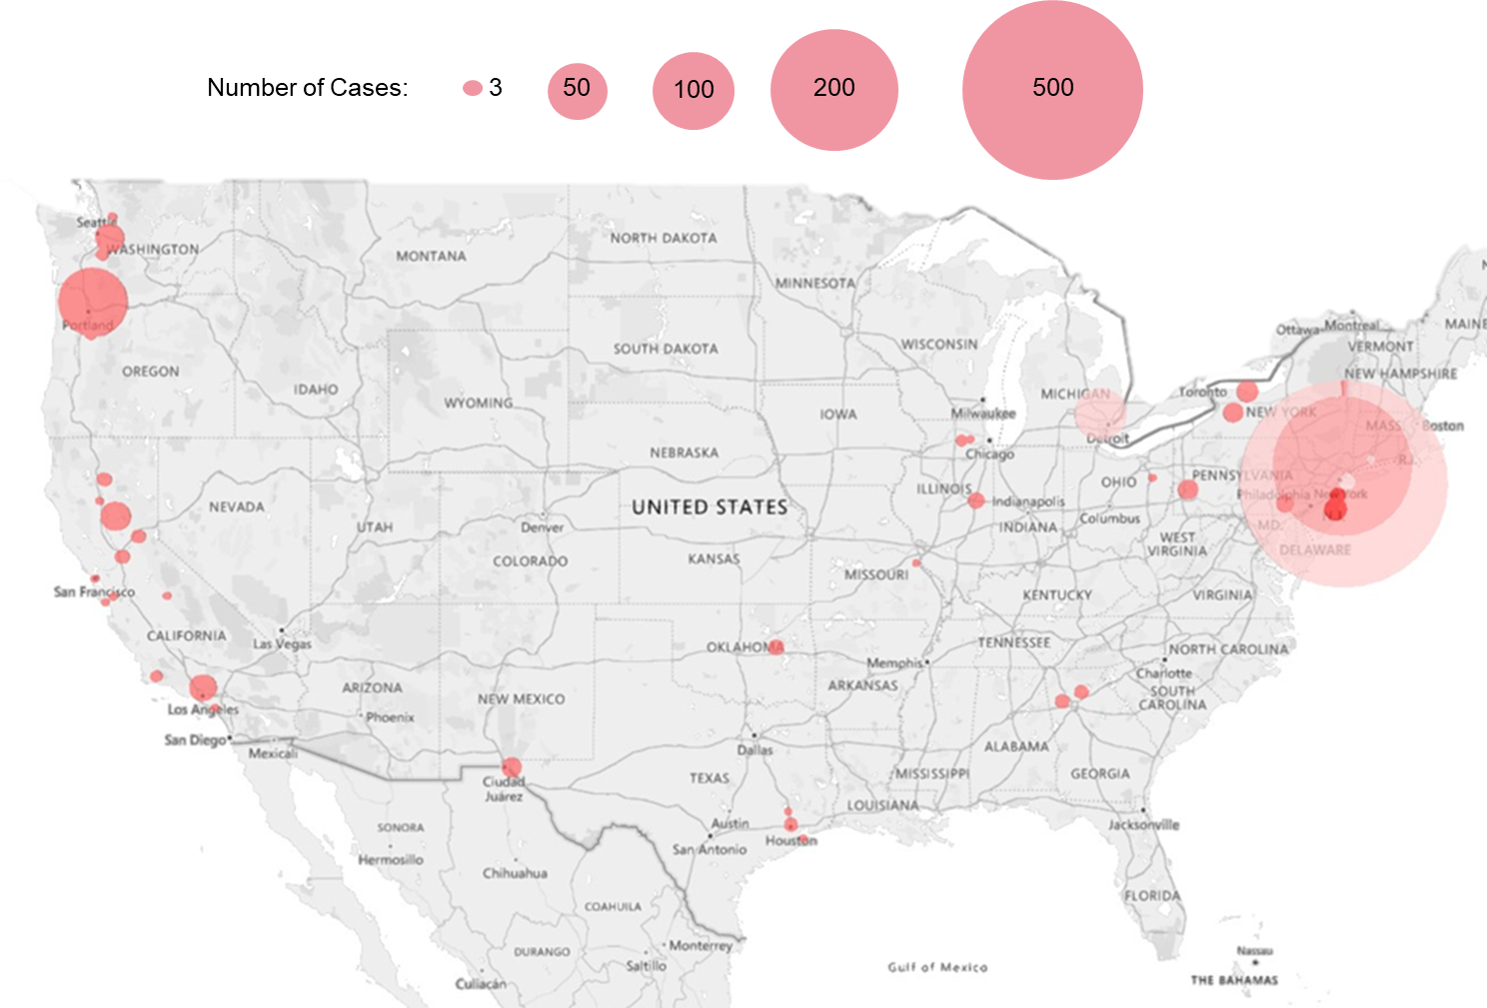
The problem
Increased levels of under-vaccination
  Outbreaks of Vaccine Preventable Diseases
    Pertussis
    Varicella
    Measles
Measles outbreaks (N=22) by county, U.S., 2019
Based on The Washington Post. A record number of measles cases is hitting the U.S. this year. Who is being affected? (Keating, Mayes, Meko) (updated)

Slide 8


The solution: Evidence-based ways to increase vaccination
Enhance Access
  Reducing or eliminating out-of-pocket costs
  Vaccination programs in schools/child care/homes/WIC settings
Increasing community Demand
  Incentive rewards
  Client reminder/recall systems
  Vaccination requirements for schools and child care
Practices/system interventions
  Immunization information systems
  Clinician assessment, feedback, and reminders
  Standing orders
  Communication
https://www.thecommunityguide.org/pages/task-force-findings-increasing-vaccination.html

Slide 9
Brief history of Vaccine Hesitancy

Slide 10
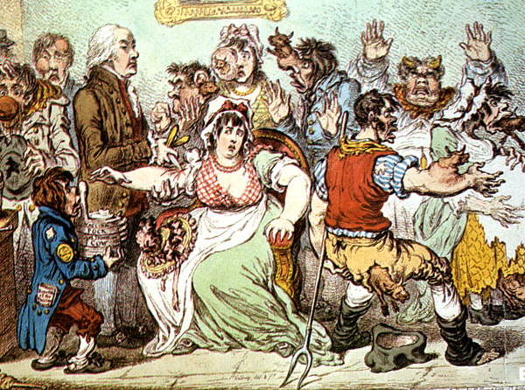
History of vaccine hesitancy
Cowpox vaccine, 1802

Slide 11
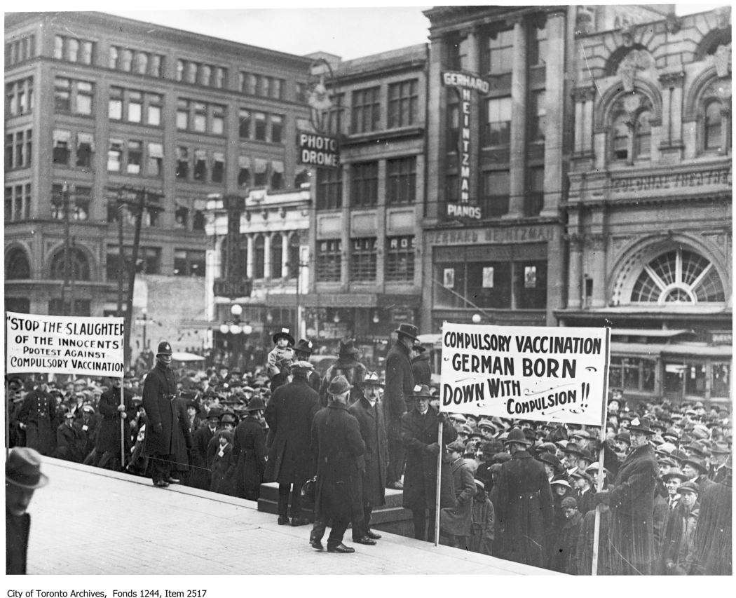
Fast-forward 123 years…
Anti-Vaccination League of Canada, 1919

Slide 12
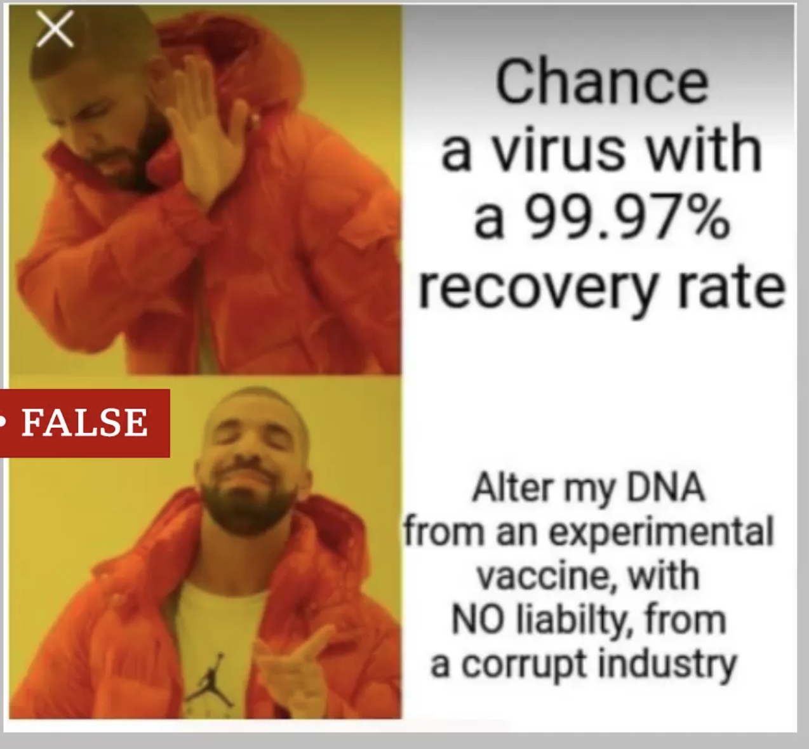
Fast-forward 227 years…
Image from BBC Nes: https://www.bbc.com/news/55101238
Social Media, 2023

Slide 13
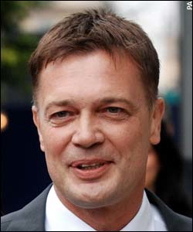
An example of how we got here…

Slide 14
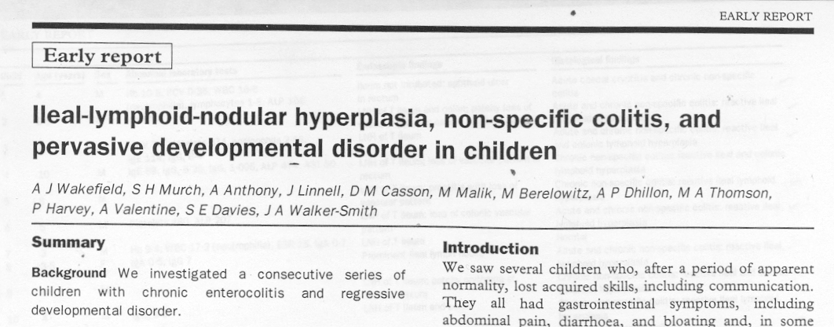
How did we get here?
Wakefield, A.J., et al. Lancet 351: 637-641, 1998.
Wakefield et al. suggested relationship between measles, mumps, and rubella immunization and autism

Slide 15
Problems with “the study”
Case series methodology (12 cases)
Most cases were self-referrals from anti-vaccine groups
Several cases’ symptoms began before (5) or long after (3) MMR vaccine
Prior to submission, Wakefield had applied for patents on a vaccine to rival MMR vaccine
Wakefield received >£400,000 from lawyers to prove that the MMR vaccine was dangerous

Slide 16
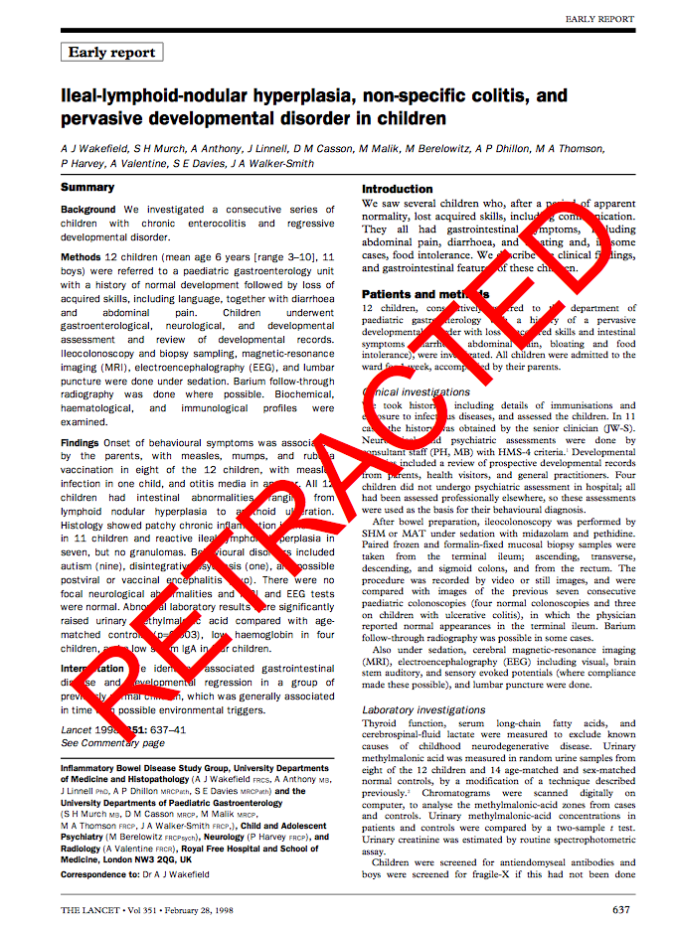

Slide 17
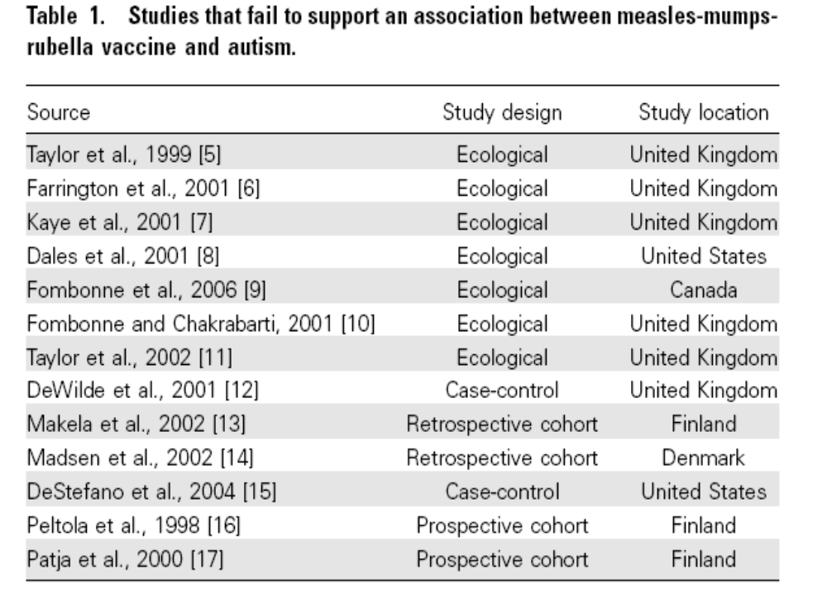
Extensive data do NOT support an association between MMR and autism
Gerber JS, Offit PA. Vaccines and autism: a tale of shifting hypotheses. Clin Infect Dis. 2009;48(4):456-461. doi:10.1086/596476

Slide 18
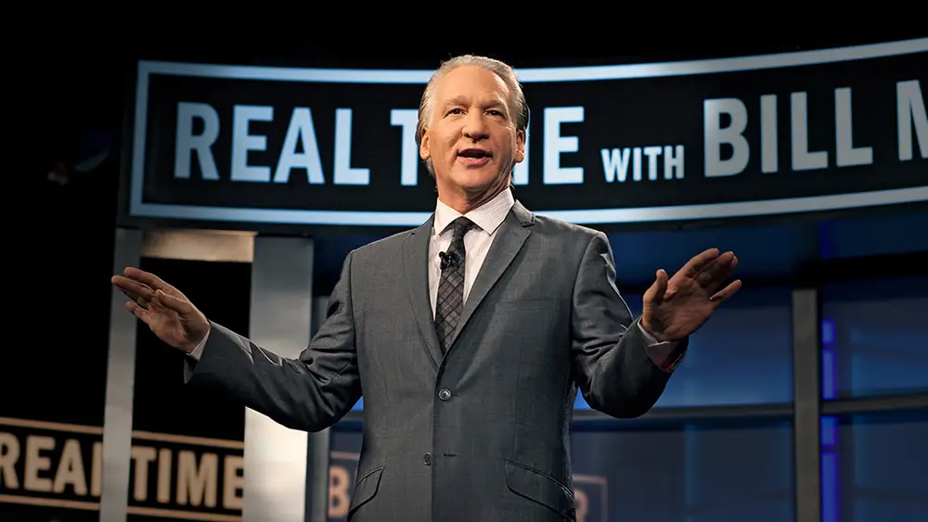
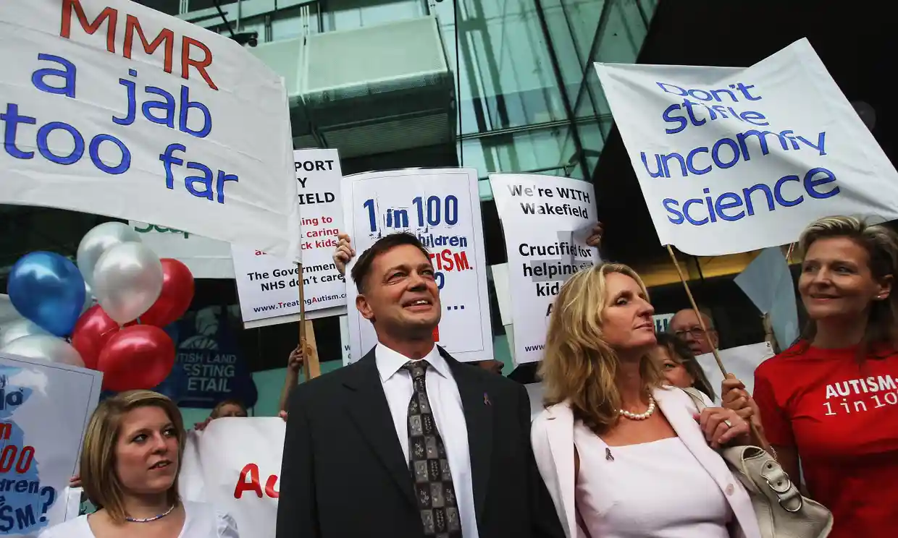

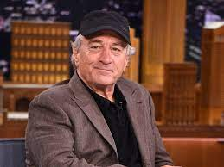
However, the damage was already done…

Slide 19
How did we get here?
Vaccines are victims of their own success
  Loss of diseases’ visibility
  Loss of a sense of urgency
  Lack of fear
The assault on science
  Evidence or facts are seen as just a matter of opinion
  Simple ‘belief’ is often considered as valid as critical thinking

Slide 20
Epidemiology of Vaccine Hesitancy

Slide 21
What is “vaccine hesitancy”?
A motivational state of being conflicted about, or opposed to, getting vaccinated (or having their children vaccinated).

Slide 22
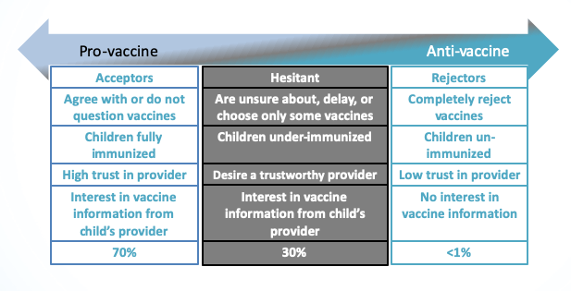
Vaccine Hesitancy Continuum
The percentage who refuse all vaccine remains low (<1.3%)
Prevalence of under-vaccination has been rising (alternative schedules)

Slide 23
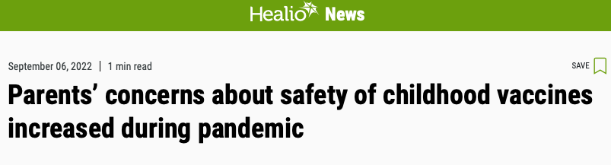
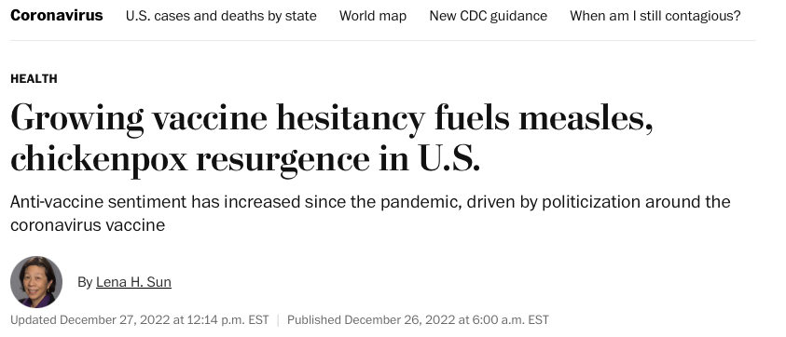

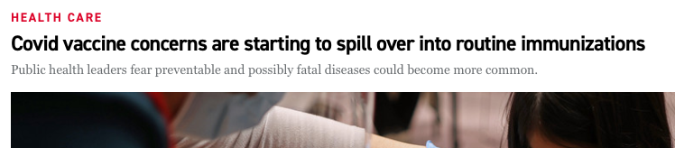
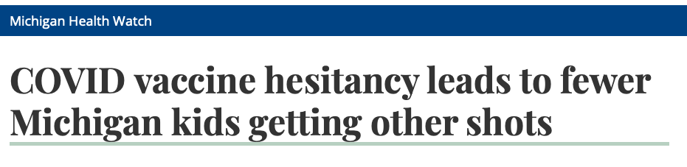

Slide 24
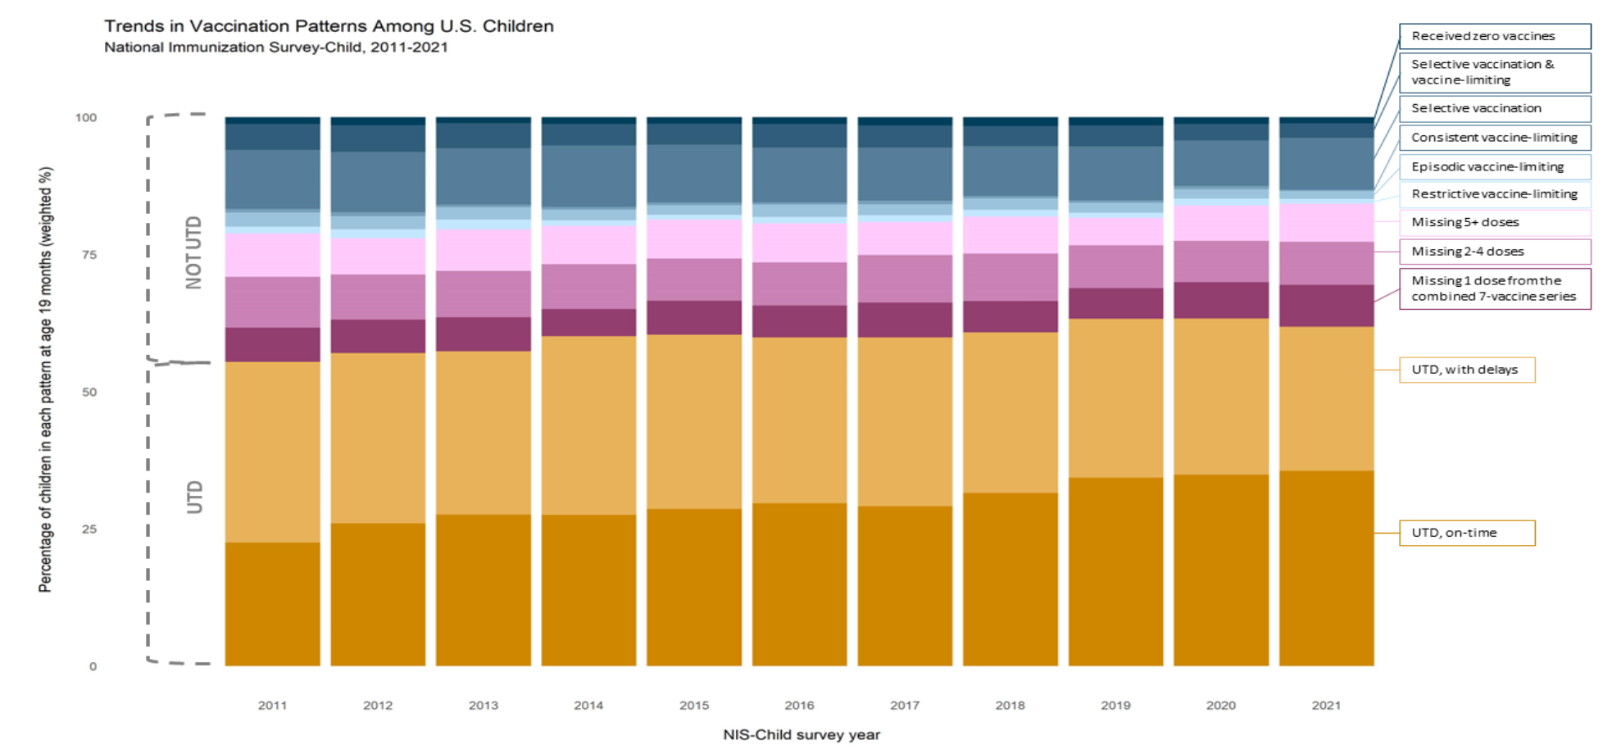
Daley, M., Glanz, J., Clarke, C., Albers, A., Michels, S., Freeman, R., Newcomer, S. National Trends in Patterns of Undervaccination in Early Childhood. Peditric Academic Societies Meeting, April 2023, Washington, D.C. (Preliminary data)

Slide 25
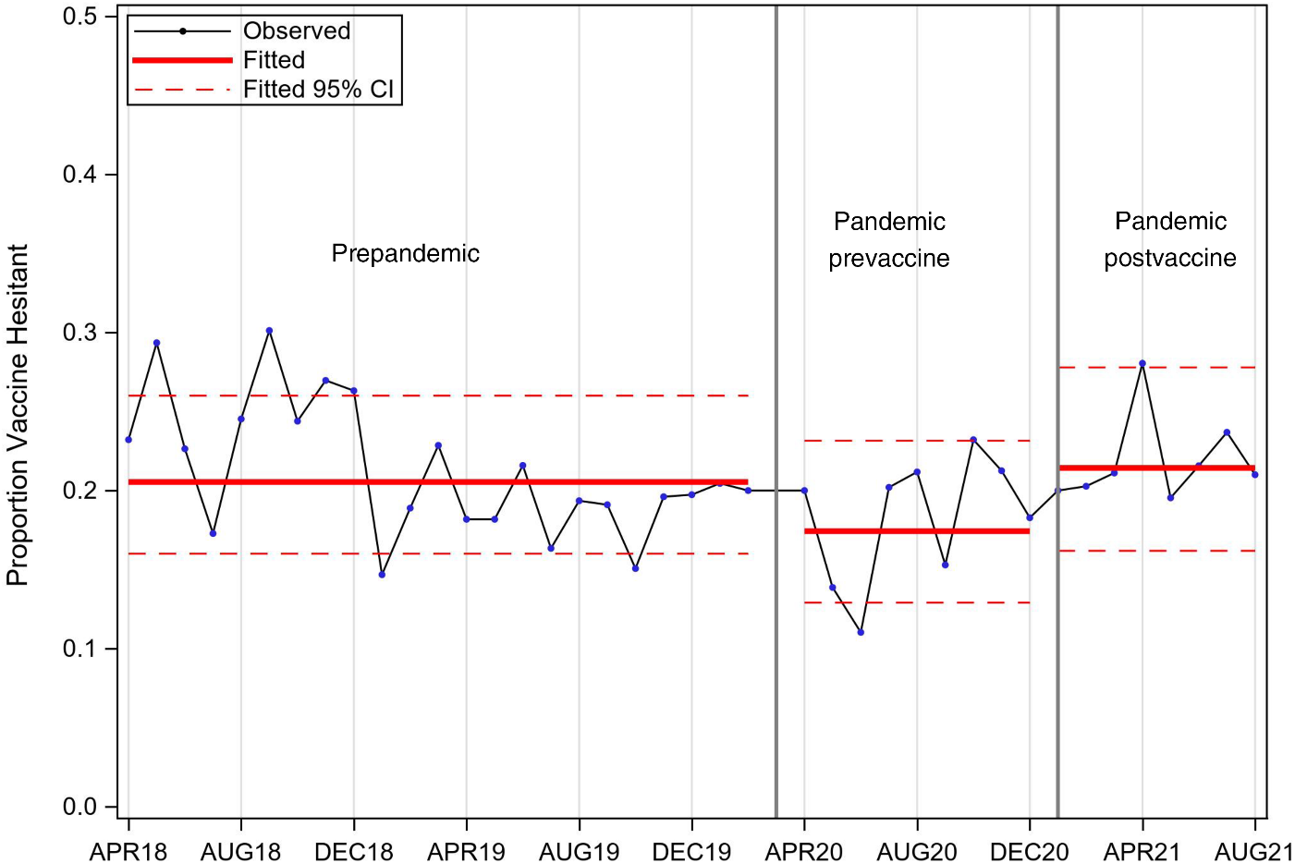
The COVID-19 Pandemic and Parental Attitudes Toward Routine Childhood Vaccines
Higgins DM, Moss A, Blackwell S, O'Leary ST. The COVID-19 Pandemic and Parental Attitudes Toward Routine Childhood Vaccines. Pediatrics. 2023;152(5):e2023062927. doi:10.1542/peds.2023-062927
Figure Legend:
Unweighted observed numbers and average predicted proportions of vaccine hesitant parents across different COVID-19 pandemic periods in the Colorado Health eMoms survey program, 2018 to 2021.
Date of Download: 11/7/2023
Copyright © 2023 American Academy of Pediatrics. All rights reserved.

Slide 26
Communication strategies for addressing vaccine hesitancy

Slide 27

Addressing vaccine hesitancy is complicated!
No easy solutions!

Slide 28
Strategies that don’t work
“Fear appeals” – i.e. scary stories
“Data dump” – overwhelming someone with facts
“Lecture trap” - provide the full story about some aspect of the vaccine
“Persuasion trap” - a polite argument
Patient education by itself

Slide 29
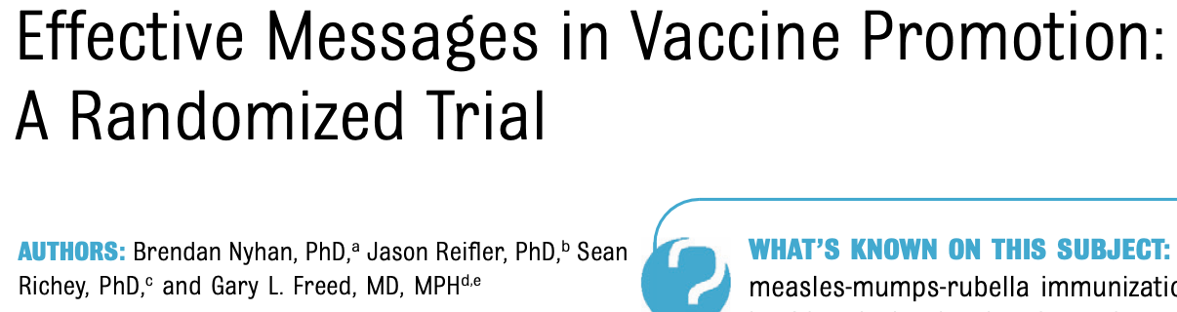
Effective Messages in Vaccine Promotion: A Randomized Trial
Parents randomly assigned to receive 1 of 4 interventions:
  (1) info explaining lack of evidence that MMR causes autism from CDC
  (2) info about measles, mumps, rubella from VIS
  (3) images of children with measles, mumps, rubella
  (4) a dramatic narrative about severe case of measles
Notes:
POLL!!!

Slide 30
Effective Messages in Vaccine Promotion: A Randomized Trial
None of the interventions increased parental intent to vaccinate, and they often BACKFIRED
  Refuting claims of an MMR/autism link reduced misperceptions that vaccines cause autism but decreased intent to vaccinate among parents who had the least favorable vaccine attitudes
  Images of sick children increased expressed belief in a vaccine/autism link

Slide 31




Information deficit model = “data dump”
The "Data dump” doesn’t work!
What if we just give them more information?
Vc=(1− 1/R0)/E
Vaccine efficacy
Side effects
Cervical cancer
Phase 3 study
Vaccine effectiveness
HPV
Surveillance
R₀
VAERS
Transmission
Herd immunity
mRNA
Variants
Clinical trials
Boosters
Adenoviral vector
Side effects
Risk
Respiratory failure
Odds ratio
Respiratory failure
Breakthrough infection
Risk of Death
V-Safe
Measles outbreak

Slide 32
The "Lecture Trap” doesn’t work!
Providing the full story about some aspect of the vaccine
Raises resistance because it implies that they don’t know the full story and you’re going to give it to them.
Can be counter-productive because you end up raising concerns that the patient had not previously considered.

Slide 33
The “Persuasion Trap” doesn’t work!
“You cannot reason people out of something they were not reasoned into.”
-Jonathan Swift, 1721
“Persuasion Trap” – tries to convince the hesitant parent of the benefits. This usually ends up in a polite argumentative type of “yes, but” cycle. This assumes human decision making is rational (It is not!)
Notes:
Jonathan Swift (30 November 1667 – 19 October 1745) was an Anglo-Irish^{[1]} satirist, author, essayist, political pamphleteer (first for the Whigs, then for the Tories), poet, and Anglican cleric who became Dean of St Patrick's Cathedral, Dublin,^{[2]} hence his common sobriquet, "Dean Swift".

Slide 34
Patient education by itself doesn’t work!
Cochrane Review 2018: “There is low‐ to moderate‐certainty evidence suggesting that face‐to‐face information or education may improve or slightly improve children's vaccination status, parents' knowledge, and parents' intention to vaccinate…. in populations where lack of awareness or understanding of vaccination is identified as a barrier.”
Kaufman J, Ryan R, Walsh L, et al. Face-to-face interventions for informing or educating parents about early childhood vaccination. Cochrane Database Syst Rev. 2018;5(5):CD010038. Published 2018 May 8. doi:10.1002/14651858.CD010038.pub3

Slide 35

Let’s review strategies that don’t work
“Fear appeals” – i.e. scary stories
“Data dump” – overwhelming someone with facts
“Lecture trap” - provide the full story about some aspect of the vaccine
“Persuasion trap” - a polite argument
Patient education by itself

Slide 36

It’s not (just) about the facts!
The What (facts) – necessary, but often not sufficient
The How – what is the best way to communicate so that a person who is hesitant will be receptive to the idea of vaccination?

Slide 37
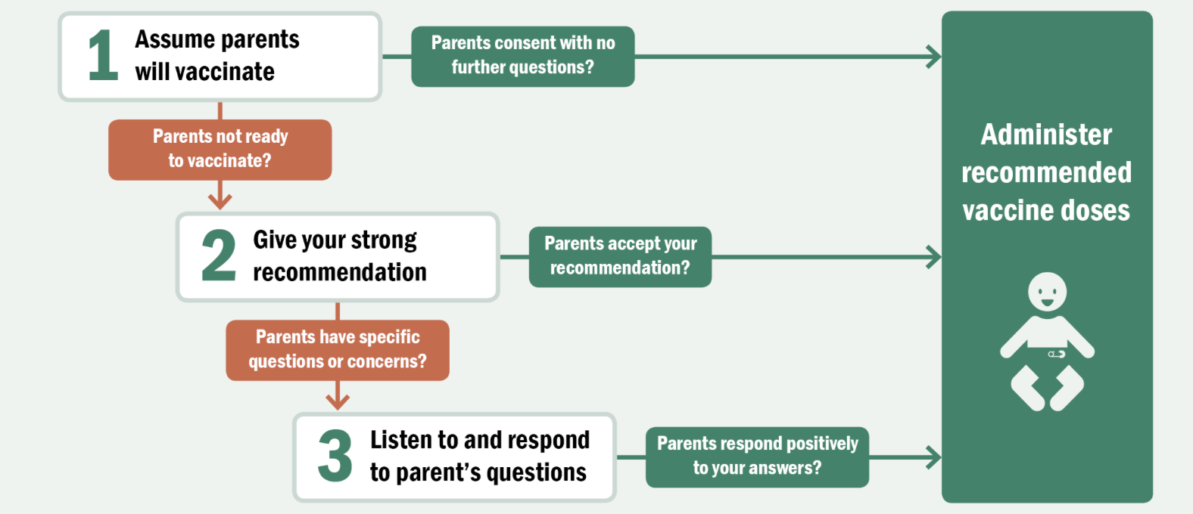
What does work?
Talking with Parents about Vaccines Framework
1. Presumptive format
2. Strong recommendation
3. Motivational interviewing “light”
https://www.cdc.gov/vaccines/hcp/conversations/talking-with-parents.html

Slide 38
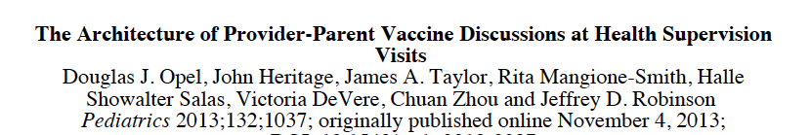
Investigators in Seattle videotaped well visits for infants and toddlers
Oversampled “vaccine hesitant parents”
111 vaccine discussions, 50% with hesitant parents
Tried to figure out what predicted uptake of vaccines

Slide 39
The best predictor of vaccination uptake for both hesitant and non-hesitant parents was how the clinician started the conversation
Presumptive Format:
-a declarative statement
-presupposes parents will vaccinate
-“Sara is due for 3 shots today.”
Participatory Format:
-an open-ended question
-shifts decisional control to parents
-“How do you feel about Sara getting shots today?”
Opel et al. Pediatrics. 2013

Slide 40
The best predictor of vaccination uptake for both hesitant and non-hesitant parents was how the clinician started the conversation
Presumptive Format:
-a declarative statement
-presupposes parents will vaccinate
-“Sara is due for 3 shots today.”
Participatory Format:
-an open-ended question
-shifts decisional control to parents
-“How do you feel about Sara getting shots today?”
Parent resists 26% of the time
Parent resists 83% of the time
Opel et al. Pediatrics. 2013

Slide 41
The presumptive format works!
Vaccination is the clear standard of care.
It normalizes the vaccine decision.
For parents with hesitancy about vaccines, a clinician using a presumptive format is often all that is needed.
Use of a presumptive format still leaves latitude for autonomy, questions, and concerns.

Slide 42
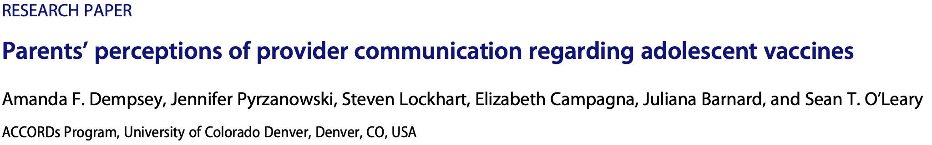
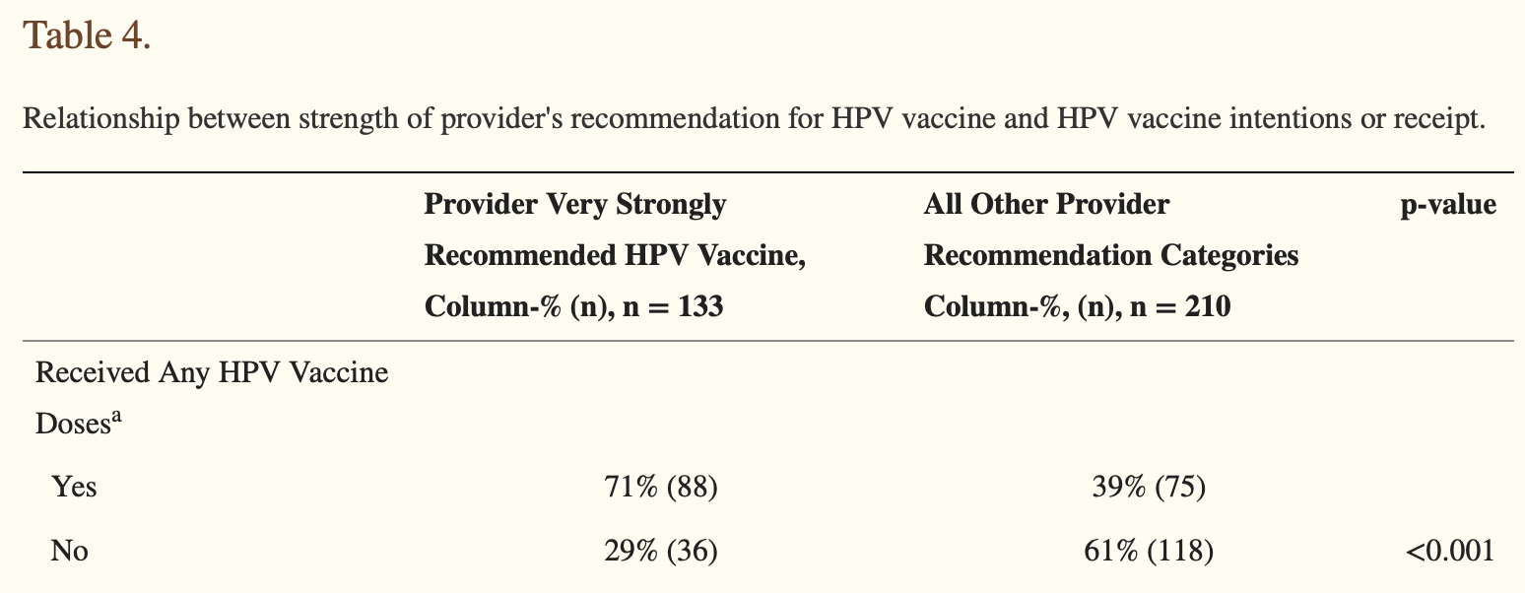
A strong recommendation works!
There is higher vaccine receipt when clinicians give a strong recommendation for the vaccine.

Slide 43
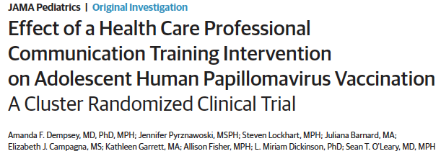
Motivational Interviewing works!
Self-efficacy for changing parents' minds about HPV vaccine improved among clinicians
Time spent in HPV vaccine discussions was the same or decreased from baseline
9.5% increase in HPV initiation in intervention versus control practices
Notes:
Cluster RCT 16 practices in Colorado with a communication training which including motivational interviewing light

Slide 44
Motivational interviewing 101
Motivational interviewing is a patient-centered, guiding communication style for enhancing a person’s own motivation for change or behavioral activation.
Open ended questions
  Curiosity! Explore and understand parent’s stance.
Reflections and Affirmations
  Improves parent engagement by helping them feel supported, appreciated, and understood.
Ask permission to share
  Encourages partnerships, deepens rapport, and allows a parent to understand themselves and their motivations on a deeper level.
Autonomy support
  Enhances a parent’s sense of control and makes them feel more at ease with the conversation.

Slide 45
Putting it together: What works
Talking with Parents about Vaccines Framework
1. Presumptive format
2. Strong recommendation
3. Motivational interviewing “light”
https://www.cdc.gov/vaccines/hcp/conversations/talking-with-parents.html

Slide 46
Practice cases!

Slide 47
Case 1
You’re seeing a 12-year-old girl for a well visit; the family has no specific concerns
You note that she is up-to-date on all recommended adolescent vaccines except she has not received an HPV vaccine

Slide 48
Case 1 - Example
You’re seeing a 12-year-old girl for a well visit; the family has no specific concerns
You note that she is up-to-date on all recommended adolescent vaccines except she has not received an HPV vaccine
You: “Cora is due for an HPV vaccine today.”
Parent: “Oh… well…. I don’t know…”
You: “I highly recommend the HPV vaccine to all of my 12-year- old patients.”
Presumptive format
Strong Recommendation

Slide 49
Case 1
Parent: “Well… I am not sure we want the HPV vaccine today.”
You: “It looks like you have some concerns about the HPV vaccine. That is perfectly understandable. Would you mind sharing what your particular concerns are?”
MI:
-Reflection
-Affirmation
-Open ended question

Slide 50
Case 1
Parent: “Well, I’ve heard that it’s a vaccine to prevent a disease that’s transmitted by having sex, and she is a looooong way from having sex.”
You: “I hear that you’re concerned that she’s too young for the HPV vaccine because HPV is transmitted by sexual activity. Well, I completely get that – she is only 12 after all. I’ve thought a lot about this. Is it okay if I go over how I’ve come to think about this vaccine?”
MI:
-Reflection/Summarize
-Affirmation
-Ask permission to share

Slide 51
Case 1
Parent: “OK, sure.”
You: “I used to think of this vaccine as something to prevent a sexually transmitted disease, but realized it’s really about preventing cancer. Almost everyone gets this virus, so I think it’s important for everyone.”
Normalize vaccination
Strong recommendation

Slide 52
Case 1
Parent: “That makes sense. I don’t want her to get cancer.”
You: “If she were my daughter I would not hesitate to recommend this vaccine for her, and most of my patients are getting the vaccine. Having said that, this is a decision that only you and your daughter can make. What do you think?”
Strong recommendation
Autonomy support

Slide 53

Case 1
Parent: “OK, we can do the HPV vaccine today. Thank you for explaining that to me.”
Vaccination communicator of the year award!

Slide 54
Case 2
You’re seeing a 1-year-old girl for a well visit; she has received all of her recommended vaccines up to this point. Before you enter the room, your nurse tells you the family doesn’t want the MMR vaccine today.

Slide 55
Case 2 - Example
You’re seeing a 1-year-old girl for a well visit; she has received all of her recommended vaccines up to this point. Before you enter the room, your nurse tells you the family doesn’t want the MMR vaccine today.
You: “Kinley is due for MMR, varicella, PCV, HiB, and hepatitis A vaccines today.”
Parent: “We are not going to do the MMR vaccine today.”
You: ““I highly recommend the MMR vaccine to all of my patients. It sounds like you’re okay with the other vaccines. Would you mind telling me what your specific concerns are with the MMR vaccine?”
Presumptive format
Strong Recommendation
MI: -Affirmation
-Open ended question

Slide 56
Case 2
Parent: “I’m really worried that the vaccine might trigger autism. I know scientists say it doesn’t but my best friend’s little boy has autism and she told me not to get it.”
You: “It sounds like you’re worried about the safety of the MMR vaccine. Would you mind if I shared with you why I think this is such an important vaccine?
***PAUSE***
MI:
-Reflection/summary
-Ask permission to share

Slide 57
Case 2
Parent: “OK.”
You: “The MMR vaccine is very safe. For your specific concern, it turns out that the whole MMR/autism thing was based on a study that turned out to be a fraud, and the doctor who led it has since lost his medical license! Personally, though, I think it’s most important to think about why we’re giving the vaccine. The diseases we’re trying to prevent are very serious. That said, this is your decision to make.”
***PAUSE***
-Debunking misinformation
-Autonomy support

Slide 58
Case 2 – Not so fast…
Parent: “We will look into it more, but we still want to wait on the MMR vaccine today.”
Despite you being a motivational interviewing rock star, it doesn’t always work, but there is one more thing left for you to do! You can still “inoculate” against something...

Slide 59
Case 2 – Not so fast
Parent: “We will look into it more, but we still want to wait on the MMR vaccine today.”
You: “As you’re looking into this further, be really careful about your sources of information. There’s a lot of incorrect and misleading information out there that can seem pretty convincing, and it can be really hard to sort out good sources from bad sources. I’d suggest completely avoiding social media for information about vaccines and encourage you to verify any sources you use. Professional organizations like AAP have great information, as does CDC and many academic medical centers. I have a list of sources I trust that I can share with you.”
Pre-bunking or “inoculating” against misinformation

Slide 60

How to deal with myths
“Pre-bunking” to cultivate “cognitive antibodies”
Because misinformation is sticky, it’s best preempted
Explain misleading or manipulative argumentation strategies to people
“This is what you’re going to see if you look for this on the Internet…”
“The media sometimes does not check facts before publishing information that turns out to be inaccurate.”
https://www.climatechangecommunication.org/debunking-handbook-2020/

Slide 61
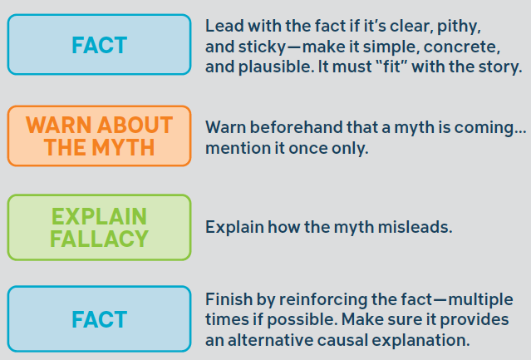
How to deal with myths
Debunk Often and Do It Properly
https://www.climatechangecommunication.org/debunking-handbook-2020/

Slide 62
Conclusions
The What AND the How matter
Avoid traps: The “Lecture Trap” or “Persuasion Trap”
Avoid ”fear appeals” or “data-dumps”
Presumptive recommendations work
Make a strong recommendation
Utilize motivational interviewing ”light”
Don’t forget to “debunk” and “pre-bunk”

Slide 63
Resources for you
CDC’s vaccine web section www.cdc.gov/vaccines
CDC’s “Provider Resources for Vaccine Conversations with Parents” www.cdc.gov/vaccines/conversations
IAC’s Responding to Concerns web section www.immunize.org/concerns and Talking with Parents web section www.immunize.org/concerns/comm_talk.asp
Vaccine Education Center www.vaccine.chop.edu
AAP’s immunization website www.aap.org/immunization
The debunking handbook https://www.climatechangecommunication.org/debunking-handbook-2020/

Slide 64
Resources for parents
Handouts for communicating with parents and patients from IAC www.immunize.org/handouts/discussing-vaccines-parents.asp
IAC’s website for the public www.vaccineinformation.org
CDC’s “Parents Guide to Childhood Immunization” www.cdc.gov/vaccines/pubs/parents-guide
CDC’s “Provider Resources for Vaccine Conversations with Parents” www.cdc.gov/vaccines/conversations
Every Child By Two’s websites: http://www.ecbt.org and www.vaccinateyourbaby.org

Slide 65
Acknowledgements
Dr. Sean O’Leary, MD, MPH - Professor of Pediatrics, University of Colorado School of Medicine/Children’s Hospital Colorado/ACCORDS. Chair, Committee on Infectious Disease – AAP; Liaison Member, ACIP, representing AAP.

Slide 66
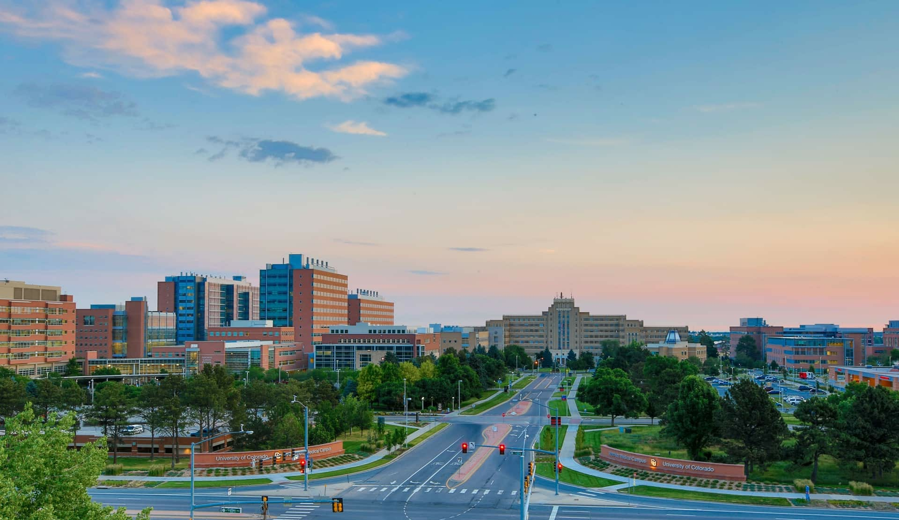
THANK YOU
David.Higgins@cuanschutz.edu
Notes:
TIP: ”Save as” this template before you begin and rename it to the title of your presentation. That way you will retain a copy of this blank template for future use.

Slide 67
References
Seither R, Calhoun K, Yusuf OB, et al. Vaccination Coverage with Selected Vaccines and Exemption Rates Among Children in Kindergarten - United States, 2021-22 School Year. MMWR Morb Mortal Wkly Rep. 2023;72(2):26-32. Published 2023 Jan 13. doi:10.15585/mmwr.mm7202a2
Hill HA, Chen M, Elam-Evans LD, Yankey D, Singleton JA. Vaccination Coverage by Age 24 Months Among Children Born During 2018-2019 - National Immunization Survey-Child, United States, 2019-2021. MMWR Morb Mortal Wkly Rep. 2023;72(2):33-38. Published 2023 Jan 13. doi:10.15585/mmwr.mm7202a3
Washington Post. A record number of measles cases is hitting the U.S. this year. Who is being affected? Accessed June, 2022. https://www.washingtonpost.com/graphics/2019/health/measles-who-is-being-affected/
The Community Guide. CPSTF Findings for Increasing Vaccination. Accessed June 2022. https://www.thecommunityguide.org/pages/task-force-findings-increasing-vaccination.html
Wakefield AJ, Murch SH, Anthony A, et al. Ileal-lymphoid-nodular hyperplasia, non-specific colitis, and pervasive developmental disorder in children [retracted in: Lancet. 2010 Feb 6;375(9713):445]. Lancet. 1998;351(9103):637-641. doi:10.1016/s0140-6736(97)11096-0
Gerber JS, Offit PA. Vaccines and autism: a tale of shifting hypotheses. Clin Infect Dis. 2009;48(4):456-461. doi:10.1086/596476
Kaufman J, Ryan R, Walsh L, et al. Face-to-face interventions for informing or educating parents about early childhood vaccination. Cochrane Database Syst Rev. 2018;5(5):CD010038. Published 2018 May 8. doi:10.1002/14651858.CD010038.pub3
Nyhan B, Reifler J, Richey S, Freed GL. Effective messages in vaccine promotion: a randomized trial. Pediatrics. 2014;133(4):e835-e842. doi:10.1542/peds.2013-2365
CDC. Talking with Parents about Vaccines for Infants. Accessed June, 2022. https://www.cdc.gov/vaccines/hcp/conversations/talking-with-parents.html
Opel DJ, Heritage J, Taylor JA, et al. The architecture of provider-parent vaccine discussions at health supervision visits. Pediatrics. 2013;132(6):1037-1046. doi:10.1542/peds.2013-2037
Dempsey AF, Pyrzanowski J, Lockhart S, Campagna E, Barnard J, O'Leary ST. Parents' perceptions of provider communication regarding adolescent vaccines. Hum Vaccin Immunother. 2016;12(6):1469-1475. doi:10.1080/21645515.2016.1147636
Dempsey AF, Pyrznawoski J, Lockhart S, et al. Effect of a Health Care Professional Communication Training Intervention on Adolescent Human Papillomavirus Vaccination: A Cluster Randomized Clinical Trial. JAMA Pediatr. 2018;172(5):e180016. doi:10.1001/jamapediatrics.2018.0016
George Mason University Center for Climate Change Communication. Debunking Handbook 2020. Accessed June 2022. https://www.climatechangecommunication.org/debunking-handbook-2020/

Slide 68
Extra slides

Slide 69
Choice architecture
Presumptive format leverages “choice architecture” - how a decision is presented.
When presented with choices, a large majority of people will stick with the “default option”.
“Default options” are most justifiable where there is a high degree of certainty that an intervention is of low risk and high benefit, such as recommended vaccines!

