Slide 1

Introducing
The Patient Health Questionnaire
(PHQ-9) as an Alternative Depression Screening Tool

Slide 2

Criticality of Universal
Depression Screenings
Research has demonstrated that up to 50 percent of parents served by home visiting have experienced clinically elevated levels of depression during the critical first years of their child’s development (Ammerman et al., 2010)
Half of postpartum depression in new mothers go undiagnosed due to: (Beck, 2010)
  Conflict in privacy
  Not wanting to disclose to close family members
  Stigma and shame around new mothers in that disclosure may lead to abandonment and fear of lack of support
  Concerns about being seen as unfit
  Poor mental health literacy

Slide 3
Home Visiting Standard 4
Family Goal Setting
This standard determines tools and usage of state-approved screening processes, ongoing assessment and goal setting, referrals, follow-ups, and bridge to community resources.
4.1 Tools, Screenings and Curricula to Support Families
4.1.a The completion of the following screening tools is required, and staff must be trained to fidelity. In addition, staff must enter the screening results into the HV Data system and share the results with families and document the disposition of the referral in the database. Screening tools must be completed in their entirety to include the demographics and scoring pieces and follow the periodicity and/or model or curriculum requirements.
Edinburgh Postnatal Depression Scale (EPDS) (prenatal to 12 months) or the Patient Health Questionnaire 9 (PHQ-9) (not dependent on age, and may be used with fathers, grandparents, foster parents, etc.)
Ages and Stages Questionnaire (ASQ-3)
Ages and Stages Questionnaire: Social /Emotional (ASQ-SE)
Interpersonal Violence Screening Tools: Relationship Assessment Tool (RAT) or /Hurt-Insult-Threaten-Scream (HITS)
Parenting Interactions with Children: Checklist of Observations Linked to Outcomes (PICCOLO)/ Dyadic Assessment of Naturalistic Caregiver-child Experiences (DANCE) or other approved tool/screening as determined by ECECD
Maternal Adult and Child Health Questionnaires (MCH)
Any other tool as determined by ECECD
1 of 2

Slide 4

Home Visiting Standard 4
Family Goal Setting
This standard determines tools and usage of state-approved screening processes, ongoing assessment and goal setting, referrals, follow-ups, and bridge to community resources.
4.1 Tools, Screenings and Curricula to Support Families
4.1.b Other identified curricula and training to support families
  Mothers and Babies to support Maternal Depression
  Facilitated Attunement Training
  Circle of Security
  Any other curricula as determined by ECECD
2 of 2

Slide 5

Complications of Depression on a Family
Mother: It can lead to chronic depressive disorder if not treated on time. Even if treated, PPD can be a risk for future episodes of major depression.
Father: This can be a precipitating factor for depression in the father as this will be a stressful event for the entire family.
Infant: Children of mothers who have untreated depression can develop behavioral and emotional problems. More commonly seen are delays in language development. They can also suffer from sleeping problems, eating difficulties, excessive crying, and attention-deficit/hyperactivity disorder (ADHD).

Slide 6

PHQ-9 Quick Facts
The PHQ-9 is a multipurpose instrument for screening, monitoring and measuring the severity of depression
The tool rates the frequency of the symptoms over the past two weeks
Question #9 screens for the presence and duration of suicide ideation
Available in more than 50 languages
Takes less than two minutes to complete and less than one minute to score
Well validated and documented in a variety of populations
Can be used in adolescents as young as 12 years of age
(University of Washington Department of Psychiatry and Behavioral Sciences, 2023)

Slide 7
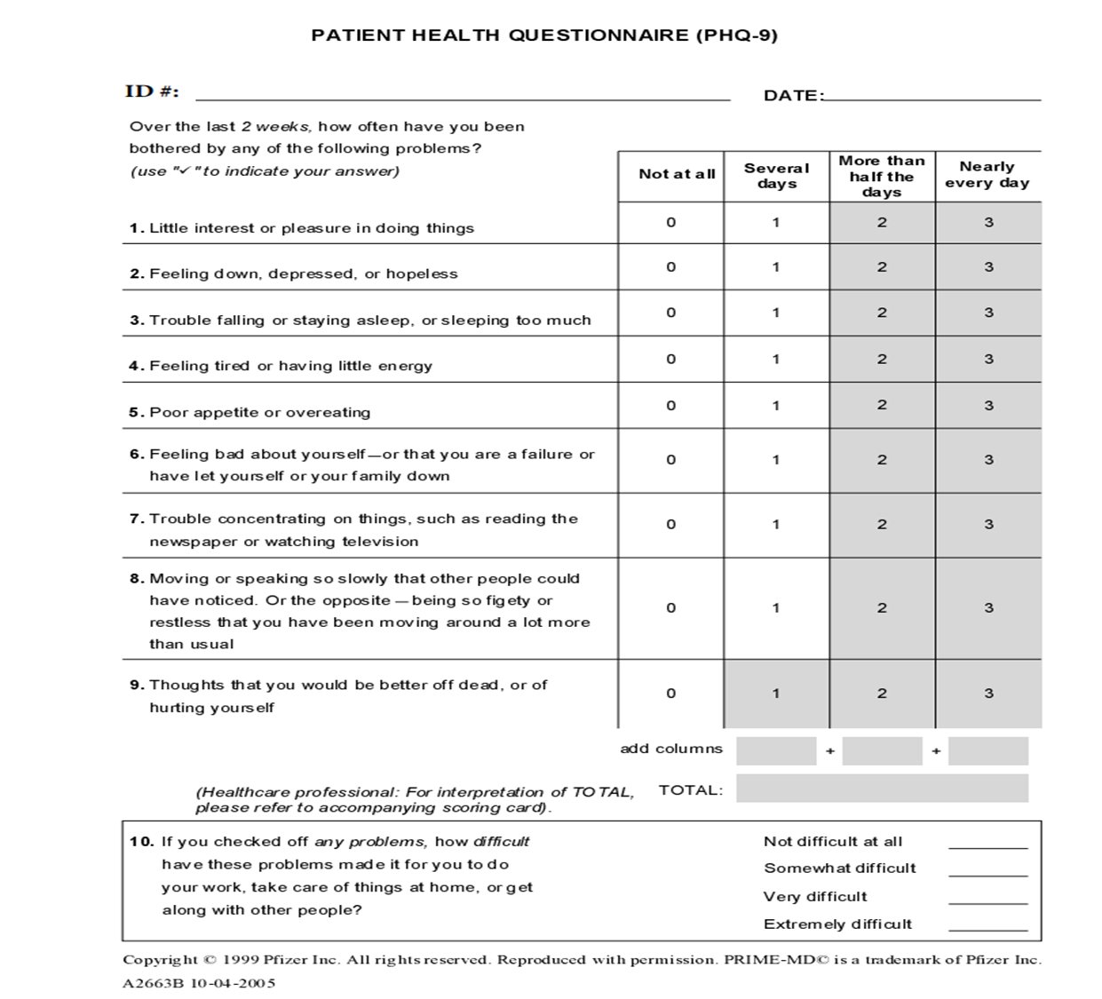
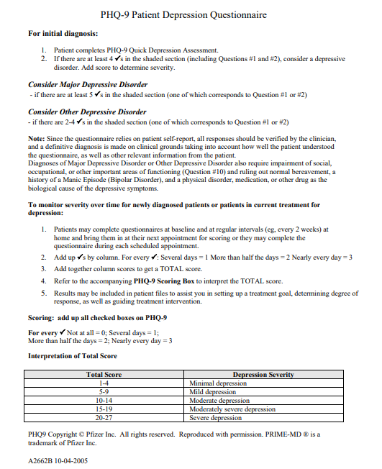
Notes:
.

Slide 8
Scoring PHQ 2 and 9 at Risk for Referral
PHQ-9 Score | Depression Severity | Outcome
0-4 | None-minimal | None
5-9 | Mild | Watchful waiting; repeat PHQ-9 at follow-up. Consider Mothers and Babies Curriculum.
10-14 | Moderate | Watchful waiting; repeat PHQ-9 at follow-up. Consider Mothers and Babies Curriculum. Refer for mental health services.
15-19 | Moderate Severe | Needs to be referred for mental health services.
20-27 | Severe | Needs to be referred for immediate mental health services.
Interpretation:
Total scores of 5, 10, 15, and 20 represent cut-off points for mild, moderate, moderately severe and severe depression, respectively.
Note: Question 9 is a single screening question on suicide risk. A caregiver who answers yes to question 9 needs further assessment for suicide risk by an individual who is competent to assess this risk.
Notes:
Mothers and Babies

Slide 9
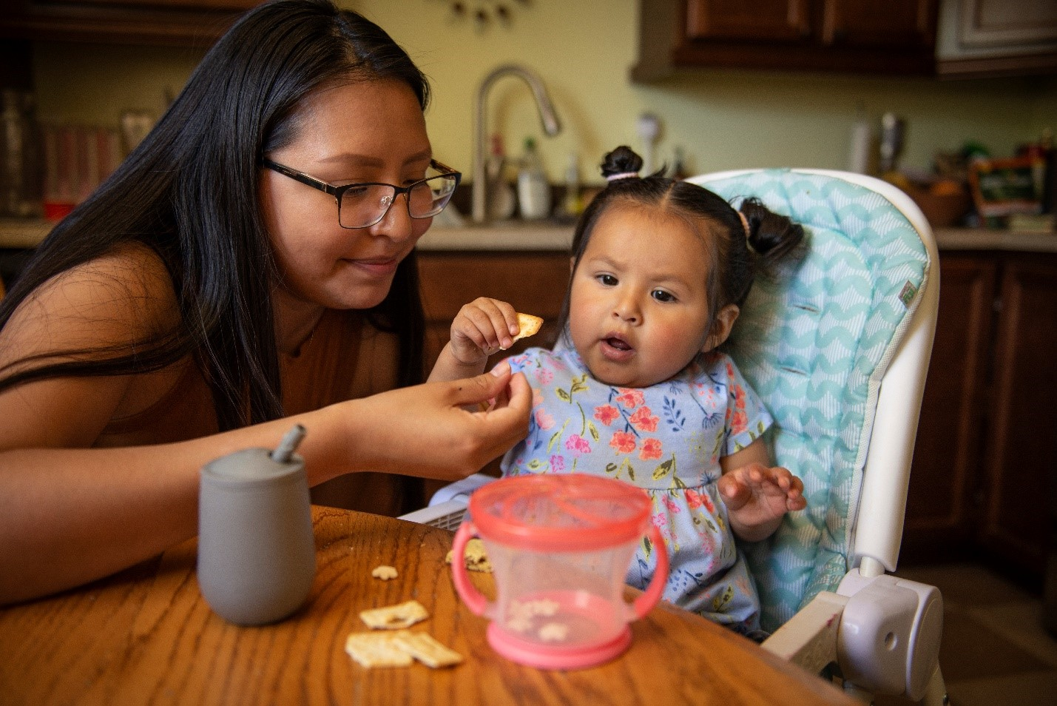
Mothers and Babies
Upcoming Training Dates
November 13, 15, and 16
1:00 p.m. - 4:30 p.m.
January 23, 24, and 25
9:30 a.m. - 1:00 p.m.
April 23, 24, and 25
1:00 p.m. - 4:30 p.m.
Notes:
Mothers and Babies
FY up coming trainings
-Brief over of M and B- stop- gap

Slide 10
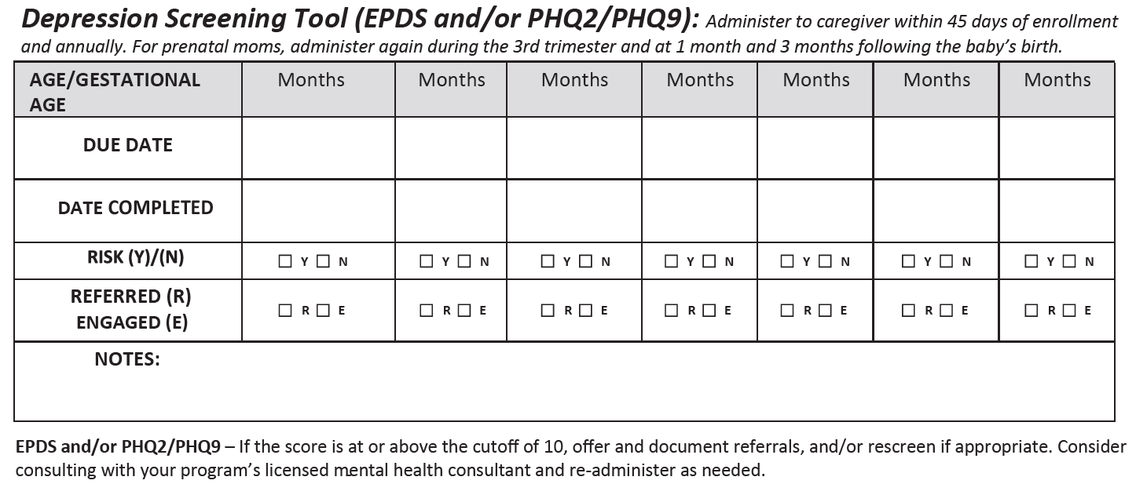
Notes:
.

Slide 11
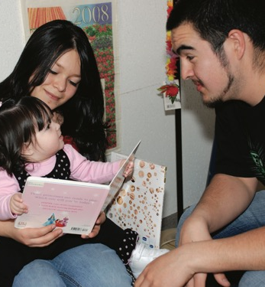
Administering
Relationship-based and universal approach
Caregiver knows the intention behind the tool (think about the language we use around “mental health” and the stigmas/cultural considerations around mental health)
Inform on the sensitivity of the tool
Preface - At any point that you feel uncomfortable, please let me know
Let the caregiver choose how they want to complete it (self-administer or interview style)

Slide 12
Tips for Home Visitors
Pre and post-contact - how are you and what do you need to be present? Please share your strategies in the chat.
  Breathing
  Self-talk
  Leaving with extra time to spare
Explore risk factors that increase the incidence of perinatal depression (Chen et al., 2022):
Past histories of mental illness
Lower educational level
Poor economic status
Domestic violence
Perinatal smoking or drinking
Multiparity
Trauma history
Young maternal age
Being African American
Know and explore your “shark music”- reflective supervision –
“How will I react if they score high?”

Slide 13

Homework
Ensure you know who your Mental Health Consultant is and that they are accessible to the entire team if/when needed.
When suicidal ideation is disclosed (question #9 on PHQ-9 or #10 on EPDS) what is your program’s process?

Slide 14


Introduction to
Family Statement
One of the goals of the home visiting program is to increase the well-being of all family members. I understand being a parent and having a new baby can be very difficult. It is okay to feel unhappy at times. To better understand how I can best support you in your parenting role, I am going to take a few minutes to ask you questions about how you have been feeling lately. Sometimes these questions give moms new words to describe how they are feeling. This screening is a simple way to understand if there is something going on that’s a bit unusual from the way you normally feel. We use this questionnaire with everyone we visit, so all parents in our program get this screening. I will not share this information with anyone outside the agency, so our conversation is confidential. I will read the question and answers and you will let me know which answer comes closest to how you have felt during the past several days.

Slide 15
References
Ammerman, R. T., Putnam, F. W., Bosse, N. R., Teeters, A. R., & Van Ginkel, J. B. (2010). Maternal Depression in Home Visitation: A Systematic Review. Aggression and violent behavior, 15(3), 191–200. https://doi.org/10.1016/j.avb.2009.12.002
Education Development Center (EDC). (n.d.). PHQ-9 Introduction Statements. https://hv-coiin.edc.org/
Mughal S, Azhar Y, Siddiqui W. Postpartum Depression. (2022). In: StatPearls [Internet]. Treasure Island (FL): StatPearls Publishing; 2023 Jan-. Available from: https://www.ncbi.nlm.nih.gov/books/NBK519070
University of Washington Department of Psychiatry and Behavioral Sciences. (2023). The Patient Health Questionnaire (PHQ-9) - overview - drugs and alcohol. AIMS Advancing Integrated Mental Health Solutions. https://www.drugsandalcohol.ie/26814/1/Patient%20Health%20Questionnaire.pdf
Yang, K., Wu, J. & Chen, X. (2022). Risk factors of perinatal depression in women: a systematic review and meta-analysis. BMC Psychiatry 22, 63. https://doi.org/10.1186/s12888-021-03684-3

Slide 16







Stay Connected with the New Mexico Early Childhood Education and Care Department
NMECECD.org
800-832-1321
PO Drawer 5619
Santa Fe, NM
87502-5619
Weekly newsletter sign up: https://bit.ly/36kZEQC.
@NewMexicoECECD

