Slide 1




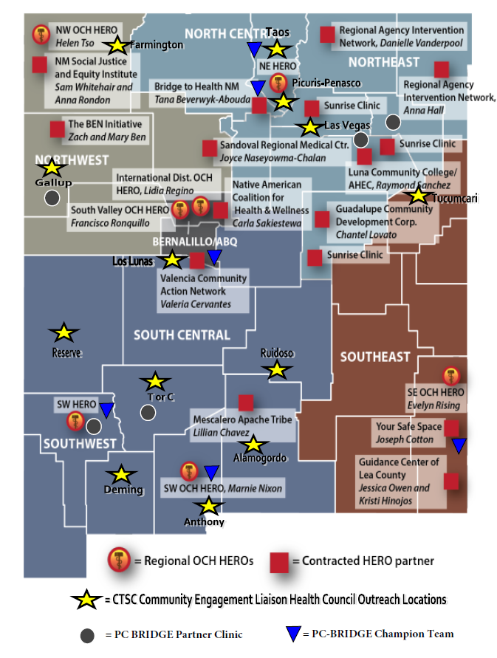


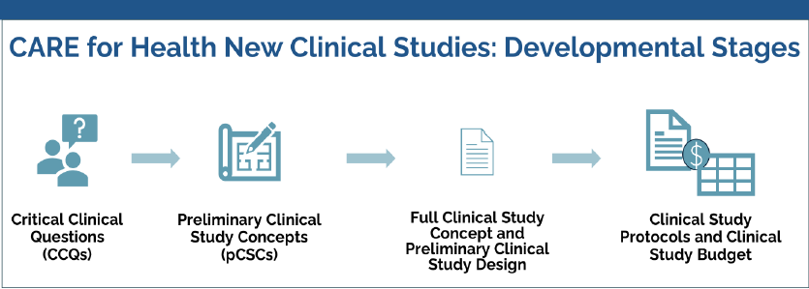


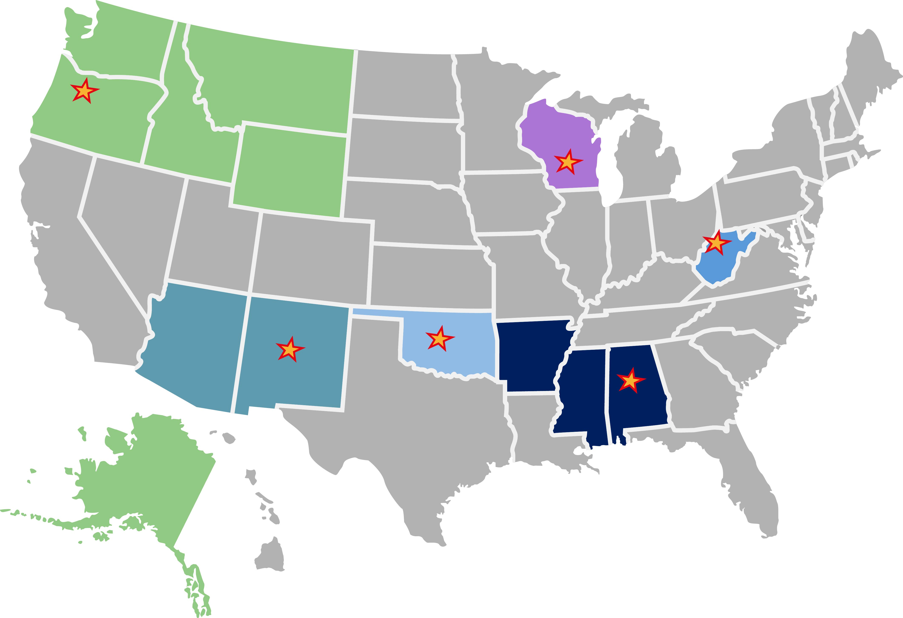
Building PC-BRIDGEs:
An Early Perspective on Extending Research Capacity to Rural Primary Care in New Mexico and Arizona
Primary Care—Building Research Integration in Different Geographic Environments
Jarod Peterman¹, Andrew Sussman¹, Nancy Pandhi¹, Hengameh Raissy¹, Karen Lutrick²,
¹University of New Mexico; ²University of Arizona
BACKGROUND
PC-BRIDGE Activities
Federally funded clinical research is often conducted in large academic centers, limiting reach into the rural and underserved communities hit hardest by health disparities.
Rural primary care clinics face barriers to participating in research: limited staffing, resource shortages, administrative burdens, and patient hesitancy.
PC-BRIDGE was established in Jan 2025 as a hub for the NIH CARE for Health Initiative™.
Our goal: build sustainable capacity for clinical research in rural primary care settings, ensuring equity, generalizability, and translation of NIH research.
Build relationships and infrastructure with rural clinics that support research participation.
Engage clinics and communities to define future study priorities.
With input from the other hubs and NIH, develop pragmatic studies tailored to rural realities.
Community Engagement
Existing Study Implementation
Future Study Development
Built a network of “Primary Care Champion Teams” in NM and AZ.
Teams include providers and staff who:
Share clinic capacity data and community health priorities.
Advise on feasibility of proposed research activities.
Serve as liaisons for bidirectional communication between NIH, researchers, and local communities.
Outreach to community groups supports both study recruitment and identification of health priorities.
As part of its pilot year, PC-BRIDGE is embedding two existing NIH-funded clinical trials into rural primary care settings. These efforts are designed to broaden participant recruitment, evaluate feasibility in resource-limited clinics, and test workflows that can be applied to future multi-site studies under CARE for Health.
Tai Chi Knee | Tufts Medicine
Evaluates remote Tai Chi for knee osteoarthritis symptom management.
Remote delivery => low clinic burden.
Implemented at First Choice Community Health clinics, which are Federally-Qualified Health Centers (FQHCs).
CARE for Health™ allows each hub to co-develop new pragmatic trials with NIH.
PC-BRIDGE is collaborating to develop two new studies to launch 2026.
Design process uses national committees and cross-hub collaboration to ensure studies are:
Feasible in rural primary care.
Low burden for clinics.
Tailored to collected clinic health priorities.
PC-BRIDGE is collaborating with SW-CACTI’s (formerly CTSC) community engagement team and UNM’s Health Extension Regional Offices (HERO). These collaborations leverage existing relationships with state health councils and clinics, as well as utilize local representatives for in-community outreach.
Objectives
SUPERA | UCSF, UCI
Evaluates benefit of peer support on Spanish-language digital CBT for depression and anxiety.
Addresses language and access barriers in underserved communities.
Implemented at Sandoval Regional Medical Center, Truman Health Clinic, North Valley Clinic, Southeast Heights Clinic.
CARE for Health™ Initiative
PC-BRIDGE is collaborating with HSC’s Center for Advancing Dissemination and Implementation Science (CADIS) to achieve innovative and accessible study design.
Recruitment is open for both studies, with 2026 completion goals. PC-BRIDGE staff will collaborate with host study teams to publish outcomes and implementation papers.
EARLY INSIGHTS & CHALLENGES
IMPACTS & SIGNIFICANCE
ACKNOWLEDGEMENTS
Administrative complexity: multi-institutional coordination can be slow and burdensome.
Primary care clinic capacity constraints: staff shortages, competing demands, hesitancy to add new activities.
Personal Health Information concerns: reluctance to share and fear of patient mistrust.
Patient barriers: skepticism, lack of time, low interest.
Emerging Themes:
Community and clinic relationships will take years and multiple studies to build and sustain.
Trials must require minimal clinic resources.
Multiple southwest clinics needed for sufficient enrollment.
Flexibility is essential when working with NIH, universities, and local clinics.
Brings NIH-funded research directly into rural, underserved populations.
Improves access and generalizability of clinical trials.
Builds sustainable clinic-level research infrastructure.
Creates bidirectional communication between communities and NIH.
Lays the foundation for a national primary care research network.
PC-BRIDGE is supported by numerous faculty, staff, and offices. This includes but is not limited to:
Isaac Goldstein, Sharon Zaldivar Alatorre, Austin Arnold, Olivia Healy, Elizabeth Valdivia, Donna Sedillo, Carla Cordova, Cynthia Killough, Randy Benally, Heidi Brakey, Lexie Roesch, Fiorella Adrianzen, Christina Anderson, Christos Argyropoulos, Prajakta Adsul, Lidia Regino, Tamara Wheeler, Matthew Manicke, Daniel de Francisco Cabral, Harry Snow, Sherry Weitzen, Erin Boquin, Pilar SanJuan, Janet Page-Reeves, Alberta Kong, UNM HEROs.
Research reported in this poster was supported by the National Institutes of Health under award number OT2OD038374-01 (MPI: Sussman, Pandhi, Raissy) and UM1TR005466 (MPI: Pandhi, Campen, Radovick). The content is solely the responsibility of the authors and does not necessarily represent the official views of the National Institutes of Health.
For more information contact: jcpeterman@salud.unm.edu
National NIH program testing the feasibility of a Primary Care Research Network.
Six hubs nationwide, each housed at an academic health center with existing translational research infrastructure.
Focus: co-develop new clinical studies with NIH, informed by clinic feasibility and community priorities.
Goal: a sustainable, nationwide network embedding federally-funded research directly into primary care with bidirectional communication.
NEXT STEPS
Maintain and cultivate deep relationships with partner clinics and community
Work with NIH and collaborators to develop two new study protocols
Launch first in Fall 2026
Expand an additional existing NIH-funded study in Spring 2026
Continue PC-BRIDGE mission into 2026

