Slide 1
Contracts and Grants
Financial Services Center
HSC and Main Campus Presentation
December 4 & 5, 2012

Slide 2
Department Overview
Contract & Grant Accounting is the central office responsible for overseeing the financial compliance requirements stipulated within the sponsored award to the University based on a proposal submitted from the PI.

Slide 3
Department Overview, cont’d
Interpret UNM, Federal, State, and sponsor policies
Set up award and budget in Banner
Monitor expenditures for compliance
Review EPAFs, Labor Redistributions, Requisitions, JVs, and DPIs
Process petty cash transactions
Create and submit invoices to sponsors (including collections)
Process automated draws (payments)
Apply payments to awards (checks and wires)
Review and process sub-award invoices (incoming invoices)
Generate and track Effort Reports
Review and track Carry-over requests submitted by PI
Submit Financial Reports
Submit Invention Statements and Equipment/Inventory Reports
Close awards in Banner and with sponsor
Respond to audit requests

Slide 4
Agenda:
Contract & Grant and General Banner Forms
Business Purpose
Cost Transfers
90 day Memos
Salary Transfers

Slide 5
Agenda, cont’d:
What NOT to Charge
Retention Policy
Our Commitment to you
Participant Incentive Memo

Slide 6
Useful Banner Forms Specific to Contracts and Grants
FORM | USED FOR
FRAGRNT | Identify PI, Fiscal Monitor, other grant info. Find copies of UNM invoices and payments in Xtender.
FTMACCI | Use to find the fund number associated with an index.
FRMFUND | View the budget start and end dates of a fund.
FRIGITD | Show grant budget and expense information. Similar to FGIBDST for unrestricted indexes.
FRAAREV | Billing and Payment information.
FRIBILL | Show amount billed and paid, and outstanding balances.
Notes:
The first set of Banner forms that we will review are specific to Contracts and Grants.

Slide 7
Useful Banner Forms General
FORM | USED FOR
FOADOCU | Status of documents you have created. Disapprove your documents.
FOAAINP | Status of documents awaiting approval.
FOIAPPH | Look up history of processed documents.
FGIDOCR | View detail for posted JVs.
FOIDOCH | Show history of vendor invoices, date paid, and check number.
Notes:
The second set of Banner forms we will review can be used for general purposes.

Slide 8
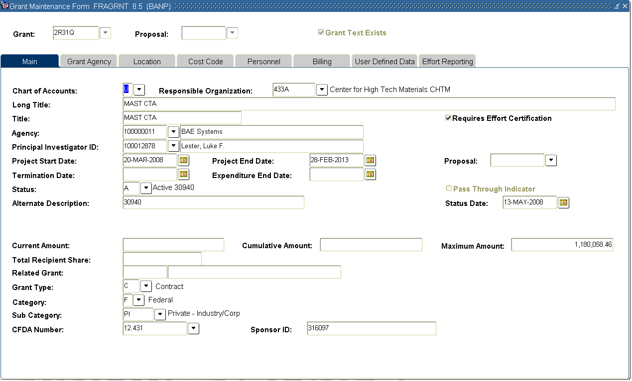
FRAGRNT
Notes:
Start by entering the grant number and select next block
- The Main tab on this form will appear
- Please note the Project dates are for the entire project period.

Slide 9
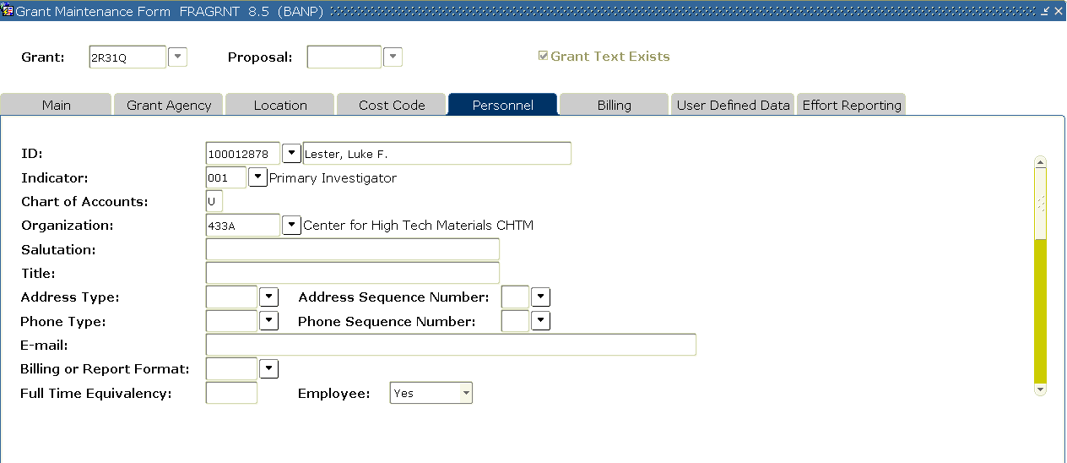
FRAGRNT
Notes:
- The personnel tab will show you the various people assigned to your grant.
- By selecting the scroll down bar on the right side of the form, the assigned personnel for the grant will be displayed.

Slide 10
FRAGRNT
Notes:
- Note that the Account Administrator is the person who will receive email and workflow notifications on this grant. This will include effort cert. notifications and other notifications as the grant end date nears. Please contact your respective C&GA office if this information needs to be changed or updated.

Slide 11
FTMACCI
Notes:
You can use this form to identify the fund number associated with an index number.
- Start by inputting the index number in the Account Index field and execute query (F8).
- You can also view all of the Signature Authorization forms scanned to this index through Xtender.
To convert the fund number to the grant number just add an “R” as the second character to the fund number and drop the last number. In this example, the grant number would be 2R31Q.
You can also use this form to find old FRS account numbers. Who remembers the old FRS days? Yes, that is going back quite some time!

Slide 12
FRMFUND
Notes:
FRMFUND is primarily used by departments to look up the start and end dates of the fund, and cost codes.
- Query by fund number to see the budget period dates.
The budget end date triggers the Invalid Labor Distribution notifications, as well as the Closeout workflow email.
This date is also used to trigger the salary to post to your OEI if it is past the end date.
- The cost code section tells Banner how to apply the F&A (Facilities and Administration) rates to the fund.

Slide 13
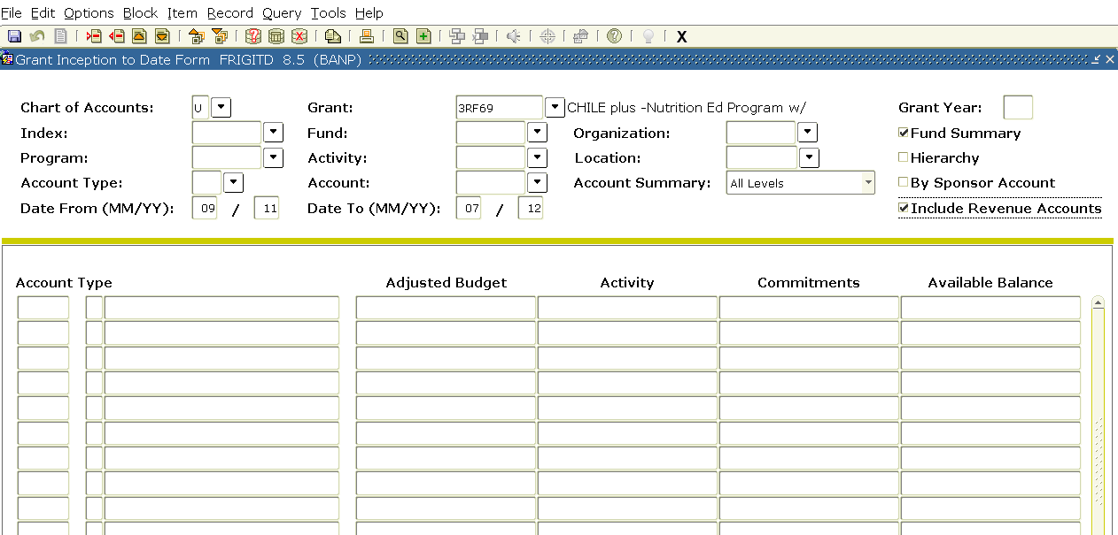
FRIGITD
Notes:
You can query by grant, fund, or index. However, org level security does apply to this form so you may only have access to view index information for your org level.
- If your award has multiple funds, you can select fund summary and Next Block to view the information by fund.
- Click on Include Revenue Accounts to see the Revenue Account Codes.
You can also use this form to query by using specific date parameters.
This is the form C&GA uses to identify charges that have posted either before or after the contract dates. So you know… the auditors use this form for the very same reason!

Slide 14
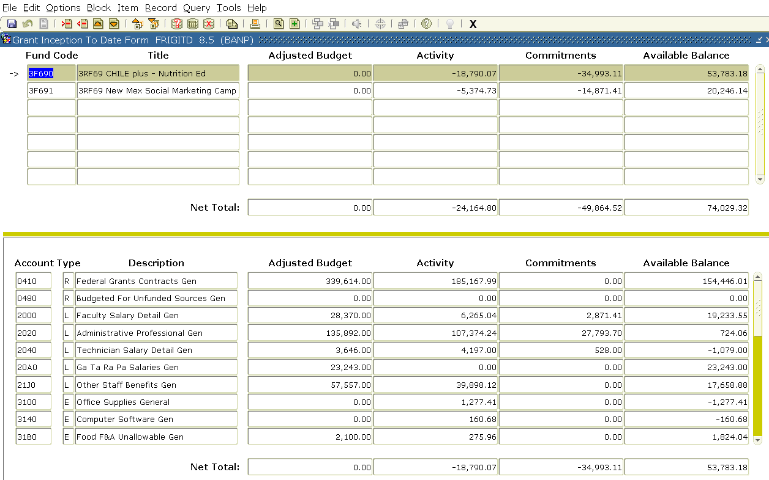
FRIGITD
Notes:
After you hit next block, the detail for the highlighted fund is displayed in the lower section of the screen. You can see the Budget, Activity ( which are Expenditures),
- Commitments (Encumbrances) and Available Balance on this form. C&GA staff LOVES this Banner form!

Slide 15
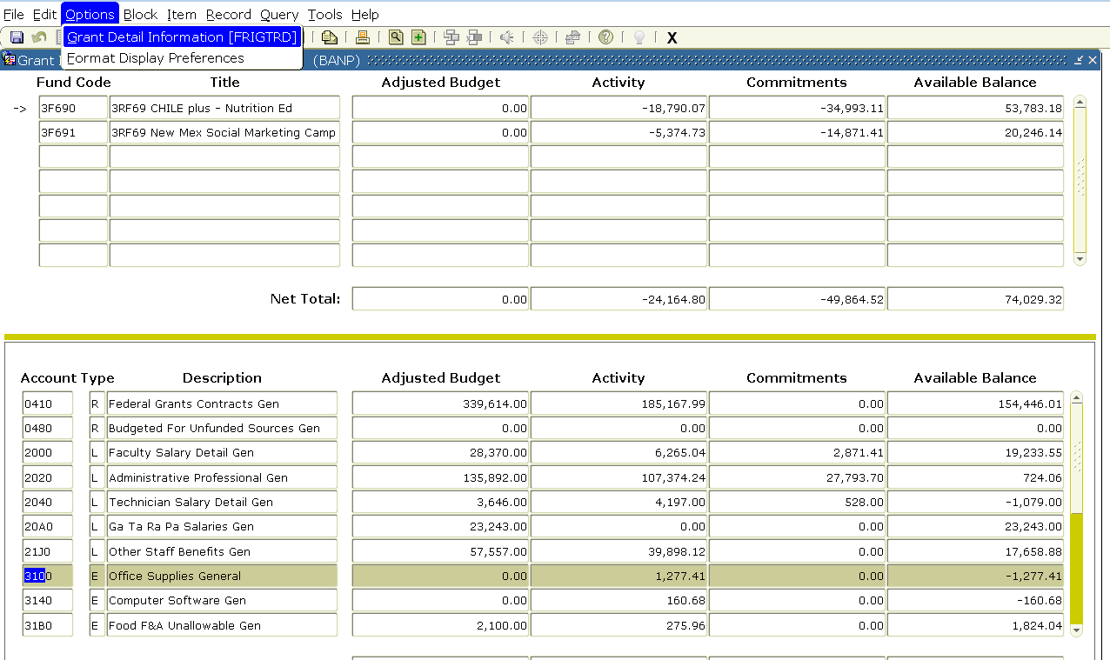
FRIGITD
Notes:
You can also to drill down to detailed information within an account code
- By selecting Options/Grant Detail Information option at the top of the screen, the detail will appear for a
- highlighted row. In this example, we are going to query on Account Code 3100 Office Supplies.

Slide 16
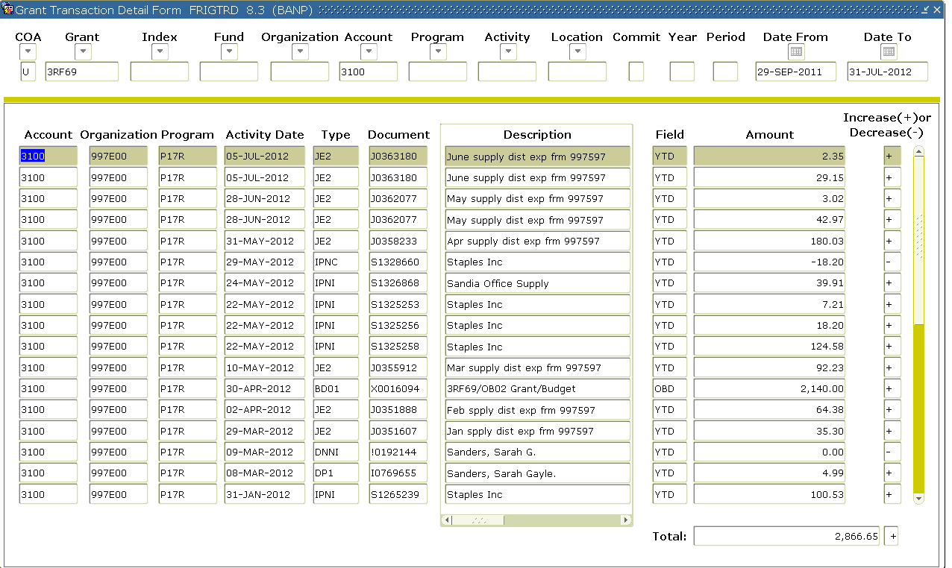
FRIGITD
Notes:
This detail screen shows all the activity in account 3100. YTD indicates an actual expense, OBD identifies the Budget entry.

Slide 17
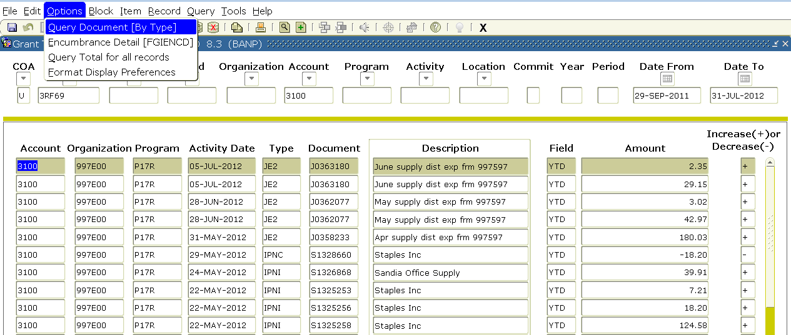
FRIGITD
Notes:
You can also drill down even further into a specific document by selecting
- Options/Query Document [By Type] for the highlighted row. In this example, we are going to query this
- JV document.

Slide 18
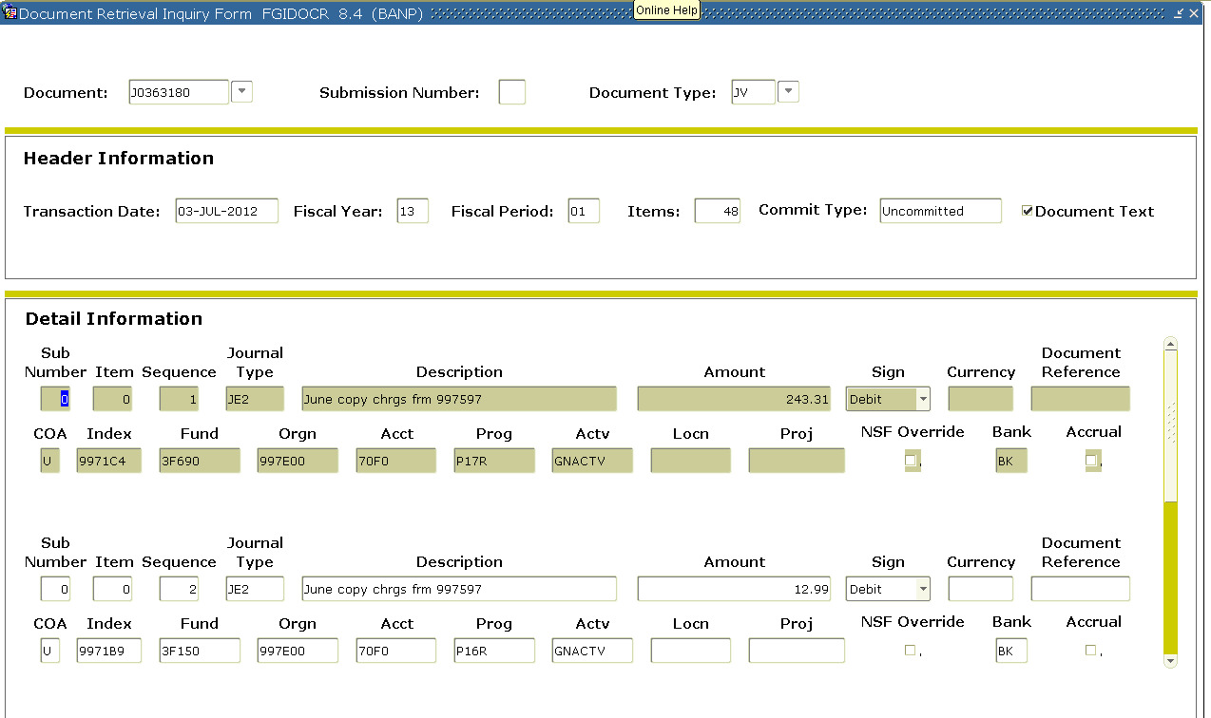
FRIGITD
Notes:
The document detail for this JV will be displayed. You can use the scroll bar to view the each debit and credit entry.

Slide 19
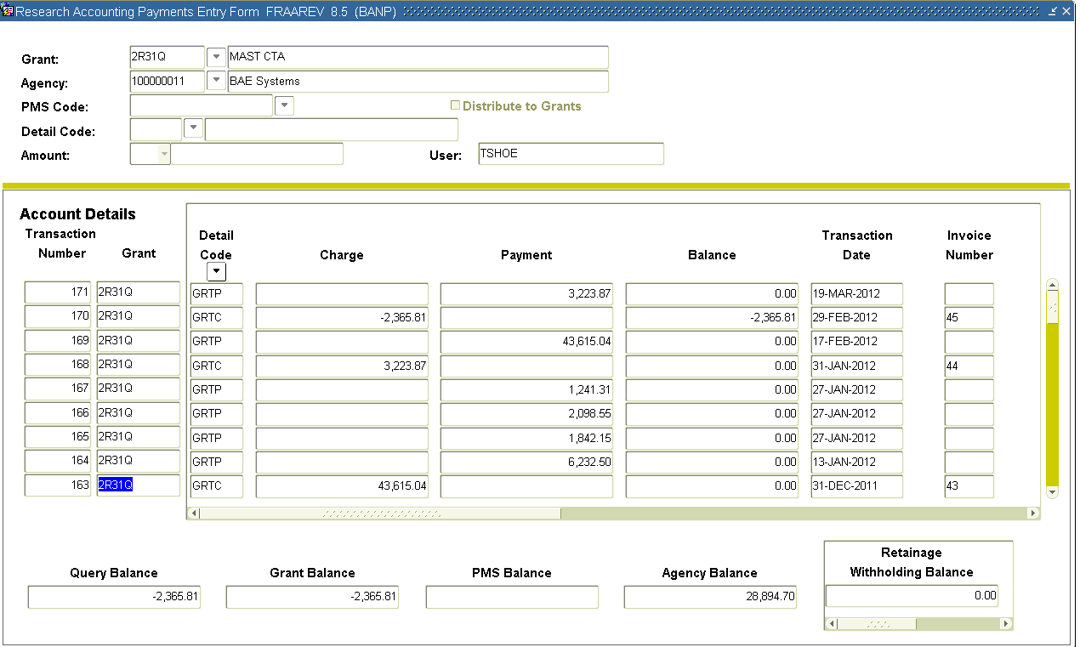
FRAAREV
Notes:
Ok, on to the FRAAREV screen!
Start by entering the grant # and then next block.
- The amounts in the Charge column represent the invoices that have been mailed to the sponsor, and the
- payments received are displayed in the Payment column.
- Any balances that remain open are displayed in the Balance column. In this example there is a credit Charge amount, due to the department moving charges off the award.

Slide 20
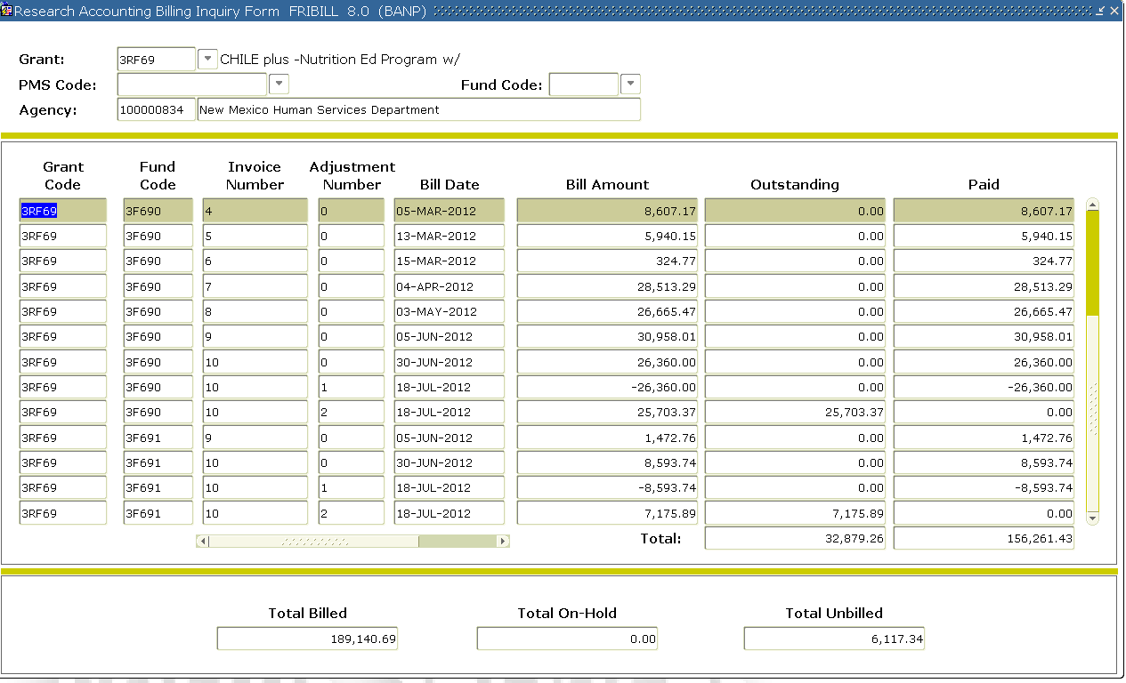
FRIBILL
Notes:
Our last Contract and Grant specific Banner screen! FRIBILL screen is very similar to FRAAREV. This screen displays and summarizes
- billings and
- payments for your award. Enter the grant # and next block. You can quickly see the
- outstanding invoice amounts and any
- unbilled amounts on your award. It is most common to see Unbilled amounts with shell awards.

Slide 21
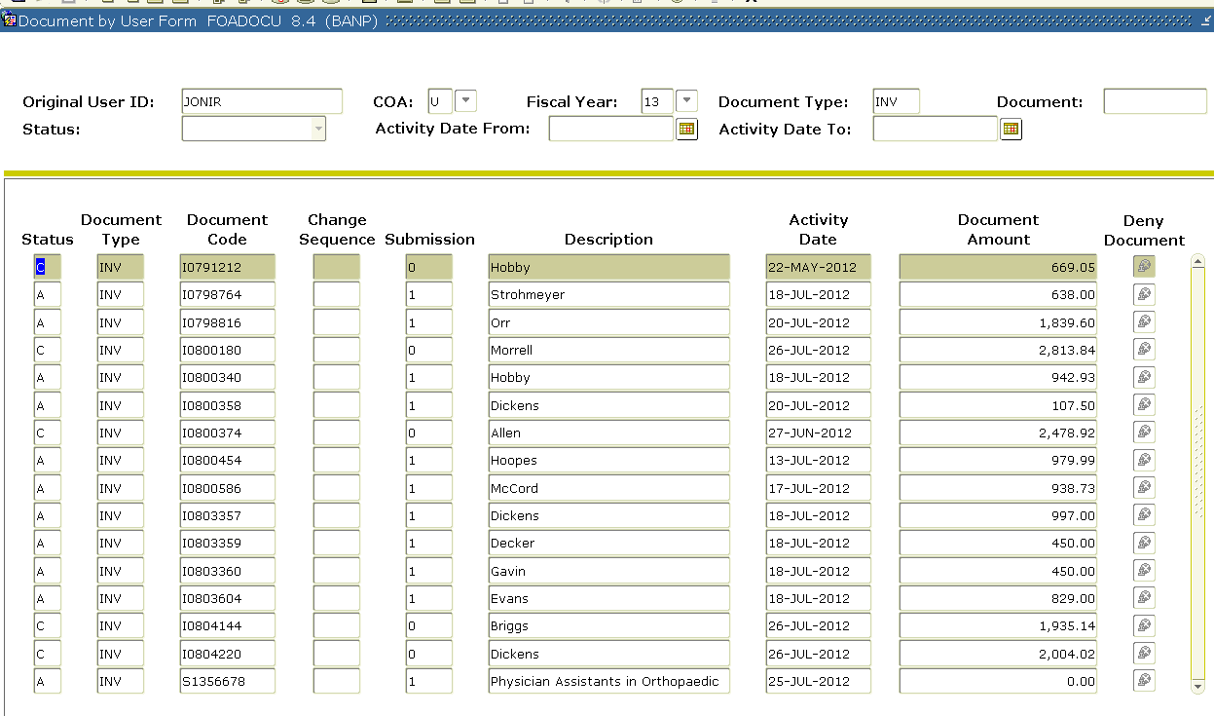
FOADOCU
Notes:
Now we’ll review some general purpose Banner forms. FOADOCU, no – I wasn’t cussing at you, shows the status of documents you have created. Query by your user ID and document type.
- A is approved, I is incomplete, P is posted, C is complete and X is cancelled.
- You can isolate the activity date,
- document type and/or number to narrow your search and return the results more quickly.
- In the right hand column you can click on the icon (if it is red) to self-deny your document.

Slide 22
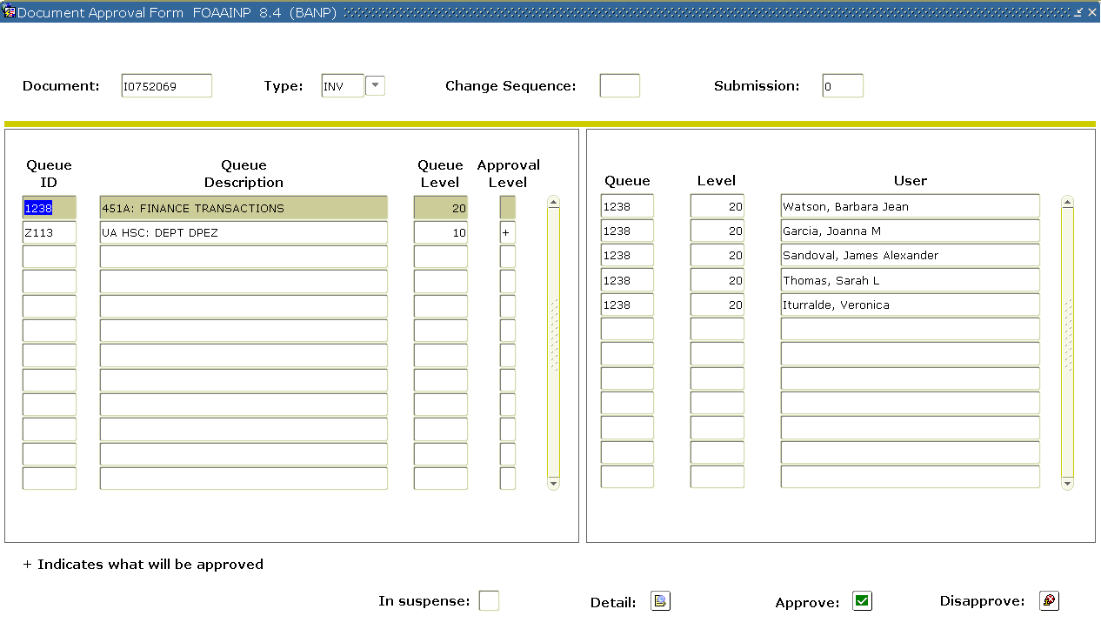
FOAAINP
Notes:
In FOAAINP,
- input the document number, then next block. This will show you the remaining approvers before the document is completed and can post. This screen does not show you who has already approved (or denied) the document.
In this example, the document is still pending approvals in the department. The document will route to the appropriate C&GA office once the department approval process is complete.

Slide 23
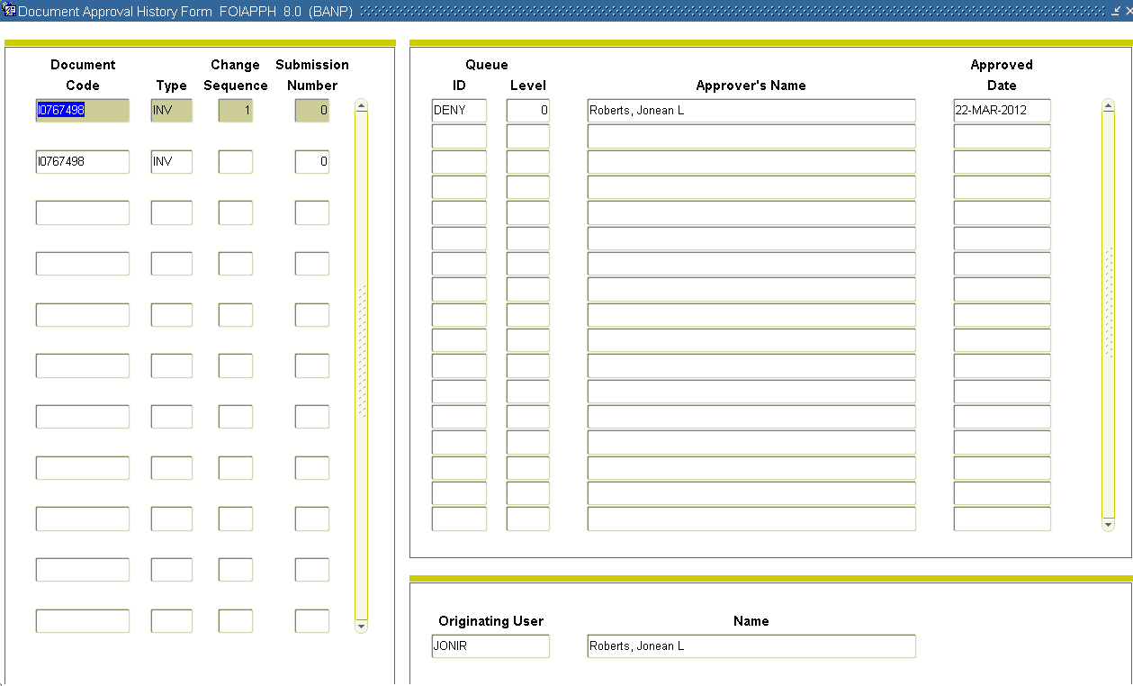
FOIAPPH
Notes:
FOIAPPH is similar in that you
- input the document number and then execute query. This will show you the document history. In this example, this document was
- denied on 3/22/12. There will be multiple tiers if denials have occurred.

Slide 24
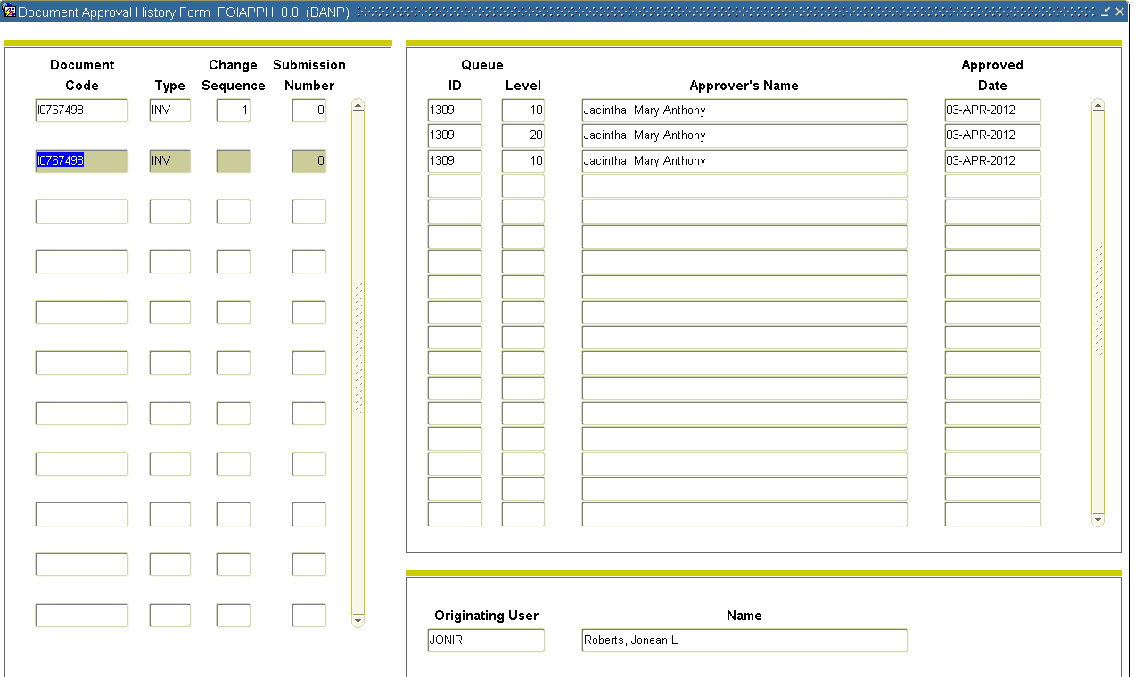
FOIAPPH
Notes:
You’ll see on the 2nd approval tier for this document that this JV was approved on April 3rd by Mary Jacintha. If this JV requires additional approvals, you will not see that on this screen because this screen contains only document history.

Slide 25
FGIDOCR
Notes:
FGIDOCR will allow you to pull up posted JVs. If the document text box is checked, you can view the JV text while in this form, by selecting
- Options / Document Text at the top of the form.

Slide 26
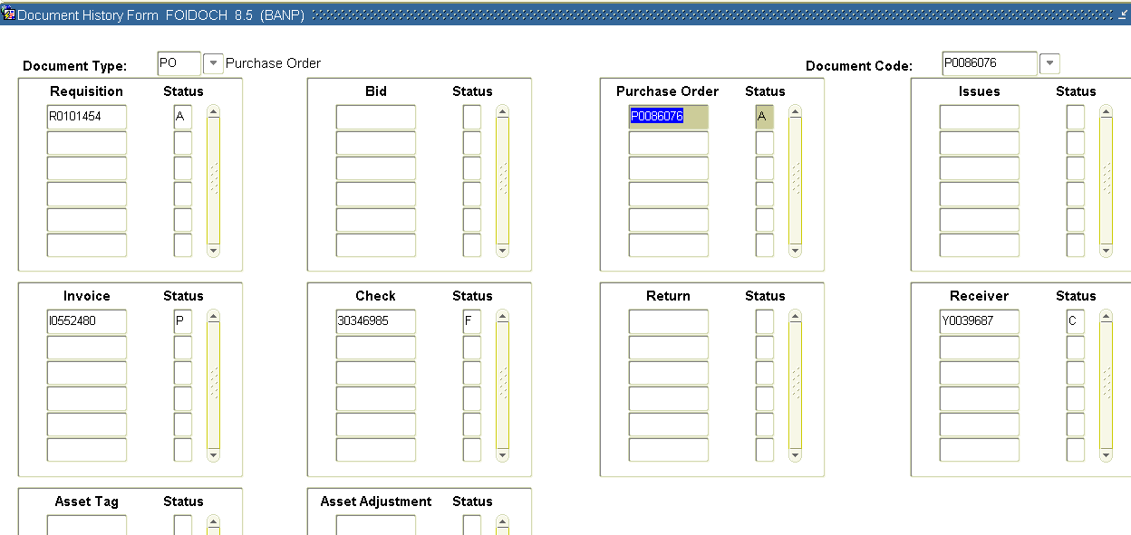
FOIDOCH
Notes:
To use FOIDOCH, first input the document type (use the drop down menu if needed) and input the document number. You can use this screen to query by requisition, invoice, PO, or check number.

Slide 27
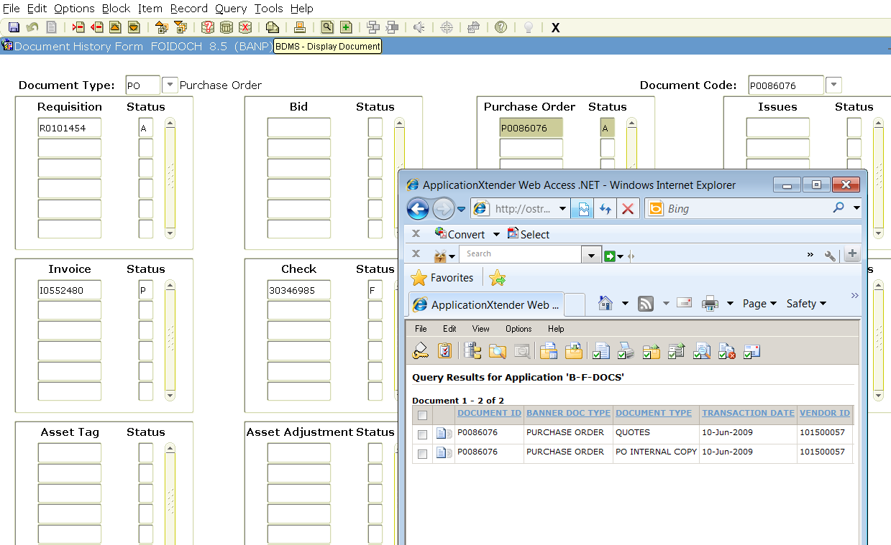
FOIDOCH
Notes:
In FOIDOCH, you can see the entire procurement process from requisition through payment. You can also access Xtender to view copies of the purchase documents or DPIs. For this example, click on the PO # and then the Xtender / magnifying glass to see available Xtender documents. Then click on the paper icon to view the scanned documents.

Slide 28
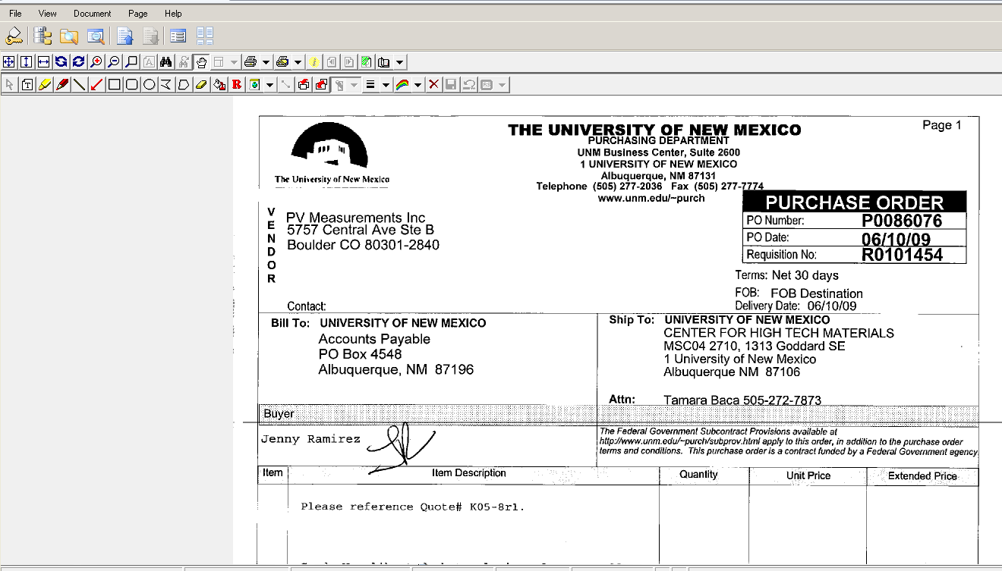
FOIDOCH
Notes:
The scanned document will be displayed. You can also print the document if needed.

Slide 29
Business Purpose
Always required
Essential on Contract or Grant purchases
Justifies the expense
Documents the expense in layman’s terms
Notes:
How does your purchase help the Contract or Grant fulfill its purpose? Does each purchase help attain the goals of the Contract?

Slide 30
Business Purpose
A business purpose is required on a DPEZ, JV, Pcard Exception, Requisition, or Labor Redistribution:
NOT ONLY “what I bought (or redistributed)”
But ALSO “Why I bought (or redistributed) it”
Who
What
Where
Why
Justify
Notes:
A business purpose is mandatory on all the above listed. Who authorized it; what was it; Where is it being used; Why was it purchased (how does it fulfill the Contract or Grant’s mission); Justify the need for the item

Slide 31
Business Purpose – Examples
Good example for an Invoice:
“Purchase reactant for Dr. Smith to complete final experiments on grant so conclusions for grant can be finalized.”
Weak / Unacceptable example:
“To spend down the remaining grant funds.”

Slide 32
Business Purpose – Examples
Weak / Unacceptable example for a JV:
“Move expense to correct index”
Good example:
“Move Joe Smith’s SW air travel (S07564) to attend a seminar on the grant-related topic, how to hydrolize FSQ with greater accuracy, attended 7/12-16/2012 to the grant index”
Notes:
“Move expense to correct index” is too vague. A better Business Purpose would be……

Slide 33
Cost Transfer Policy
Items must be:
Of reasonable cost
Allowable on the award
Allocable to the award
Be transferred when identified
Ideally within 90 days
Note: transfers within the last 90 days of the budget period are highly scrutinized
Can anyone guess why?
Notes:
UNM or Big Red Policy 2450= Cost Transfer Policy
any cost transfer submitted later than ninety (90) days after the original date of the transaction must include an explanation for the delay and approval of the dean or director.
Here is what needs to be included

Slide 34
90 Day memo
Required if an expense has not been properly allocated to a grant within 90 calendar days from original transaction date
Includes Business Purpose for the transaction
Memo includes an explanation - why did this late entry happen?
This is preventative - explain how this is NOT going to happen again
Notes:
For the HSC - 90 day memos for Salary Reallocations can be added to the Comments Section of the Labor Redistribution itself (thru Self Service) for SOM indexes. Contact your Fiscal Monitor for more specifics on how to process 90 day memos using this process.
The Cost transfer memo should include why the entry is late?
Why it is not going to happen again?

Slide 35
Salary Transfers
Must also meet ALL of the Cost Transfer requirements!
If later than 90 days, a 90 day memo is still required
Additionally:
Total salary must be an accurate reflection of work performed on the project
Business Purpose must indicate name of person who requested the transfer (with signature authority)
Department must maintain supporting documentation in their files
Reminder: payroll records are locked when effort is certified

Slide 36
What NOT to Charge!
Items included in “F&A” are generally not allowed as direct costs on awards
Examples may include:
Administrative and clerical salaries
Copier paper and toner
General office supplies
Telephone line and cell phone charges
Notes:
F&A = Facilities and Administrative Costs, or “Indirect Costs”
Note: These apply to awards with full F&A rates.
There are some exceptions

Slide 37
And Some Exceptions…
OMB Circular A-21 explains in more detail. In general:
On a “Major Project” direct administrative and/or clerical salaries may be appropriate
These are large, complex programs
Projects that involve extensive data accumulation
Projects that are geographically inaccessible to normal departmental administrative services
Notes:
OMB=Office of Management and Budget
An example of a Major Project is a Center Grant like the Cancer Center Grant or the CTSC Grant

Slide 38
Know your Retention Policy
Grant retention policies vary; READ YOUR CONTRACT OR GRANT
Payroll does NOT keep copies of timesheets
This is a department responsibility
The years of retention required begin AFTER the final financial report is accepted
If a 3 year grant ends in June of 2014 and has a 7 year retention policy, you must keep original source documents until:
2021!
Notes:
NIH is usually 3 years after the final financial report is submitted and accepted!
There have been some recent audits on Main Campus that resulted in disallowed costs because we could not provide the sponsor with copies of the timesheets. It’s very important for the department to retain the original timesheets.
In this example, the records are retained for 10 years for the first year. Not just 7 years.
Contact the C&GA office if you have questions. Preferably before you destroy the documents!

Slide 39
Our commitment to you
Item | Will be Reviewed/Approved
Journal Vouchers | 3 business days
Requisitions | 2 business days
DPIs | 3 business days
PHAREDS | 3 business days
NSP | 1 business day
Notes:
These are the guidelines we follow when reviewing your documents. The clock starts ticking AFTER we receive the document in our queue, or the paperwork in our office.

Slide 40
Study Participant Payments
Memo dated November 14, 2012
Merchant and pre-loaded bank cards are the PREFERRED methods for incentive payments
Cash can be used under extreme circumstances
Must follow tightly controlled procedures
Must distribute the money within 3 business days of receiving the funds
After 30-day notification period, any remaining cash funds must be returned to the Cashier’s office

Slide 41
Resources
HSC Contract and Grant Accounting Website: http://hsc.unm.edu/financialservices/cga/
Main Campus Contract and Grant Accounting Website: http://www.unm.edu/~cgacctng/
UNM Cost Transfer Policy-2450: http://www.unm.edu/~ubppm/ubppmanual/2450.htm
Cost Transfer Justification Memo template: http://hsc.unm.edu/financialservices/CGA/Forms.shtml
Unrestricted Accounting, Main: http://www.unm.edu/~gacctng/
Notes:
Unrestricted Accounting has good reference materials/links on their site.
This presentation will be posted on the FSSC website under the LEARN link and also on the HSC Unrestricted Accounting website.

Slide 42
Any Questions?
Notes:
If time allows

