Slide 1
LEARN- MyReports January 14 & 15, 2014
Laura Putz, Associate Controller
HSC Unrestricted Accounting

Slide 2
UNM Reporting Changes
MyReports is our new reporting tool
Many Finance Reports are now available
Hyperion Reports are scheduled to sunset March 31st, 2014

Slide 3
Accessing MyReports
Notes:
[same as last presentation]
Sign in to MyUNM, select the Employee Life tab, and select MyReports.

Slide 4
Accessing MyReports
Notes:
[same as last presentation]
You will use your Banner ID and Password to sign into MyReports.
Note the information on the right of this screen. Help is available; visit the WebFOCUS website and/or the online help website.

Slide 5
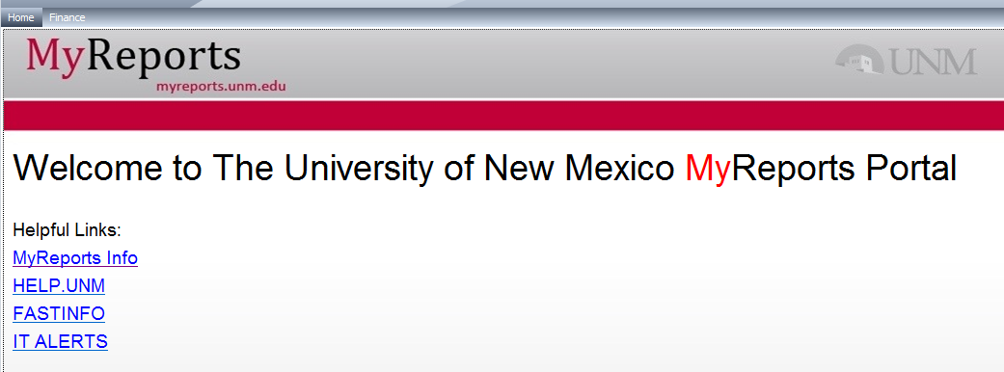
Accessing MyReports List
Notes:
[same as last presentation]

Slide 6
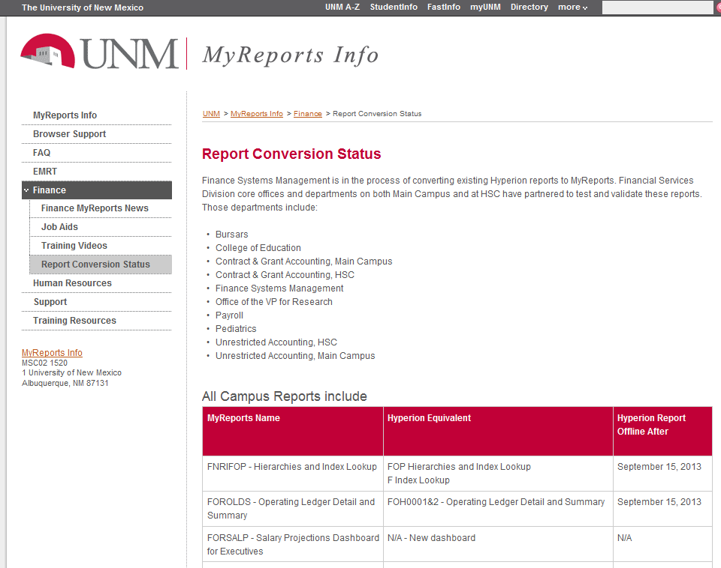
Notes:
[similar to last presentation] By scrolling down, you will find both “All Campus Reports” and “HSC Specific Reports”, along with their Hyperion equivalent, and when the Hyperion report will .

Slide 7
All Campus Reports Include:
MyReports Name | Hyperion Equivalent
FNRIFOP - Hierarchies and Index Lookup | FOP Hierarchies and Index Lookup F Index Lookup
FOROLDS - Operating Ledger Detail and Summary | FOH0001&2 - Operating Ledger Detail and Summary
FORSALP - Salary Projections Dashboard for Executives | ﻿﻿﻿﻿﻿N/A - New dashboard
FRRCGES - Contract and Grant Ledger Executive Summary | FRH0003 - Contract and Grant Ledger Executive Summary
FORSABL - Summary of Account Balances in Operating Ledger | FFRHOO03 - Summary of Account Balances in Operating Ledger (F Executive folder)
FORNESF - Non Endowed Spending Funds | FORHOO02 - Non Endowed Spending Funds Report
FNRECRT – Effort Certification Status Report | FRRHOZ05 - Effort Certification Status Detail

Slide 8
All Campus Reports Include:
MyReports Name | Hyperion Equivalent
FARUNAG - Unrestricted Aging by Department Main | FBRH003 - Unrestricted Aging by Department - Main
FMRFAQR - Finance Approval Queue Inquiry Report | FORHOZ01 - Finance Approval Queue Inquiry Report
FODEMTR - Enterprise Metrics Executive Dashboard | N/A - New dashboard
FORBCRA - Branch Campus Fiscal Year End Report of Actuals | FBRHOO20 - Branch Campus Fiscal Year End Report of Actuals - Detail FBRHOO21 - Branch Campus Fiscal Year End Report of Actuals - Summary
FNRSLBE - Salary Labor Benefits and Encumbrance Report | FSH0001 Salary Labor Benefits and Encumbrance Report
FNRLDST - Labor Distribution Report | FSH0002 Labor Distribution Reports

Slide 9
All Campus Reports Include:
MyReports Name | Hyperion Equivalent
FORUBSS - Unrestricted Balances and Saving Summary for UAP 7000 – JUST RELEASED 1/13/14 | FOH0007 - Unrestricted Balances and Saving Summary for UAP 7000
FORBAUF - Budget Availability for Unrestricted Funds/Indices -JUST RELEASED 1/13/14 | FOH0009 - Budget Availability for Unrestricted Funds - Indices
Coming Soon | FBRH0Z01 – Main and Branch Campus Transfers Allocations
Coming soon | FRH0001&2 Grant Ledger Detail and Summary
Coming soon | FRH0004 - F&A Generated by PI
Coming soon | FRH0005 - Closeout Workflow for Funds Ending on Contracts and Grants

Slide 10
HSC Specific Reports Include:
MyReports Name | Hyperion Equivalent
FGRBONH HSC General Ledger Accounts Balance Opposite Normal | FGRH001 - GL Accounts with Balance Opposite of Normal Balance
FORBUDH HSC Original Budget | FORH004A HSC Original Budget
FORITAH HSC Transfer Allocation | FORH008 HSC Transfers Allocation
FORUAGH HSC Unrestricted Aging | TBRH001 Unrestricted Aging TBRH003 Unrestricted Aging by Department TBRH002 UH Unrestricted Aging
FORUBIH HSC UBIT | FRXH006A UBIT

Slide 11
HSC Specific Reports Include:
MyReports Name | Hyperion Equivalent
FORUMGH HSC Operating Ledger UNMMG | FOHH003 Operating Ledger Summary UNMMG
FORURAH HSC Unrestricted Account Code Summary | FORH006 - Unrestricted Account Code Activity Summary
FORURBH HSC Unrestricted Balance | FORH004 - Unrestricted Balances by Index FORH005 - Deficit Balances in Unrestricted Indices
FRRARDH HSC Active Accounts Receivable Detail Code | TBRH004 Active Accounts Receivable Detail Code Report
FRRFGXH HSC Fund Grant Attribute Exception | FRRH004&5 Attribute Exception Report

Slide 12
HSC Specific Reports Include:
MyReports Name | Hyperion Equivalent
FSRCAPH HSC NIH Salary Cap | 3 NIH CAP
FMRFAQH HSC Approval Queue Summary Detail | FORH009 Approval Queue Summary and Detail Report
FGRADH HSC General Ledger Account Detail | FORH001A - Account Code Detail
FOROLDH Operating Ledger Detail and Summary HSC | FOHH001&2 Operating Ledger Detail and Summary FOHH001&2 Operating Ledger Detail and Summary No Compare
FORNSFH Job Distribution with Unrestricted Index NSF Balance
FOROLMH HSC Operating Ledger Management

Slide 13
MyReports – Finance Training Opportunities
Learning Central – 7 sessions offered
MyReports Website home tab - select
MyReports Info
Finance
Training Resources

Slide 14
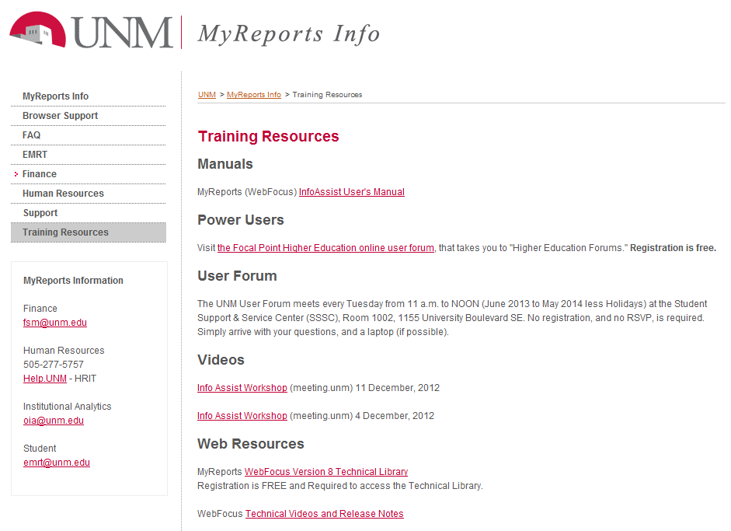
Notes:
You can now search for the most current training opportunities.

Slide 15
FNRPCRD – PCard Transaction Report
Only available in MyReports
How to save a report for future use
How to export data for analysis
How to use excel pivot tables
Notes:
This report replace Hyperion

Slide 16
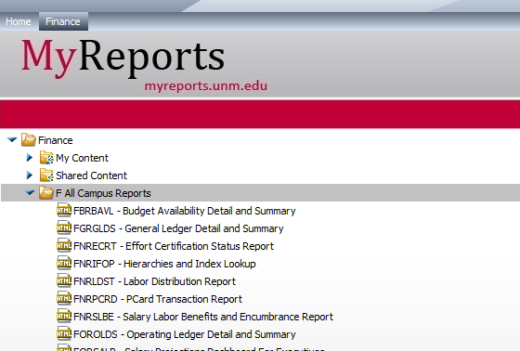
Accessing the PCard Report
Notes:
Select the Finance tab. To see the reports you can access, click on the arrow next to F All Campus Reports, select the FNRPCRD report

Slide 17
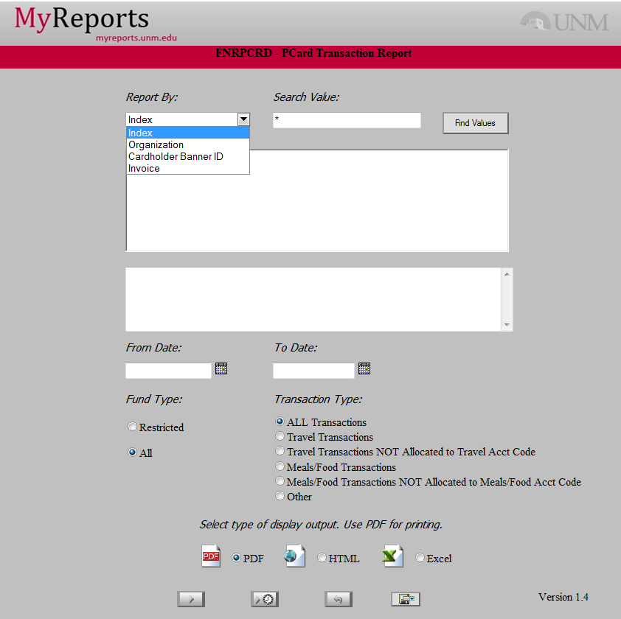
Notes:
Double Click on the report name. This report will report by Index, Organization, Cardholder Banner ID, or Invoice. You can also select only Certain types of transactions, or the Fund type (restricted or “all”). You must select a posting date range.

Slide 18
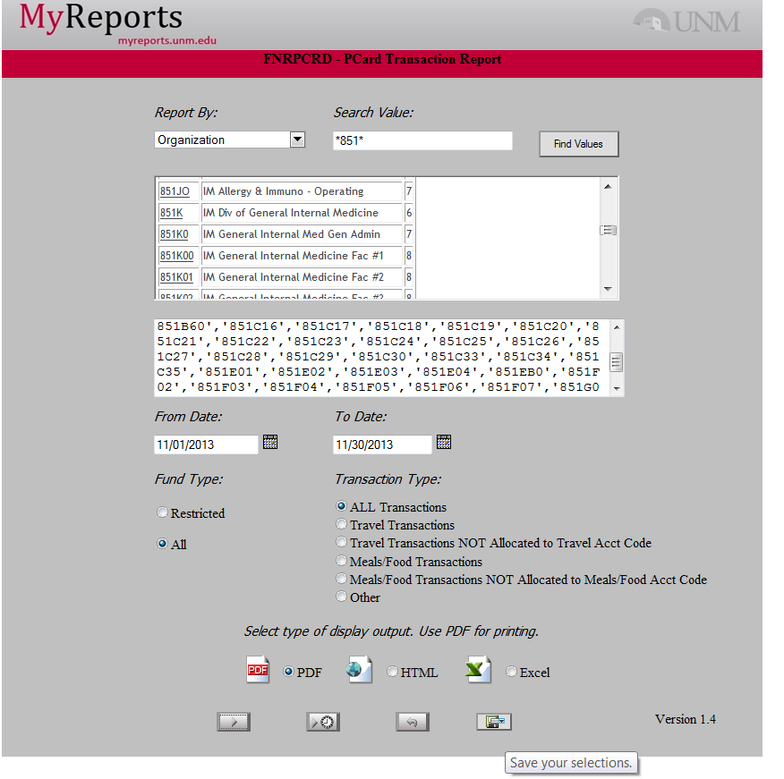
Notes:
Let’s assume you want to analyze all the PCard transactions in your area for the month of November. You have multiple PCard holders and Organizations to which they post. Because this report contains multiple organizational units, you can create your report once, and save it for ongoing use. Here is how you would create a report for multiple organizational units: 1)Search for the organizational units, using “*” or “%” as a wildcard. 2) select the units you need. 3) Save the report for future use

Slide 19
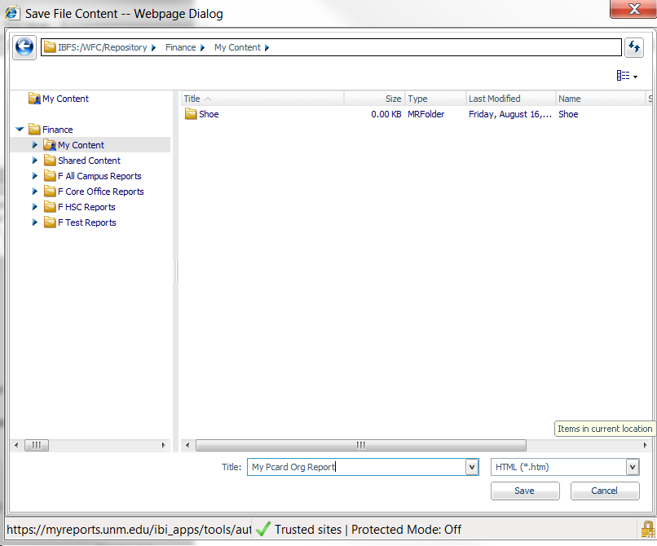
How to Save “My PCard Org Report”
Notes:
When you select “save your selections” you will be taken to the MyReports area, which is where you need to save the report. Save the report in your “My content” folder. It will then be available for ongoing use. (You may choose different date ranges when you run the report, or otherwise modify it when you run it in the future) To save a different version of the report START WITH THE ORIGINAL ONLINE REPORT, set it up (ie, by PCard Holder instead of Org), and save the new report as indicated)

Slide 20
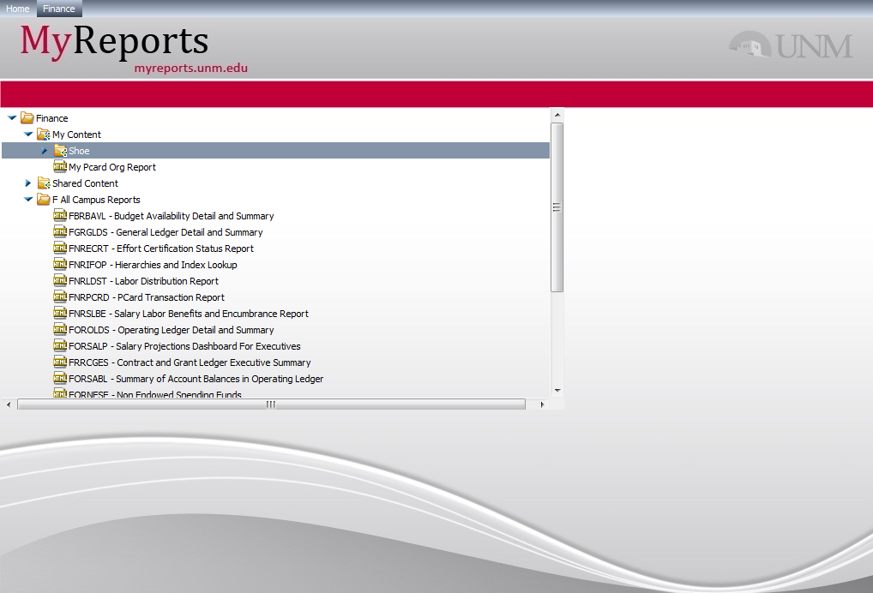
After Saving “My PCard Org Report”
Notes:
You will find the saved report under the Finance Tab, My Content folder.

Slide 21
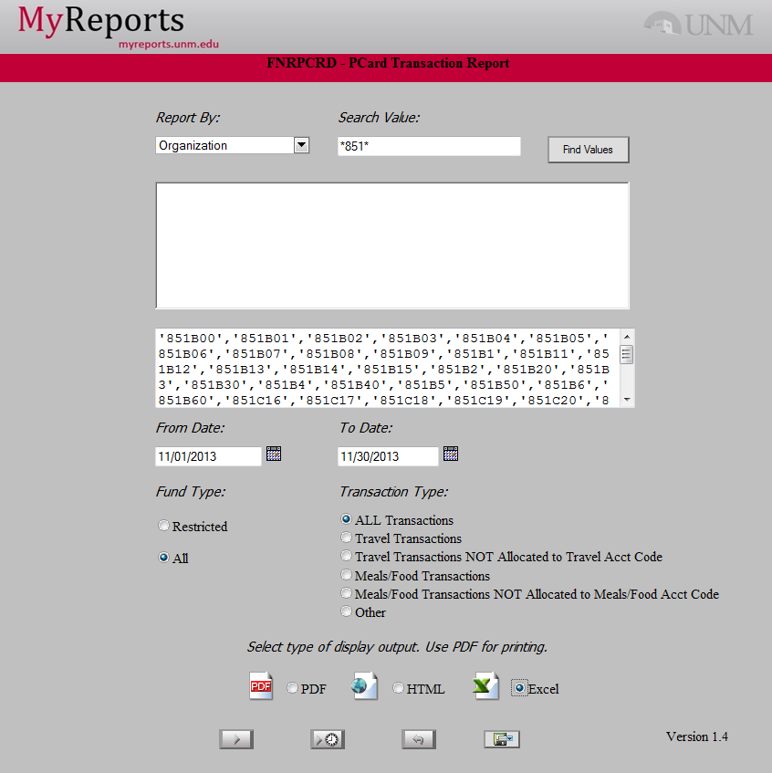
Running PCard by Organization
Notes:
After you have selected your organizational units, select “Excel”, and run the report.

Slide 22
Running the Report
This Report can be run several ways:
PDF
HTML
Excel
Notes:
PDF is fine if the report will be exactly what you need to print
HTML, unless it is “Active HTML” may not be as useful. This report does not offer Active HTML as an option
Excel will allow you to sort and filter the data. We will run the report in Excel.

Slide 23
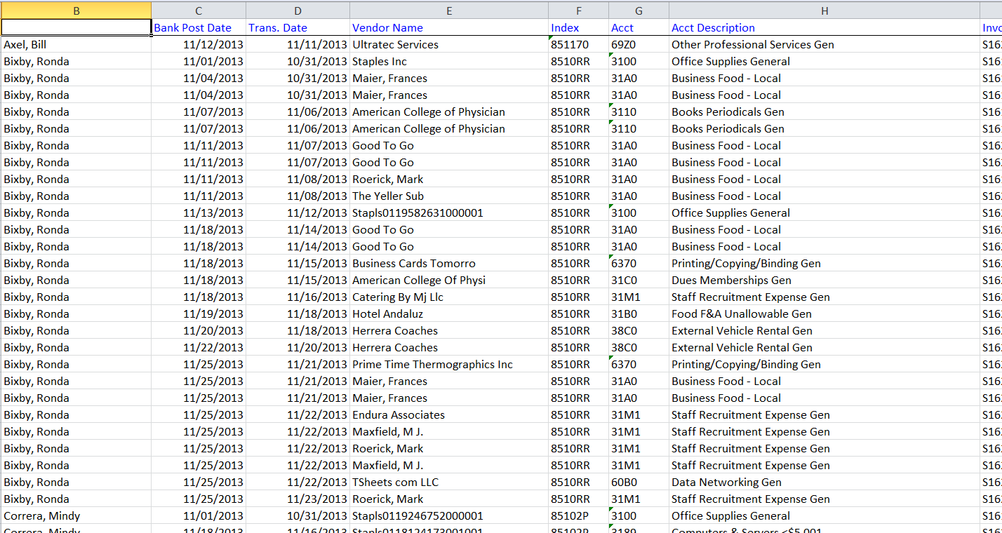
Raw Excel Data: FNRPCRD by Org
Notes:
You may have to run it twice; You will be led through the process. Here is the raw data. There are 94 lines of data for November 2013 in the selected orgs:
Easy to sort/filter
Has all PCard transaction data for selected orgs.

Slide 24
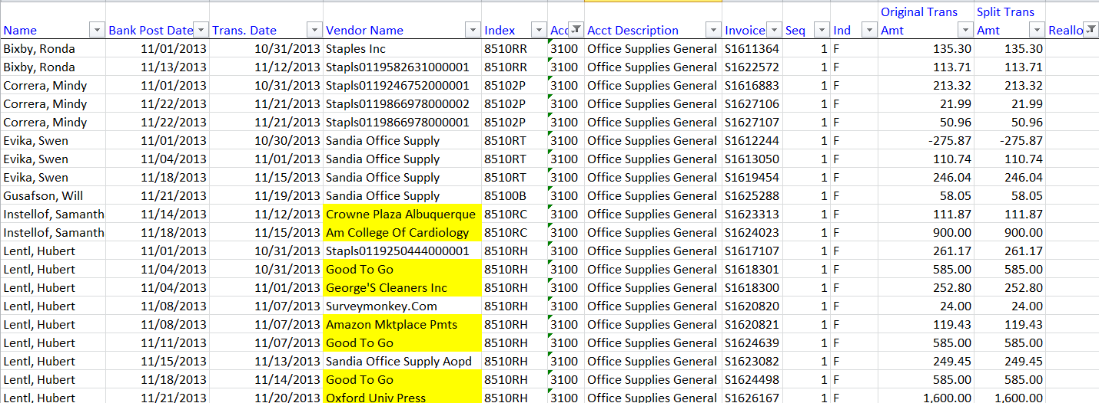
Excel Data Filters “Realloc.” and account 3100
Notes:
(several columns have been hidden)This was filtered by Account 3100(only 3100 selected), which we will assume was the default account for many of your PCard transactions. Then it was filtered by the “Realloc”(blank=not reallocated) column, N. Now, instead of 96 of transactions to review to see if reallocations out of 3100 were missed, you only have 20 lines. Some of the ones you would want to review are highlighted in yellow.

Slide 25
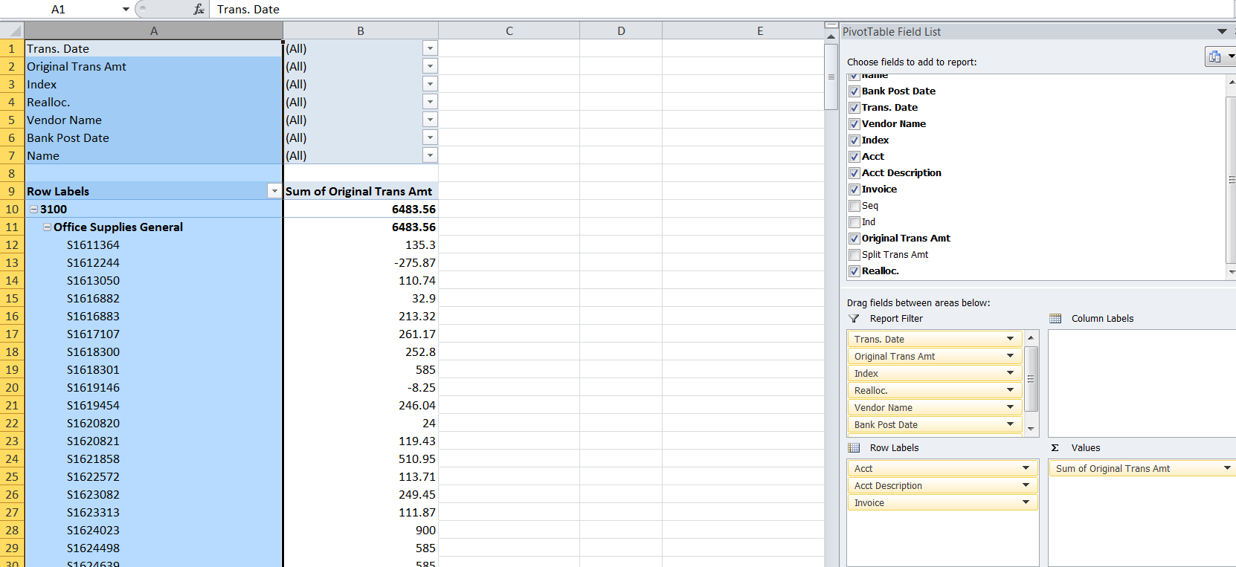
Excel Data: Using a Pivot Table
Notes:
Pivot tables can make the data useful. Here,Most items are put in the Report Filter section, making it easy to limit the data

Slide 26
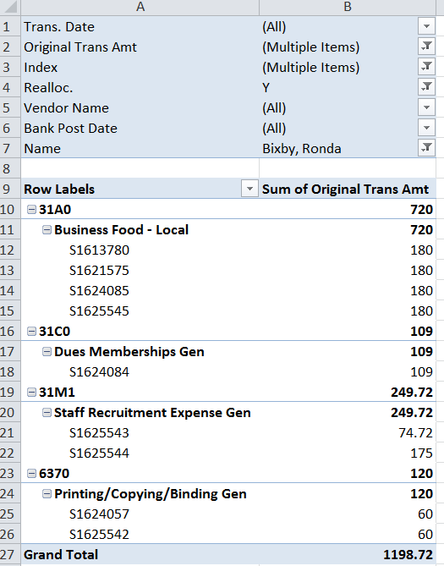
Excel Data: Filtering a Pivot Table
Notes:
The data has been filtered to contain positive dollar amounts up to $200, Indices where the expense being searched for is expected to reside, Only reallocated items, on Ronda Bixby’s PCard. The results are shown. The sort values can be easily modified at any time.

Slide 27
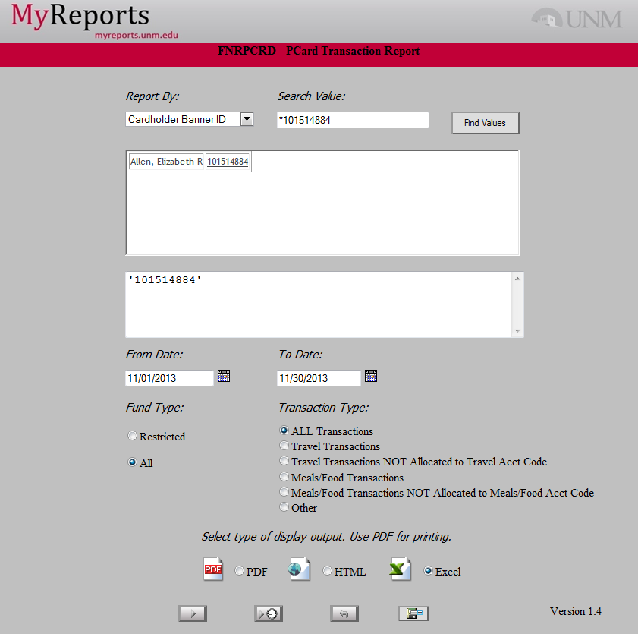
Running PCard by Originator
Axel, Bill
Notes:
Another useful way to run this report is by PCard holder.
1)Add all your cardholder IDs (Explain how to look them up in FAICARD, if they don’t already have the ID numbers; query on Last Name,wildcard, First Name)

Slide 28
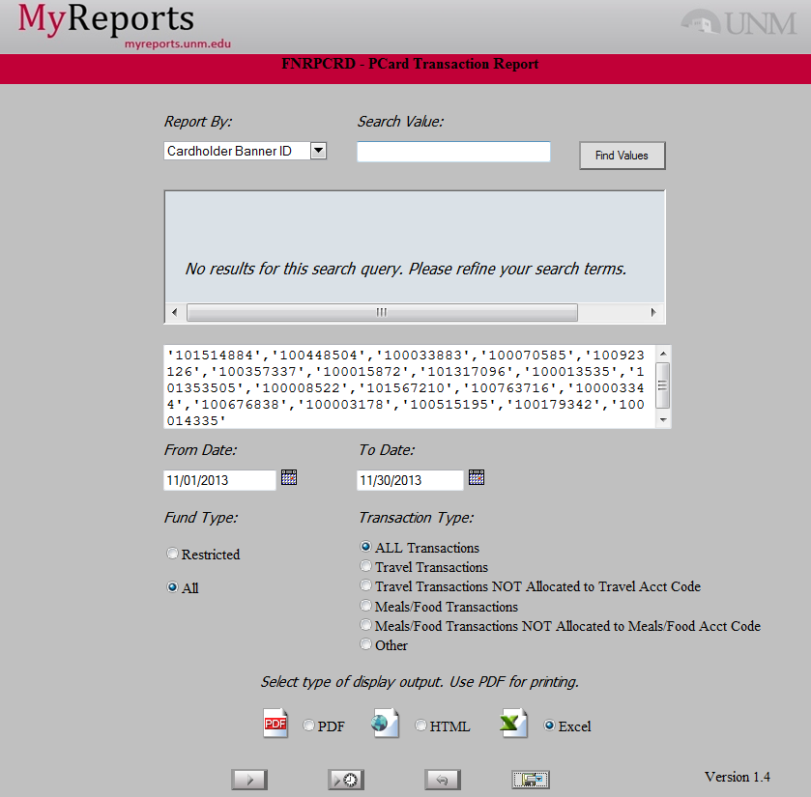
Running PCard by Originator
Notes:
Save the file with your PCard holders selected, so you can run it easily in the future.

Slide 29
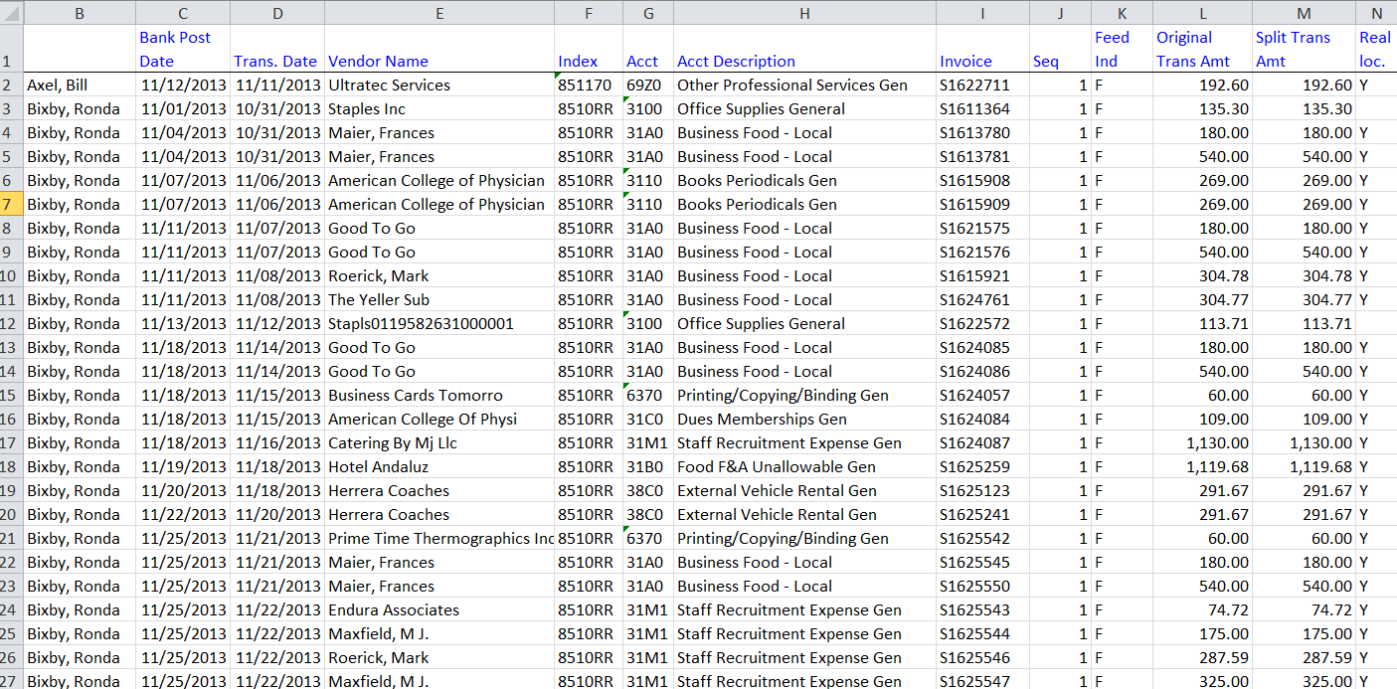
Raw Excel Data: FNRPCRD by PCard Holder
Notes:
There are 159 lines of data for November 2013 in the selected PCard Holders Report:
Has all PCard transaction data for selected PCard Holders, regardless where the transaction was posted.

Slide 30
Excel Data: filtered by Travel Accounts
Notes:
You are interested in checking to see if any of the travel accounts have inappropriate items in them. You filter by travel accounts. All of the Vendor names, in the 8 lines you have to review, seem appropriately travel related. You are now reviewing ALL the Pcard transactions made by your PCard holders, not just the transactions they made that were posted to your indices.

Slide 31
Understanding the Structure
Notes:
To understand what the information on your reports reflects, you must understand the way UNM is structured.

Slide 32
Tips and Tricks for Analysis
Using UNM Chart of Accounts Hierarchy
Organization Structure
Fund Structure
Program Structure
Account Code Structure
Notes:
Mention that you are going to show them one way, there are other ways they may discover and prefer.

Slide 33
Organization Hierarchy
Level 1
President/Governing Board
A - President
Level 2
Vice President
AF – Executive VP for HSC
Level 3
College
AFA - HSC Admin
Level 4
Classification
AFA2 – AVP for Finance
Level 5
Department
258A - Unrestricted Accounting - HSC
Level 6
Division/Financial Reporting Unit
258B – HSC Unrestricted Accounting
Level 7
Financial Reporting element
Level 8
PI or other Reporting Unit
Notes:
The University of New Mexico has defined the basic structure for our organization codes as identified above.
Level 4 provides some flexibility for the Colleges and Campuses to classify their departments. For example, the School of Medicine uses this level to group departments that are primarily Institutional Support, Clinical, Basic Medical Sciences, etc.
The data entry level can either be at Level 5, which is what we essentially know as a department today, or at a more detailed divisional or financial reporting unit level, defined in Level 6 or Level 7.
The definition of Level 6 and/or Level 7 are established for each area by training and working with Colleges, Campuses, and departments. The decision to use these additional levels will be largely based on the level of complexity of each organization and the needs of each unit.

Slide 34
Program Hierarchy
Program
Level 1
Mission (Education, Research, Public Svc, etc.)
P2 Research
Level 2
NACUBO Functional Classifications
P16 – Research Unrestricted
(Sponsored Research, Dept Administration, etc.)
Level 3
Program or Project
P163 – Fetal Alcohol Syndrome
(Endowed and Non-Endowed Spending, etc.)
Level 4
Reserved for Future Use
Reserved for Future Use
Level 5
Reserved for Future Use
Notes:
Above is an example of the structure of the program code at the University of New Mexico.
Level 2 breaks the program code into subcategories to facilitate Facilities and Administrative rate proposals.
Level 3 is used where appropriate to identify specific spending accounts related to endowed and non-endowed gifts.

Slide 35
Fund Hierarchy
Fund Type: Level 1
Level 2
Fund Accounting Category
Current Restricted
10
Fund Entity
CR - HSC
13
Fund Code: Level 1
Level 2
Level 3
Level 4
Level 5
Fund Classification/Source
HR Federal C & G HSC
3RFED
Fund Detail/Project
HR Analysis Soil Moisture Dynamics
3R01Y
Project Year/
HR Analysis Soil Moisture Dynamics
Sub Project
301Y0
Project Year/
Subproject
Reserved
for future use
Notes:
The basic structure for the UNM fund codes is:
This example is a restricted fund.
We will now discuss Fund Hierarchy in more detail.

Slide 36
Unrestricted Fund Types
Level | Title | Funds Included
1 | 00 | All Current Unrestricted
2 | 01 | Institutional Unrestricted
2 | 02 | Main Campus Unrestricted
2 | 03 | HSC Unrestricted
2 | 04 | Gallup Unrestricted
2 | 05 | Los Alamos Unrestricted
2 | 06 | Valencia Unrestricted
2 | 07 | Taos Unrestricted
Notes:
These are the level 2 accounts. The typical level 4 accounts roll up into these accounts. Ie: OJ1-Supplies, includes Accounts 3100-Office supplies through 37Z0-Other Supply Costs Gen.

Slide 37
Restricted Fund Types
Level | Title | Funds Included
1 | 10 | All Current Restricted
2 | 11 | Institutional Restricted
2 | 12 | Main Campus Restricted
2 | 13 | HSC Restricted
2 | 14 | Gallup Restricted
2 | 15 | Los Alamos Restricted
2 | 16 | Valencia Restricted
2 | 17 | Taos Restricted
Notes:
These are the level 2 accounts. The typical level 4 accounts roll up into these accounts. Ie: OJ1-Supplies, includes Accounts 3100-Office supplies through 37Z0-Other Supply Costs Gen.

Slide 38
Account Hierarchy
Account Type:
Level 1
Level 2
Revenue, Expense, Asset, & Liability
Revenues & Intra-University Activity
50
Operating, Non-Operating
Operating Revenue
51
Account Code:
Level 1
Level 2
Level 3
Level 4
Current & Non-Current
Statement of Net Assets and SCF Summary
Cash Inflow Operating Activities
OA
(Balance Sheet & Cash Flow)
Statement of Net Assets and SRECNA Det
Tuition Revenue
OA1
(Balance Sheet & Income Statement)
SRECNA/Notes/Council Higher Education
Resident Full Time
012
(Income Statement & State Reporting)
Line Item Detail
Resident Full Time General
0120
Notes:
The basic structure for the University of New Mexico’s account codes is identified above. The only level departments routinely deal with is level four, which is line item detail. This rolls up to level 3 which is used for the income statement and state reporting. This makes the selection of an account code IN THE CORRECT LEVEL 3 CATEGORY important.
Our approach groups the account code into logical categories required for reporting and is primarily based on the GASB (Governmental Accounting Standards Board) model.

Slide 39
Account Level 2 - Revenue:
Account Level 2 | Title | Level 4 Accounts included
OA1 | Tuition Revenue | 0120-01Z1
OA2 | Student Fees | 0210-02Z1
OA3 | Patient Services | 0330-03Z0
OA4 | Grants Contracts | 0410-0480
OA5 | Sales Services | 0510-07ZZ
OA6 | Other Operating | 0810-08Z1
OP1 | Appropriations | 0710-07D0
OP2 | Bond Revenue | 0910-0970
OP3 | Gifts and Other | 1000-1080
OP4 | Investment Income | 10A0-10Z0
OP5 | Other Non Operating Revenue | 1090-1092
OS1 | Transfers | 1100-12T0
OV1 | Allocations | 1600-1668
OW1 | Subsidy | 1800
OZ1 | Reserves | 1900-1904
Notes:
These are the level 2 accounts. The typical level 4 accounts roll up into these accounts. Ie: OJ1-Supplies, includes Accounts 3100-Office supplies through 37Z0-Other Supply Costs Gen.

Slide 40
Account Level 2 - Expense:
Account Level 2 | Title | Level 4 Accounts included
OJ1 | Supplies | 3100-37Z0
OJ2 | Travel | 3800-39Z1
OJ3 | Student Costs | 4000-45Z0
OJ4 | Research Costs | 4600-49Z0
OJ5 | Patient Care Costs | 5000-55Z0
OJ6 | Communication Charges | 6000-62Z0
OJ7 | Services | 6300-60Z0
OJ8 | Plant Maintenance | 7000-75Z0
OJ9 | Utilities | 7600-79Z0
OJA | Other Expenses | 8000-8190
OM1 | Capital Expenditures | 9000-9550
OM2 | Bond Expenses | 9600-97Z1
OM3 | Non Cash Expenses | 9800-98F0
Notes:
These are the level 2 accounts. The typical level 4 accounts roll up into these accounts. Ie: OJ1-Supplies, includes Accounts 3100-Office supplies through 37Z0-Other Supply Costs Gen.

Slide 41
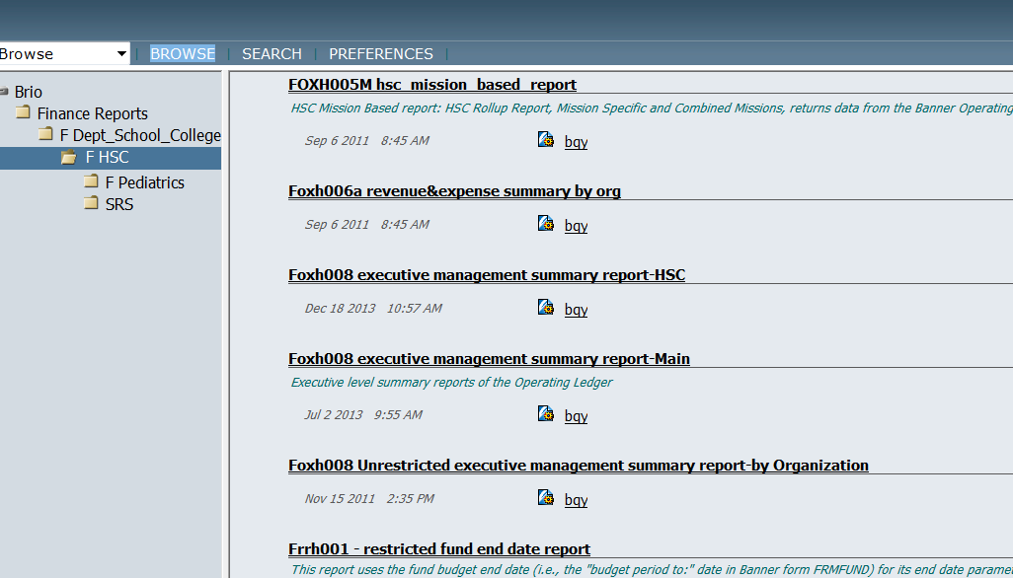
Executive Summary Report
Notes:
Hyperion Executive Management Summary Foxh008-how to

Slide 42
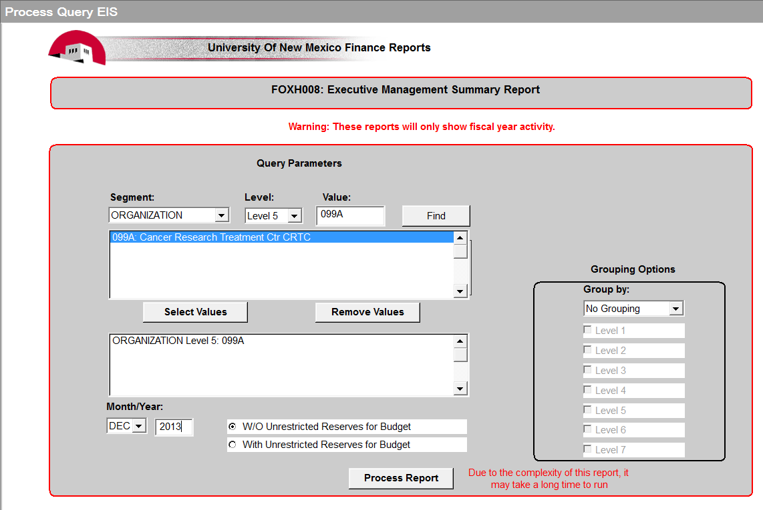
Run Management Summary Report
Notes:
Set up to run report for HSC This is a hyperion report.

Slide 43
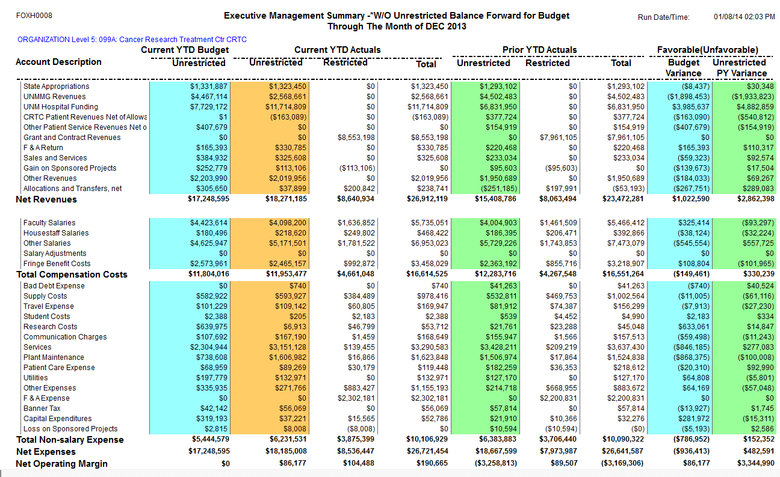
Executive Management Report
Notes:
Hyperion Exec Mngmt for CRTC for FY14 through December (FOXH0008)
Services: Budget=2,304,944
Actual=3,151,128 for a negative variance of $846,185
You need to analyze why the service expenses are so much greater than the budgeted amount. Let’s use MyReports to do this analysis.

Slide 44
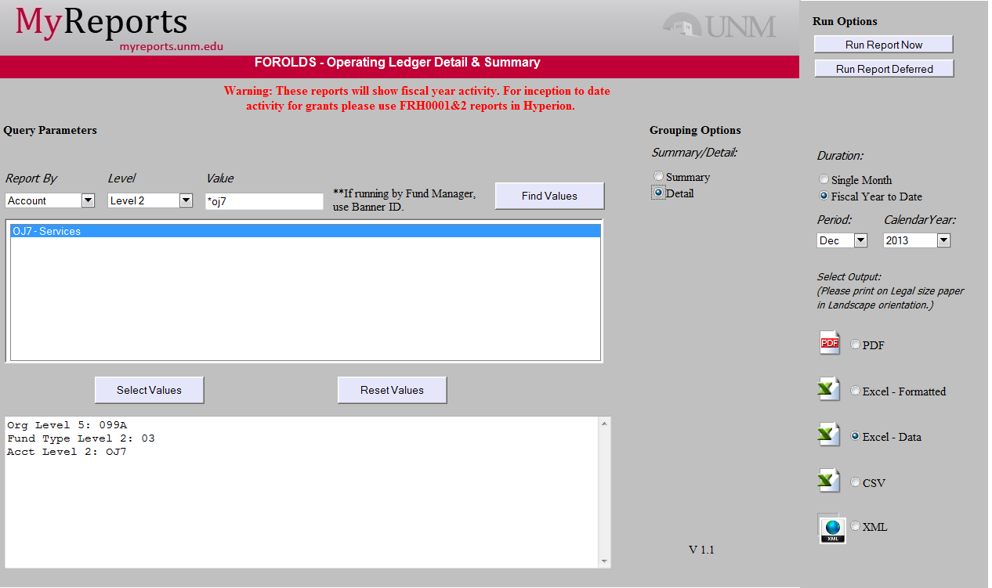
Run FOROLDs for Services
Notes:
The report that will produce the detail needed is in
Select:
Level 5 org desired
Level 2 account (see list)
Fund Type Level 2=03 for Unrestricted indices HSC only
[Fund Type Level 2= 02 for Unrestricted MC indices only]
Explain:Budget column will download the entire budget for the year; ignore it. Actual column will be correct.

Slide 45
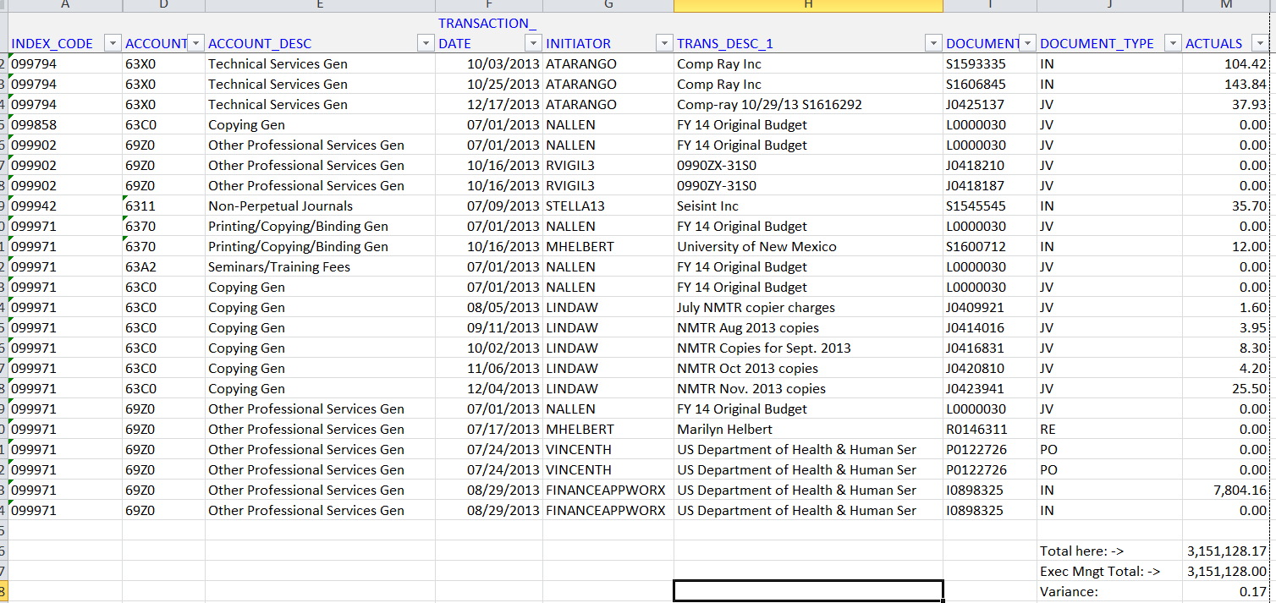
Raw Data reconciled
Notes:
The data has been totaled and reconciled to the Management Report. Note that most of the excel columns have been hidden so you can see the Actual data column. This is the last page of the report.
Selected:
Level 5 org desired
Level 2 account (see list)
Fund Type Level 2=03 for Unrestricted indices HSC only

Slide 46
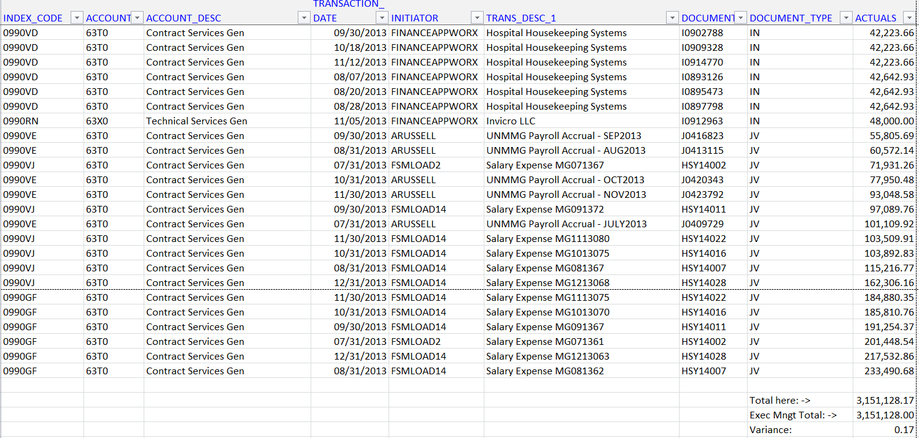
Sorted data for Analysis
Notes:
The data has been sorted, “smallest to largest “, on the actual column. Zeros have been hidden. The data has been reduced to 12 pages (from 21), with the largest negative entries at the top, and the largest positive entries at the bottom. Individual entries can now be analyzed.

Slide 47
In Summary:
74 days and counting…
Hyperion reports will not be produced after March 31, 2014
MyReports will be the finance reporting vehicle
MyReports allows greater flexibility in data analysis and output options

Slide 48
Optional Report Demonstrations

