Slide 1


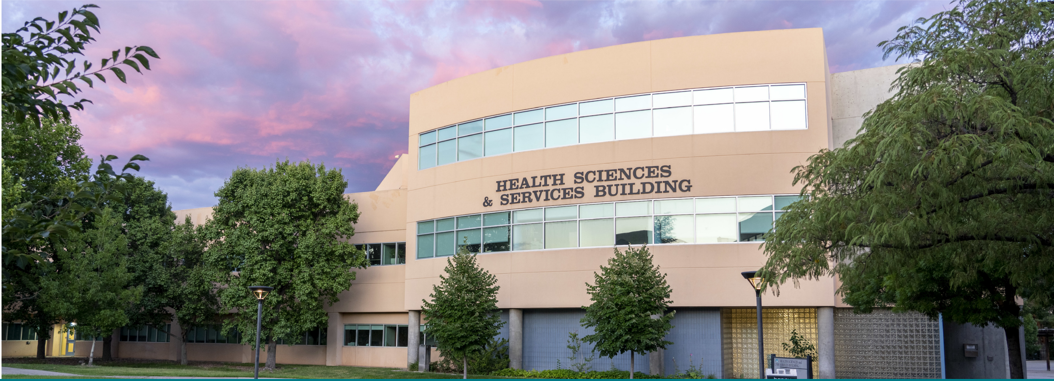
Group Advisement Presentation 2026
Visit us at: goto.unm.edu/pt
Email us at: HSC-UNMPTProgram@salud.unm.edu

Slide 2
IS PT THE RIGHT CAREER FOR ME?
The primary goal to ask yourself is; "Is PT the right profession for me?"
Wanting to help people is a noble cause however there are many types of jobs where you can help people. Being a PT is wonderful, but it is not for everyone. If there is an opportunity to speak with a PT, it will help you understand the knowledge needed to treat patients and some of the complicated issues that go into being a PT. Knowing you have considered the career in its entirety and can talk about your ideas and goals as a future PT helps our program have confidence you have the grit to make it through the program.
We do not require observation hours
All shadowing experience is for personal growth but not a requirement of admissions. However, we strongly encourage you to explore the field in ways that are feasible for you (e.g., informational interviews with PTs, attending virtual clinic tours or professional webinars, speaking with current students, or learning through reputable PT organization resources) so you can make an informed decision about this career path.

Slide 3

LEARN ABOUT THE MISSION/VISION OF THE AMERICAN PHYSICAL THERAPY ASSOCIATION (APTA)
Source of information about the physical therapy profession.
1-800-999-APTA
www.apta.org

Slide 4
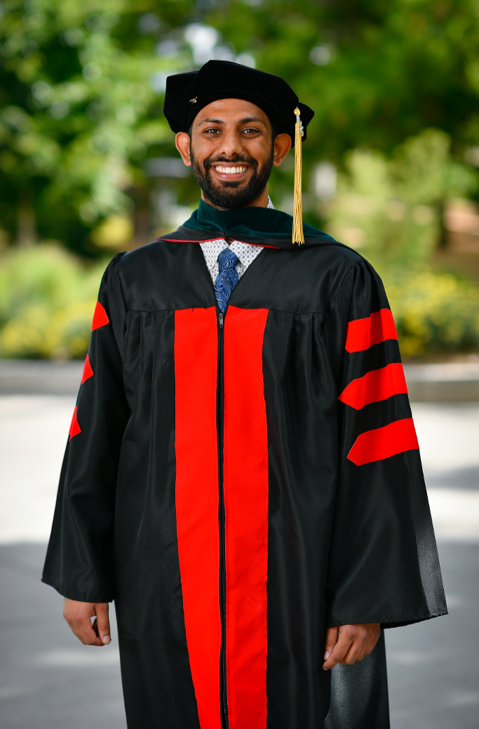
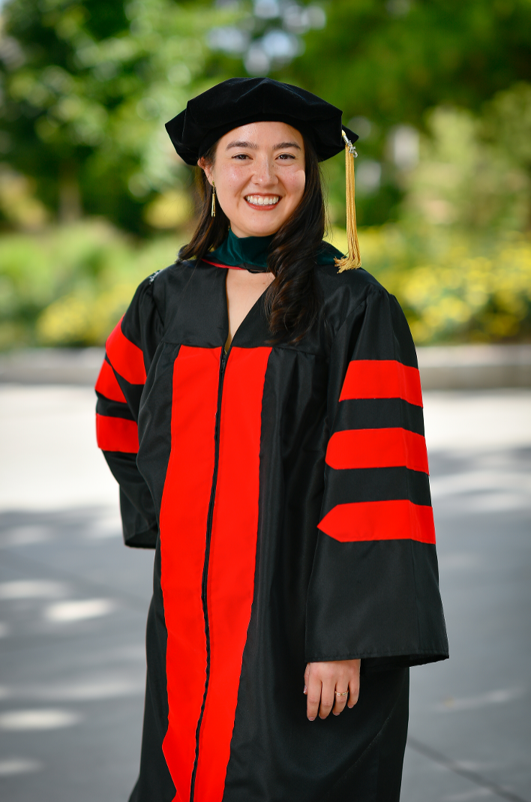
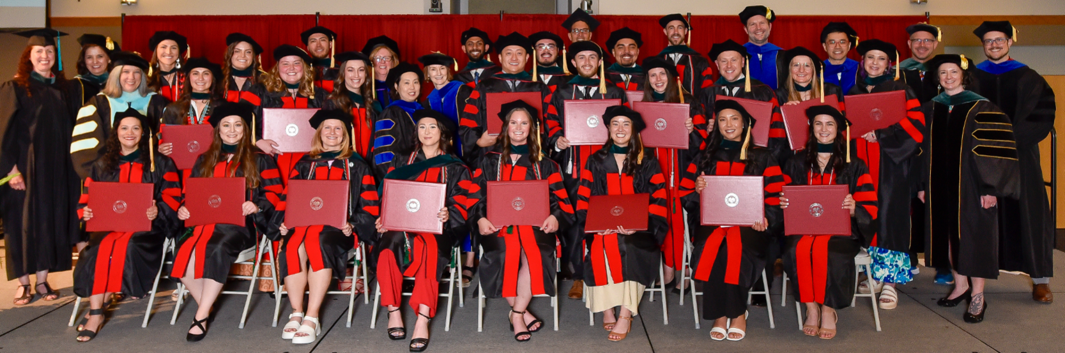
HOW DO I BECOME A PT?
Graduate from an accredited program
UNM Doctor of Physical Therapy Program
Pass the NPTE (National Physical Therapy Examination)

Slide 5

PROGRAM LENGTH
The program expands for 34 months (3 years) and it starts in mid-August with several 2-4 week breaks
Year 1 = Foundations, Anatomy and MSK, & patient interactions
Year 2 = Neurological conditions and topics in pediatrics, gerontology, and wound care
Year 3 = Advanced topics & rotating through your clinical sites

Slide 6
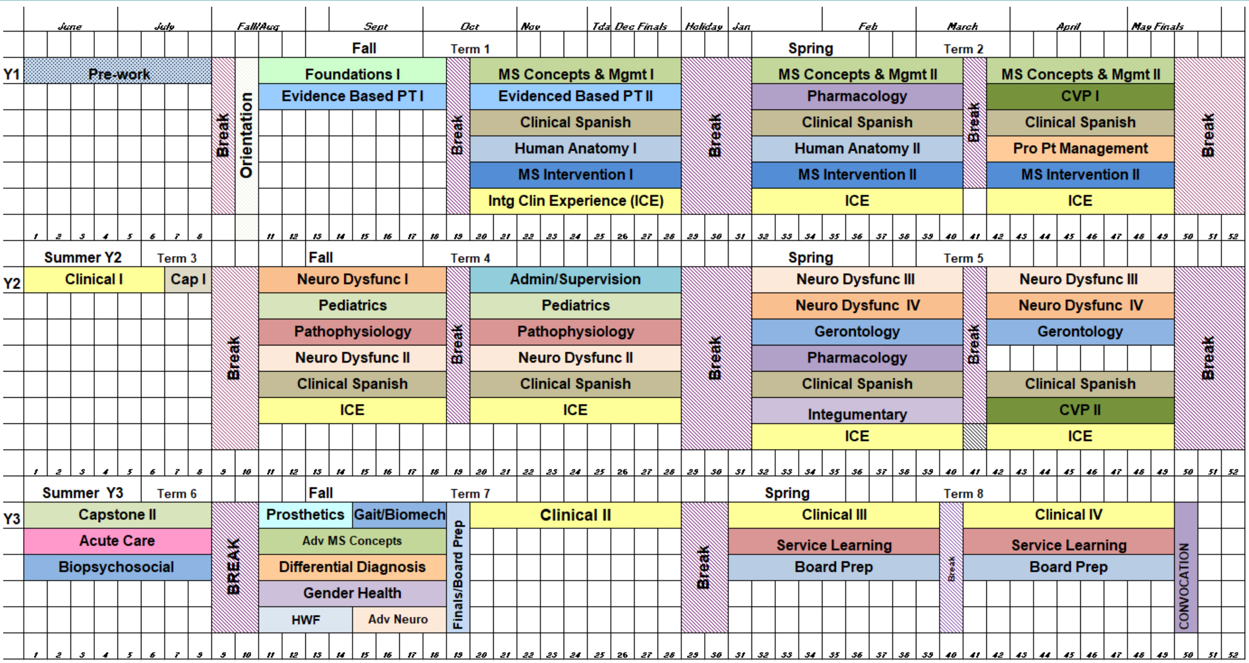
PROGRAM CALENDAR

Slide 7
TAKE 30 HOURS OF PREREQUISITES
You should have all prereqs completed by December 2026.
You are permitted to have 1 final prereq to be taken during the 2027 Spring semester.
If you have more than 1 outstanding prerequisite yet to be taken after the 2026 December academic update, your application will be considered incomplete and will not move forward.
You should have a B- or better in prerequisite classes. And it is recommended to have a B or better in Anatomy/Physiology I and II to ensure success in the program.
Must have a prerequisite GPA as defined by PTCAS of at least a 3.0
All prerequisites must be taken in the US or Canada.
Prerequisites:
May be taken at any accredited college or university
*Statistics (3 hrs)
*Physics I & II (8 hrs)
*Anatomy & Physiology I & II (8 hrs)
*Chemistry I & II (8 hrs)
*Upper-level Pyschology (3 hrs)

Slide 8
RESTRICTIONS ON PREREQUISITES
Pass, S, or CR options are only acceptable for the Spring and Summer 2020 semesters.
If you are trying to use AP credits for a prereq class, please contact us so that we can verify that it meets the specific class requirements and is listed appropriately on your transcript.
Anatomy/Physiology prereqs must be taken within the last 5 years. There is no expiration date on the other prereq classes that meet the acceptable course, credit, and lab criteria.
Psychology must be upper level.
  For a complete list of classes that are accepted please visit the UNM PTCAS directory page under course prerequisites.
Please use the highest course grade possible for your prerequisite selection.
You may substitute a higher-level class for the prerequisite as long as you have taken the lower level required class.
As an example: you took Chemistry 1 + lab (4 cr.) your sophomore year and earned a B. Your junior year you took biochemistry + lab (4 cr.) a higher-level chemistry that had a prerequisite requirement of Chemistry 1 and you earned an A. You may use that higher-level chemistry class with the A, to match our prerequisites.

Slide 9
POLICY ON WEB-BASED PREREQUISITE COURSES
For the University of New Mexico (and PTCAS) to accept credits earned from a web-based course, that course must appear on a transcript from an accredited college or university. Therefore, if the online course you have taken or plan to take is offered by UNM or CNM (or any other accredited college or university), and it satisfies our requirement, the course will be accepted.
All course work is verified through PTCAS. If you have questions regarding the validity of an institution, please contact PTCAS directly.

Slide 10


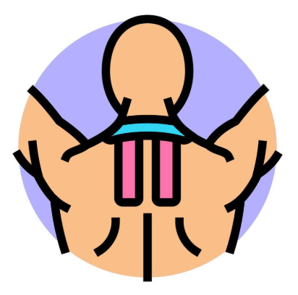


YOU NEED YOUR BACHELORS DEGREE
ANY DEGREE IS ACCEPTABLE
Applicants must have an overall GPA as defined by PTCAS of at least a 2.67
Remember, you also must have a prerequisite GPA as defined by PTCAS of at least a 3.0

Slide 11
TAKE THE GRE
Submit scores to UNM PT Program Institution Code:
7670
Deadline for taking the GRE:
October 1st, 2026
General test must be taken within 5 years of application.
No Minimum Score Requirements.
Recommended scores for program readiness:
Quantitative 20th percentile
Verbal 25th percentile
Submitting GRE scores that are considerably lower than the recommended scores may influence your overall application score.

Slide 12
GRE ASSISTANCE
Prep classes and books are helpful!
- GRE Intensive Prep Course offered throughout the year at Anderson School of Business, please visit at:
https://mba.mgt.unm.edu/testprep/
-Other classes offered online and in person visit at:
https://www.kaptest.com/
HSC Office for Diversity offers Test Prep Programs- Applications due in April for summer course June-July
-Please visit at: https://hsc.unm.edu/diversity/programs/community/test-prep.html
-Stipened upon completion of the program.
-Contact the office of diversity for more information by calling 1(866) 494-0064 or emailing them at: HSC-diversity@salud.unm.edu

Slide 13
PTCAS ESSAYS
The topic of one essay is set by the APTA, the topic of the second is decided by the school you are applying to.
For our program we want you to share a meaningful personal story (not a resume highlight) that shows your values and who you will be in a demanding, team-based program.
Guidelines:
- Please do not focus on clinical observation/shadowing experience.
- We’re interested in your story, not your profession of choice.
- Avoid retelling your resume; one meaningful story is enough.
We do read the application essays carefully, and we view them much like an assignment—an opportunity for you to demonstrate clear thinking, professionalism, and the ability to communicate effectively. We’re not looking for perfection, but we do expect your responses to be thoughtful, well organized, and reflective of the care you would bring to graduate-level work.

Slide 14
OBSERVATION HOURS
We do not require physical therapy observation hours as part of our application.
We recognize that in our largely rural state, access to PT clinics can be limited, and requiring observation can create an unintended barrier—especially for applicants with significant work, family, transportation, or financial constraints. That said, it’s still important that you have a clear understanding of what physical therapists do and what the profession entails. We strongly encourage you to explore the field in ways that are feasible for you (e.g., informational interviews with PTs, attending virtual clinic tours or professional webinars, speaking with current students, or learning through reputable PT organization resources) so you can make an informed decision about this career path.

Slide 15
APPLY ON PTCAS
http://www.ptcas.org/
Application portal opens JUNE/JULY
Completed application due OCTOBER 1st, 2026

Slide 16
FALL 2026 / SPRING 2027 COURSES
All classes being taken in the Fall of 2026 should be listed in PTCAS as in progress
You will update the grades for the classes being taken in the Fall of 2026 during the Academic Update in December 2026
All classes you are planning to take in the Spring of 2027 must be listed in PTCAS as in progress as well.
*Only 1 of these can be a prerequisite class
Must complete Bachelor degree by May of 2027
*June of 2027 for trimester curriculum

Slide 17
TOTAL ADMISSION REQUIREMENTS
- Baccalaureate degree in any field
- Overall GPA of > 2.67
- Prerequisite classes with a B- or better and GPA ≥ 3.0
-GRE
-Essays on PTCAS
* Our personal story essay
* APTA essay
-2 Letters of Recommendation
*(1 must come from a PT)
-Asynchronous interviews in November
-In person interview on January 9th 2027

Slide 18
HOW COMPETATIVE AM I?
Average PREREQUISITE GPA Class of 2029: 3.64
Average OVERALL GPA Class of 2029: 3.59
Average GRE Scores Class of 2029:
  Verbal Percentile 41st
  Quantitative Percentile 22nd
Essays
LORs
Asynchronous & In-person Interview

Slide 19
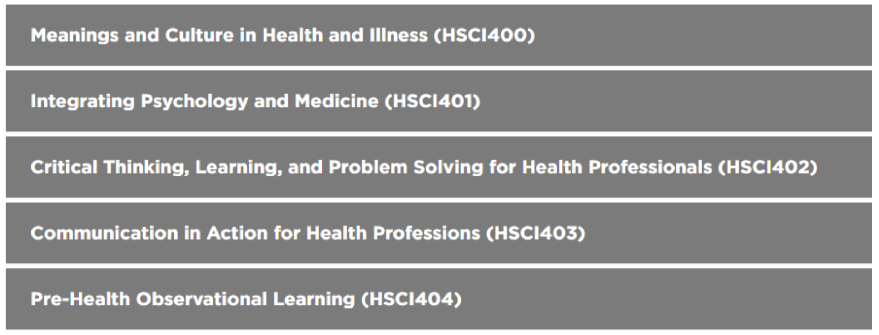
PRE-HEALTH SCHOLARS CERTIFICATE
Students must have Junior Standing (60 credit hours) with a cumulative 3.0 GPA or higher, which must include at least:
*General Chemistry – 2 semesters
*Biology – 2 semesters
*English - 2 semesters
*Intro to Psychology PSY1110
*Intro to Statistics Math 1350 or PSY2510
*Exceptions to prerequisite requirements can occasionally be made by petition to the director for special approval.
Strengthen your application:
This unique social science focused Pre-Health Scholars Certificate was designed with input from graduate health programs. The curriculum was developed to address many areas of weakness in applications as identified by the programs. Through highly interactive, discussion-based, rigorous curricula the program incorporates thought-provoking engagement and mindful learning. Through demanding discussion, activities, application exercises, and field trips, students will be challenged to think deeply and analyze factors influencing healthcare.
Notes:
It’s a highly interactive, discussion based, rigorous program that addresses some weaknesses in applicants across health care fields. So it’s a good way to prepare for you field.

Slide 20
APPLICATION MATERIALS FOR PTCAS
Complete online application
Enter all college courses taken and GRE scores
Send unofficial transcript from each school attended (update December 2026 when transcript is available for courses in progress during time of application) to PTCAS
Complete PTCAS essays & documents
Upload your reference contact information
$140 Application Fee (financial assistance may be available through PTCAS)

Slide 21
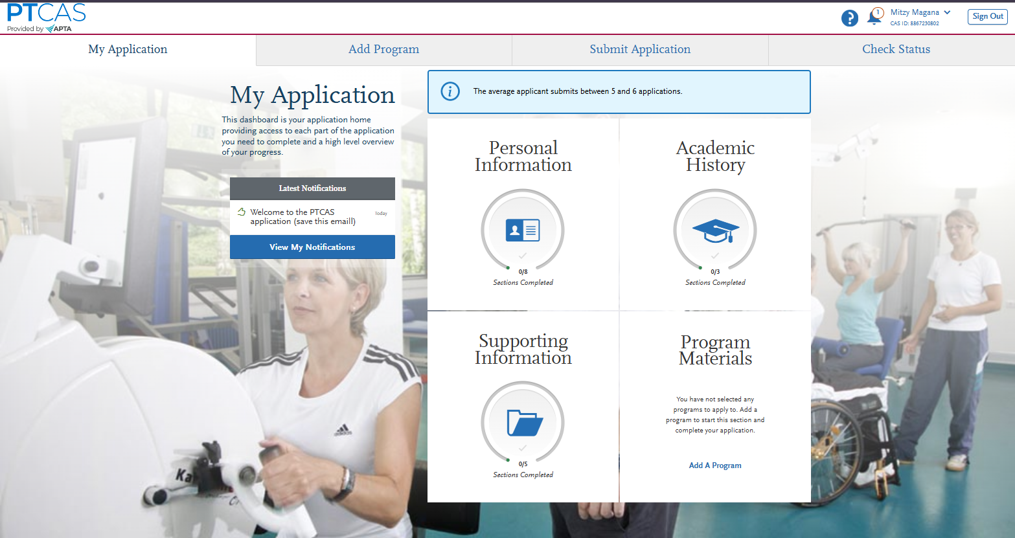
PTCAS APPLICATION HOME – CREATE A PROFILE

Slide 22
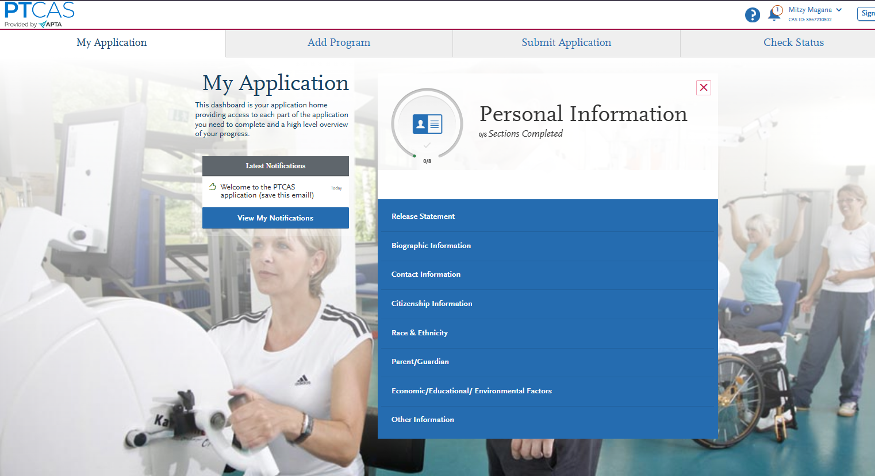
COMPLETE YOUR PERSONAL INFORMATION

Slide 23
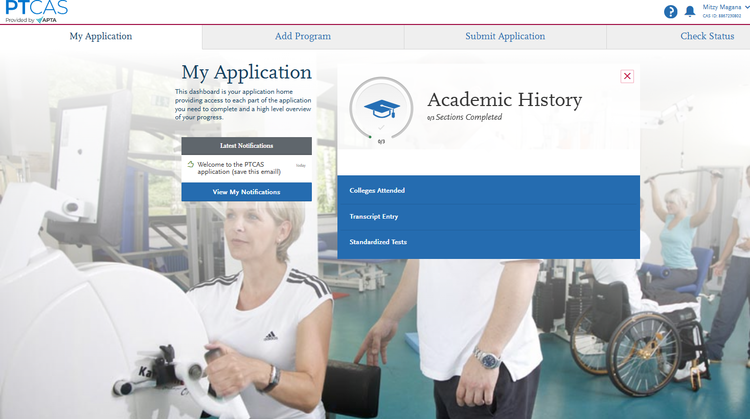
COMPLETE YOUR ACADEMIC HISTORY

Slide 24
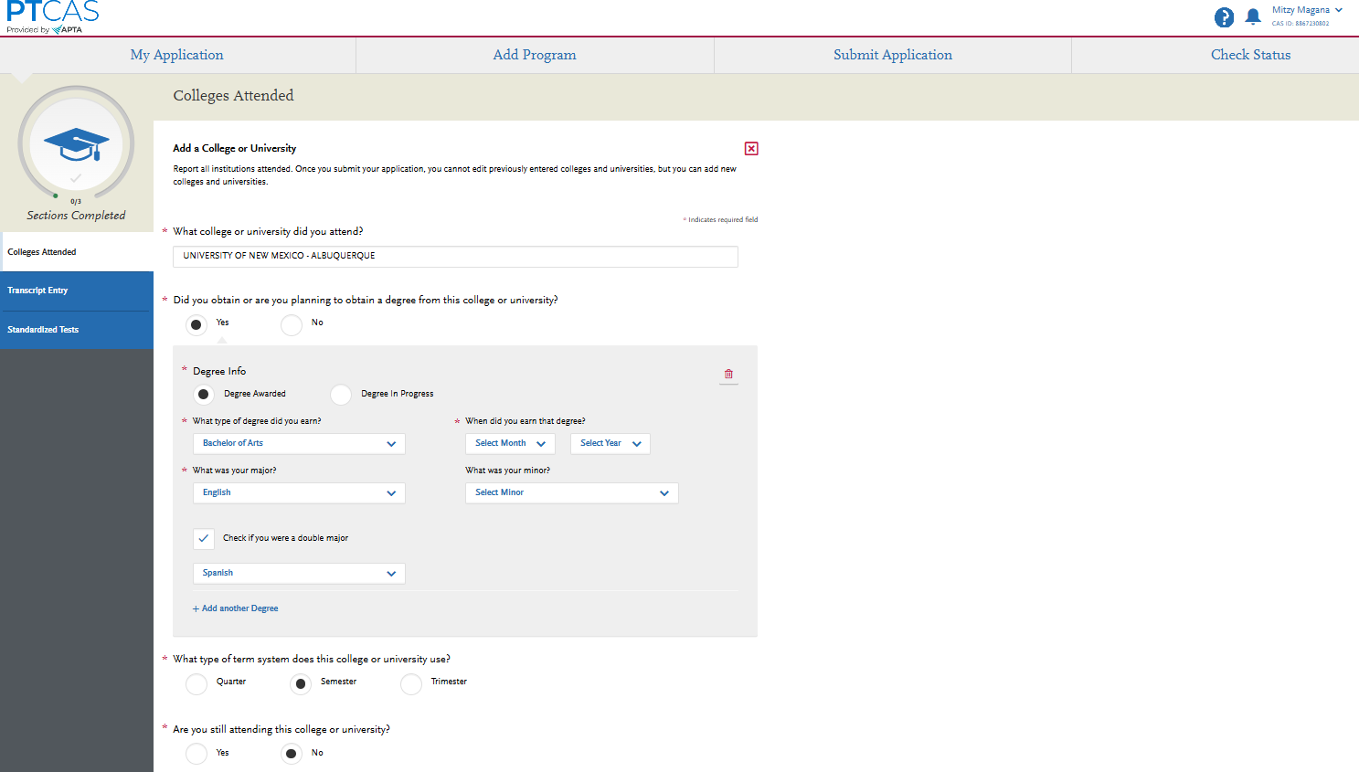
ENTER ALL COLLEGES ATTENDED

Slide 25
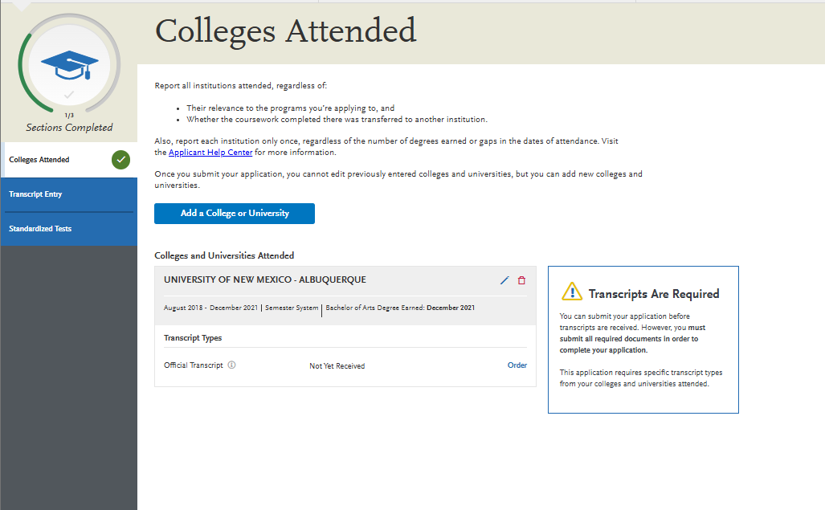
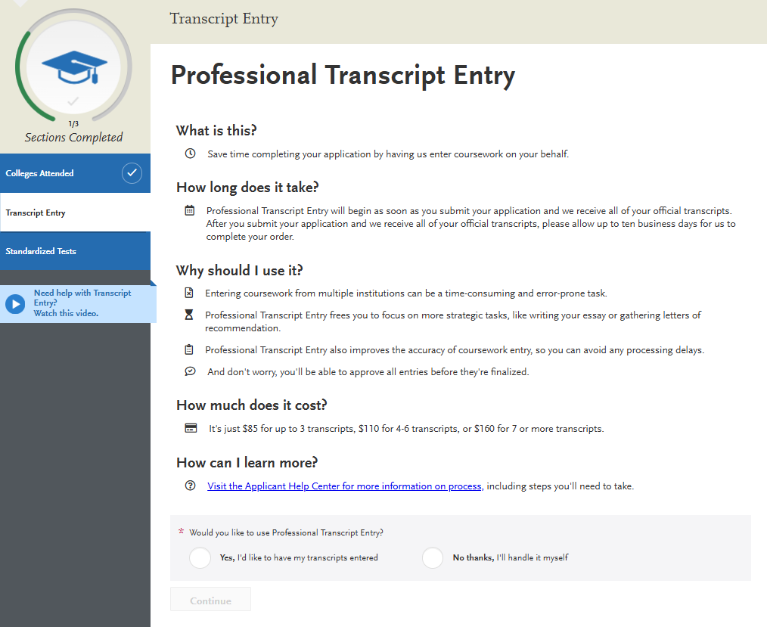
SUBMIT YOUR TRANSCRIPTS
This is optional, but may be useful in verifying that your transcripts are inputted correctly

Slide 26
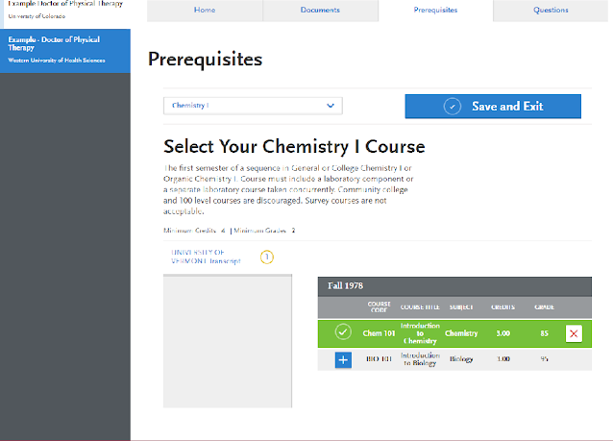
MATCH PREREQUISITES FROM YOUR TRANSCRIPTS. CHOOSE THE BEST FIT FOR THE HIGHEST GRADE!

Slide 27
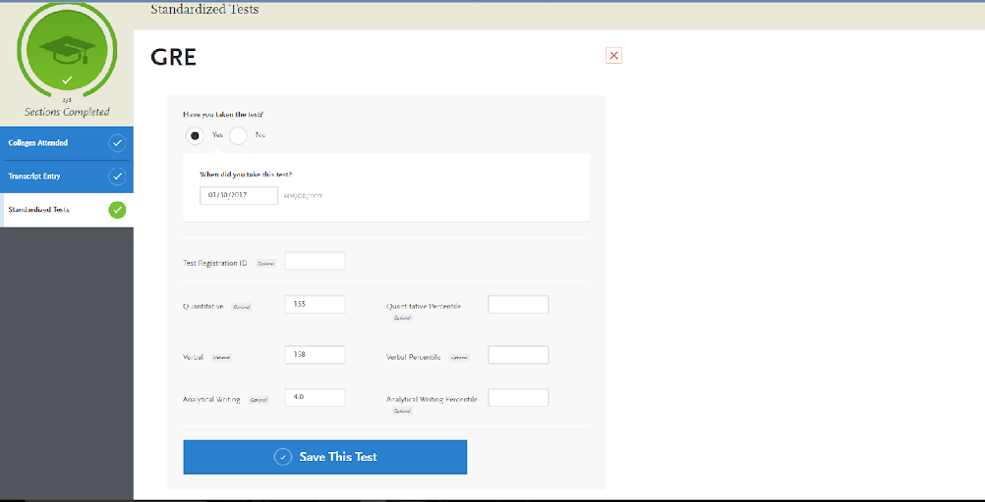
ENTER YOUR GRE – MAKE SURE YOU HAVE YOUR OFFICIAL SCORES SENT TO OUR PROGRAM (7670)
You are required to take the GRE by October 1st 2026; However, we know it will take a few weeks for the scores to arrive in PTCAS.
If your official scores have not been received in PTCAS by November 1st, please call ETS and PTCAS to identify the delay

Slide 28
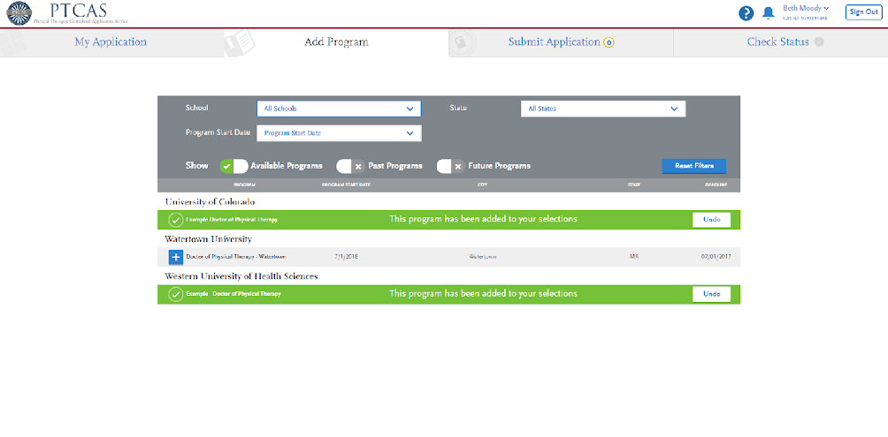
SELECT PROGRAMS YOU WANT TO APPLY TO
VERIFY YOU MEET THE REQUIREMENTS FOR EACH INDIVIDUAL PROGRAM; WE ARE NOT ALL THE SAME!!

Slide 29
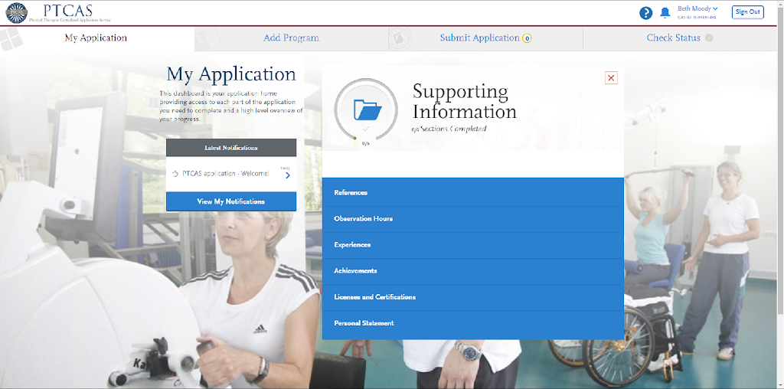
COMPLETE SUPPORTING DOCUMENTATION

Slide 30
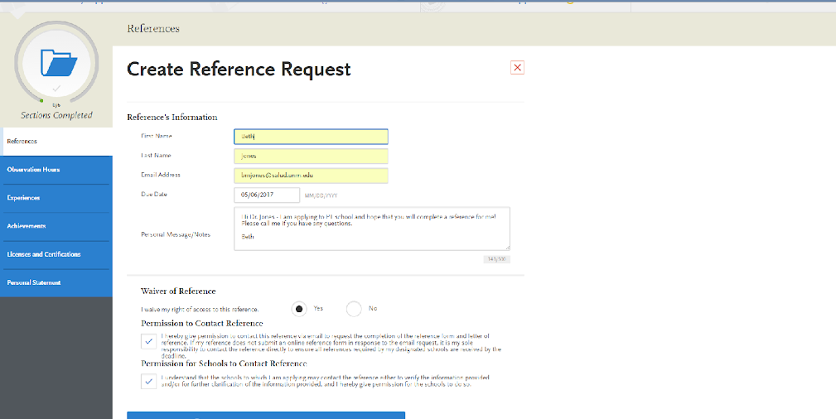
CREATE REFRENCE REQUEST
Please inform the people you select to write your reference letters that the UNM Division of Physical Therapy cannot contact them for more information about you, they need to be thorough and include everything they want UNM DPT to know about you in their reference letter.

Slide 31
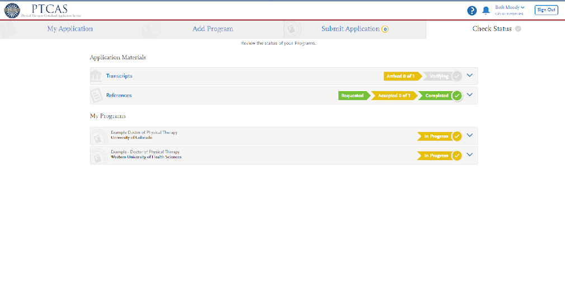
CHECK STATUS OFTEN!
THESE TRANSCRIPTS ARE NOT VERIFIED
Make sure that your official GRE are received and that your transcripts are verified by PTCAS. If your transcripts are not verified or your official GRE is not received it can cause delays in processing your application.

Slide 32
NM RESIDENCY
If Applicable, complete the NM Residency Application found in PTCAS If you are a New Mexico Resident, please complete the NM Residency form found on our website under the application requirements page.
Upload the needed documents (3) on PTCAS
- The completed form
- A copy of your driver's license
- A copy of your vehicle registration or other verification of residency.
***IF YOU ARE NOT A RESIDENT OF THE STATE OF NEW MEXICO, YOU NEED NOT COMPLETE THE RESIDENCY FORM

Slide 33
ACADEMIC UPDATE
If needed complete an academic update in PTCAS in December 2026, to update any classes listed as in progress in the Fall semester, if applicable.
If you are enrolled in classes in Spring of 2027, they should also be listed in PTCAS as in progress. Remember only one of those classes can be a prerequisite.
For more information, visit:
Help.liaisonedu.com/PTCAS

Slide 34

ASYNCHRONOUS INTERVIEW
In November if chosen you will be asked to complete an asynchronous interview.
Record yourself answering 4 questions.
30 seconds to read/listen to the question.
1 minute to answer the question.

Slide 35
IN PERSON INTERVIEW
- January 9th, 2027
Discussion with students
Panel of 3 interviewers (faculty & clinicians)
Growth with skills: communication, problem-solving abilities and grit
Career services gives one-on one mock interviews, email at: career4u@unm.edu
Volunteer experience helpful but not required – a basic knowledge of PT issues is recommended (check APTA website and ask your LOR author)
Only the top 75-80 applicants will be offered an interview

Slide 36

FINAL SELECTION
Offers are made to the top 30 applicants with up to 20 alternates
Strong preference is given to residents of the State of New Mexico

Slide 37
SUMMER CURRICULUM
Applicants admitted to the program will complete a required preparatory course on the foundational concepts of biomechanics, kinesiology, and joint structure and function. Through this course, learners will revisit various joints and regions of the body to gain an understanding of the detail and dept of learning required for success in our program. Learners will be assigned weekly readings, pre-recorded lectures, short assignments, and short weekly quizzes in the four foundational modules.
4 modules
- Kinesiology/biomechanics/joint structure
- Spine
- Upper extremity
- Lower extremity
Students will be required to purchase, in advance, a book used within the 1st year of our program to complete all assignments (https://www.fadavis.com/product/physical-therapy-joint-structure-function-levangie-norkin-6 ). The purpose of the course is three-fold. 1. It provides exposure to some foundational concepts in anatomy and kinesiology which will help with content in your first-year curriculum. 2. This course gives an introduction to the rigor expected in the program. 3. Performance in this course can help us identify those that might need tutoring early in the program to ensure they are set up to succeed as early as possible.
Notes:
This course is helpful in getting an understanding of what the program will consist of.

Slide 38
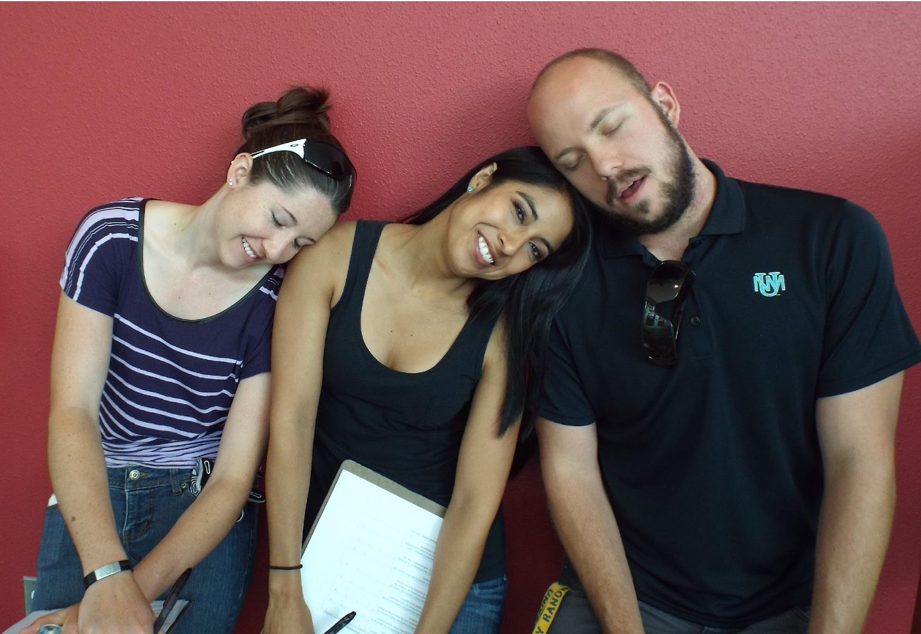
NONDISCRIMINATION POLICY
The admission procedure in the Physical Therapy Program at the University of New Mexico does not discriminate against any student on the basis of gender, sexual orientation, marital or parental status, race, color, religion, age, national origin or physical handicap.

