Slide 1
Evaluating Health Professional Students’ Attitudes and Practices Regarding Physical Activity, Sleep, and Nutrition
Presented by: Jared Rocco, PharmD
PGY2 Ambulatory Care Pharmacy Resident
University of New Mexico College of Pharmacy
Albuquerque, NM
May 23rd, 2025

Slide 2
Disclosure Statement
Jared Rocco, PharmD
Co-investigators: Vany Nguyen PharmD; Gretchen Ray, PharmD, PhC; Kelsea Aragon, PharmD, PhC
Potential conflict of interest: none
Sponsorship: none
Proprietary information or results of ongoing research may be subject to different interpretations
Speaker’s presentation is educational in nature
This research project has been approved by the IRB

Slide 3
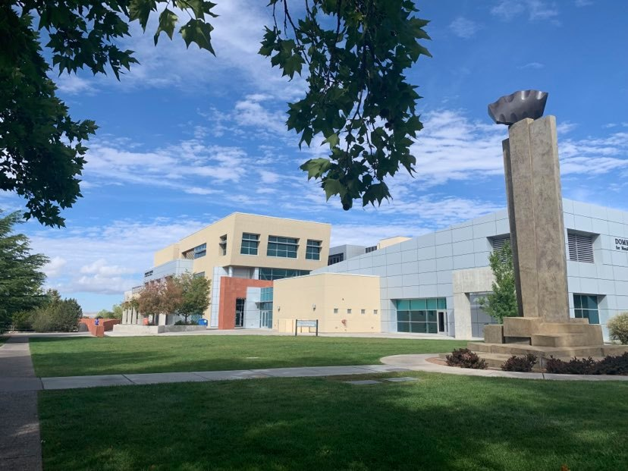
Facility/Institution
University of New Mexico Health Sciences Center (UNM HSC)
• Large academic health center
• Diverse student population
• Multiple health professions programs

Slide 4
Pre-Test Assessment: Question 1
According to the U.S. Department of Health and Human Services’ Physical Activity Guidelines for Americans (2nd Edition, 2018), adults should perform at least how many minutes of moderate-intensity aerobic activity per week?
A. 75 minutes
B. 150 minutes
C. 225 minutes
D. 300 minutes

Slide 5
Pre-Test Assessment: Question 2
Current national sleep guidelines state that, to support optimal cognitive performance, mood, and long-term health, adults should aim for a minimum of how many hours of sleep each night?
A. 5 hours
B. 6 hours
C. 7 hours
D. 10 hours

Slide 6
Pre-Test Assessment: Question 3
Research shows that health-professional students who maintain healthier personal habits are more likely, once they become clinicians, to:
A. Order additional diagnostic tests for preventive screening
B. Counsel patients on those same healthy behaviors
C. Shorten follow-up appointments to save time
D. Say little about lifestyle, assuming patients already understand healthy choices

Slide 7
Background
Studies evaluating the impact of rigorous academic and clinical demands on health-professional students have shown significant increases in stress and burnout
Many students fail to meet recommended guidelines for physical activity, sleep duration, and balanced nutrition, undermining resilience and academic performance
Poor lifestyle behaviors in pharmacy and medical students are associated with higher rates of anxiety, depression, and reduced quality of life
Research examining personal health behaviors and professional practice has shown that students who engage in regular exercise, adequate sleep, and healthy eating counsel patients more confidently on lifestyle modification
No prior research has systematically compared physical activity, sleep, nutrition, and mental well-being across multiple health-profession programs.

Slide 8
Objectives
Assess physical activity, sleep, and nutrition habits
Explore changes in behavior since program start
Identify barriers to wellness
Compare behaviors across health programs

Slide 9
Research Methodology
Design: Descriptive, observational, cross-sectional electronic survey ​
Population: Spring 2025 students in Medicine, Pharmacy, Nursing, Advanced Nursing, Nurse Practitioner, Physician Assistant, Physical Therapy, Occupational Therapy, Dental Hygiene ​
Data Collection:
Online REDCap survey assessing physical activity, sleep, nutrition, mental health, overall well-being
Two-wave email distribution with reminder at 2 weeks
In-person recruitment with snack incentive ​
Confidentiality:
No identifiers collected; data stored de-identified on secure HSC network

Slide 10
Research Methodology
24-item survey (demographics, wellness domains)
Custom survey items conceptually informed by PHQ-2, GAD-2, and SF-20 domains.
Recruitment via email and in-person outreach
Incentive: nutritional snack (in-person only)
The online survey was available from March 27 to April 26, 2025

Slide 11
Student Participant Demographics
Gender: 75.0% Female, 22.4% Male
Age: 20–24 years most common (~38.4%)
Race: White most common (~75.4%)
Hispanic/Latino Origin: 43.5% identify as Hispanic/Latino

Slide 12
Student Participant Demographics
Variable | Total (N = 232)
Age Range, n (%) Under 20 yrs 20-24 yrs 25-29 yrs 30-34 yrs 35-39 yrs 40 yrs and over | 6 (2.6) 89 (38.4) 72 (31.0) 25 (10.8) 10 (4.3) 30 (12.9)
Female Sex, n (%) | 174 (75.0)
Race, n (%) White Asian Other American Indian/Alaska Native Black/African American Native Hawaiian or Other Pacific Islander | 175 (75.4) 23 (9.9) 14 (6.0) 10 (4.3) 9 (3.9) 1 (0.4)
Hispanic/Latino Ethnicity, n (%) | 101 (43.5)

Slide 13
Parental Demographics
38 students (16.4%) reported having children <18 years old
Mean number of children: 1.76 (SD 0.75), median = 2
Range: 1 to 4 children

Slide 14
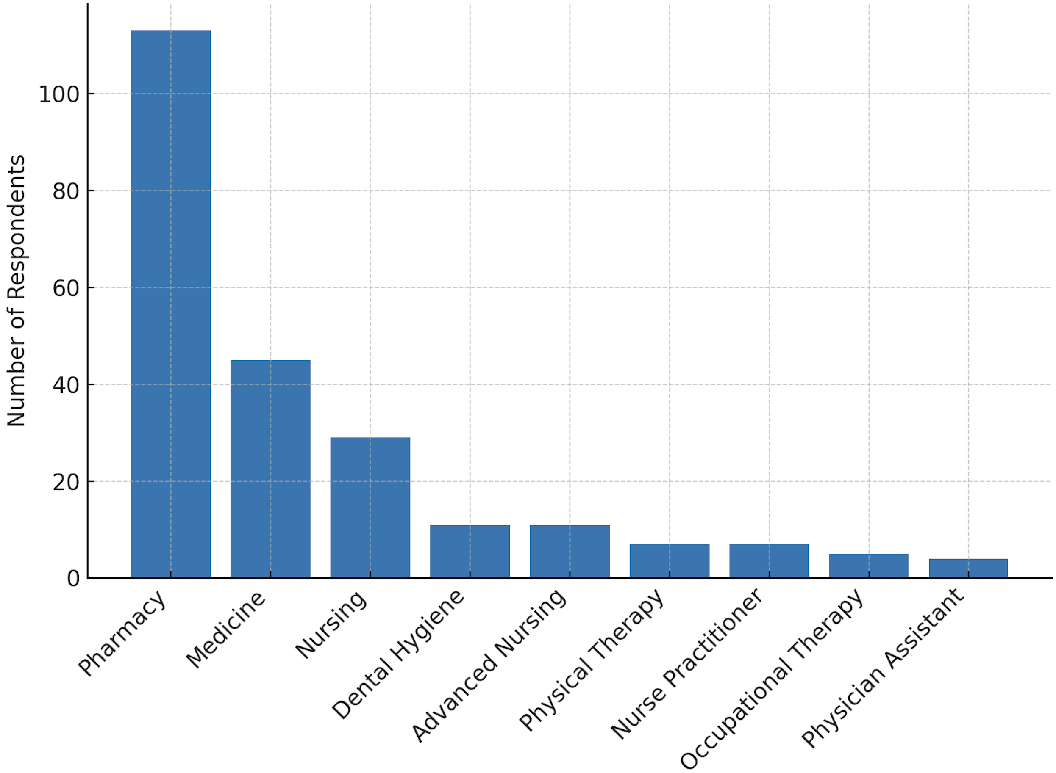
Participant Distribution by HSC Program
Notes:
Pharmacy: 113 students (46.9%)
Medicine: 45 students (18.7%)
Nursing: 29 students (12.0%)
Dental Hygiene: 11 students (4.6%)
Advanced Nursing: 11 students (4.6%)
Nurse Practitioner: 7 students (2.9%)
Physical Therapy: 7 students (2.9%)
Occupational Therapy: 5 students (2.1%)
Physician Assistant: 4 students (1.7%)

Slide 15
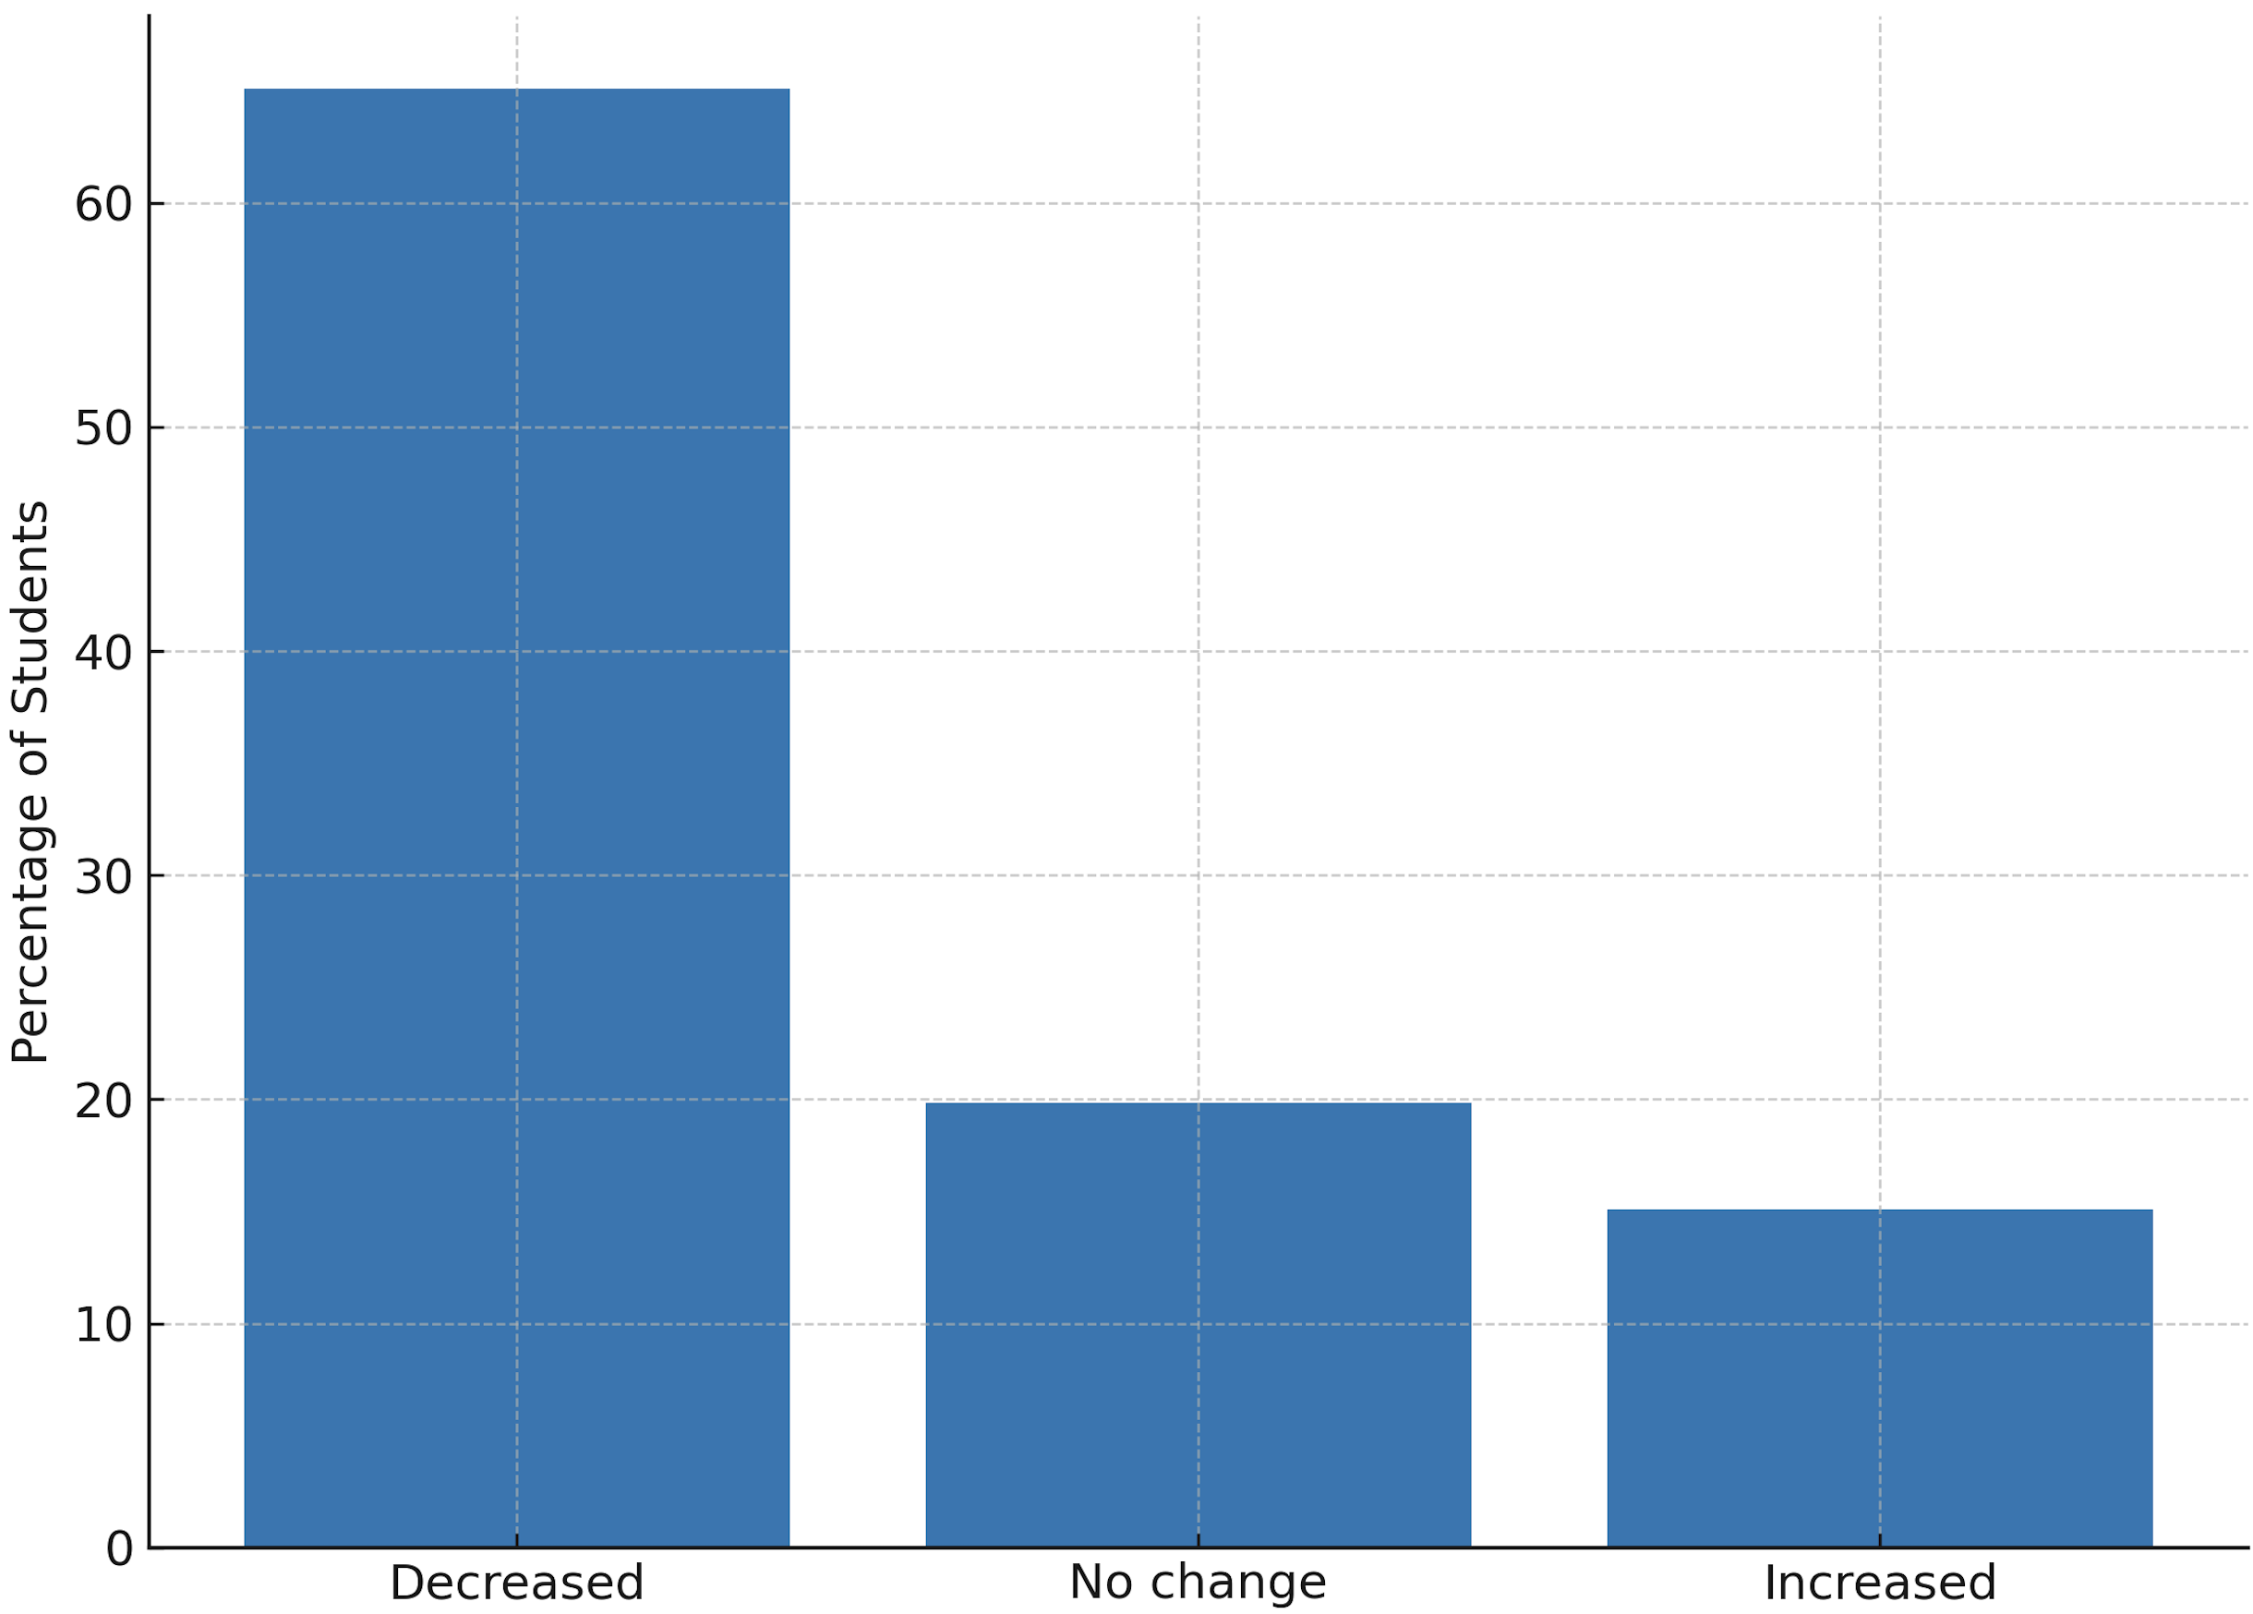
Change in Physical Fitness Since Program Start
Notes:
129 students (55.6%) reported a decrease in physical fitness since starting their program.
65 students (28.0%) reported no change in their physical fitness.
38 students (16.4%) reported an increase in their physical fitness.

Slide 16
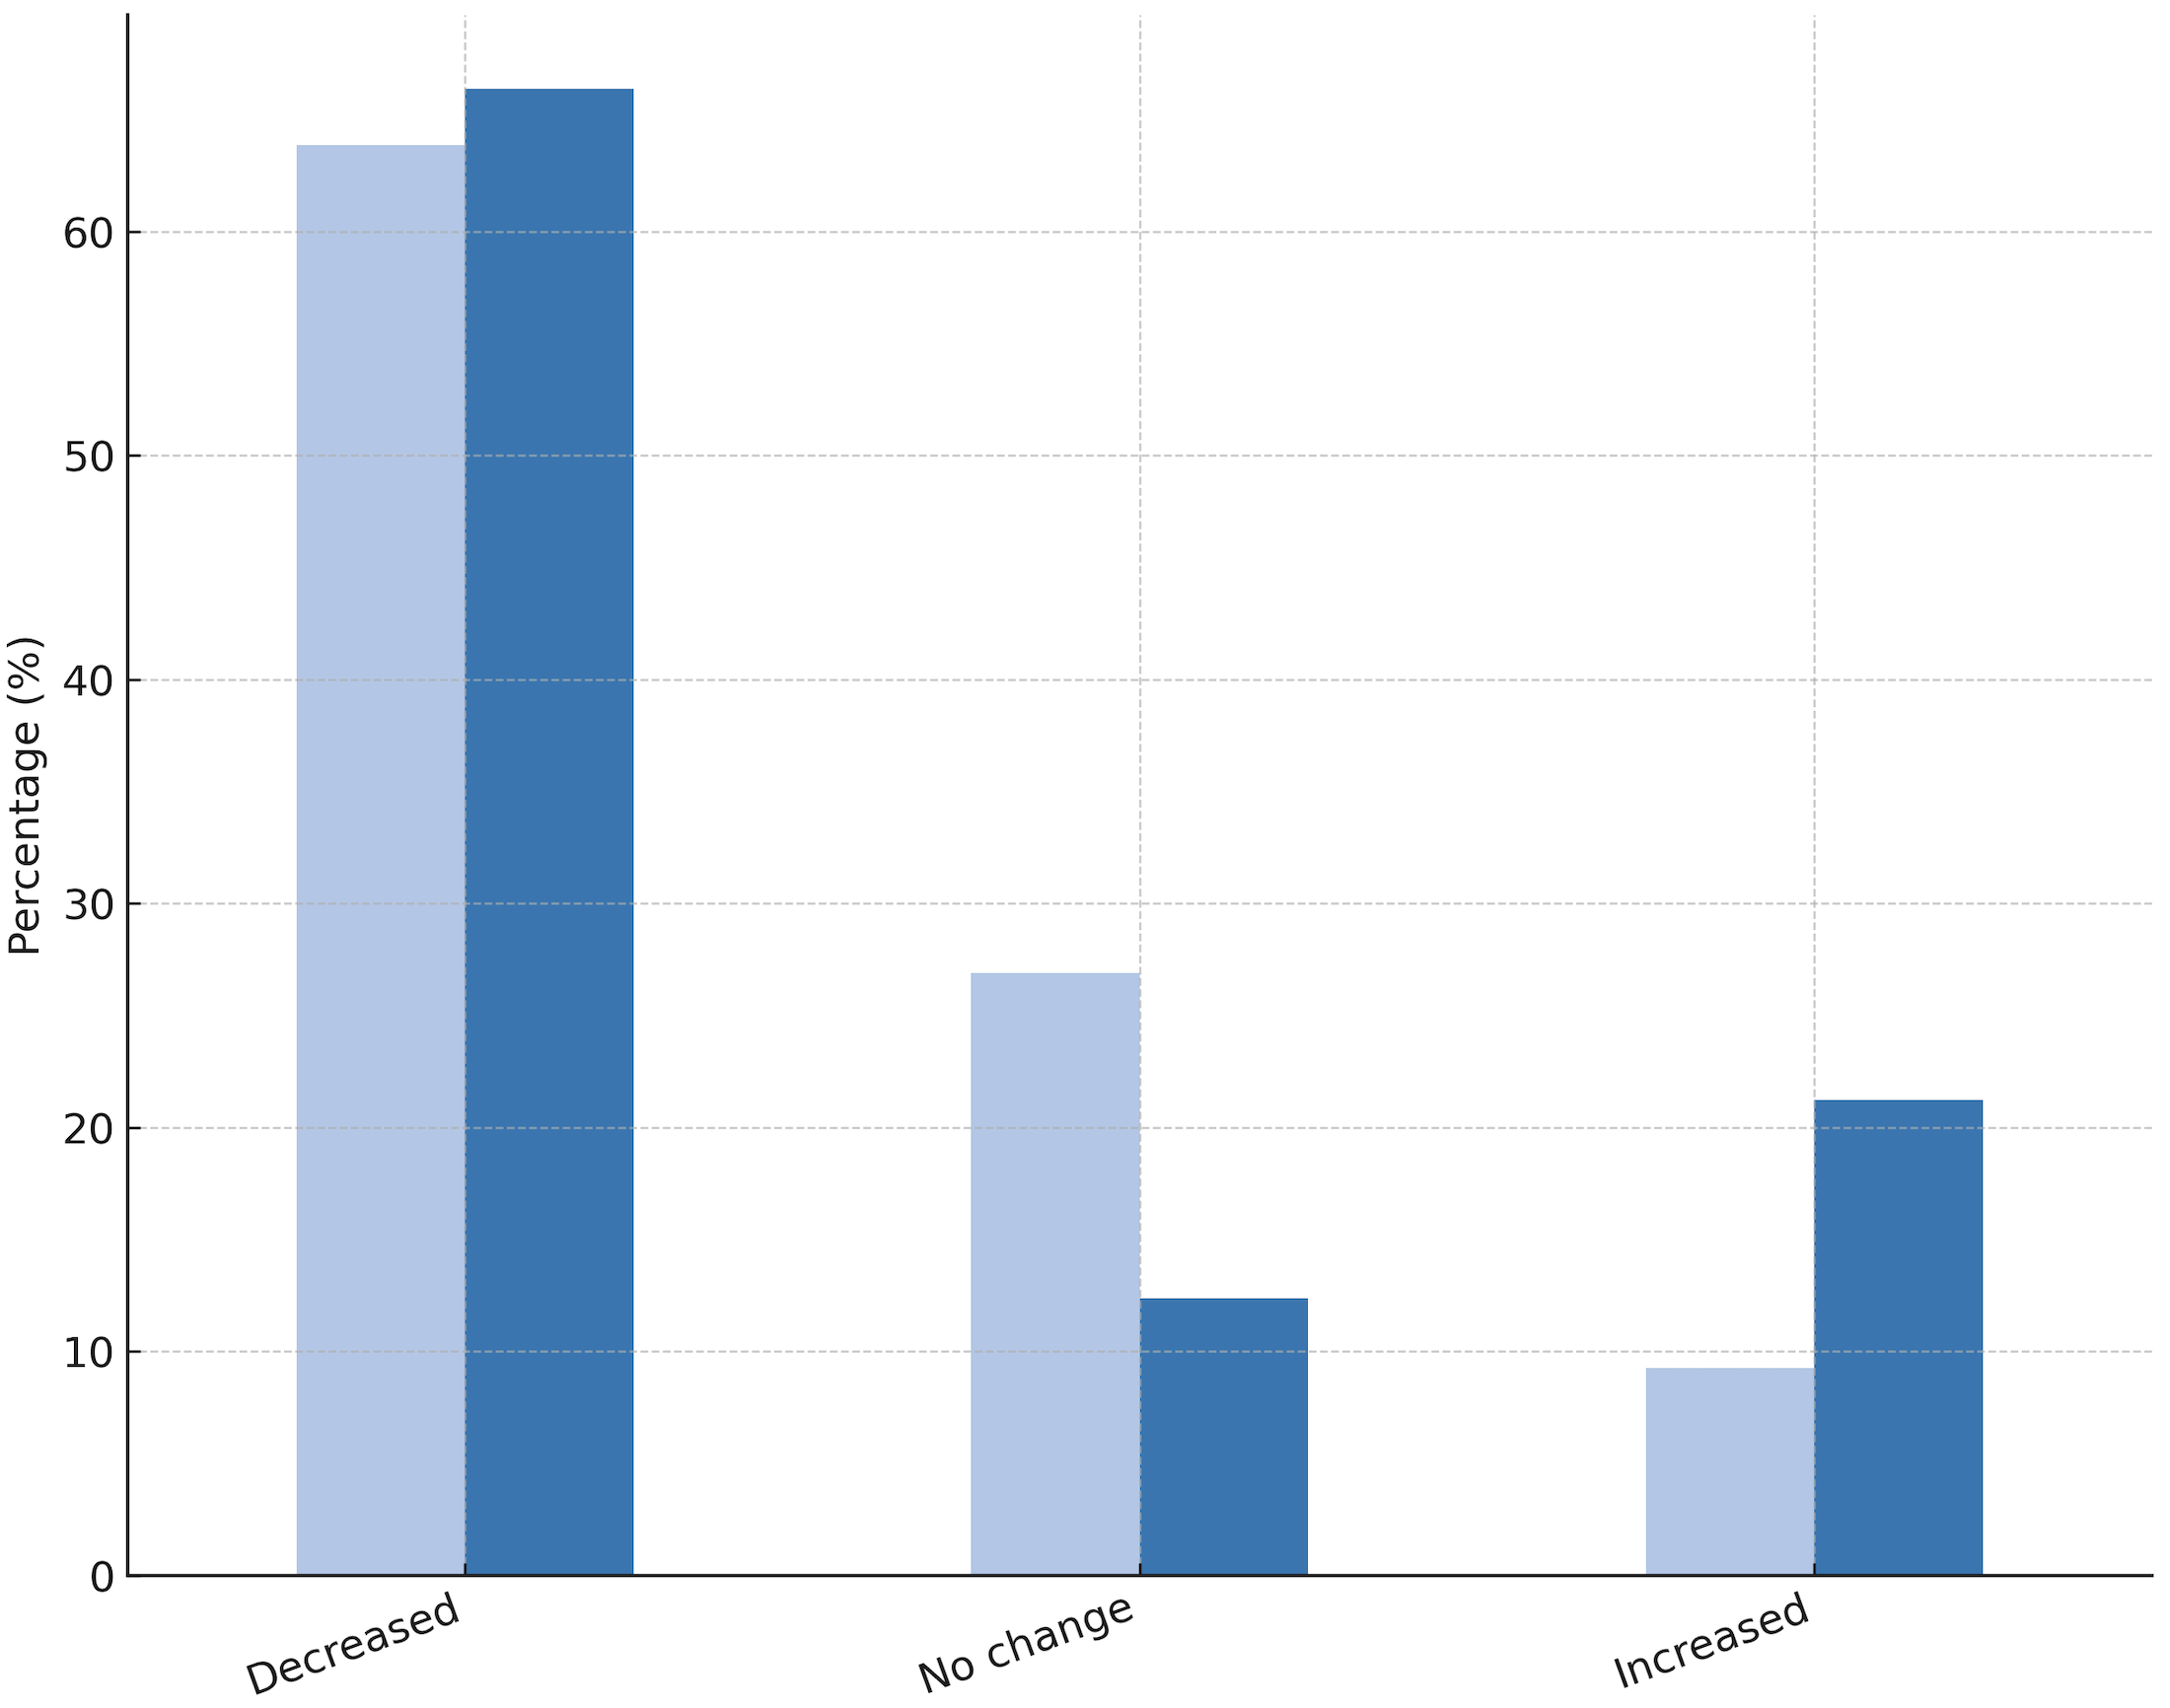
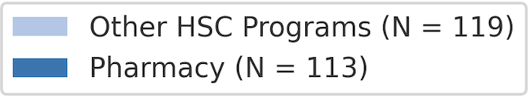
Changes in Physical Fitness Levels Among Students in Pharmacy vs. Other HSC Programs

Slide 17
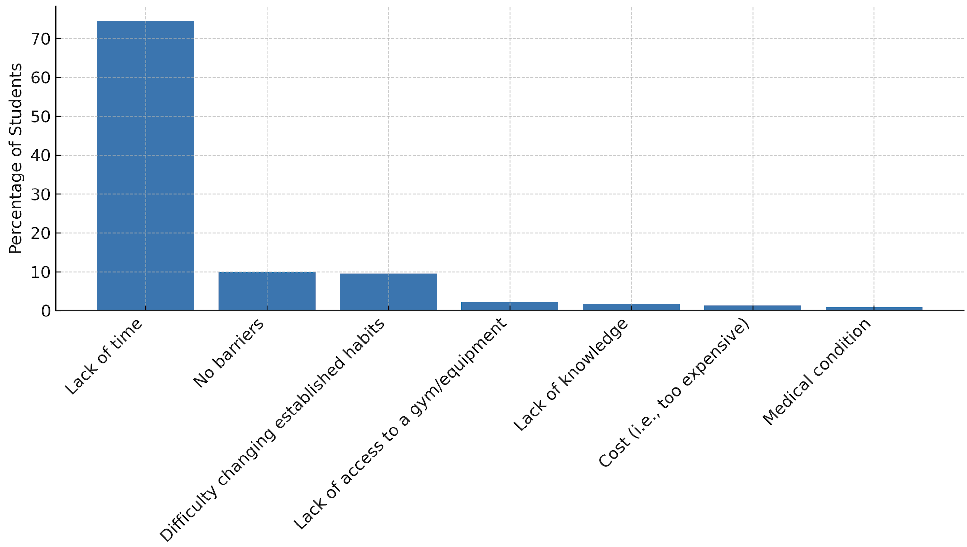
Barriers to Physical Activity

Slide 18
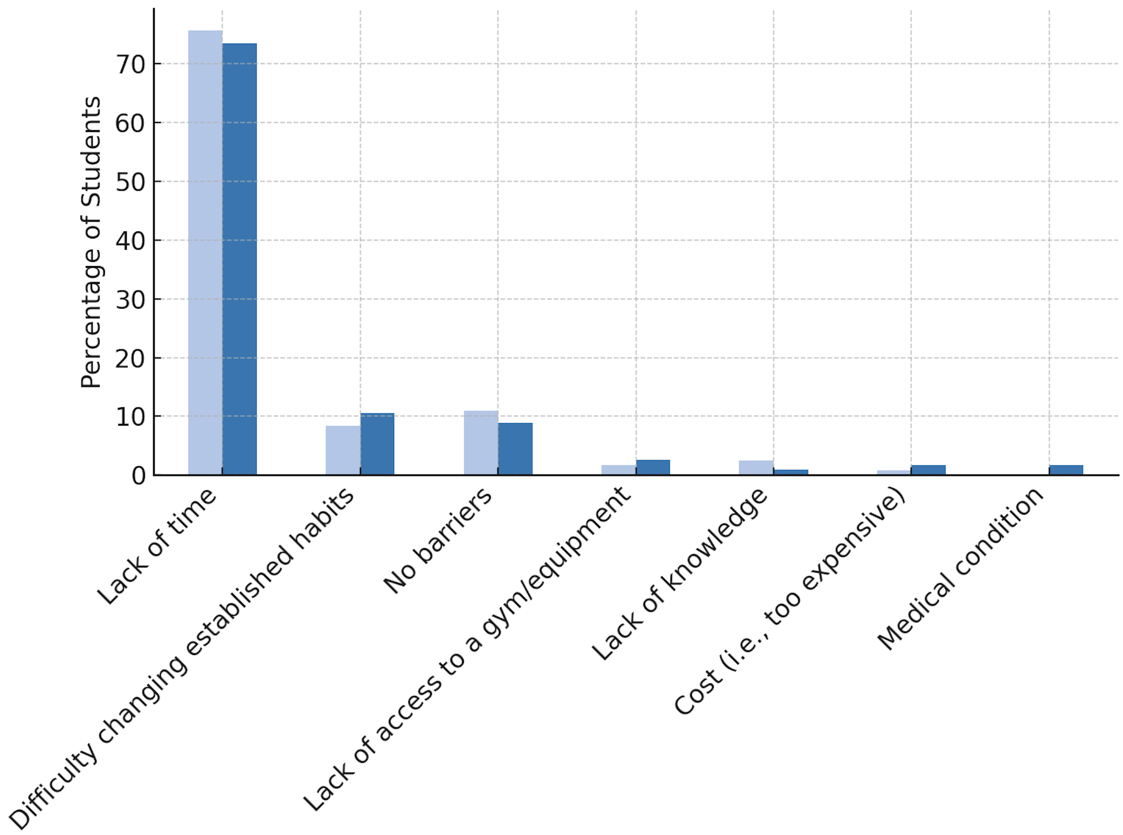
Barriers to Maintaining Physical Activity Among Students in Pharmacy vs. Other HSC Programs

Slide 19
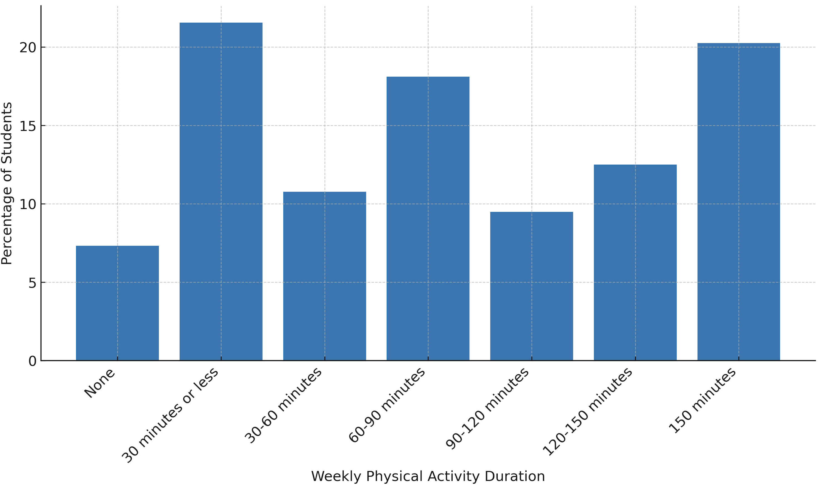
Weekly Physical Activity Levels

Slide 20
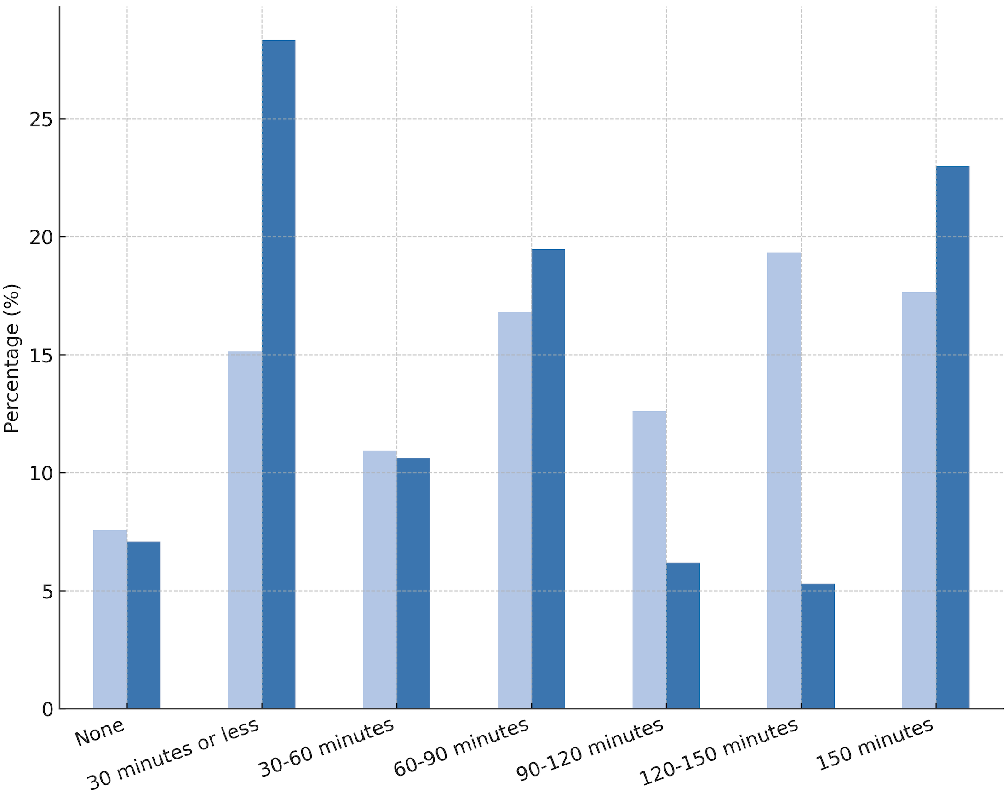
Self-Reported Weekly Minutes of Physical Activity Among Students in Pharmacy vs. Other HSC Programs

Slide 21
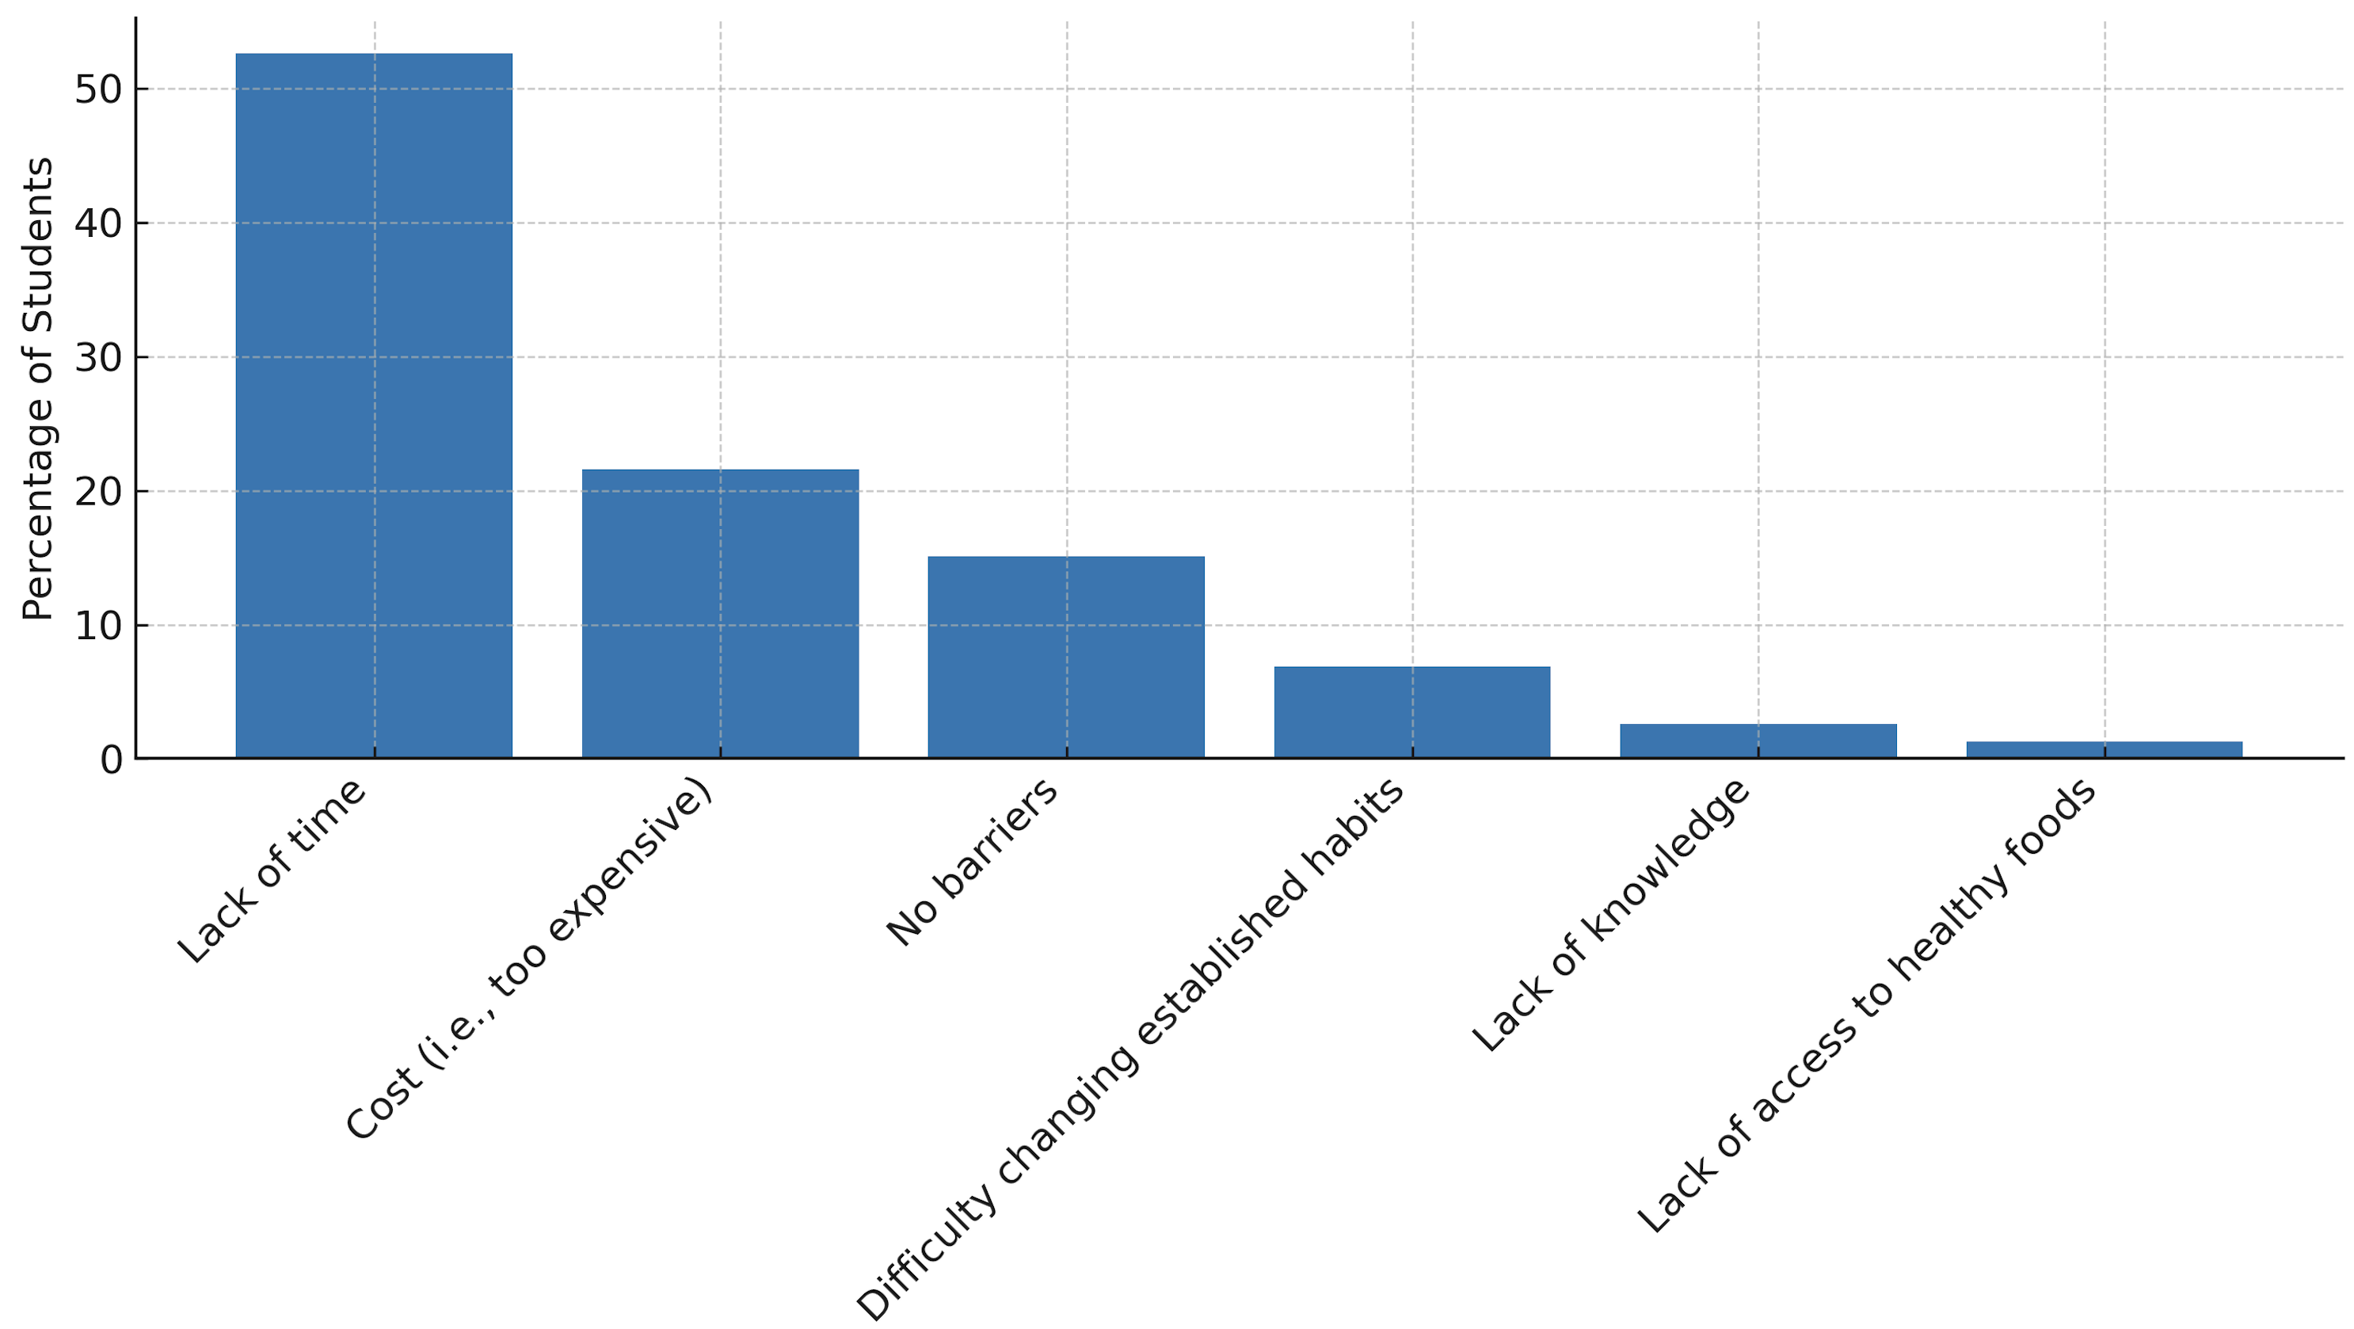
Barriers to Maintaining a Healthy Diet

Slide 22
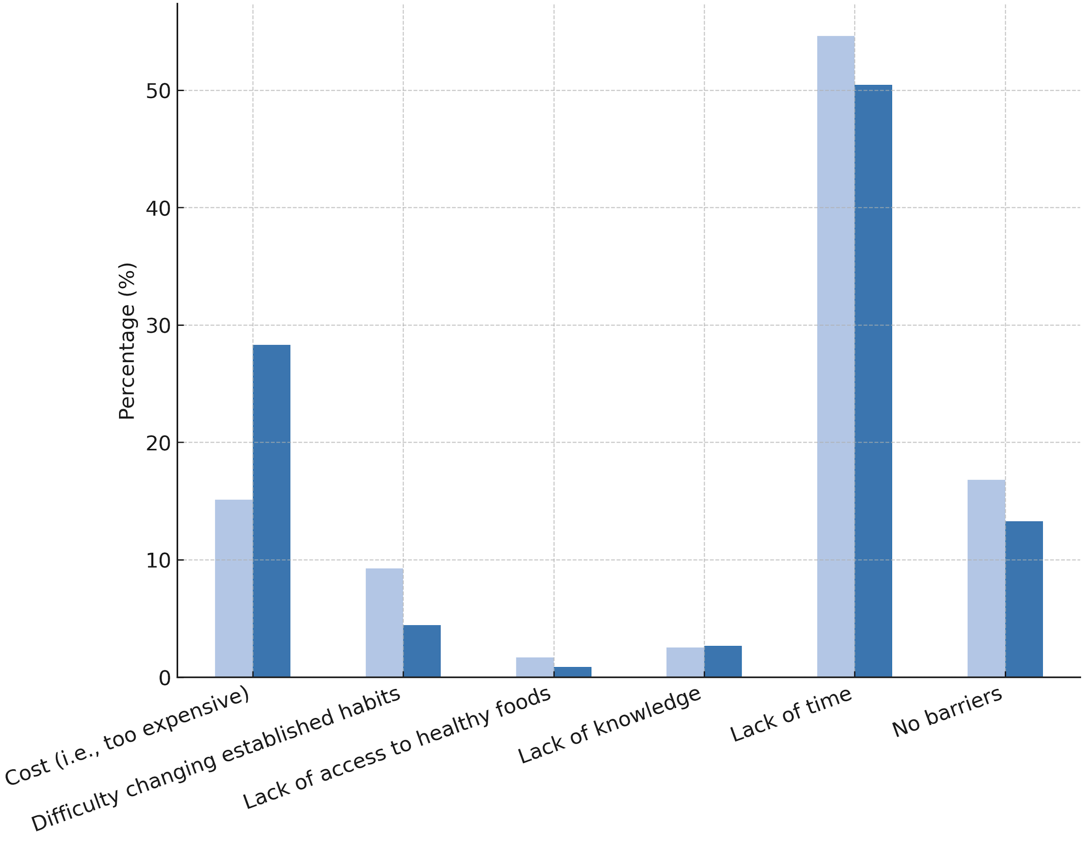
Barriers to Maintaining a Healthy Diet Among Students in Pharmacy vs. Other HSC Programs

Slide 23
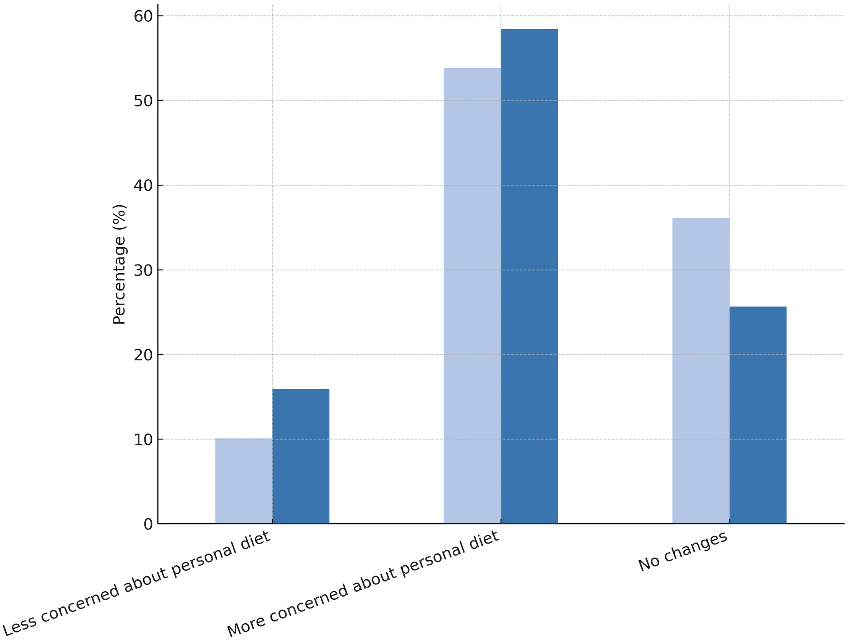
Diet Change by Program Among Students in Pharmacy vs. Other HSC Programs

Slide 24
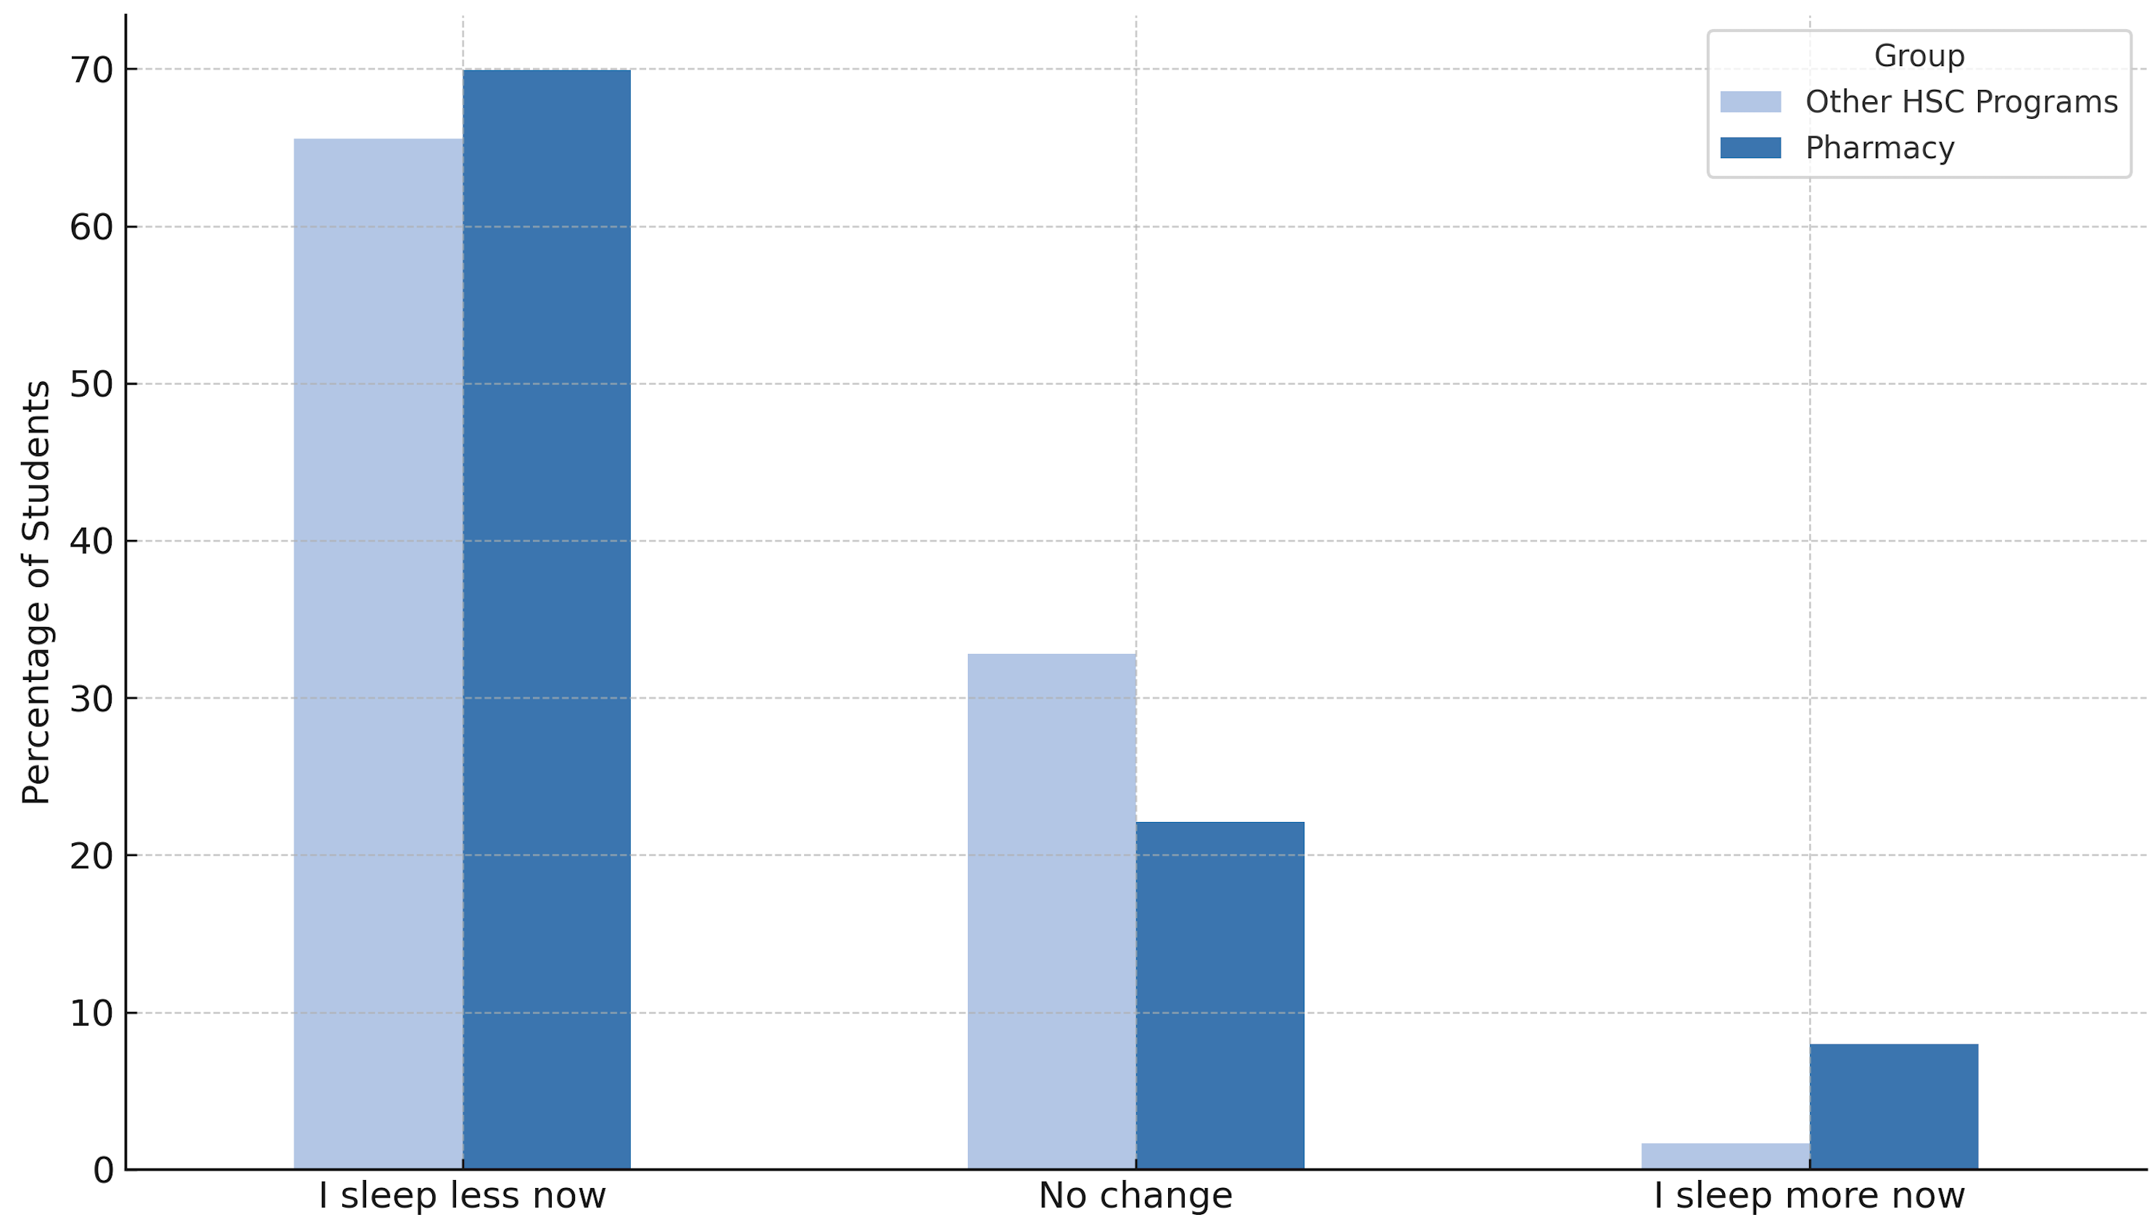
Changes in Sleep Patterns Among Students in Pharmacy vs. Other HSC Programs

Slide 25
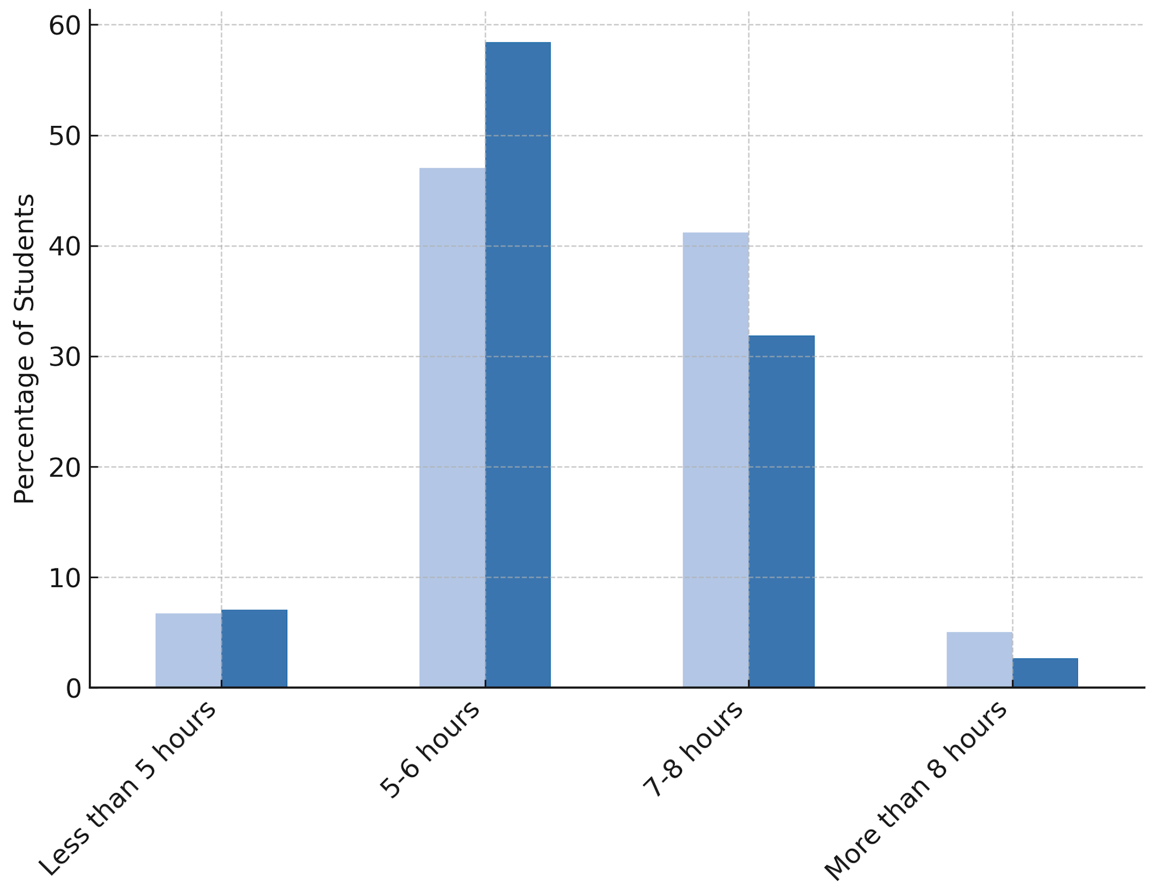
Average Sleep Duration Among Students in Pharmacy vs. Other HSC Programs

Slide 26
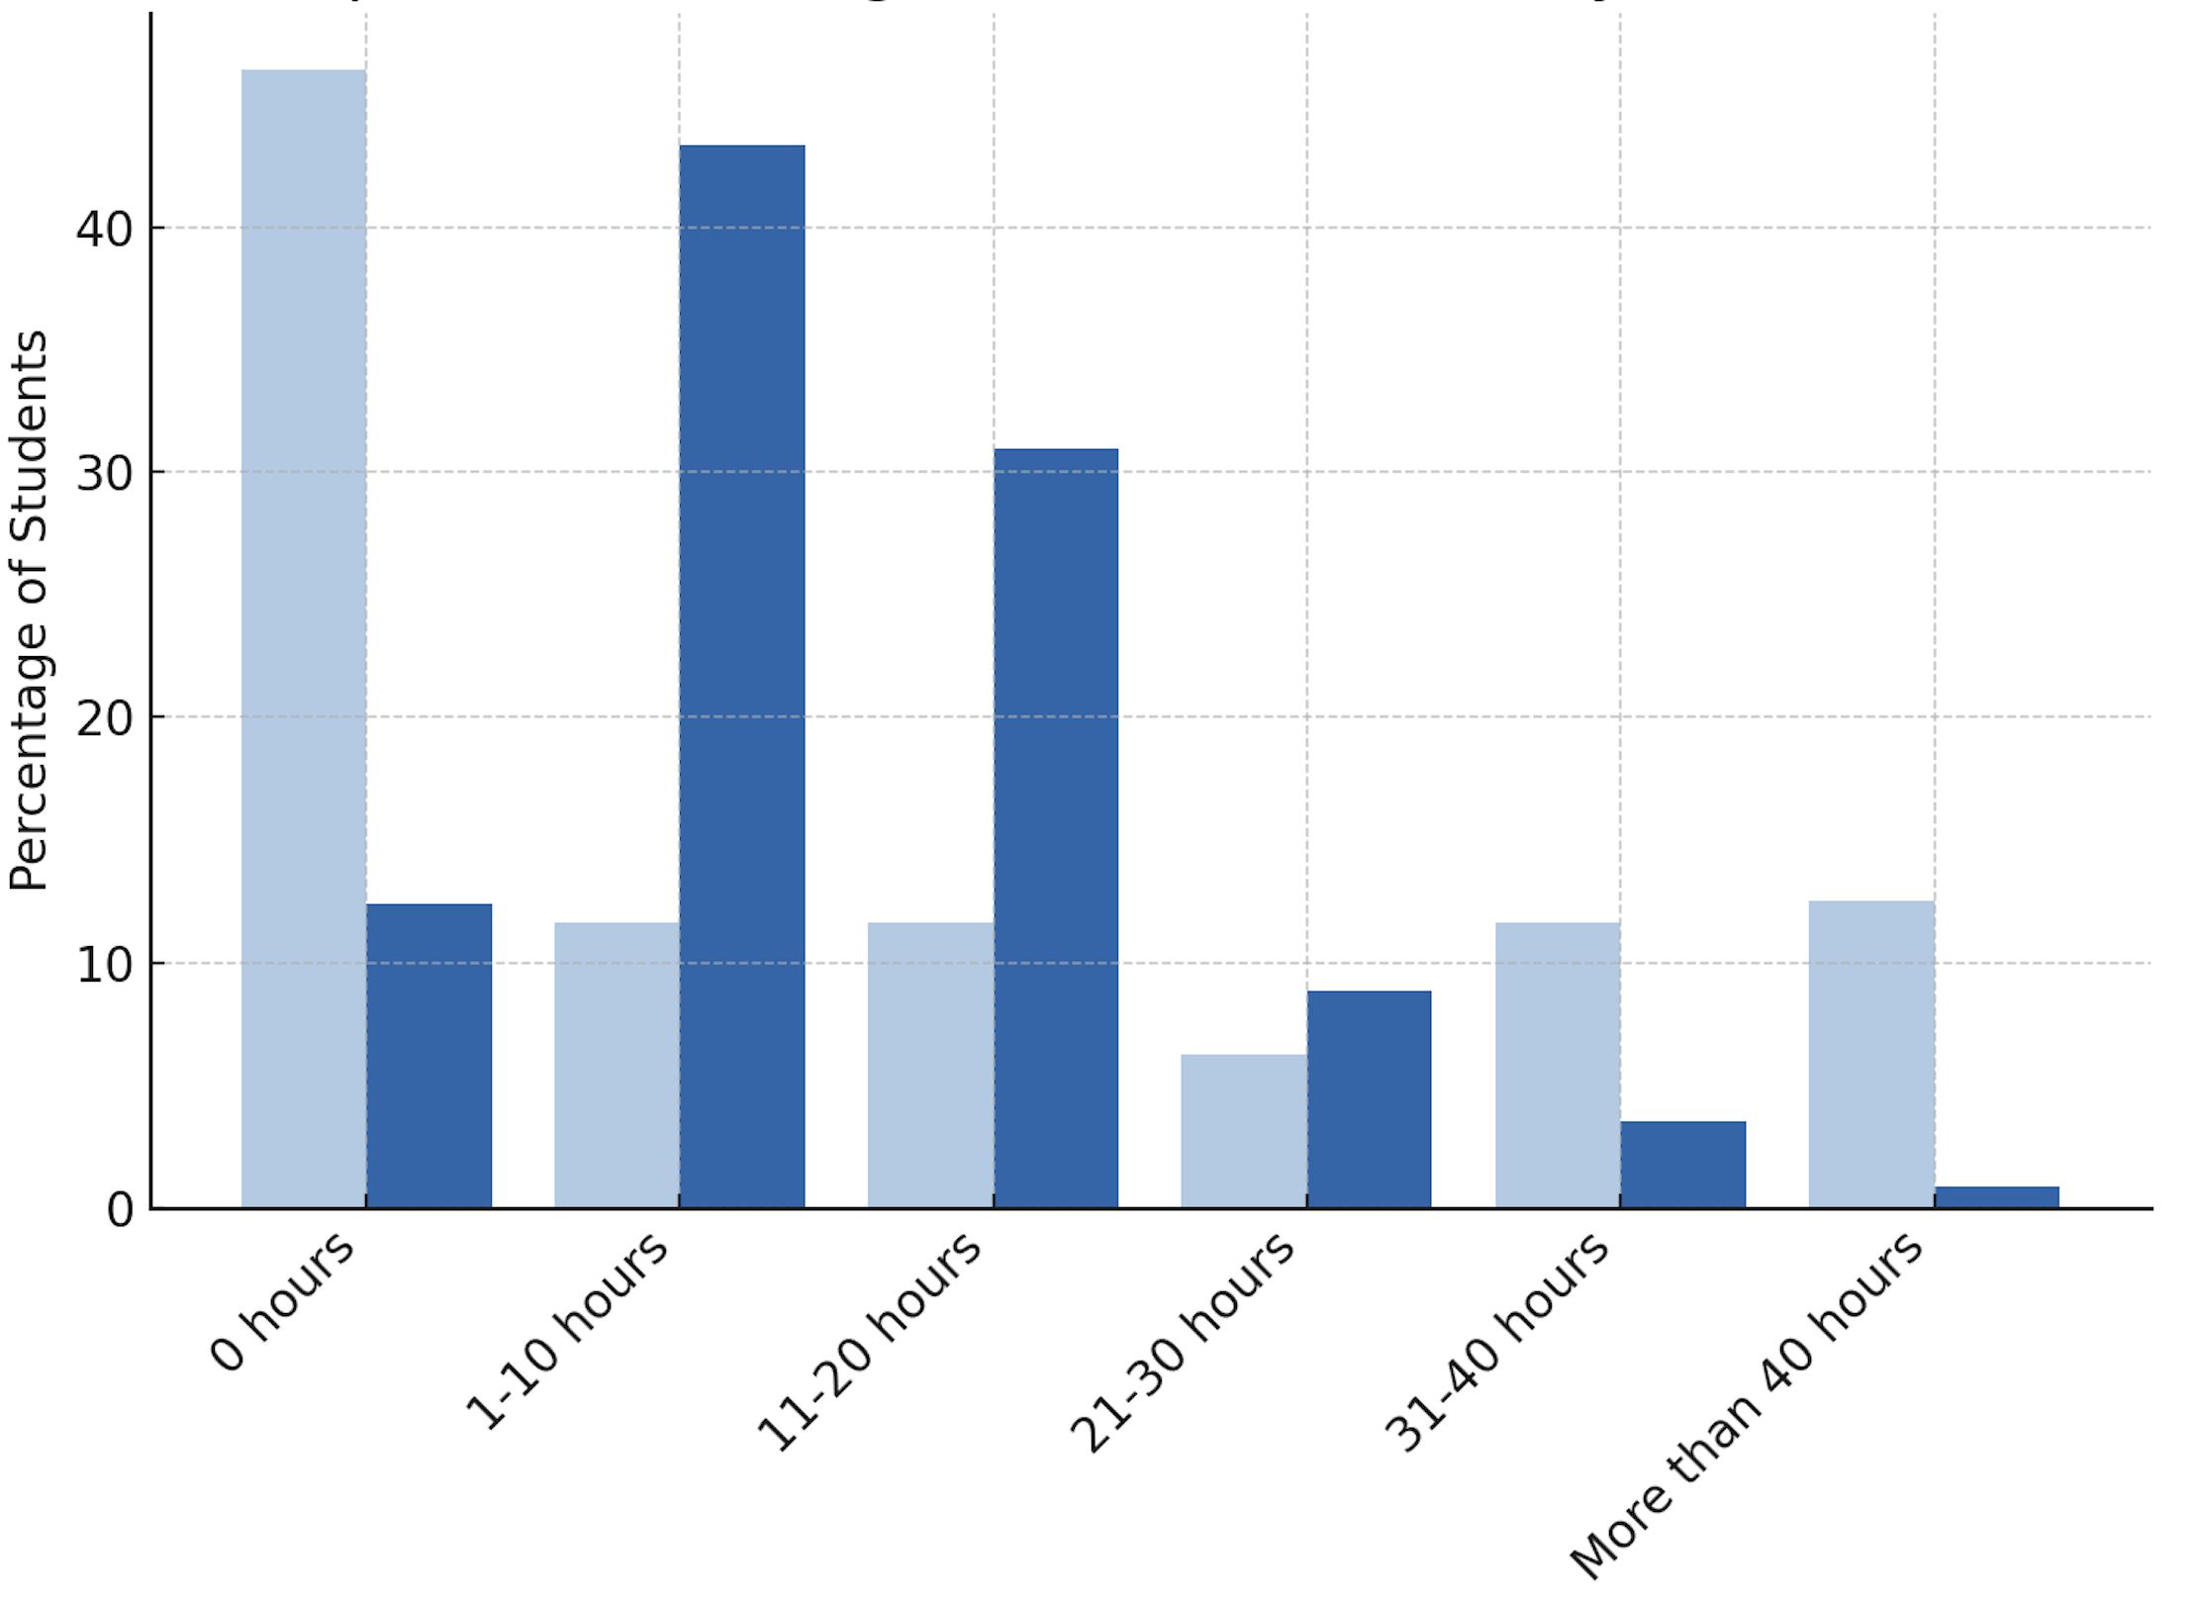
Hours Worked per Week Among Students in Pharmacy vs. Other HSC Programs

Slide 27
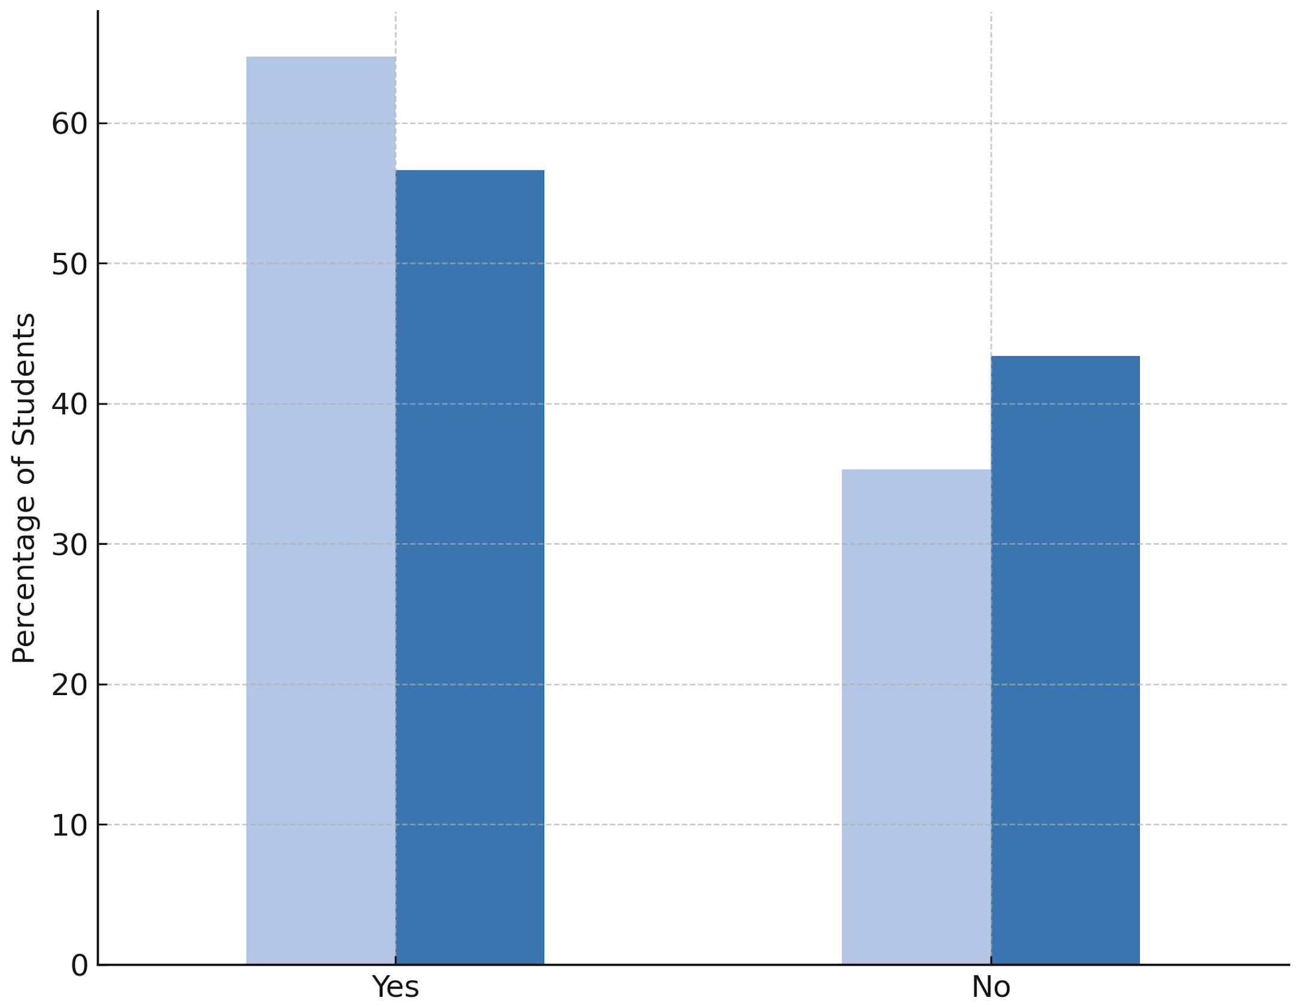
Primary Care Access in the Last 12 Months Among Students in Pharmacy vs. Other HSC Programs

Slide 28
Wellness Trends Among Students with Children
62.1% of students with children reported sleeping <6 hours/night vs. 58.8% without children.
Students with children had slightly lower diet scores (5.69 vs. 5.75) but reported less decline in fitness (58.6% vs. 63.7%).
Volunteer participation was lower among parents (55.2% vs. 74.8%), likely due to time constraints.
More student-parents worked 30+ hours/week (17.2% vs. 11.9%).
Frequent fast-food intake was lower among those with children (41.4% vs. 51.9%).

Slide 29
Conclusions
Students across UNM HSC programs reported a self-perceived decline in physical fitness after entering their professional studies
Time constraints were the most frequently cited barrier to maintaining regular exercise and healthy eating behaviors
A significant portion of students reported low levels of weekly physical activity, often falling below recommended guidelines
Many students expressed increased concern for nutrition, but this did not consistently result in healthier dietary patterns
These patterns are likely contributing to elevated stress and may impair both academic performance and future patient care behaviors
Institutional efforts to address time constraints and wellness barriers could support healthier student lifestyles and long-term professional development

Slide 30
Limitations
Low response rate
Single-institution
Survey not fully validated
Response bias possible

Slide 31
Next Steps / Future Directions
Expand study to other institutions
Develop structured wellness initiatives
Inform curriculum and support service design

Slide 32
Pre-Test Assessment: Question 1
According to the U.S. Department of Health and Human Services’ Physical Activity Guidelines for Americans (2nd Edition, 2018), adults should perform at least how many minutes of moderate-intensity aerobic activity per week?
A. 75 minutes
B. 150 minutes
C. 225 minutes
D. 300 minutes

Slide 33
Pre-Test Assessment: Question 2
Current national sleep guidelines state that, to support optimal cognitive performance, mood, and long-term health, adults should aim for a minimum of how many hours of sleep each night?
A. 5 hours
B. 6 hours
C. 7 hours
D. 10 hours

Slide 34
Pre-Test Assessment: Question 3
Research shows that health-professional students who maintain healthier personal habits are more likely, once they become clinicians, to:
A. Order additional diagnostic tests for preventive screening
B. Counsel patients on those same healthy behaviors
C. Shorten follow-up appointments to save time
D. Say little about lifestyle, assuming patients already understand healthy choices

Slide 35
References
Nguyen MD, Stocks AM, Anksorus HN, Harris SC. Assessing the mental health, physical health, and well-being of doctor of pharmacy students. Curr Pharm Teach Learn. 2023;15(2):170-177. doi:10.1016/j.cptl.2023.02.023
Howie EK, Cannady N, Messias EL, McNatt A, Walter CS. Associations between physical activity, sleep, and self-reported health with burnout of medical students, faculty and staff in an academic health center. Sport Sci Health. 2022;18(4):1311-1319. doi:10.1007/s11332-022-00902-7
Zuhair HMU, Fatima K, Hussain U, Ayub A. Assessment of eating habits, lifestyle and physical activity among medical and dental students of Faisalabad Medical University. Pak J Med Sci. 2024;40(3Part-II):473-476. doi:10.12669/pjms.40.3.7323
Howe M, Leidel A, Krishnan SM, Weber A, Rubenfire M, Jackson EA. Patient-related diet and exercise counseling: do providers' own lifestyle habits matter? Prev Cardiol. 2010;13(4):180-185. doi:10.1111/j.1751-7141.2010.00079.x
Bergeron N, Al-Saiegh S, Ip EJ. An Analysis of California Pharmacy and Medical Students' Dietary and Lifestyle Practices. Am J Pharm Educ. 2017;81(8):5956. doi:10.5688/ajpe5956
Fischbein R, Bonfine N. Pharmacy and Medical Students' Mental Health Symptoms, Experiences, Attitudes and Help-Seeking Behaviors. Am J Pharm Educ. 2019;83(10):7558. doi:10.5688/ajpe7558
Marshall LL, Allison A, Nykamp D, Lanke S. Perceived stress and quality of life among doctor of pharmacy students. Am J Pharm Educ. 2008;72(6):137. doi:10.5688/aj7206137
Koon K, Wettergreen S, Hemstreet BA, Fink RM. Identification of Social Determinants of Education Among Pharmacy Students: Results From a Single-Institution Survey. Am J Pharm Educ. 2024;88(5):100691. doi:10.1016/j.ajpe.2024.100691
Piercy KL, Troiano RP, Ballard RM, et al. The Physical Activity Guidelines for Americans. JAMA. 2018;320(19):2020-2028. doi:10.1001/jama.2018.14854
Watson NF, Badr MS, Belenky G, et al. Recommended Amount of Sleep for a Healthy Adult: A Joint Consensus Statement of the American Academy of Sleep Medicine and Sleep Research Society. Sleep. 2015;38(6):843-844. Published 2015 Jun 1. doi:10.5665/sleep.4716

Slide 36
Questions?
Contact:
Jared Rocco, PharmD
PGY2 Ambulatory Care Pharmacy Resident
University of New Mexico College of Pharmacy
jmrocco@salud.unm.edu

Slide 37
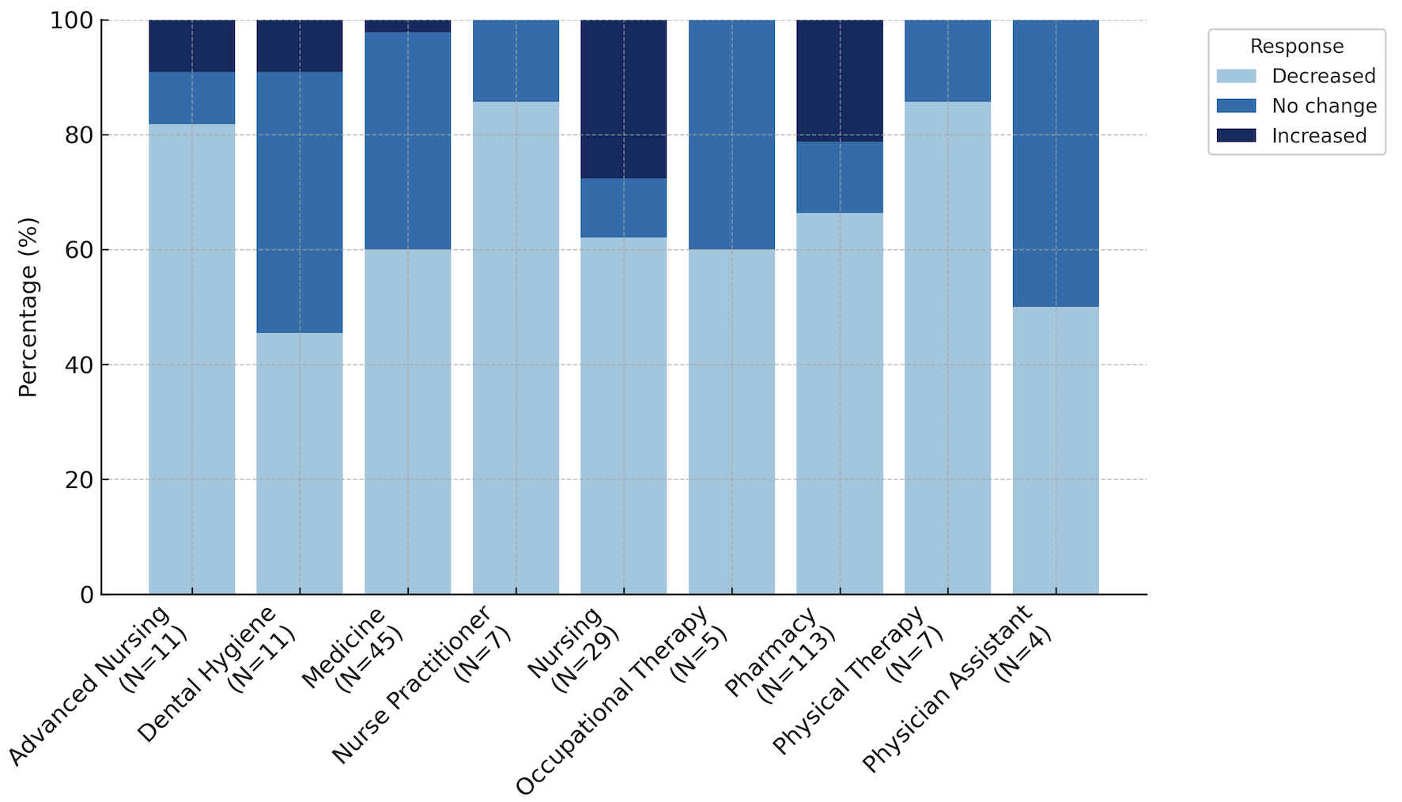
Fitness Change by Program

Slide 38
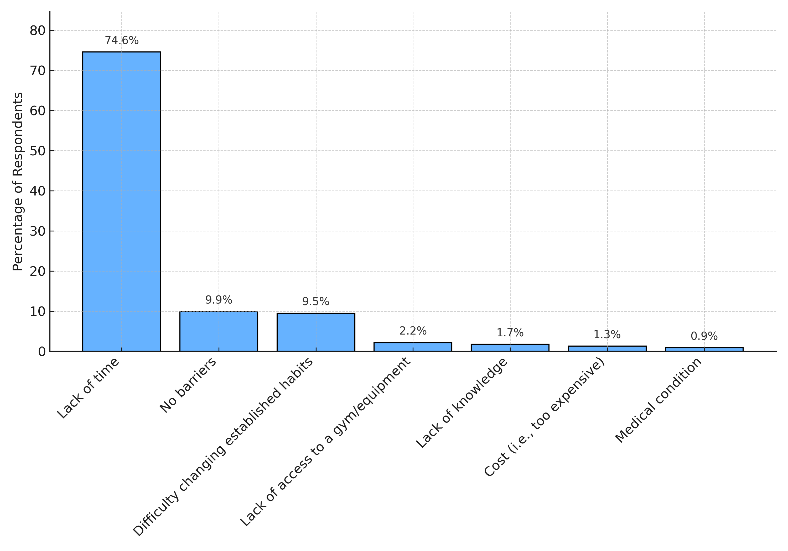
Barriers to Physical Activity

Slide 39
Fitness Change by Program

Slide 40
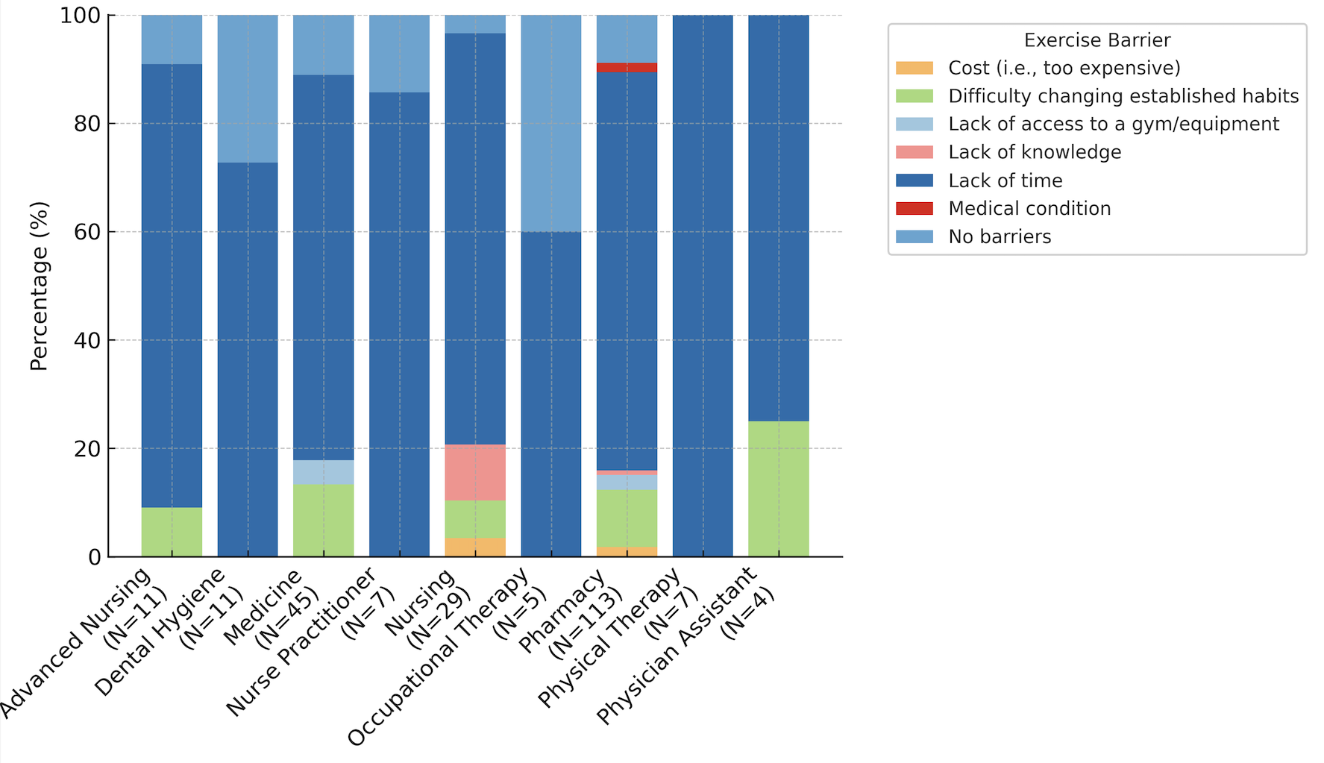
Barriers to Exercise by Program

Slide 41
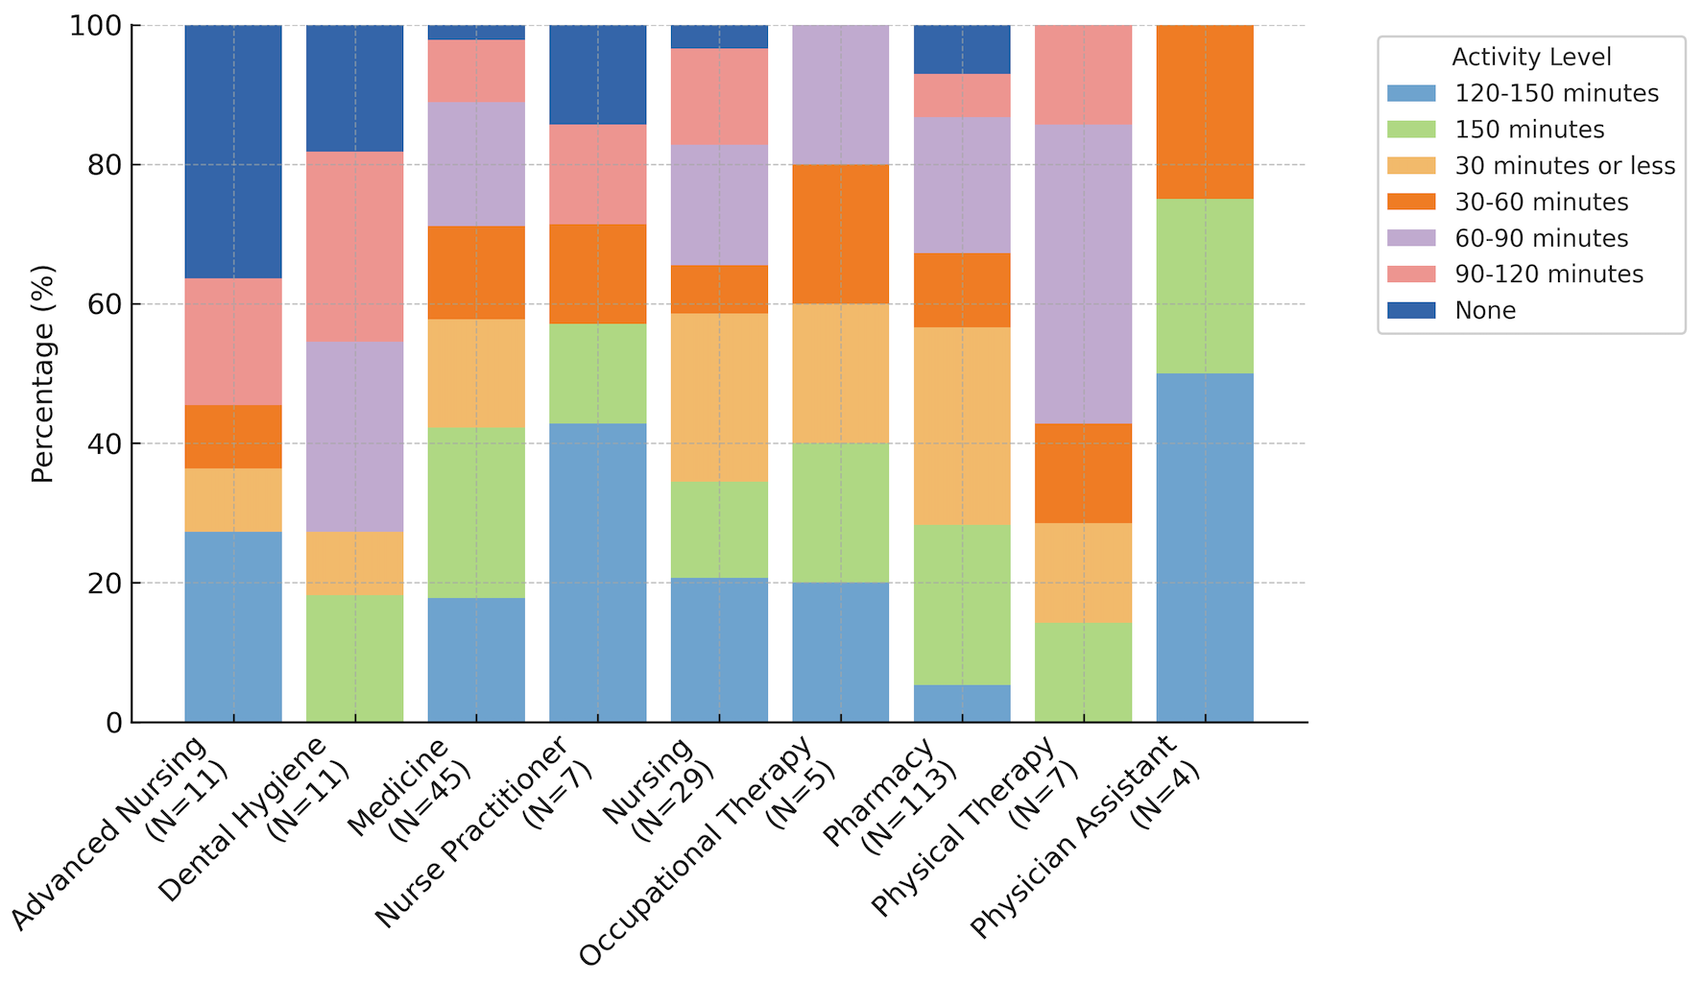
Physical Activity Levels by Program

Slide 42
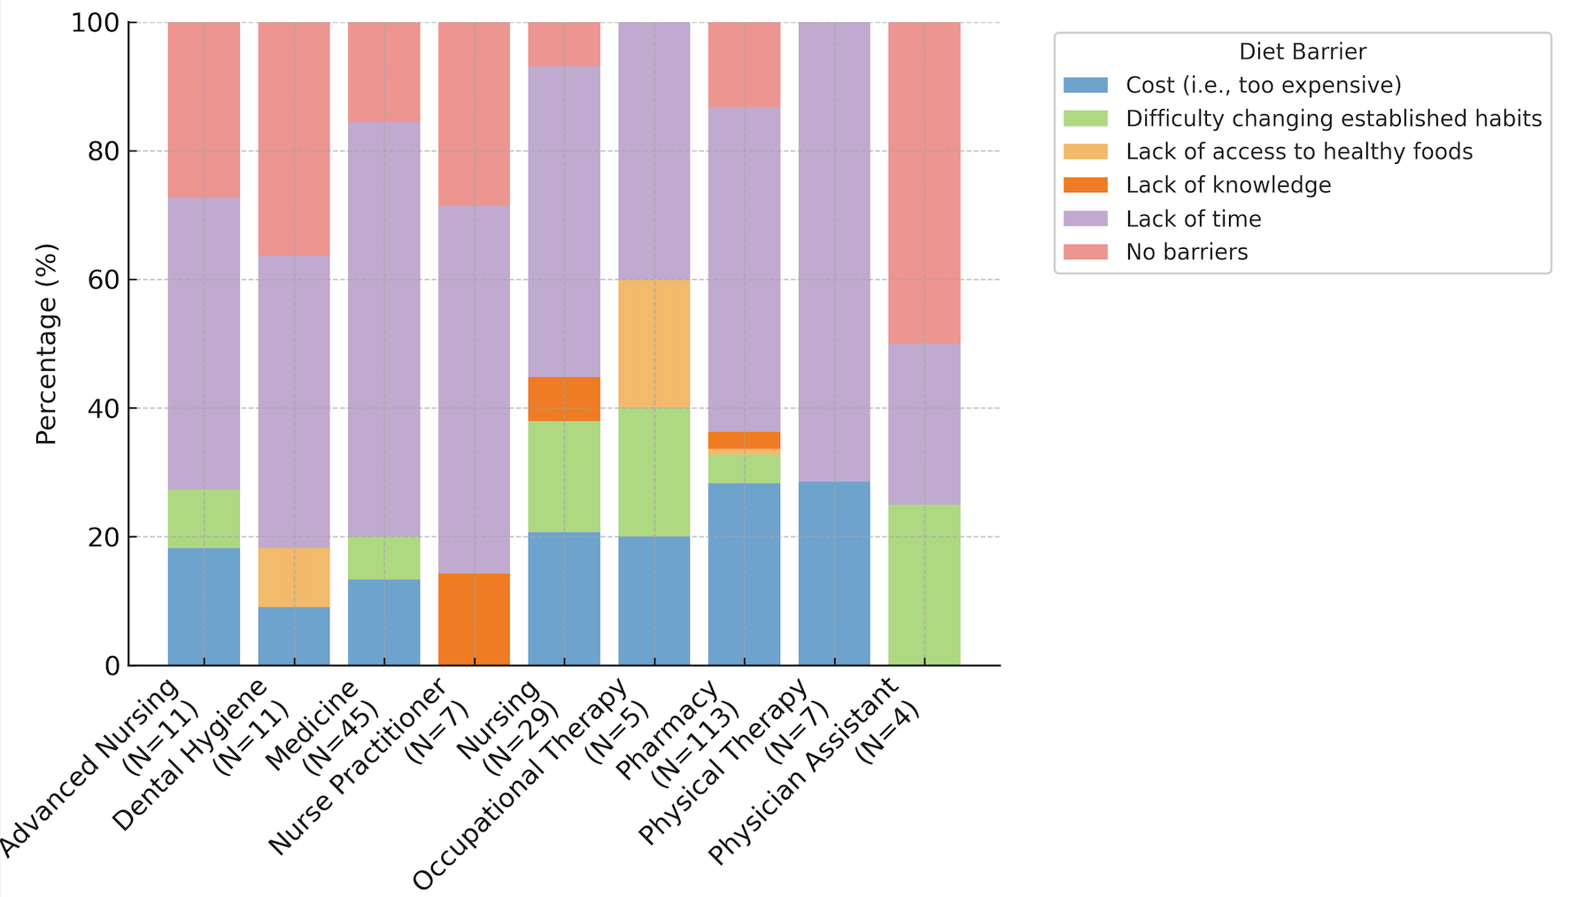
Barriers to Diet by Program

Slide 43
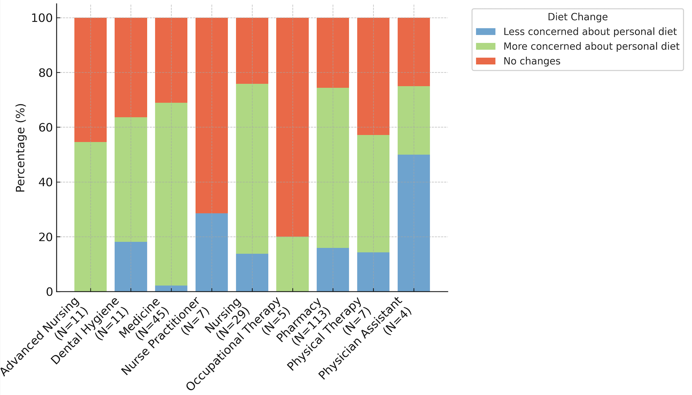
Diet Change by Program

