Slide 1
Racism and Health I: Pathways and Scientific Evidence David R. Williams and Selina A. Mohammed
Article Discussion
NM CARES
April 15, 2014

Slide 2
Racism and Health
Racial minorities have poorer health as evidenced by higher rates of mortality, earlier onset of disease, greater severity and progression of disease, and higher levels of comorbidity and impairment
Disadvantaged racial populations also have lower levels of access to medical care and receive care that is poorer in quality
Article describes the complex nature of contemporary racism in the U.S. and how racism affects health.

Slide 3
Overview of Racism and its Persistence
RACISM – an organized system premised on the categorization and ranking of social groups into races and devalues, disempowers, and differentially allocates desirable societal opportunities and resources to racial groups regarded as inferior (Bonilla-Silva, 1996; D Williams, 2004)

Slide 4
Overview of Racism and its Persistence
Racism leads to the development of negative attitudes (PREJUDICE) and beliefs (STEREOTYPES) toward nondominant, stigmatized racial groups and differential treatment (DISCRIMINATION)

Slide 5
Evidence of Persistence
Whites reveal positive changes over time in support of the principle of racial equality
BUT support for laws and policies to achieve equality lags behind support for the principle of equality
74% of Blacks and 31% of blacks report that they have personally experienced racial discrimination
70% of Americans have implicit biases that favor Whites over Blacks

Slide 6
Discrimination
Racial discrimination persists in contemporary society:
Audit studies in employment
Prices of fast food meals in Black neighborhoods
Subprime lending

Slide 7
Institutional Racism
Residential Segregation
High levels of incarceration of Blacks and other minorities

Slide 8
Institutional Racism and Health
“Although institutional racism is arguable the most important mechanism by which racism adversely affects health, it is challenging to capture in traditional epidemiological research, and we have not fully quantified the impact of institutional racism on health.”

Slide 9
Institutional Racism and Health
Racial segregation
Restrict social mobility by limiting access of education
Reduces access to employment opportunities
Poorer quality houses
Neighborhood environments that are deficient in resources including medical care
RESULT: lower access and poorer quality of health care and higher rates of violent crime and homicide

Slide 10
Cultural Racism
The persistence of institutional and interpersonal discrimination is drive by racism that is deeply ingrained in American culture
Ideas of Black inferiority and White superiority
Anti-Black ideology and representation is the benchmark to which other groups are compared
Examples: Pop culture, TV programs, description of convicts in newspapers, language studies

Slide 11
Cultural Racism and Health
Lack of positive emotion for stigmatized racial groups can lead to lack of political will to address racial inequalities including those in health
Recent research reveals that racial prejudice is a driver of Obama’s health reform legislation
Internalized racism → alcohol use, distress, overweight, violence, delinquent behavior
Stereotype threat → anxiety
Unconscious bias → blacks and other minorities receive fewer procedures and poorer-quality medical care than Whites (IAT)

Slide 12
Experiences of Discrimination
Psychosocial stress → adverse affect on health outcomes and risk behaviors
Coronary artery calcification, CRP, blood pressure, lower-birth-weight infant births, cognitive impairment, poor sleep, visceral fat, mortality
Lower levels of health care seeking and adherence among racial minorities partly due to racial bias
Sept 11 – Low birth weight among Arab American women

Slide 13
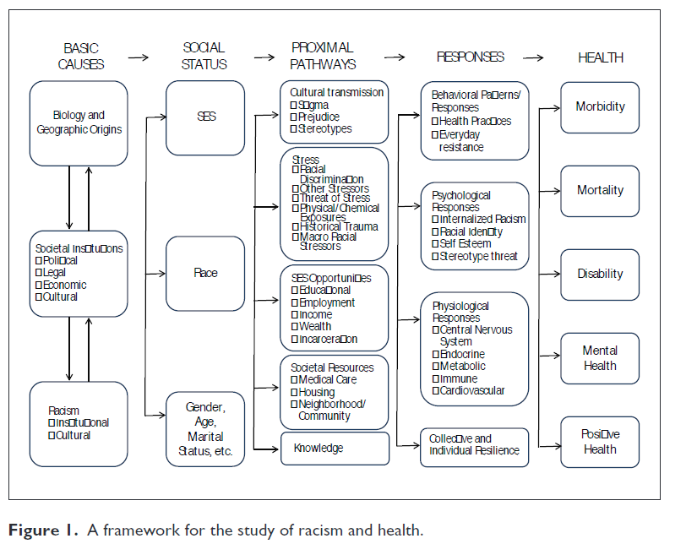
How Racism Can Affect Health

Slide 14
Conclusions
Racial variations in health are not simply genetic or biological but rather contributed to by institutional and cultural forms of racism
Inadequate research attention to ways multiple aspects of racism relate to each other and combine with other psychosocial risks and resources to affect health.
New analytic models are needed.
We need a science base to intervene to reduce and eliminate the effects of racism on health.

